Slide 1


Slide 2

Mission
For XPression, Voyager, and DashBoard customers in broadcast and venue production, Rocket Surgery offers unmatched design and data integration expertise because we have exclusive insight and input into Ross’ advanced system.
www.rocketgfx.com

Slide 3

Triggering & Control
Graphics are only part of the story; device and playback control are what make it all sing, and Rocket Surgery creates scalable DashBoard control systems specific to your needs. As with XPression, the Rocket has direct access to Ross development resources, ensuring the highest-quality triggering & control system.

Slide 4
Elections & Data
Triggering & Control

Slide 5
Election Data – JSON/XML
Election data can most often be retrieved in either JSON or XML format
Built-in JSON parsing via JavaScript JSON object
XPath for XML parsing

Slide 6
Election Data – Aggregation
JavaScript uses objects
Create custom objects with a combination of multiple objects
Combine XML and JSON into a single object in JavaScript

Slide 7
Retrieving the Data
In DashBoard there are multiple ways to get data. From polling for it over HTTP to a direct socket connection where the data is automatically pushed to DashBoard to reading a file with the data in it.

Slide 8
Retrieving the Data - HTTP
asyncPost for simple GET/POST
asyncHTTP for more advanced GET/POST allowing custom headers
If an authentication key is needed as a header, use asyncHTTP and if the data is open, use asyncPost

Slide 9
Retrieving the Data – Listeners
DashBoard uses Listeners to create TCP/IP and UDP connections
Can create a direct TCP connection to the server and wait for data
Can listen on a UDP port for incoming data

Slide 10
Retrieving the Data – File
DashBoard can also read text files and get the data that way
JSON or XML file retrieved and saved to file
Parse normally once we’ve got the file as a String

Slide 11
Getting the data into Datalinq
Once we’ve got our data we need to be able to get it into our graphics package and in the case of Ross, that is done via XPression Datalinq

Slide 12
Getting the data into Datalinq
Save the data to a file that is associated with a Datalinq
Stream the data directly from DashBoard params using its built in Datalinq streaming

Slide 13
User Interface
It’s one thing to be able to get, parse and stream data to our graphics package but what about seeing or manipulating the data? In DashBoard a UI can be created to cover any need we might have

Slide 14
User Interface – Data Visualization
Since we’ve got all the election data, why not show it
Full screen canvas that can be used to display any of the data while it’s being parsed and streamed

Slide 15
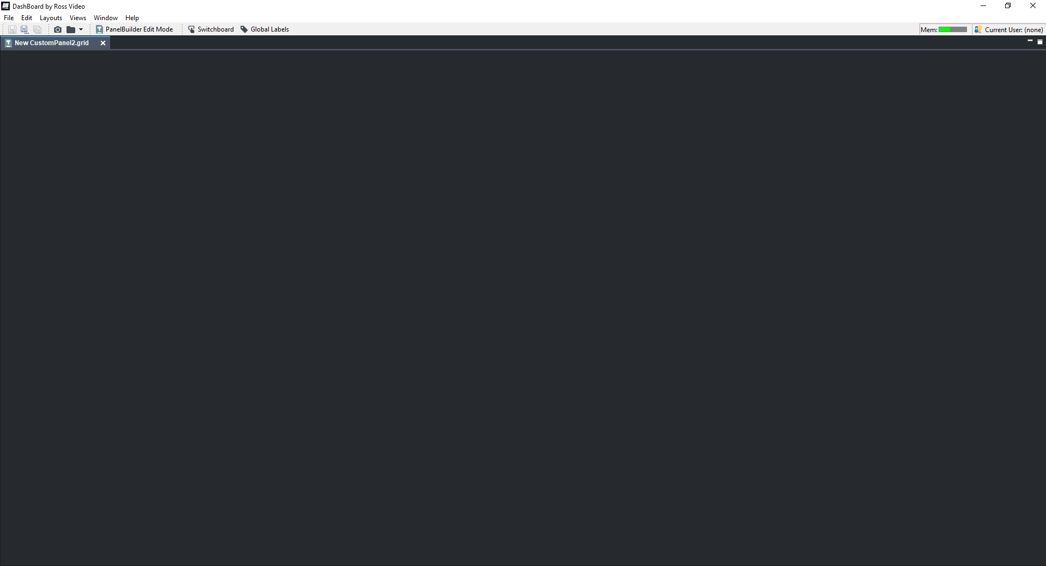

Slide 16
User Interface – Data Manipulation
There are times when we need to manipulate the data
Manually override data points in case of errors
Custom data can be added to the retrieved data
Full set of UI widgets and elements can be used to both display and modify data

Slide 17
Putting it all together
Let’s look at a few examples

Slide 18
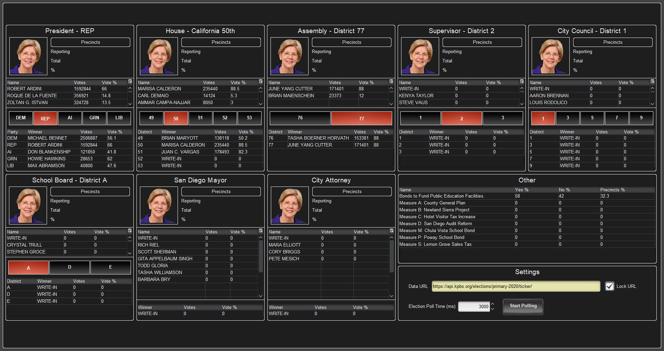

Slide 19
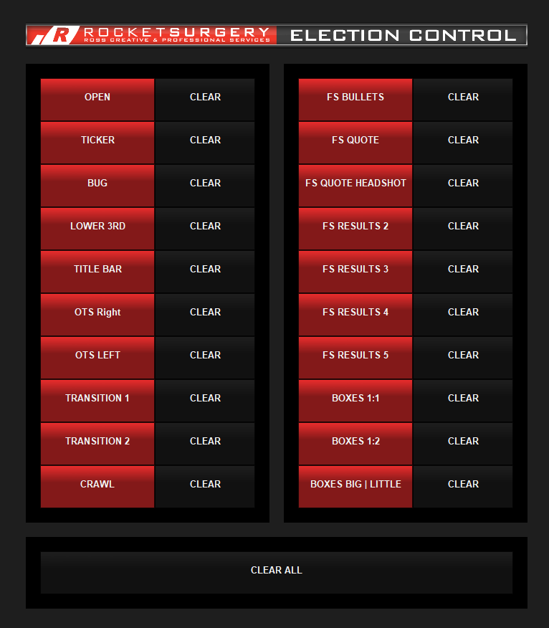

Slide 20
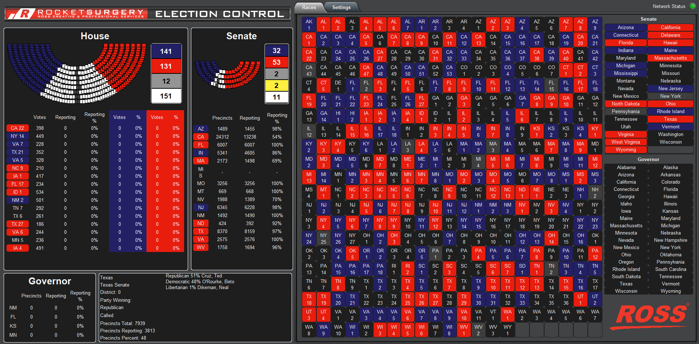

Slide 21
When it comes to election control it’s hard to beat DashBoard. With JavaScript as the scripting language, built in JSON/XML parsing and open UI creation, DashBoard is the perfect tool to get election data into your graphics package

Slide 22
Helpful Links
Dashboard: https://www.rossvideo.com/products-services/management-systems/automated-production-control/dashboard/ Dashboard U: https://www.rossvideo.com/products-services/management-systems/automated-production-control/dashboard/dashboard-u/ Rocket Surgery: https://www.rossvideo.com/products-services/services/creative-services/ Forums: https://support.rossvideo.com/hc/en-us/community/topics/360001072612-DashBoard XPression: https://www.rossvideo.com/products-services/acquisition-production/cg-graphics-systems/xpression/ XPression U: https://www.rossvideo.com/products-services/acquisition-production/cg-graphics-systems/xpression/xpression-u/

Slide 23

Recent Customers
Kansas City Royals
Pittsburgh Pirates
Buffalo Sabres
Colorado Rockies
Atlanta Falcons
NBC Sports
Alamo Dome
College Football Championship
Winter Classic
New Jersey Devils
Cleveland Indians
Florida State
Philadelphia Phillies
Atlanta Braves
Superbowl 51, 52, & 53
St. Louis Blues
Seattle Mariners
New York Mets
NFL Draft
Edmonton Oilers
LinkedIn
The Switch - TVG
NCCA FINAL FOUR
Adelaide Oval
Philadelphia Eagles
Minnesota Lynx
University of Pittsburgh
Tennessee Titans
Atlanta Hawks
Baltimore Ravens
Wells Fargo Center
University of Arizona
Nashville Predators
Miami Dolphins
New Jersey Devils
NBC Sports- SNF
Marquette University
University of Central Florida
Tampa Bay Bucs
MCG Etihad
University of Louisville
TVG Betfair
Sistemas
Sydney Cricket Grounds
Minnesota Timberwolves
Microsoft Corporation
Arizona Cardinals
DGMO
Arlington eSports Stadium
CRTV
Accenture
ABC Disney
RIOT! Games
Turtle ESL
And many more!

Slide 24
Contacts
Jim Doyle
Director of Creative Services
O: (613) 228-0688 ext. 4316
M: (804) 382-6893
jdoyle@rossvideo.com
Alikhan Manji
Project Coordinator, Creative Services
amanji@rossvideo.com
O: (613) 228-0688 ext. 4372
M: (613) 355-7746
Bryan A. Bray
RSVP Project Manager
M: 254.709.7196
O: 613.652.4886 ext.4178
E: bbray@rossvideo.com
Terry Daily
Sr. Designer &
Virtual Productions Specialist
O: 613.652.4886 ext. 4367
M: 512.364.1068
tdaily@rossvideo.com
Matt Zidik
Art Director
mzidik@rossvideo.com
Chris Mollomo
Manager, Virtual Design Group
+1 (413) 717-1588
cmollomo@rossvideo.com
Matt Marion
Triggering and Control
+1 (343) 996-4978
mmarion@rossvideo.com

