Slide 1
Mike Kljucaric
1

Slide 2
What’s NEW | Abekas Products

Slide 3





DashBoard Integration with Abekas Servers

Slide 4
Tria and Mira DashBoard Integration
New Abekas OGP Service
Natively integrates Abekas API commands
Provides access to control panels
MiraTouch Horse Racing panel
Tria / Mira Explorer panel

Slide 5
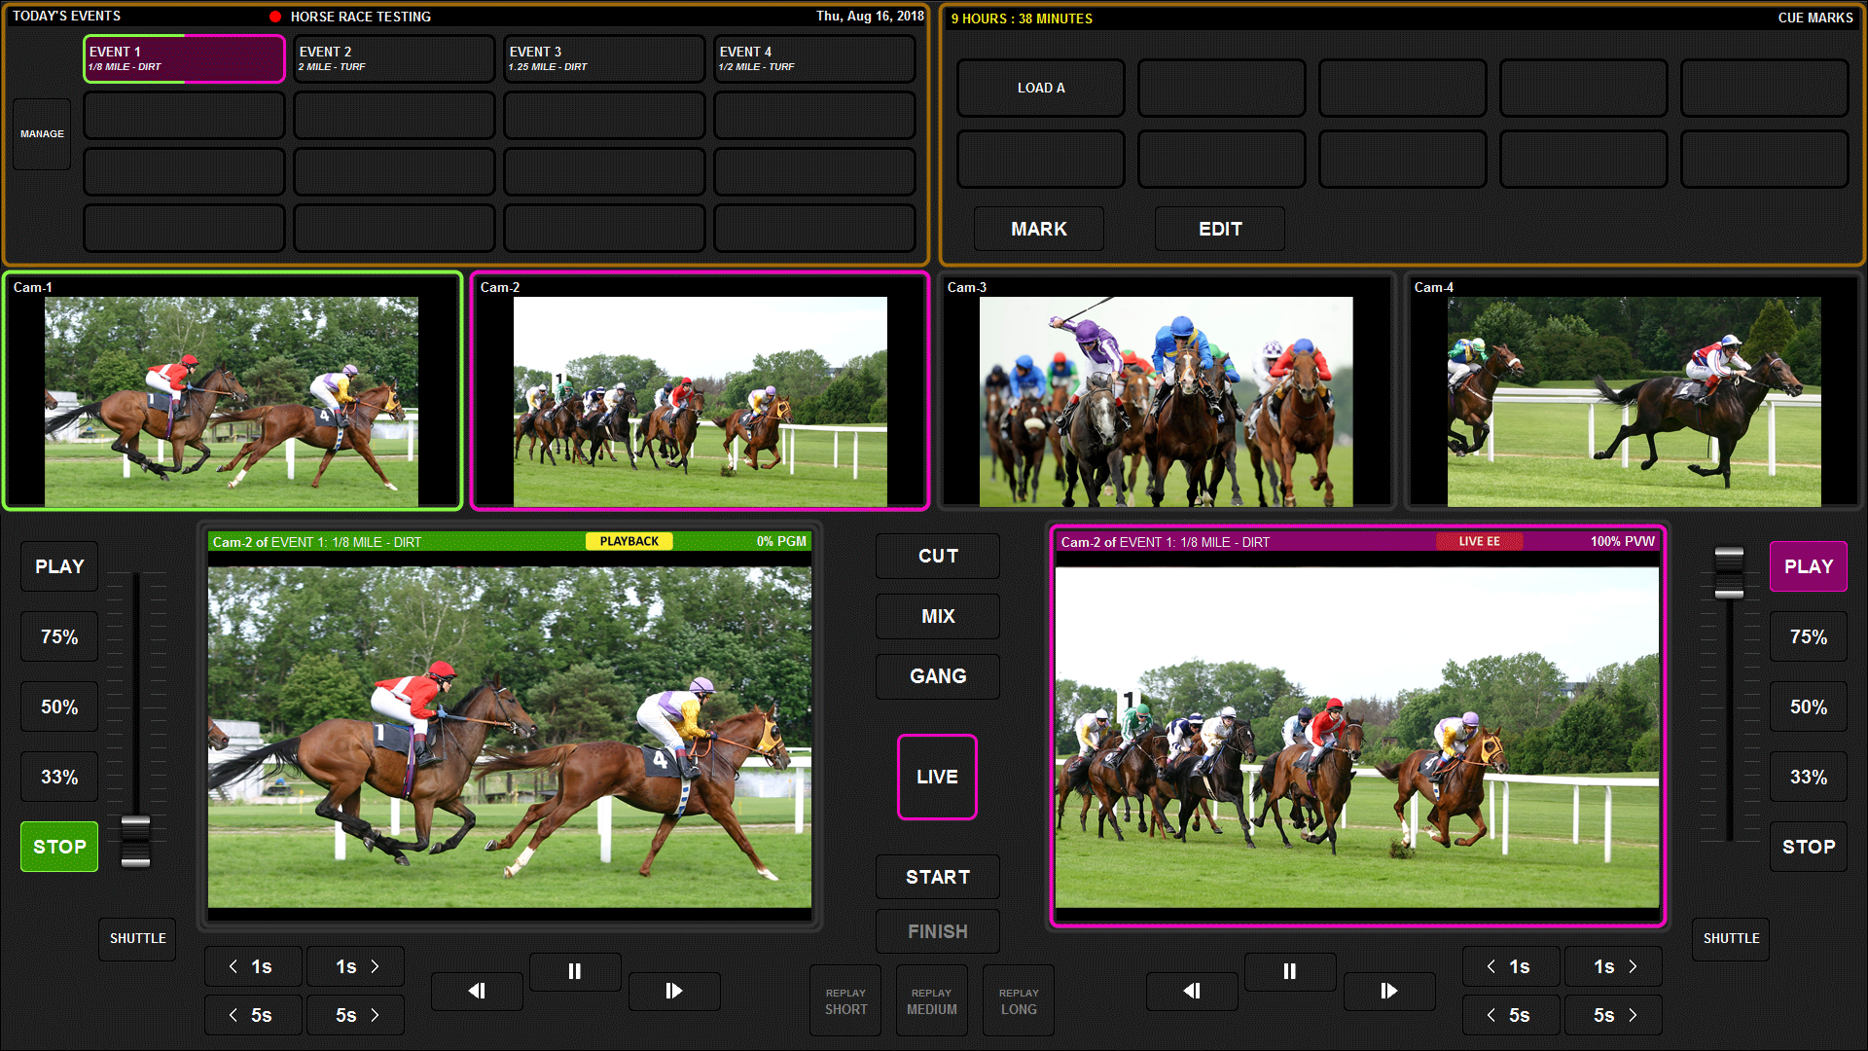
MiraTouch Horse Racing
Tria and Mira DashBoard Integration

Slide 6
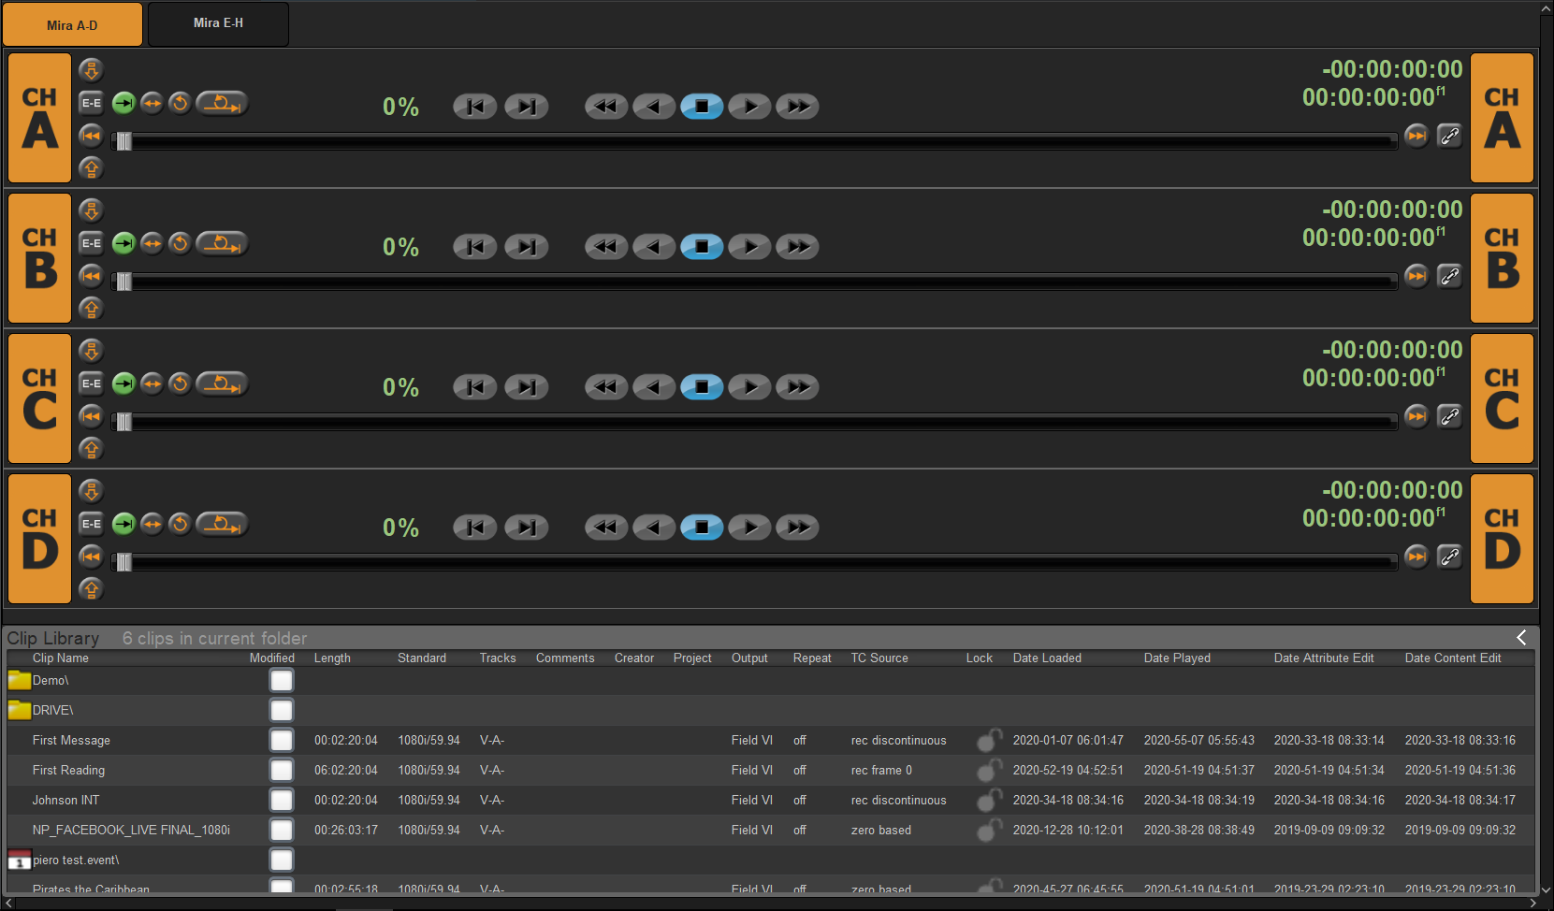
New Tria/Mira Explorer panel with enhanced functionality and features
Tria and Mira DashBoard Integration

Slide 7
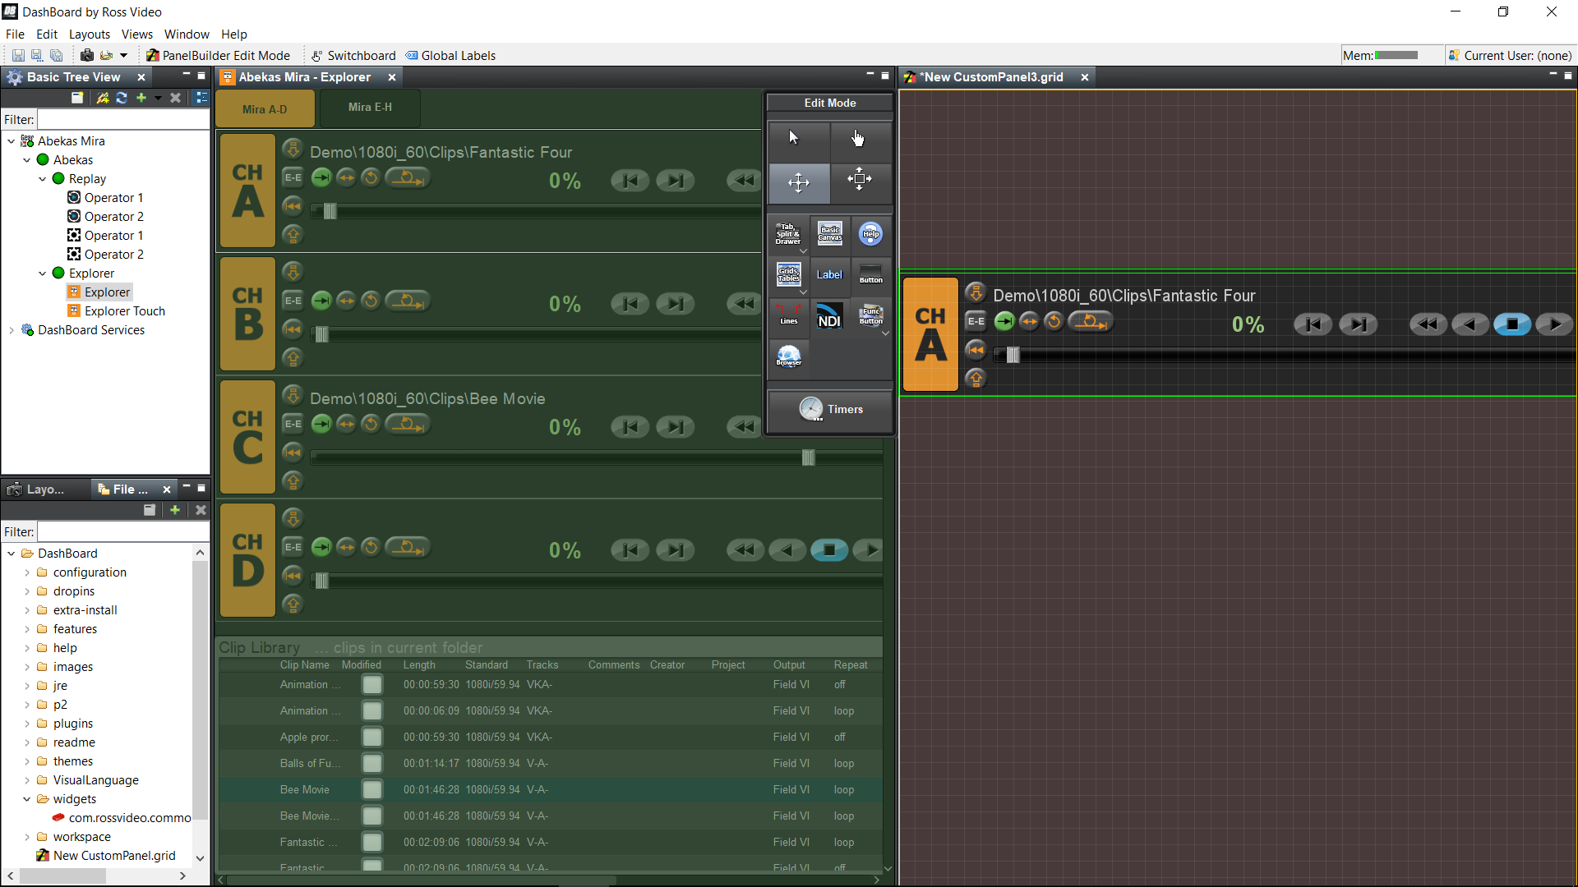
New Tria/Mira Explorer panel with enhanced functionality and features
Tria and Mira DashBoard Integration

Slide 8
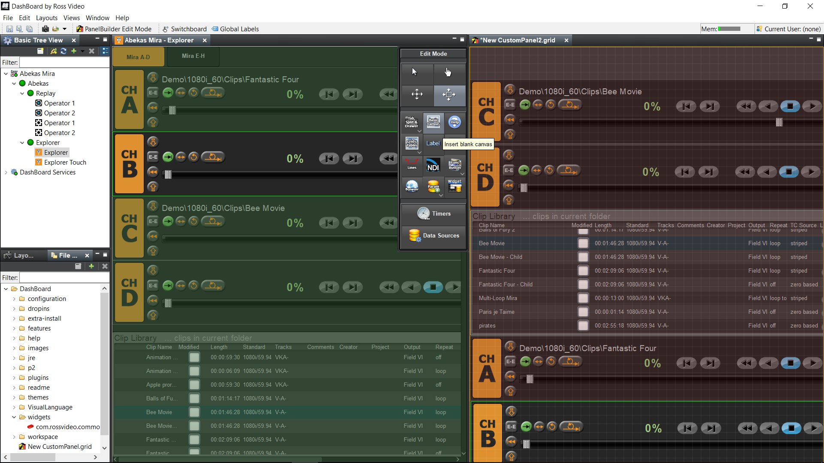
Control multiple servers from one control panel
Tria and Mira DashBoard Integration

Slide 9
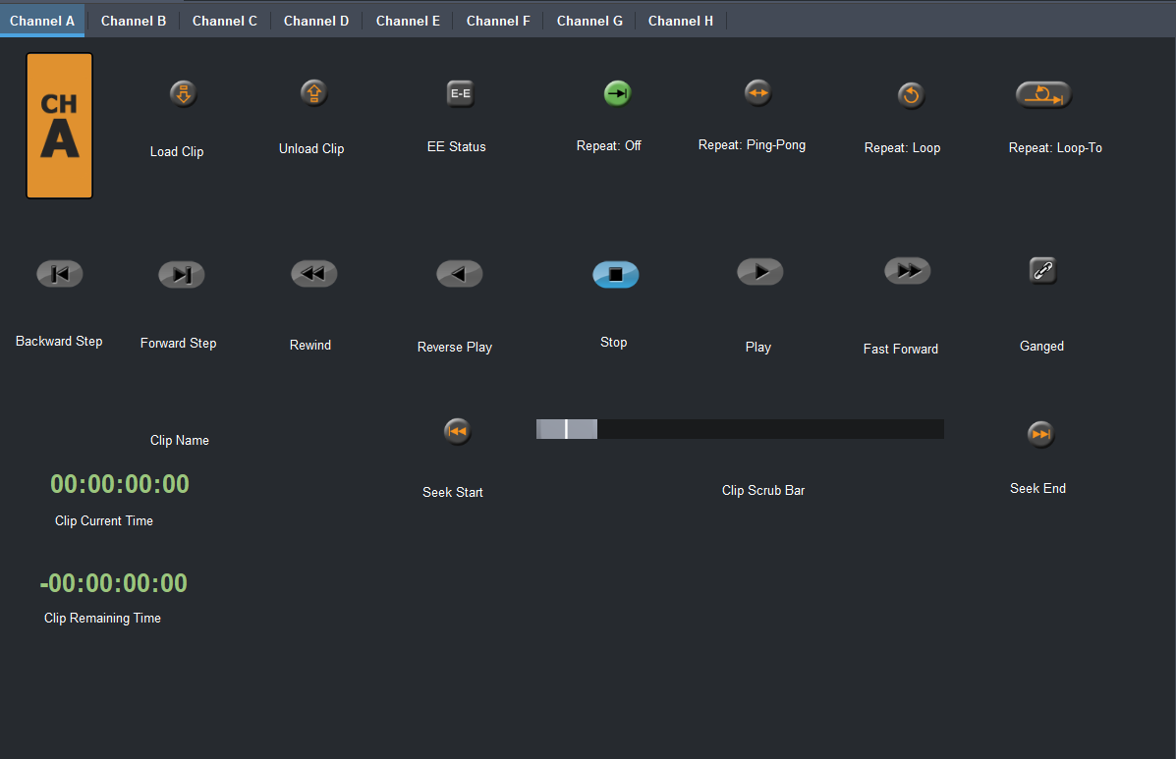
Tria and Mira DashBoard Integration
Everything in Explorer is its own widget!

Slide 10
Who Benefits?
Customers who…
Work remotely
Need for centralized control
Require specialized custom control panels
Purchase Ross products (Graphite, Carbonite Ultra)
We do!
Brand unity
Part of complete solution
10

Slide 11

PIERO Integration with Mira+

Slide 12
PIERO Integration with Mira+
Problem: Manually-intensive workflow between PIERO and replay systems

Slide 13
Obstacles of Current Workflow Between PIERO, Replay Systems
PIERO operator gets clip from replay operator
PIERO renders graphics over clip for analysis
Final “playthrough” of PIERO is recorded in real-time into replay system
Replay operator finds, trims, saves playthrough from PIERO
Cumbersome, time-consuming, manually-intensive
Requires attention of two busy operators

Slide 14
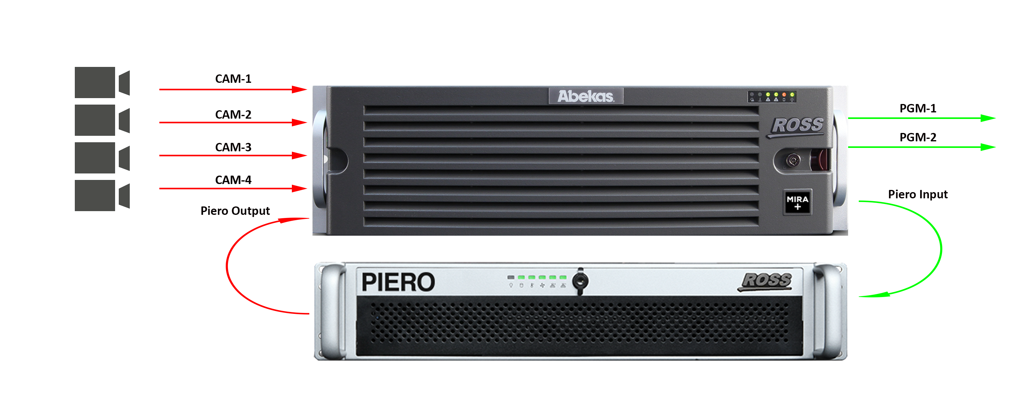
Solution: PIERO Integration with Mira+
8-Channel Mira+ | 4-In 2-Out replay
PIERO uses 2 channels | 1-in 1-out

Slide 15
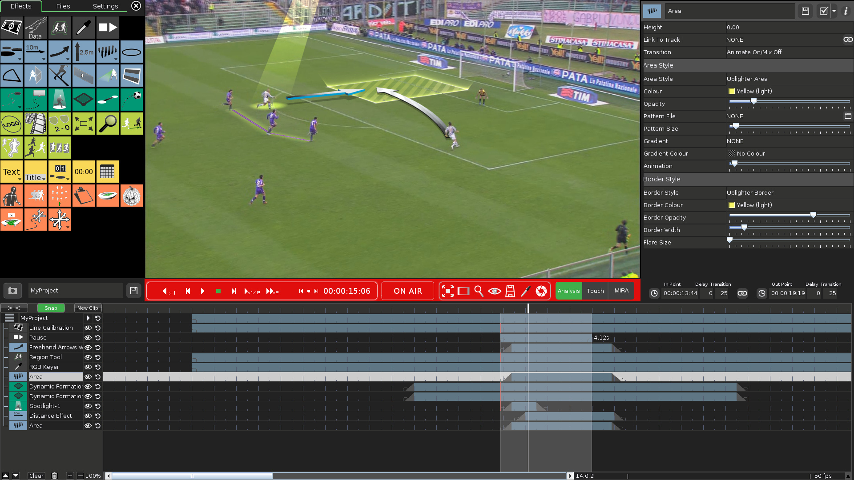
PIERO Integration with Mira+
PIERO can access clips that have been saved in the Mira Replay application

Slide 16
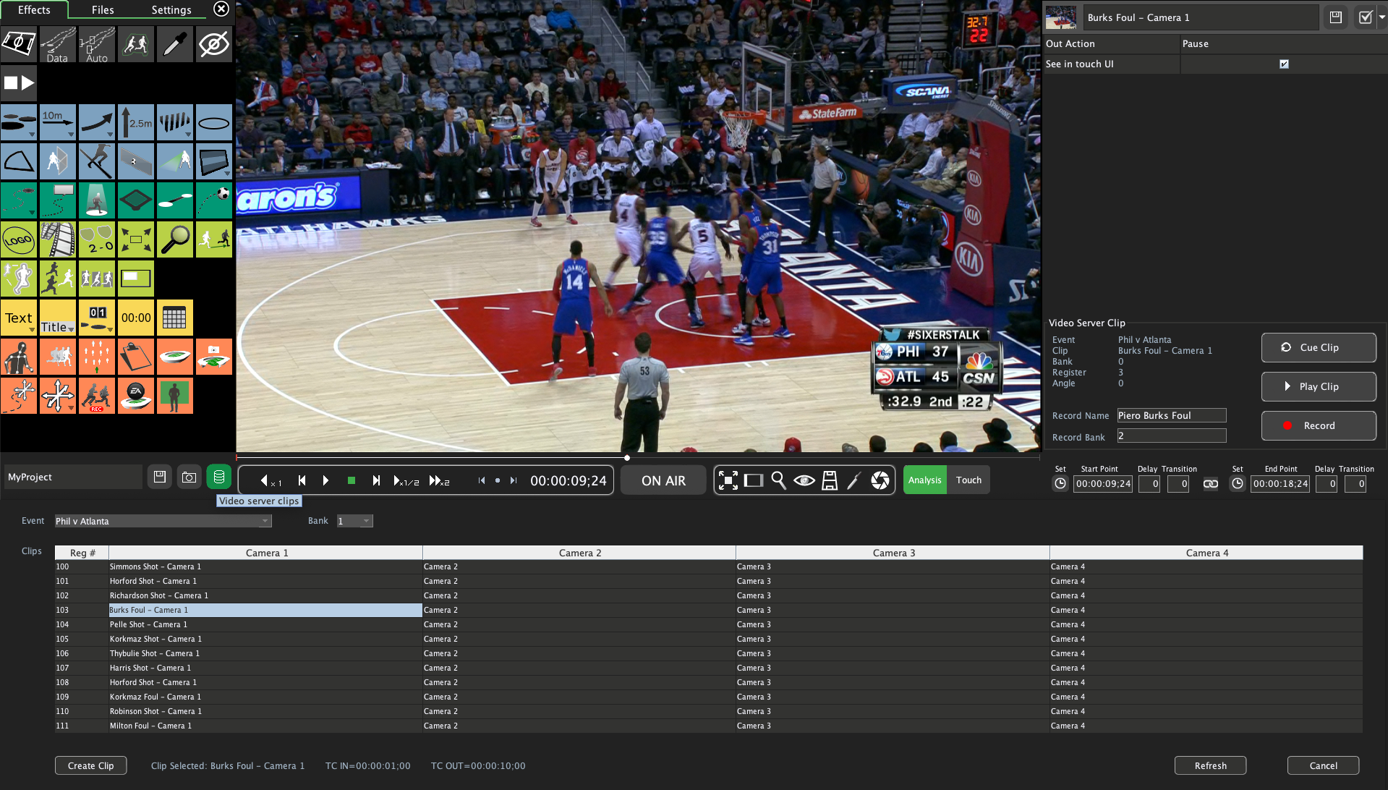
PIERO Integration with Mira+
PIERO can access clips that have been saved in the Mira Replay application

Slide 17
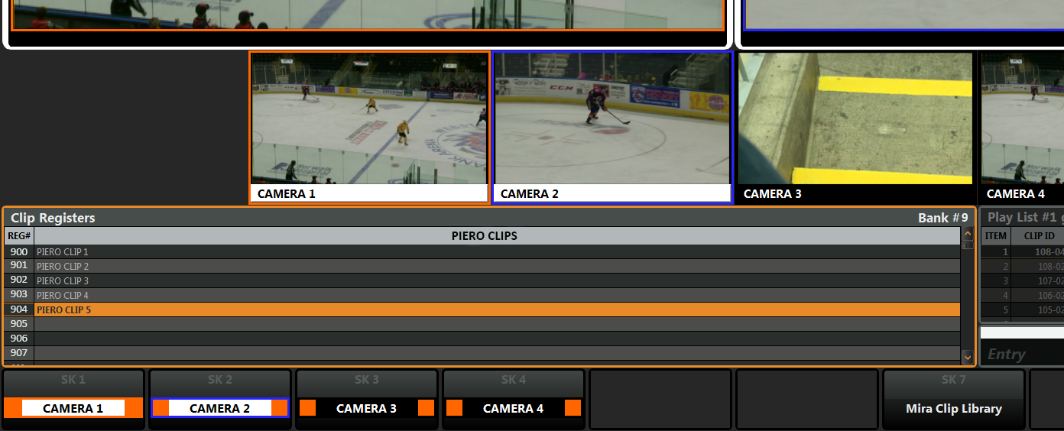
PIERO Integration with Mira+
Clips with graphical analysis automatically saved to the Mira Replay Application

Slide 18
In Conclusion:
This is the best integration that exists between PIERO and any replay system!

Slide 19
Happy Selling!
19

