Slide 2
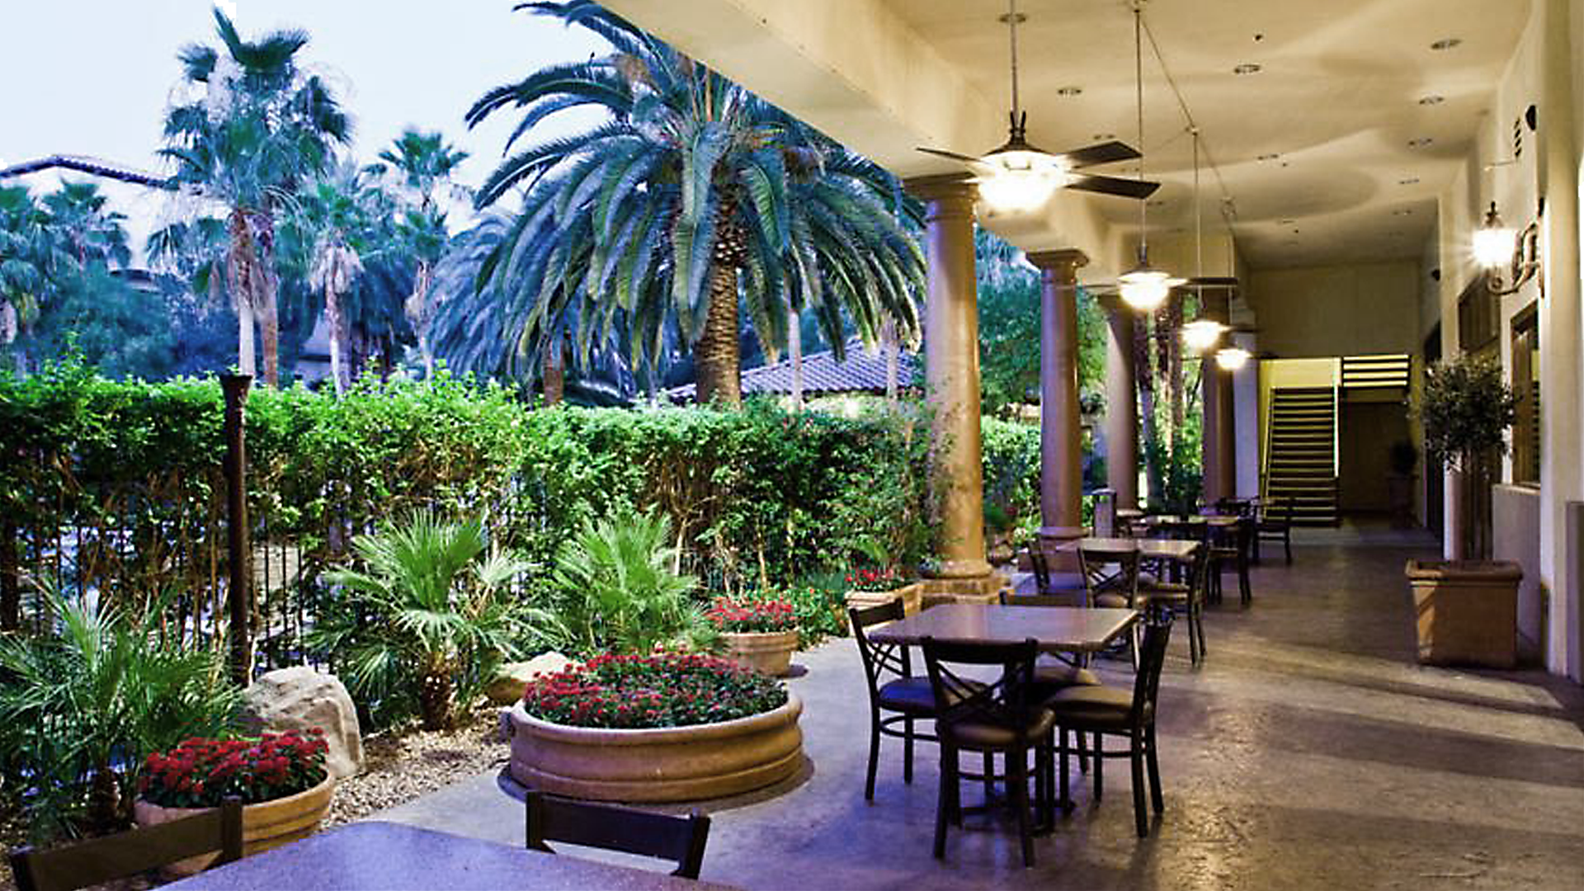

Slide 3
Ultrix - Acuity
NOT TO BE SHARED
This is only for discussion under NDA
With Senior Management Approval
The WHY…
Freedom to Choose Transport / Connectivity Scheme
Future Proof Your Investment
Deploy 1.5G, 3G, 12G - SDI, ST 2110 IP or make it a Hybrid
Take advantage of all Ultrix Features
Size
MultiViewers
Audio
Other stuff Todd will talk about ☺

Slide 4
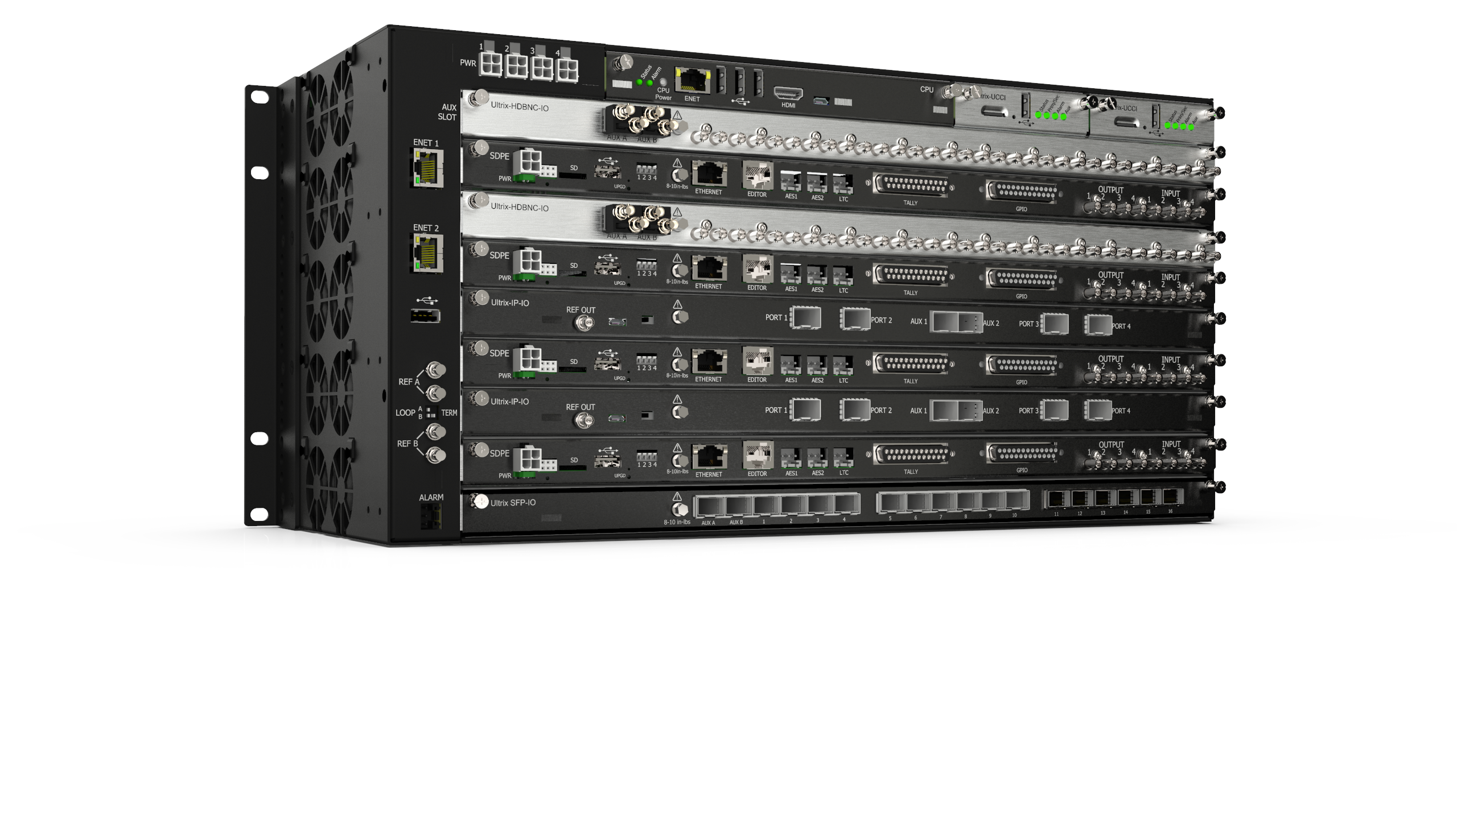
Ultrix - Acuity
NOT TO BE SHARED
This is only for discussion under NDA
With Senior Management Approval
What is it …
New Software Defined Production Engines
Ultrix Acuity Frame CPU Card
Up to 4 HD/UHD MEs
Up to 80 x 80 + 8 Aux Ports with 4 MEs installed
Additional Power Connectors for full Redundancy
Uses Existing Acuity Panels and Menus

Slide 5
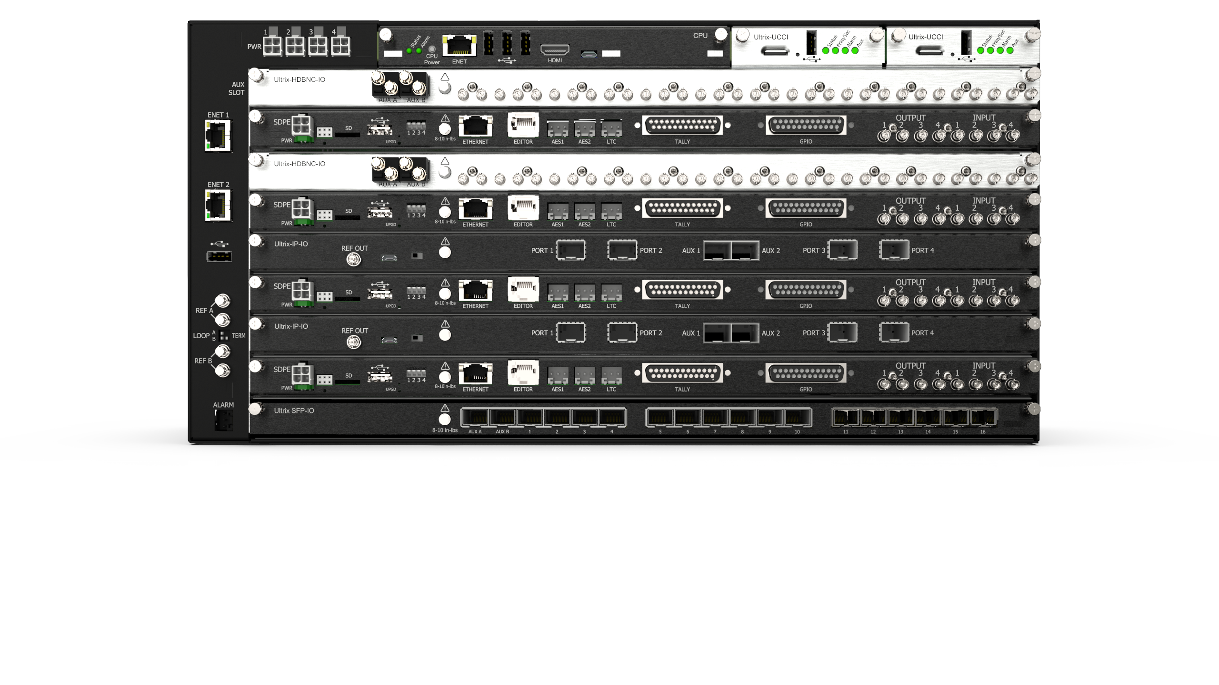
Ultrix - Acuity
NOT TO BE SHARED
This is only for discussion under NDA
With Senior Management Approval
What is it …
Hybrid I/O connectivity – 2110 and SDI
Full 12G Signal Architecture
Ultrix MultiViewers
6 keys, 6 DVE per UHD ME
Optional 3D DVE UHD, 4 in HD
Fancy 3D Borders on 2D DVE

Slide 6
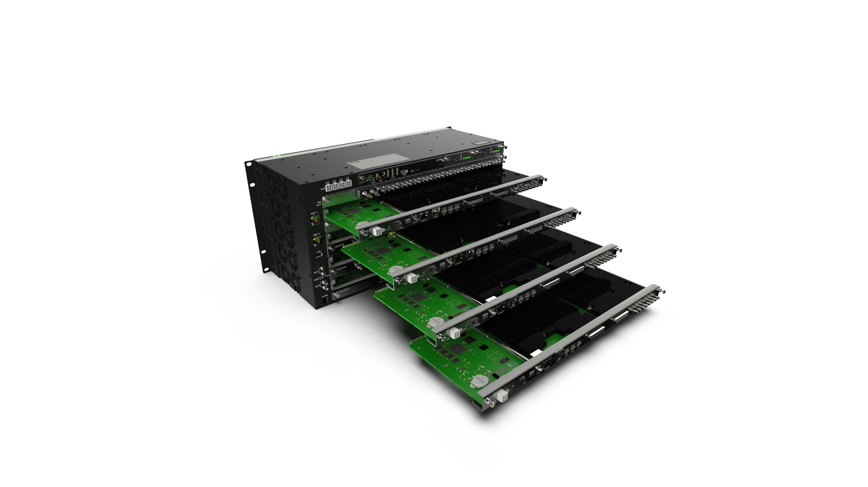
Ultrix - Acuity
NOT TO BE SHARED
This is only for discussion under NDA
With Senior Management Approval
What is it …
4 Key/Fill Mediastores per ME
Operationally – It’s Acuity
Caprica / Overdrive Compatible
To Be Announced in September 2020

Slide 7
And Now…
Over to Mr. Douglas Johnson who
has some exciting new product announcements
(Read – New sales opportunities $$$)

Slide 8
And Now…
Ultra V4.0

Slide 9
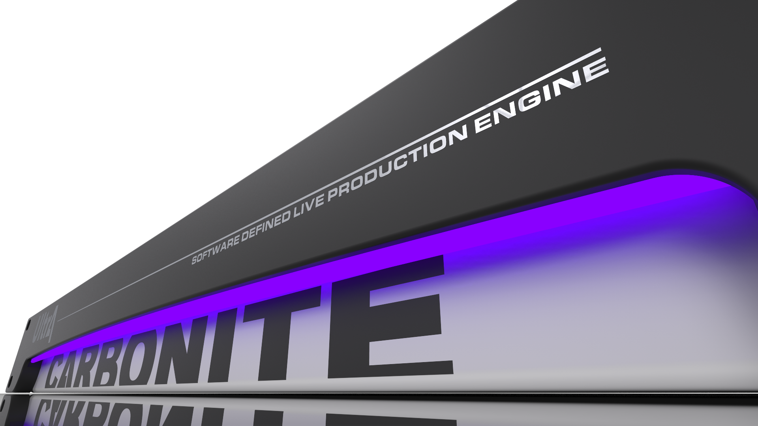
Carbonite Ultra v4.0
NOW WITH AUDIO!!!
RAVE Audio Mixer License…
13 x 48 channel stereo mixers (same source selection)
384 external input channels (24 SDI x 16)
10 internal inputs
Up to 3 x RAVE ABU’s supported
Sample Rate Conversion for all Frame Syncs
(Plus I/O reduced to 26 from 34 FSFC when in SRC mode)

Slide 10
Carbonite Ultra v4.0
NOW WITH AUDIO!!!
Audio Mixer License
List $2000.00
Included with the purchase of a RAVE ABU
With Standard I/O
8 Sample Rate Converters (SRC)
With Plus I/O
24 SRC with Plus I/O (when turned on FSFC reduced to 26, 24 in – 2 out)

Slide 11
Carbonite Ultra v4.0
New 3D Borders with Lighting and Shadows for DVE’s !!!
Perspective look for 2 box shots
Complete Creative Control
Transparency, Bevels, Tubular, Glass looks
Drop Shadow tracks lighting and has independent softness
All included in Mem’s, Effect Dissolves and CC’s
Free with 4.0

Slide 12
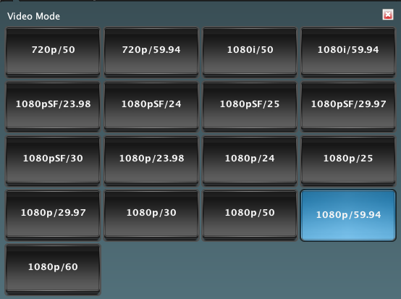
Carbonite Ultra v4.0
New Features
By Popular Demand - New Frame Rates
Now all possible SMPTE rates supported
HD and UHD formats included
UHD now w/ 23.98, 24 & 29.97
Free with 4.0

Slide 13
Carbonite Ultra v4.0
New Features
New Processing Features
HDR<>SDR and WCG conversion (like UHD)
HLG & PQ Supported
Adjustable Input Delay for all inputs (in Plus I/O version, 8 in std ver.)
Add from 1 to 13 frames of delay to any / all inputs
Great for VS/AR applications
V 4.0 Available May/June 2020

Slide 14
And Now…
New Solo Pricing

Slide 15
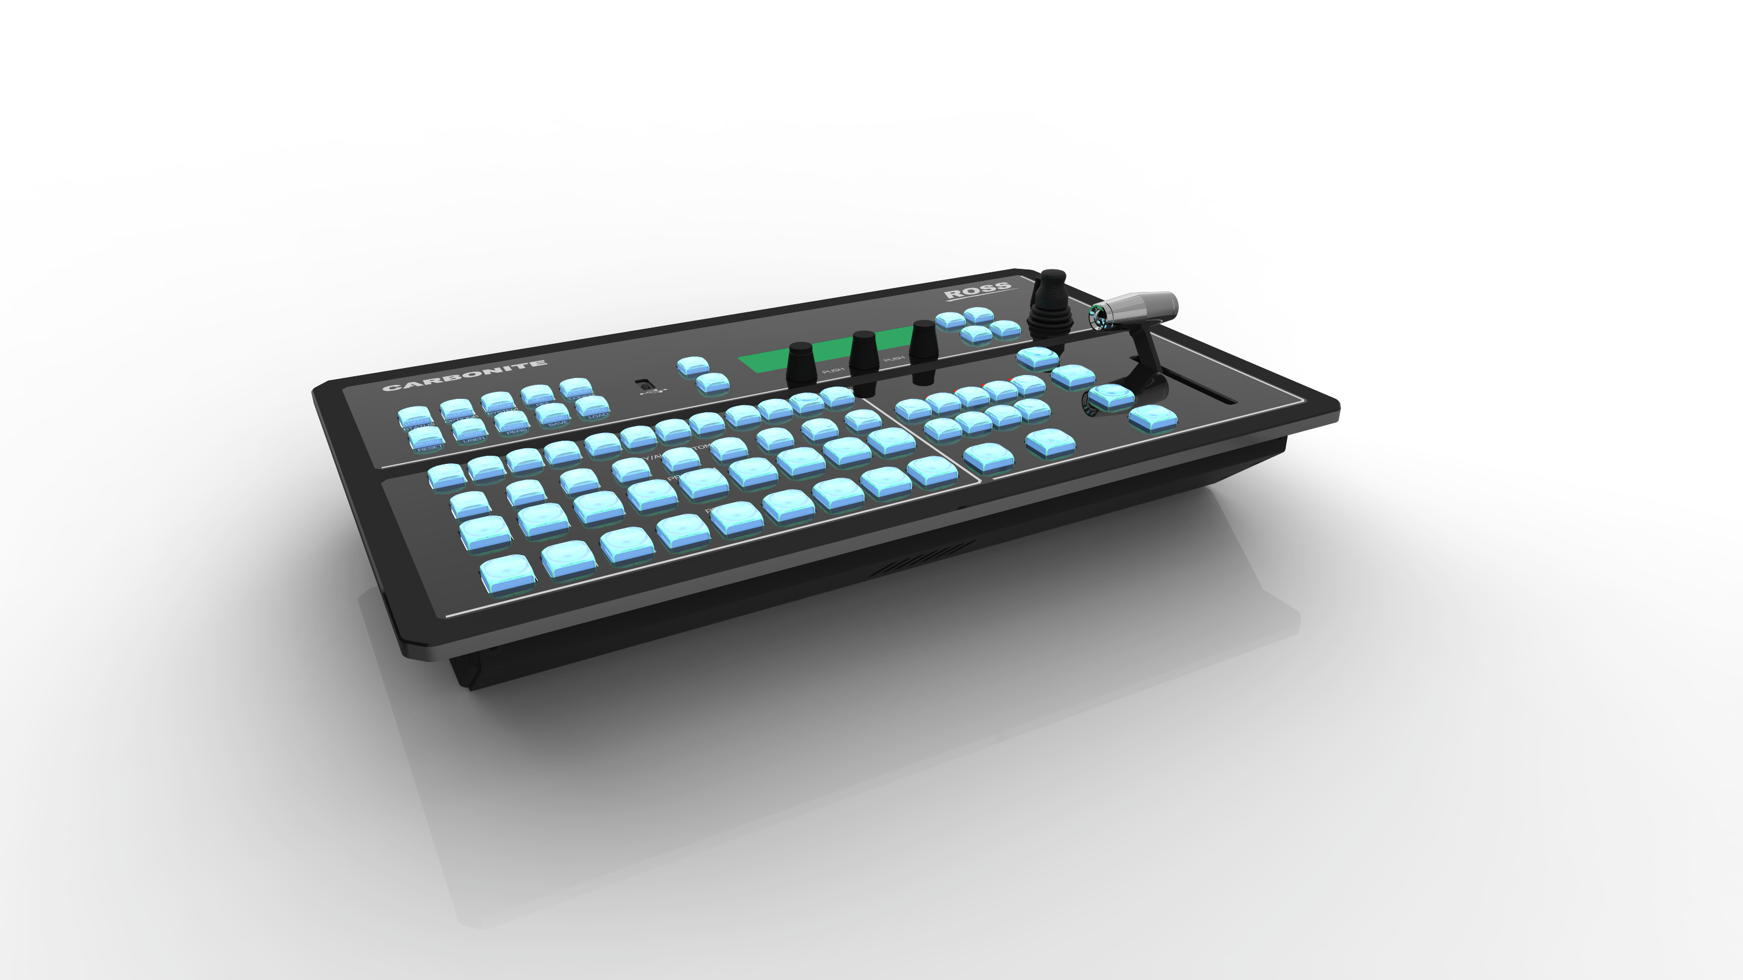
Carbonite Solo
Carbonite Solo Price Reset
New Lower Pricing with Fixed Maximum Discount
CBF-109 $3,999
CBF-113 $4,999
Solo-9 $5,999
Solo-13 $6,999
CB9 – Panel – No change (still $4,899)
Maximum Discount set at 25% - strictly enforced
To be published on our website with release of new pricelist

Slide 16
And Now…
Back to…

