Slide 1
Douglas Johnson
Notes:
GREETINGS EVERYONE!
I’M DOUGLAS JOHNSON, PRODUCT MANAGER FOR ALL VIDEO SERVER PRODUCTS HERE AT ROSS
I’M BASED IN OUR SUNNYVALE, CALIFORNIA OFFICE…
…AND TODAY, I’M PRESENTING THIS WEBINAR FROM
MY HOME OFFICE IN SAN FRANCISCO
I’M LOOKING FORWARD TO SHARING A COUPLE OF
VERY EXCITING NEW PRODUCT INTRODUCTIONS!
AND JUST FYI:
I’LL CONDUCT A 5-MINUTE Q&A AT THE END OF MY PRESENTATION

Slide 2


Live Event Protection Delay
Notes:
FIRST UP:
…IS A TERRIFIC NEW PRODUCT UPGRADE COMING SOON FOR AIRCLEANER!
,,,OUR LIVE EVENT PROTECTION DELAY SYSTEM…
[take]

Slide 3

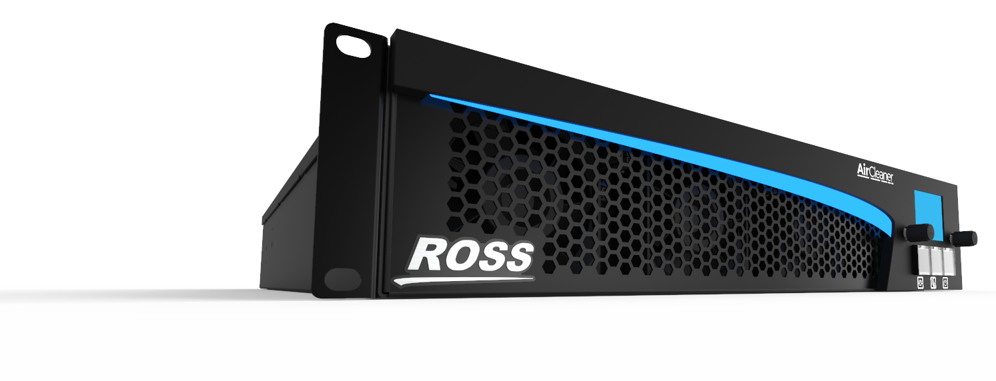
Live Event Protection Delay
Completely new 2RU Hardware Platform
Identical Operations of existing AirCleaner
Notes:
THIS UPGRADE IS A COMPLETELY NEW HARDWARE PLATFORM…
…WHICH FORMS THE FOUNDATION FOR ALL FUTURE VIDEO SERVER PRODUCTS AT ROSS!
[take]
INITIALLY: OPERATIONS WILL BE IDENTICAL TO CURRENT AIRCLEANER…
BUT FUTURE NEW FUNCTIONALITY IN AIRCLEANER WILL NOW BE POSSIBLE
THEREFORE, ONCE WE START SHIPPING THIS NEW AIRCLEANER…
PLEASE STAY TUNED FOR ADDITIONAL FUTURE DEVELOPMENT!

Slide 4
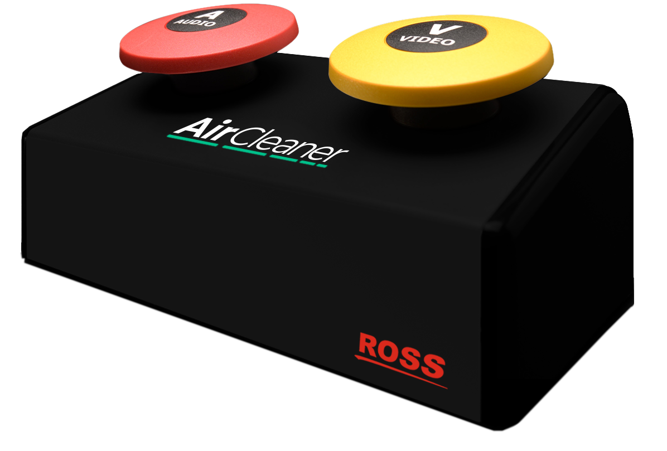
Live Event Protection Delay
New “Black” Control Panel
Notes:
WITH THIS NEW HARDWARE REFRESH,
THE MUCH-LOVED AIRCLEANER “PANIC BUTTON” CONTROL PANEL…
ALSO GETS A NEW “ROSS BLACK-FINISH” LOOK!
AS MENTIONED JUST A MOMENT AGO,
OPERATIONS REMAIN SAME AS BEFORE…FOR NOW
[take]

Slide 5
Live Event Protection Delay
New Video Standards with WCG & HDR
3G 1080p HD Video I/O Standard [ Q2 2020 ]
| 23.98 | 24 | 25 | 29.97 | 30 | 50 | 59.94 | 60 |
12G 2160p UHD-4K Video I/O Optional [ Q4 2020 ]
| 50 | 59.94 | 60 |
100G SMPTE 2110 IP Video I/O Optional [ Q4 2020 ]
Dual QSFP 100G Cages included
QSFP-28 Transceivers NOT included
Notes:
SO, WHAT’S NEW YOU MAY ASK?
NEW VIDEO STANDARDS!
IN ADDITION TO ALL EXISTING VIDEO STANDARDS…
…THESE NEW STANDARDS ARE ADDED TO AIRCLEANER
WITH SUPPORT FOR WIDE COLOR GAMUT AND HIGH DYNAMIC RANGE
THERE’S NEW 3G VIDEO STANDARDS TO SUPPORT 1080P
…WITH ADDITIONAL FRAME RATES LIKE TRUE 60P
[take]
ALSO ADDED IS 12G VIDEO I/O TO SUPPORT UHD — COMING END OF THIS YEAR
[take]
AND FINALLY, 100G SMPTE 2110 IP VIDEO I/O — COMING END OF THIS YEAR
PLEASE NOTE THE 100-GIG QSFP CAGES ARE INCLUDED;
BUT CUSTOMERS MUST PURCHASE THEIR OWN TRANSCEIVERS
[take]

Slide 6
Live Event Protection Delay
Models | Delay Time in Seconds @ 59.94
 | 720p | 1080i | 1080p | 2160p
AirCleaner-2 Model-A | 80s | 40s | 10s
AirCleaner-2 Model-B | 160s | 80s | 20s
AirCleaner-2 Model-C | 360s | 180s | 45s
Notes:
THERE’S NOT (YET) ANY NEW FUNCTIONALITY TO DESCRIBE,
…SO LET’S JUMP RIGHT INTO THE HEART OF THE MATTER: THE AVAILABLE MODELS!
ORDERING THE NEW AIRCLEANER IS JUST A LITTLE BIT DIFFERENT FROM THE CURRENT MODEL…
THERE ARE:
3 MODELS | INSTEAD OF 4 MODELS
…AND ALL THREE NEW AIRCLEANER MODELS SUPPORT: ALL THE VIDEO STANDARDS DESCRIBED A MOMENT AGO… AND FOR THOSE WEBINAR VIEWERS NOT IN THE KNOW: 2160P = UHD-4K
AS YOU CAN SEE: THE DELAY TIMES HAVE SIGNIFICANTLY INCREASED
OVER THE CURRENT AIRCLEANER PRODUCT!
THIS INCREASE IS MAINLY TO SUPPORT UHD-4K

Slide 7
Live Event Protection Delay
Base Models List Prices
AirCleaner-2 Model-A | $15,900.USD
AirCleaner-2 Model-B | $17,900.USD
AirCleaner-2 Model-C | $22,900.USD
Notes:
THE THREE AIRCLEANER BASE MODELS ARE ALL ATTRACTIVELY PRICED…
…ESPECIALLY CONSIDERING THE HUGE BOOST TO THE UNDERLYING HARDWARE PERFORMANCE!
THERE ARE ALSO ADDITIONAL OPTIONS AVAILABLE FOR THE NEW AIRCLEANER…

Slide 8
Live Event Protection Delay
Options List Prices
UHD-4K Video Standards | $2,900.USD | Software License for after-sale upgrade
SMPTE-2110 IP Video I/O | $2,900.USD | Software License for after-sale upgrade
AirCleaner Control Panel | $900.USD | (1) for Single-User | (2) for Dual-User
Notes:
AND THESE OPTIONS ARE:
1) UHD-4K VIDEO STANDARDS
2) SMPTE-2110 IP VIDEO I/O
NOTICE: THESE ARE BOTH SOFTWARE OPTIONS!
…AND FOR BOTH OPTIONS, USERS CAN…
BUY AT TIME OF INITIAL PRODUCT PURCHASE
—OR—
BUY & ADD ANYTIME LATER AND INSTALL VIA INTERNET
THIS IS QUITE THE DEPARTURE FROM CURRENT AIRCLEANER…
…AND WILL MAKE “AFTER-PURCHASE” UPGRADING SIMPLE AND EASY!
AIRCLEANER CONTROL PANEL
IS A HARDWARE OPTION, WHICH USERS CAN…
BUY WITH INITIAL PURCHASE
—OR—
BUY & ADD ANYTIME LATER
(IF THEY DECIDE TO HAVE DUAL-USER OPERATIONS LATER ON)

Slide 9
Live Event Protection Delay
Public Announcement June 2020
Shipping July 2020
Notes:
WE PLAN TO ANNOUNCE THIS NEW AIRCLEANER TO PUBLIC & ROSS SALES PARTNERS…
IN JUNE 2020
WE PLAN FIRST SHIPMENT…
IN JULY 2020

Slide 10

Live Presentation Server
Notes:
NEXT UP:
I’M QUITE EXCITED TO PRESENT TO EVERYONE
AN ENTIRELY NEW SERVER PRODUCT
FROM ROSS
THIS BRAND-NEW PRODUCT IS CALLED KIVA...
…AND IS KNOWN AS A “LIVE PRESENTATION” SERVER
SO: WHAT’S A LIVE PRESENTATION SERVER—YOU MAY ASK?
…WELL, LET’S DIVE INTO KIVA!

Slide 11





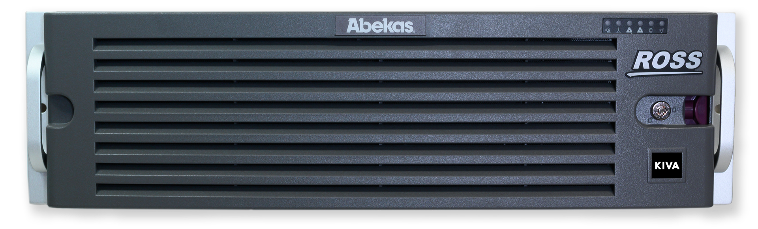
Live Presentation Server
On-Demand Playout of:
Sound | Audio-Only |
Images | Stills-Only | Stills+Key |
Clips | Video | Video+Audio | Video+Audio+Key |
Playlists | Containing Images & Clips |
Notes:
KIVA PROVIDES “ON-DEMAND PLAYOUT” FOR A VARIETY OF MEDIA CONTENT…
THIS CONTENT CAN BE…
[take]
SOUND FROM AUDIO-ONLY FILES
[take]
STILL IMAGES
[take]
CLIPS with MOTION VIDEO
[take]
PLAYLISTS CONTAINING BOTH STILLS & CLIPS

Slide 12
Live Presentation Server
Target Markets
Sports & Live Events Venues
Studio Shows with “Live” & “Live to Disk” Workflows
Corporate Video Production Studios
Any Production needing ‘on-the-fly’ playout
Notes:
SPORTS & LIVE EVENTS VENUES IS BY FAR
MOST POPULAR TARGET MARKET
[take]
STUDIO SHOWS WITH LIVE AND SEMI-LIVE PRODUCTIONS
[take]
LARGE CORPORATE ORGANIZATIONS WITH
LIVE AND SEMI-LIVE PRODUCTIONS
[take]
…OR ANY LIVE PRODUCTION NEEDING ON-DEMAND PLAYOUT

Slide 13
Live Presentation Server
Competitive Products
Chyron-Hego ClickEffects PRIME
Daktronics Live Clips
VizRT Viz Multiplay
Notes:
FORMER COMPANY “CLICK-EFFECTS” HAD “CROSSFIRE” PRODUCT…
NOW REBRANDED AS “CLICK-EFFECTS PRIME” BY CHYRON-HEGO
NOT TO BE CONFUSED WITH CLICK-EFFECTS “BLAZE” PRODUCT—WHICH IS A “RIBBON-DISPLAY” PRESENTATION SERVER!
[take]
DAKTRONICS LIVE CLIPS IS CONSIDERED ‘SECOND-BEST’
— BUT IS GAINING POPULARITY SINCE INTRODUCTION LAST YEAR
[take]
VIZRT MULTIPLAY HAS BEEN AROUND FOR A FEW YEARS
—BUT IS LITTLE-KNOWN IN INDUSTRY
[take]

Slide 14
Live Presentation Server
What’s Different about Kiva?
Highly Visual ‘picon-based’ User Interface
With Very Fast & Familiar ‘Shotbox-Style’ operational paradigm…
Notes:
UNLIKE ANY PREVIOUS ABEKAS SERVER
OR ROSS “CLIP PLAYER” PRODUCT…
[take]
KIVA FEATURES A VERY FAST & FAMILIAR
“SHOTBOX-STYLE” OPERATIONAL PARADIGM AND
USER INTERFACE`…
[take]

Slide 15
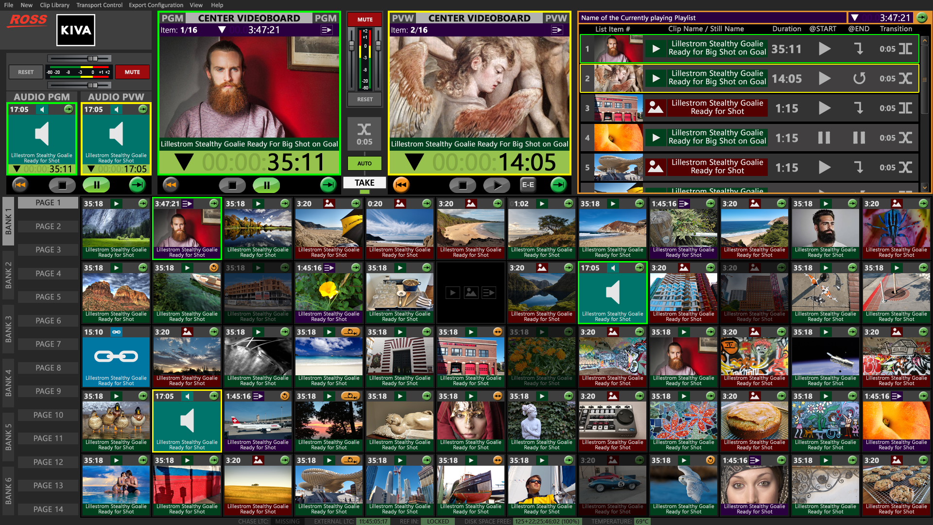

Notes:
HERE’S THE USER INTERFACE FOR KIVA
— YOU CAN SEE HOW HIGHLY VISUAL KIVA IS!
LET’S EXAMINE THE OUTPUT PLAYERS…
[take]
FEATURING TWO LARGE “PVW & PGM VIDEO PLAYERS” NEAR
TOP-CENTER WITH TRANSITION EFFECTS BETWEEN THE TWO
[take]
THERE IS ALSO AUDIO LEVEL CONTROL FOR PGM VIDEO PLAYER
[take]
AND PGM & PVW VIDEO PLAYERS EACH HAVE
INDEPENDENT PLAYBACK CONTROLS
— SO OPERATORS CAN SCRUB THOUGH CLIPS IN PVW PRIOR TO TRANSITIONING TO PGM
[take]
LEFT OF THAT:
TWO SEPARATE “PVW & PGM AUDIO PLAYERS”
FOR PLAYING SOUND-ONLY CLIPS “SEPARATELY FROM” AND
“IN ADDITION TO” AUDIO
FROM CLIPS PLAYING IN PGM VIDEO PLAYER
[take]
THERE’S ALSO SEPARATE AUDIO LEVEL CONTROL
FOR PGM AUDIO PLAYER
—THIS IS GREAT FOR PLAYING MUSIC BEDS UNDER:
STILLS; VIDEO CLIPS; AND PLAYLISTS
[take]

Slide 16
Notes:
BOTTOM 2/3 OF USER INTERFACE
DISPLAYS CLIP LIBRARY of “MEDIA BUTTONS”
—WITH EACH BUTTON COLOR-CODED FOR TYPE OF MEDIA ASSIGNED TO EACH…
[take]
● RED=STILLS
[take]
● GREEN=VIDEO CLIPS
[take]
● PURPLE=PLAYLISTS
[take]
● TEAL=SOUND CLIPS (and finally…)
[take]
● CYAN=CHAINED MEDIA
— WHICH ARE MEDIA BUTTONS THAT LOAD & PLAY
VIDEO CLIPS TOGETHER WITH A SEPARATE SOUND CLIP
[take]

Slide 17
Notes:
AT FAR LEFT OF MEDIA BUTTON CLIP LIBRARY ARE…
SIX BANKs AND FOURTEEN PAGE SELECTOR BUTTONS
STARTING WITH COLUMN OF PAGE BUTTONS…
EACH:
● PAGE CAN HAVE UP TO 60 MEDIA BUTTONS ASSIGNED TO EACH PAGE
● BANK CAN HAVE UP TO 14 PAGES ASSIGNED TO EACH BANK
THIS LAYOUT PROVIDES INCREDIBLE FLEXIBILITY
FOR OPERATORS TO ORGANIZE MEDIA BUTTON CONTENT
AS DESIRED
[take]

Slide 18
Notes:
FINAL AREA OF KIVA USER INTERFACE AT FAR-UPPER-RIGHT CORNER…
[take]
…IS A “VARIABLE WINDOW PANE” OF KIVA USER INTERFACE WITH CHANGING CONTENT…
…WHAT GETS DISPLAYED DEPENDS UPON CURRENT TASK UNDERWAY:
● SHOWN HERE:
CONTENTS of PLAYLIST CURRENTLY LOADED AND PLAYING
“ON-AIR” IN VIDEO PGM PLAYER
[take]
NOTICE FIRST ITEM IN PLAYLIST PANE IS HIGHLIGHTED IN GREEN
= ITEM PLAYING IN VIDEO PGM PLAYER
[take]
THE SECOND ITEM IN PLAYLIST PANE IS HIGHLIGHTED IN YELLOW
= NEXT ITEM READY IN VIDEO PVW PLAYER
[take]

Slide 19
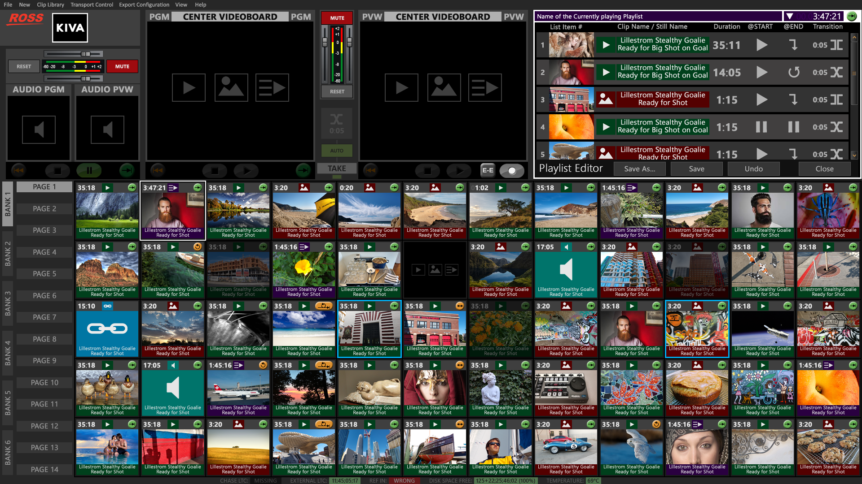
Notes:
WHEN A PLAYLIST IS BEING EDITED DURING PRE-PRODUCTION TIME… …THIS SAME WINDOW PANE DISPLAYS THE PLAYLIST EDITOR
[take]

Slide 20
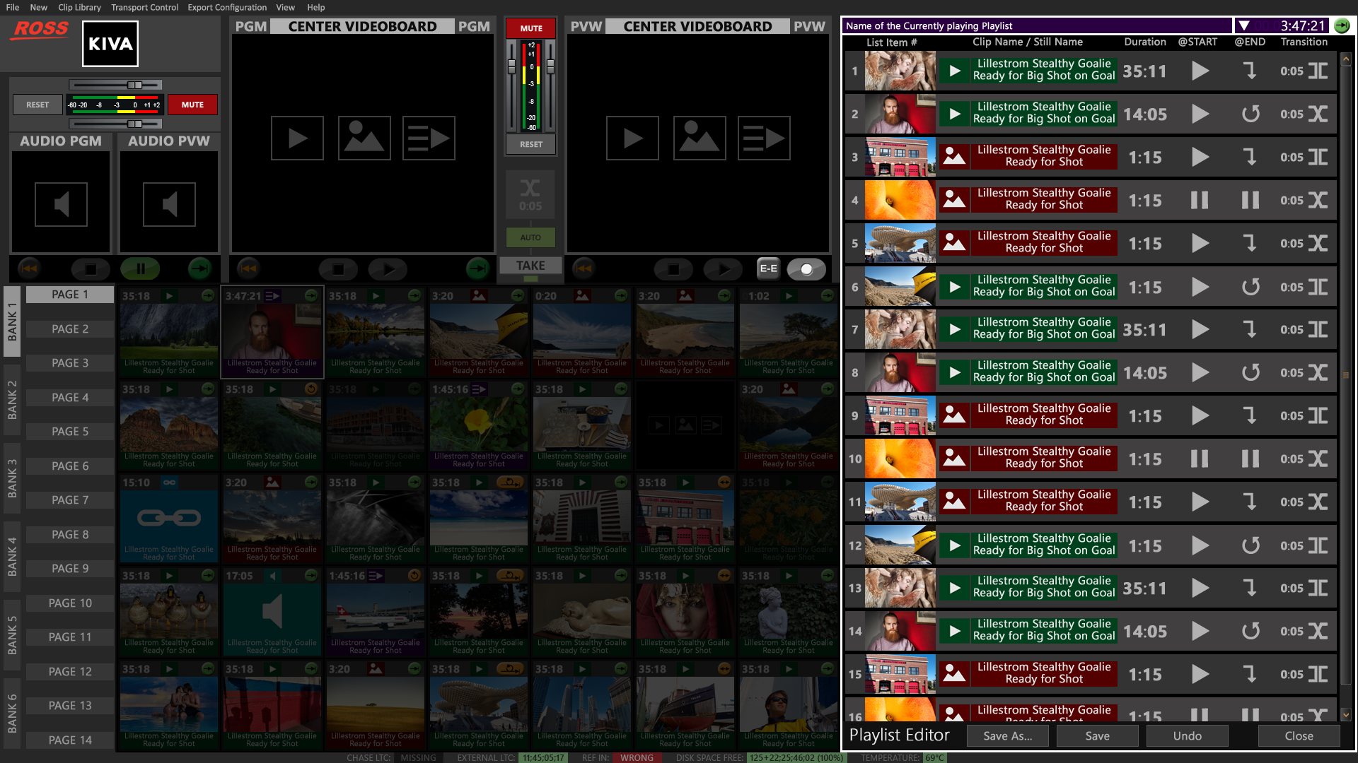
Notes:
…AND THIS WINDOW PANE IS ALSO “EXPANDABLE”
TO DISPLAY MORE CONTENT IN THE PLAYLIST BEING EDITED
[take]

Slide 21
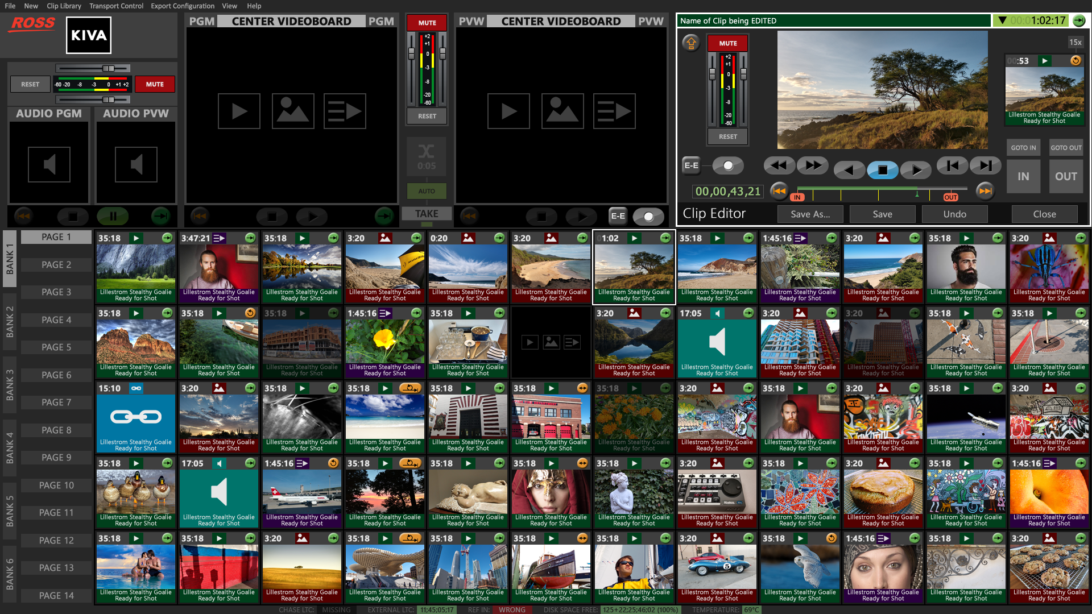
Notes:
AND INDIVIDUAL VIDEO CLIPS AND STILLS ARE EDITED IN THIS SAME WINDOW PANE…
…LET’S NEXT TAKE A QUICK LOOK AT SIMULATED OPERATIONS OF KIVA…
[take]

Slide 22
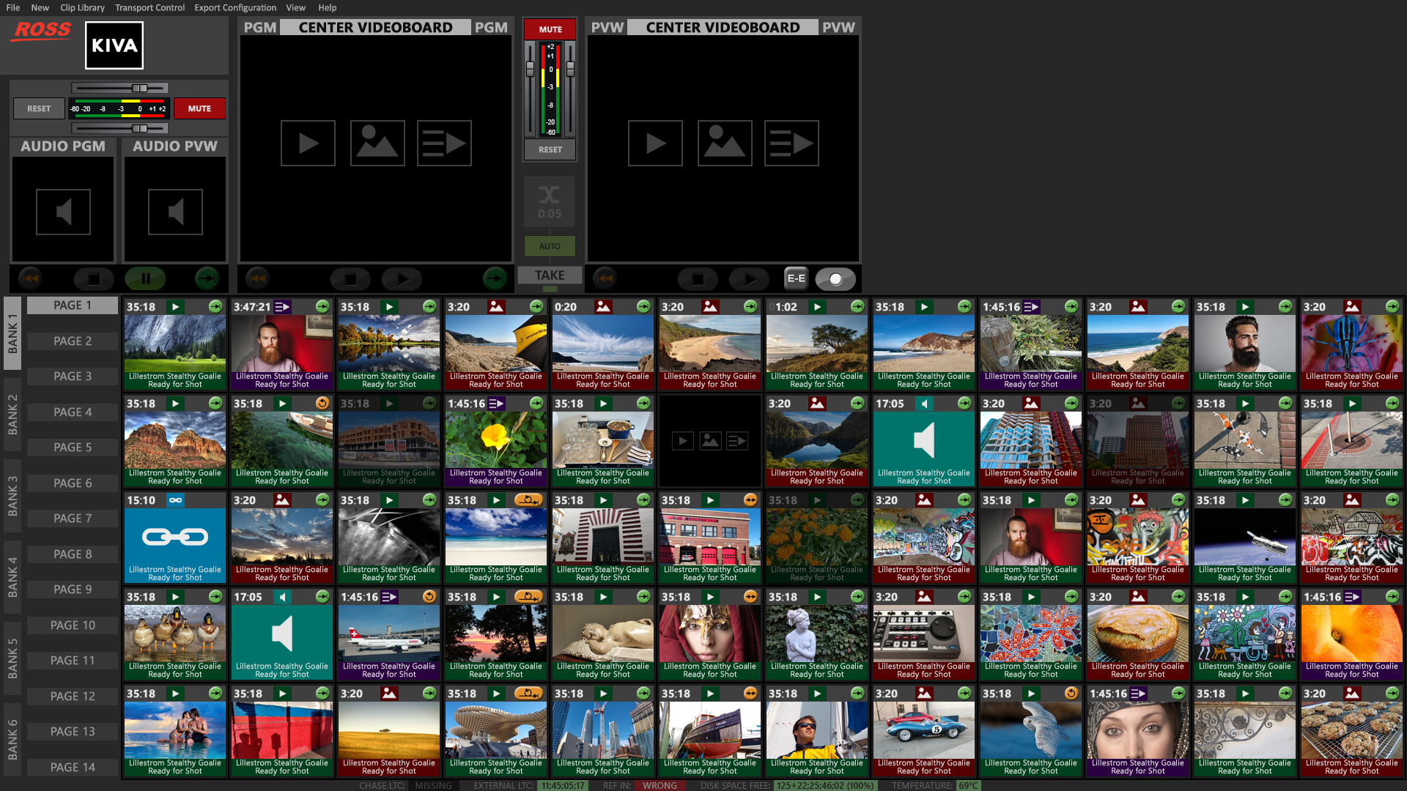
Notes:
THE OPERATOR HOVERS MOUSE OVER DESIRED MEDIA BUTTON…
…HERE, THE OPERATOR WANTS TO LOAD AND PLAY
THIS STILL IMAGE OF THESE CLASSIC RACE CARS…
…AND THEN CLICKS THAT BUTTON ONCE…
[take]

Slide 23
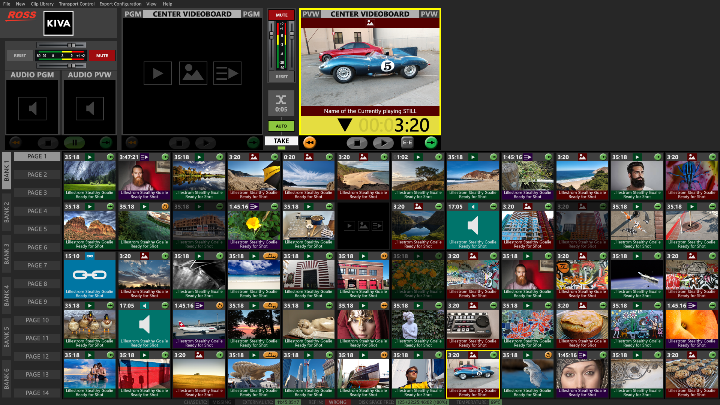
Notes:
THIS FIRST MOUSE CLICK LOADS THIS STILL INTO PVW VIDEO PLAYER…
…READY TO TRANSITION INTO THE PGM VIDEO PLAYER…
…A SECOND CLICK OF SAME MEDIA BUTTON TRANSITIONS
STILL INTO PGM VIDEO PLAYER…
[take]

Slide 24
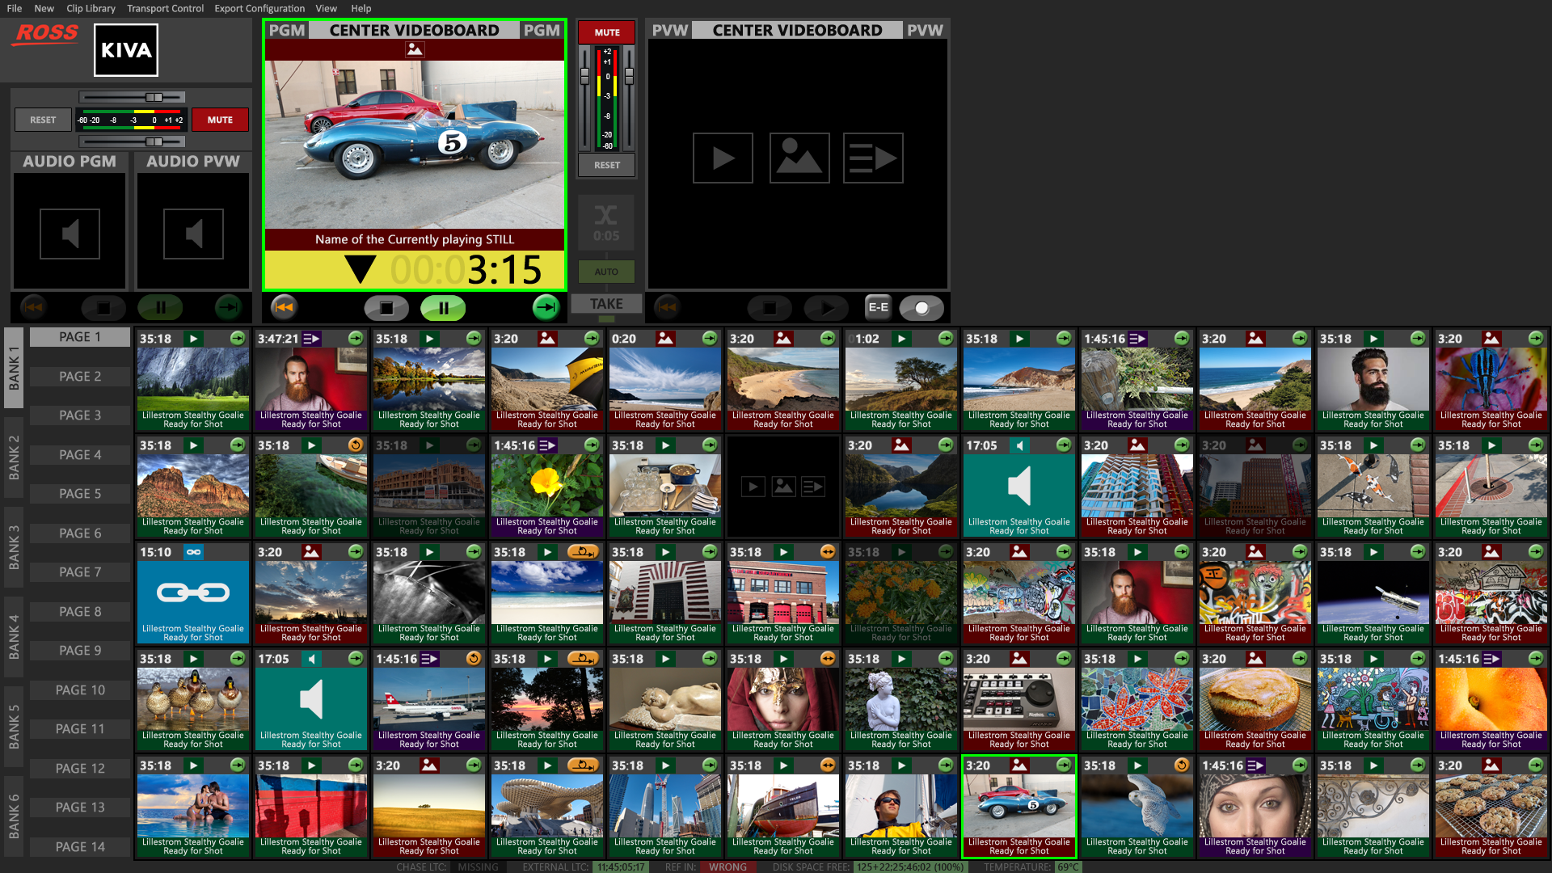
Notes:
WHERE IT PLAYS THE STILL FOR PRE-PROGRAMMED DURATION…
IN THIS CASE: FOR 3 SECONDS : 15 FRAMES…
MEANWHILE, ANOTHER MEDIA BUTTON IS CLICKED ONCE…
[take]

Slide 25
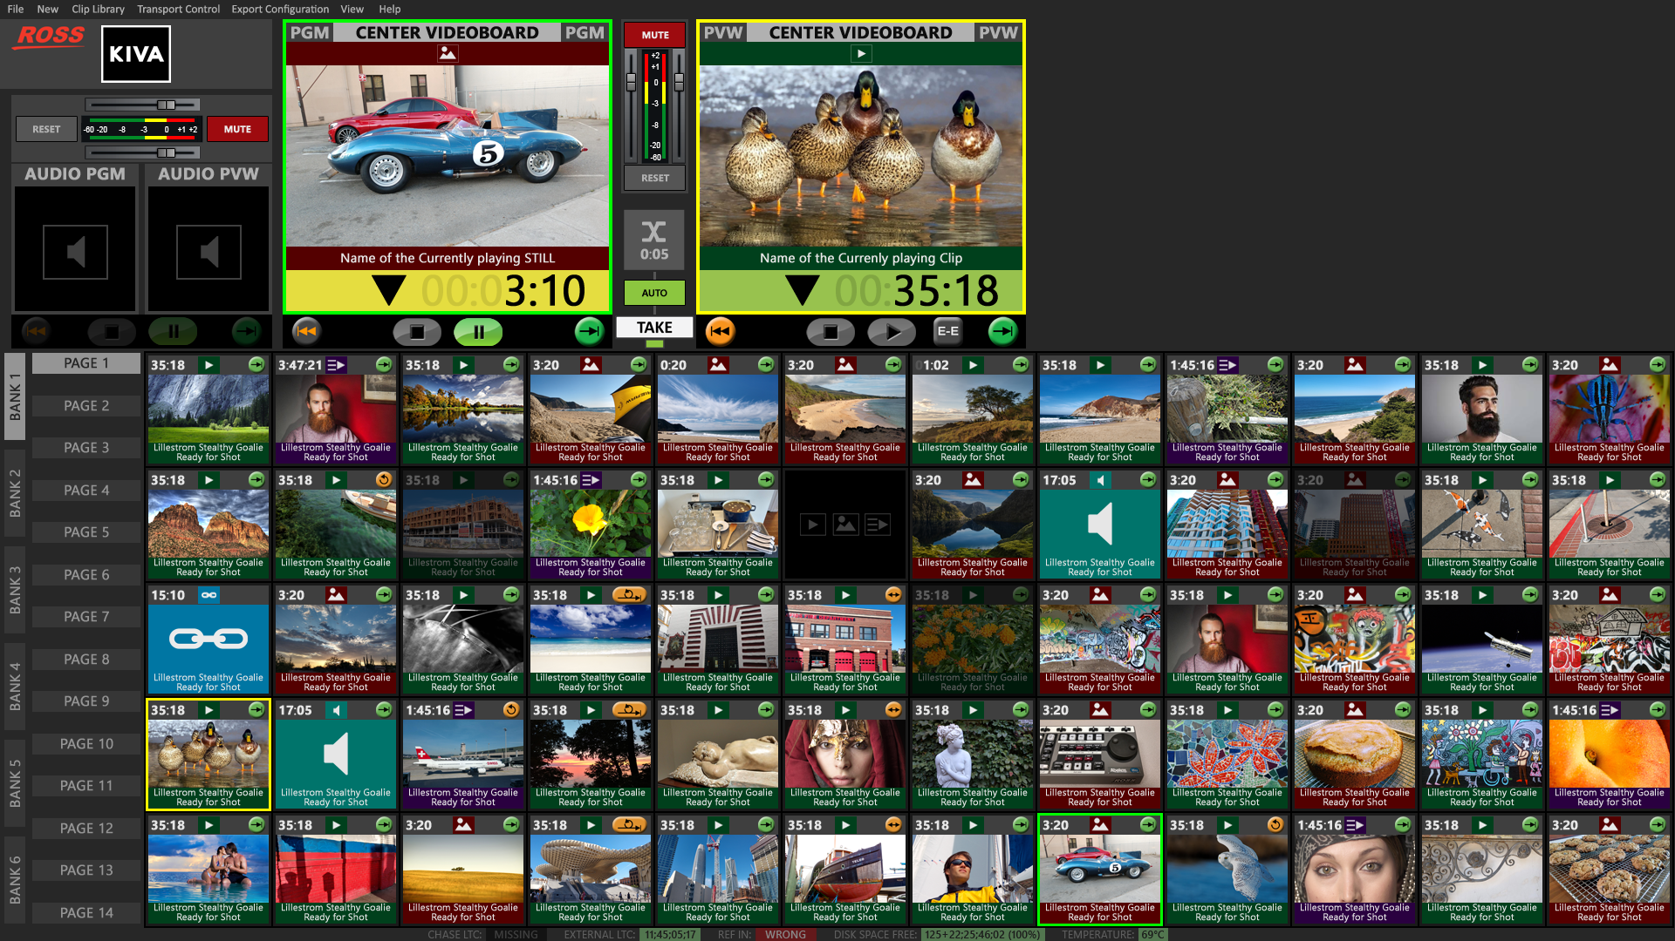
Notes:
…LOADING THE VIDEO CLIP ASSIGNED TO THAT MEDIA BUTTON OF
“DUCKIES” INTO PVW VIDEO PLAYER…
[take]
SINCE THE “AUTO” TRANSITION BUTTON IS ACTIVE…
THE DUCKIES CLIP AUTOMATICALLY TRANSITIONS TO THE PGM VIDEO PLAYER…
[take]

Slide 26
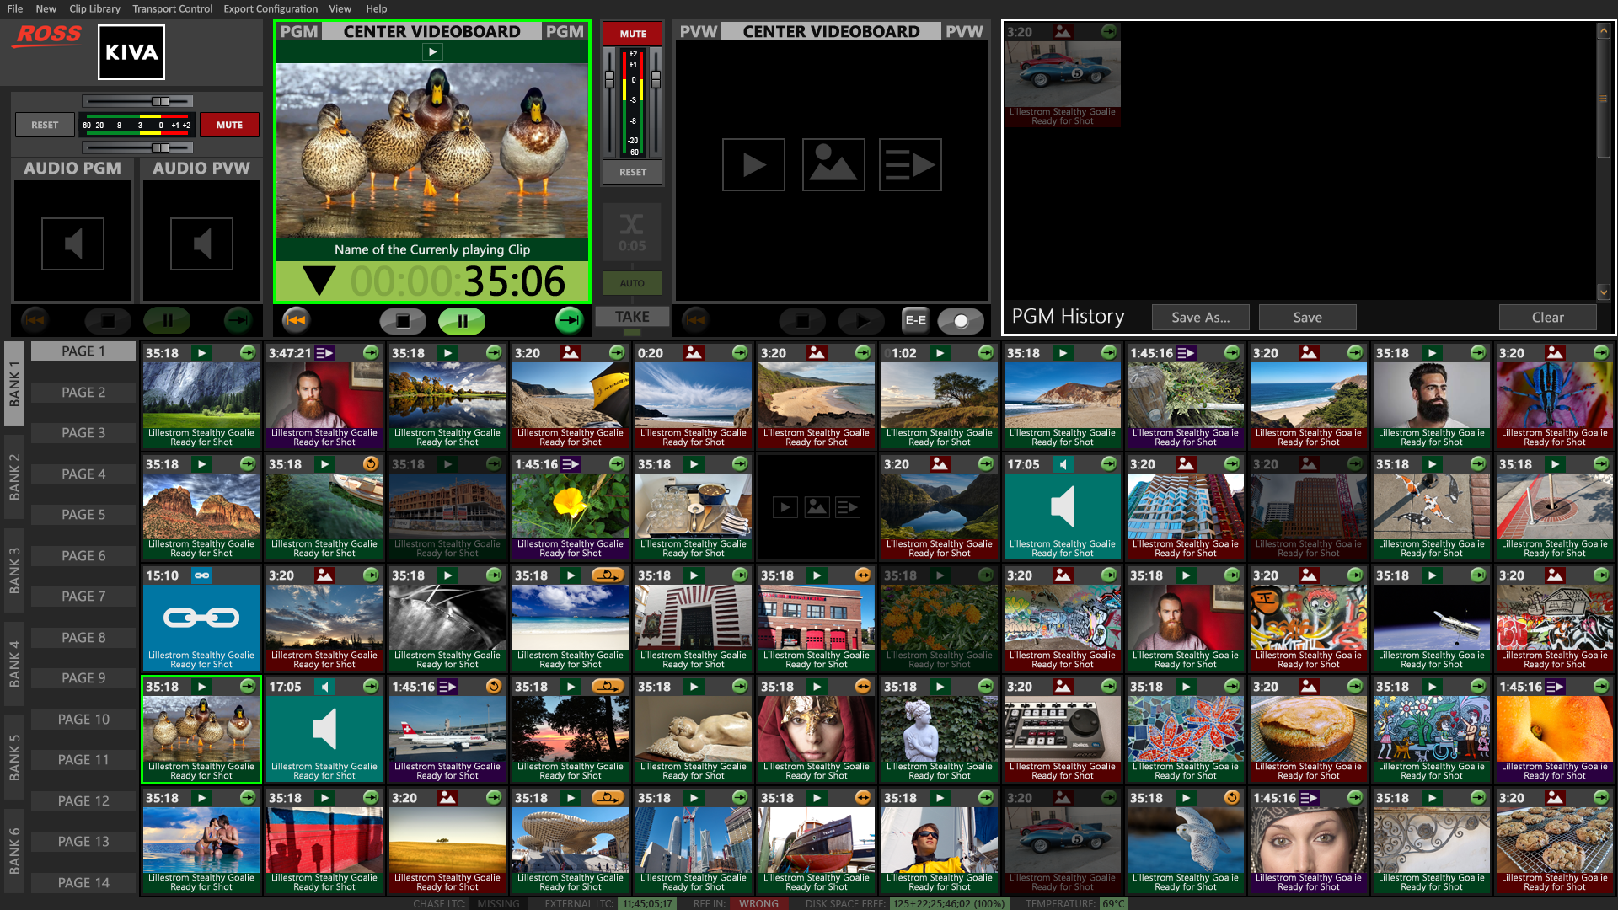
Notes:
…AND THE “DUCKIES” CLIP AUTOMATICALLY PLAYS IN PGM VIDEO PLAYER
[take]
MEANWHILE, THE PREVIOUS-PLAYED “CLASSIC CARS” CLIP…
…APPEARS “DIMMED OUT” WITHIN “PGM HISTORY” WINDOW PANE,
AT UPPER RIGHT…
[take]
NOTICE THAT ANY MEDIA BUTTON PREVIOUSLY LOADED & PLAYED
APPEARS “DIMMED-OUT” IN CLIP LIBRARY
THIS LETS OPERATORS KNOW WHICH MEDIA
HAS ALREADY BEEN PLAYED…
NEXT: THE OPERATOR CLICKS A PURPLE PLAYLIST MEDIA BUTTON…
[take]

Slide 27
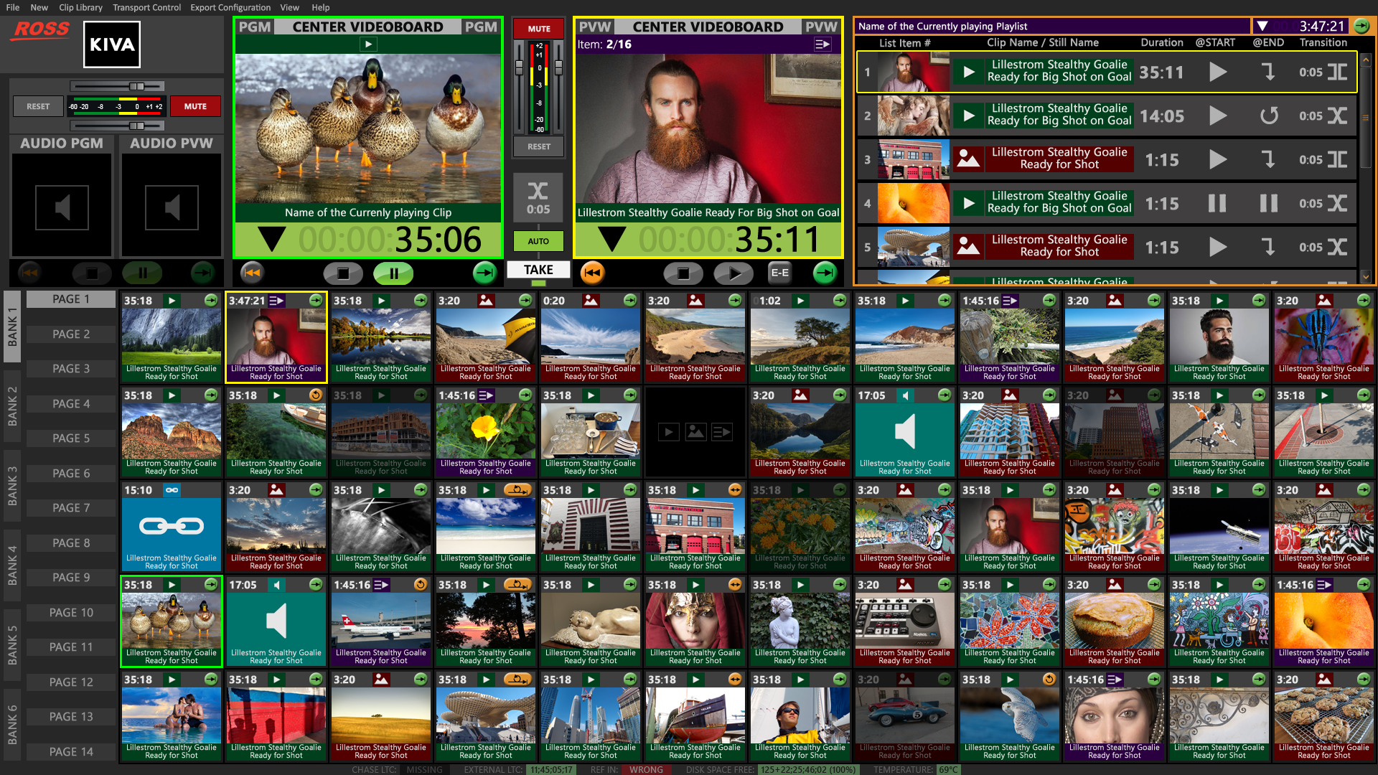
Notes:
[take]
…WHICH LOADS THAT PLAYLIST INTO PVW VIDEO PLAYER…
[take]
NOTICE THE FIRST FIVE ITEMS FOR PLAYLIST ARE VISIBLE IN UPPER RIGHT WINDOW PANE…
…AND WHEN THE “DUCKIES” CLIP FINISHES PLAYING IN PGM VIDEO PLAYER…
[take]

Slide 28
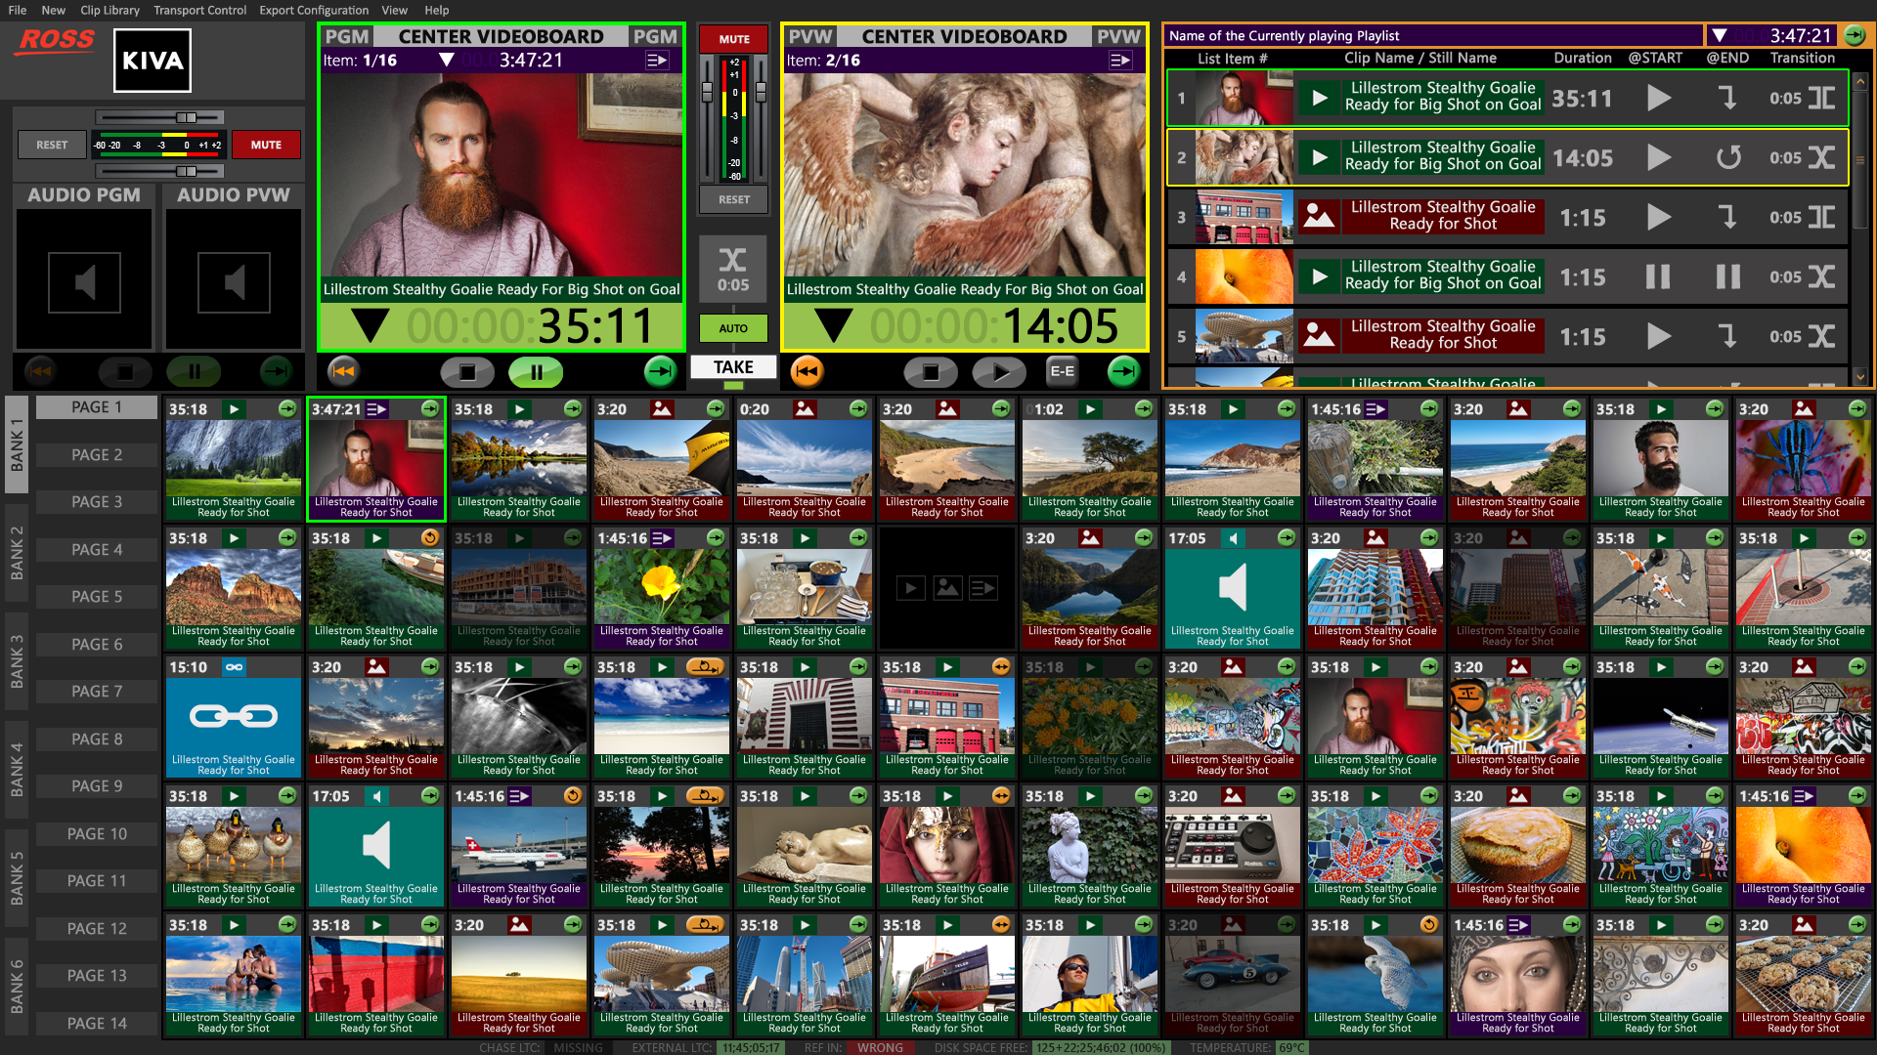
Notes:
…THE PLAYLIST CUED IN PVW
AUTOMATICALLY TRANSITIONS TO PGM…
…WITH THE NEXT ITEM IN PLAYLIST CUED UP IN PVW
WITH KIVA, OPERATIONS COULDN’T BE SIMPLER!
[take]

Slide 29
Live Presentation Server
Kiva ‘Video Channel’ Concept
SINGLE CHANNEL = Record IN | PVW+PGM OUT
X-Fade Dissolves on SINGLE CHANNEL between PVW+PGM OUT
PGM OUT includes VIDEO and KEY OUTs
Notes:
LET’S NOW TURN OUR ATTENTION TO KIVA HARDWARE…
[take]
THE “CHANNELS” ARE QUITE DIFFERENT FROM
PREVIOUS MODELS OF ABEKAS VIDEO SERVERS…
WITH KIVA:
A SINGLE CHANNEL FEATURES A SINGLE VIDEO INPUT…
…AND THIS SAME CHANNEL FEATURES BOTH
A PVW AND PGM PLAYER OUTPUT
[take]
THIS SINGLE CHANNEL IS CAPABLE OF “CROSS-FADE”
DISSOLVE AND WIPE TRANSITIONS BETWEEN PVW & PGM
[take]
AND THIS SAME SINGLE CHANNEL ALSO
FEATURES A KEY OUTPUT ON THE PGM VIDEO PLAYER…
…THEREFORE, MATTE & FILL CONTENT CAN PLAY INTO
“SWITCHER KEYERS” LOCATED DOWNSTREAM FROM KIVA
[take]

Slide 30
Live Presentation Server
Kiva ‘Video Channel’ Concept
SINGLE CHANNEL = Record IN | PVW+PGM OUT
X-Fade Dissolves on SINGLE CHANNEL between PVW+PGM OUT
PGM OUT includes VIDEO and KEY OUTs
NO User ‘channel reconfigurations’ as with Tria+ and Mira+
Notes:
…AND UNLIKE OUR PREMIUM TRIA+ AND MIRA+
VIDEO SERVER PRODUCTS…
THE VIDEO CHANNEL CONFIGURATION IS “FIXED”
AND CANNOT BE CHANGED BY THE USER!
[take]

Slide 31
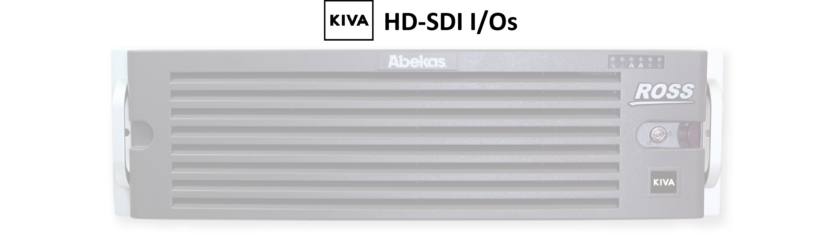
Live Presentation Server
Two Models Available
Notes:
SO, WITH THIS NEW “VIDEO CHANNEL CONCEPT” IN MIND…
…WE WILL HAVE TWO KIVA MODELS AVAILABLE FOR PURCHASE…
[take]

Slide 32
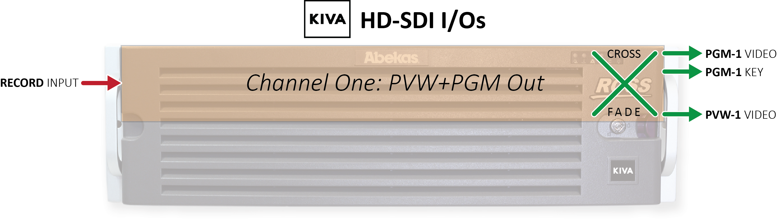
Live Presentation Server
Single-Channel Model
Notes:
THE ENTRY-LEVEL KIVA MODEL FEATURES THAT POWERFUL SINGLE CHANNEL CONCEPT…
…DESCRIBED JUST A MOMENT AGO
IT FEATURES A SINGLE VIDEO INPUT FOR RECORDING LIVE, BASE-BAND CONTENT…
…WITH A PVW+PGM VIDEO PLAYER OUTPUT PAIR IN WHICH PGM OUT HAS A KEY OUTPUT
…AND AS MENTIONED EARLIER, THERE IS A BUILT-IN CROSS-FADER
FOR TRANSITIONS ON THIS SINGLE CHANNEL KIVA
[take]

Slide 33
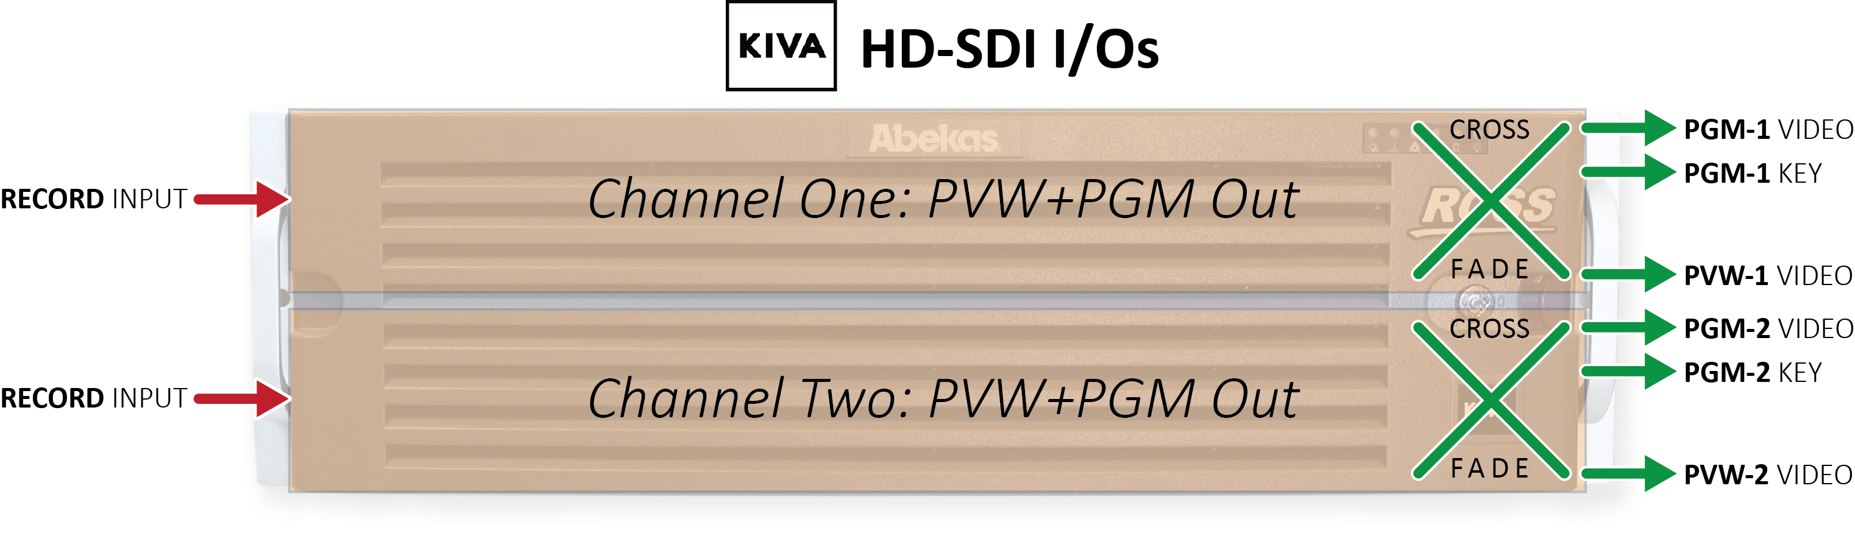
Live Presentation Server
Dual-Channel Model
Notes:
THE DUAL-CHANNEL KIVA MODEL SIMPLY FEATURES TWICE THE
VIDEO I/Os OVER THE SINGLE CHANNEL MODEL…
…WITH TWO RECORDING INPUTS…
…AND TWO PAIRS OF PVW+PGM VIDEO PLAYERS…
…WITH KEY OUTPUTS ON EACH PGM PLAYER…
…AND DUAL CROSS-FADERS
[take]

Slide 34
Live Presentation Server
AVC-Intra Codec for Import & Record
HD Video Standards Only | No SD or UHD
1.5G 720p & 1080i HD Video I/O
| 50 | 59.94 |
3G 1080p HD Video I/O
| 50 | 59.94 |
Notes:
BOTH KIVA MODELS COME WITH AVC-INTRA VIDEO HARDWARE…
SUPPORTING THE USUAL 1.5G AND 3G VIDEO STANDARDS OF EARLIER ABEKAS VIDEO SERVERS
…SORRY: BUT FOR NOW, KIVA WILL NOT SUPPORT UHD VIDEO STANDARDS OR IP VIDEO I/Os…
AT LEAST NOT INITIALLY ON FIRST SHIPMENT!
[take]

Slide 35
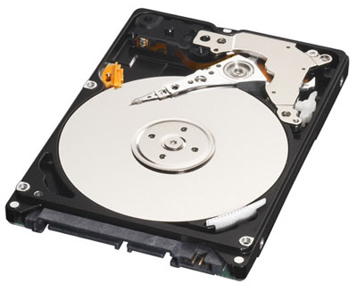
Live Presentation Server
Media Storage Options
40-Hour Storage | SSD RAID-5
80-Hour Storage | SSD RAID-5
560-Hour Storage | HDD RAID-6
Notes:
BOTH KIVA MODELS WILL BE AVAILBLE WITH
THREE SEPARATE STORAGE OPTIONS…
…40-HOURS | 80-HOURS |
AND A WHOPPING 560-HOURS
…ALL MEDIA ARE PROTECTED FROM SSD OR HARD-DRIVE FAILURES
WITH RAID-5 AND RAID-6 PARITY PROTECTION
[take]

Slide 36
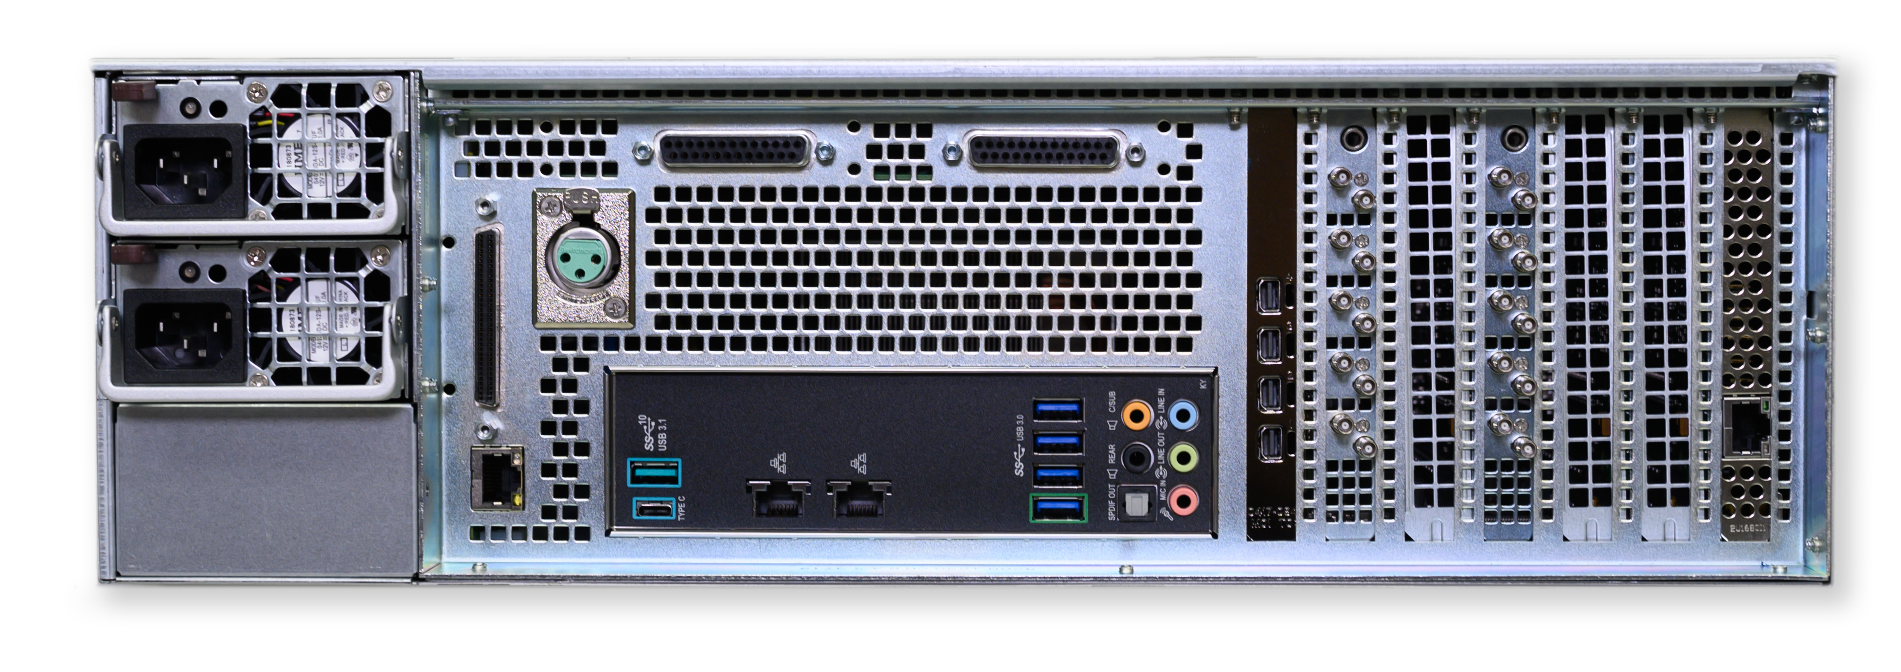
Live Presentation Server
Standard Features
Rock-Solid real-time Abekas Video Engines
Windows 10 Enterprise O/S
8-Track Embedded Audio on every Video I/O
16-Track Discrete AES Audio I/O (AES-59)
Built-In Audio Router
Built-In Media File Import Tools
Dual: 10G Ethernet | 10G USB-C
Dual: Hot-Swap Power Supplies
Notes:
AND BOTH KIVA MODELS SHARE
THE SAME COMPREHESIVE FEATURE SET
FOUND IN ALL PREVIOUS-GENERATION ROSS VIDEO SERVERS…
…THAT ARE BASED UPON ABEKAS TECHNOLOGY
[take]

Slide 37
Live Presentation Server
Single-Channel Model List Prices
40-Hour Storage | $39,900.USD
80-Hour Storage | $42,900.USD
560-Hour Storage | $52,900.USD
PRELIMINARY PRICES!
Notes:
AND ALL THIS KIVA GOODNESS
IS REASONABLY PRICED,
WHEN COMPARED TO OUR MAIN COMPETITION…
…HERE ARE THE PRELIMINARY LIST PRICES FOR
THE SINGLE-CHANNEL KIVA MODEL
[take]

Slide 38
Live Presentation Server
Dual-Channel Model List Prices
40-Hour Storage | $59,900.USD
80-Hour Storage | $62,900.USD
560-Hour Storage | $72,900.USD
PRELIMINARY PRICES!
Notes:
…AND THE PRELIMINARY LIST PRICES FOR THE
DUAL-CHANNEL KIVA MODEL

Slide 39
Live Presentation Server
Public Announcement July 2020
Shipping July 2020
Notes:
WE PLAN TO ANNOUNCE KIVA TO
PUBLIC & ROSS SALES PARTNERS IN JUNE 2020
AND WE PLAN FIRST SHIPMENT IN JULY 2020

Slide 40

Metus INGEST
Notes:
NEW NOTE

Slide 41

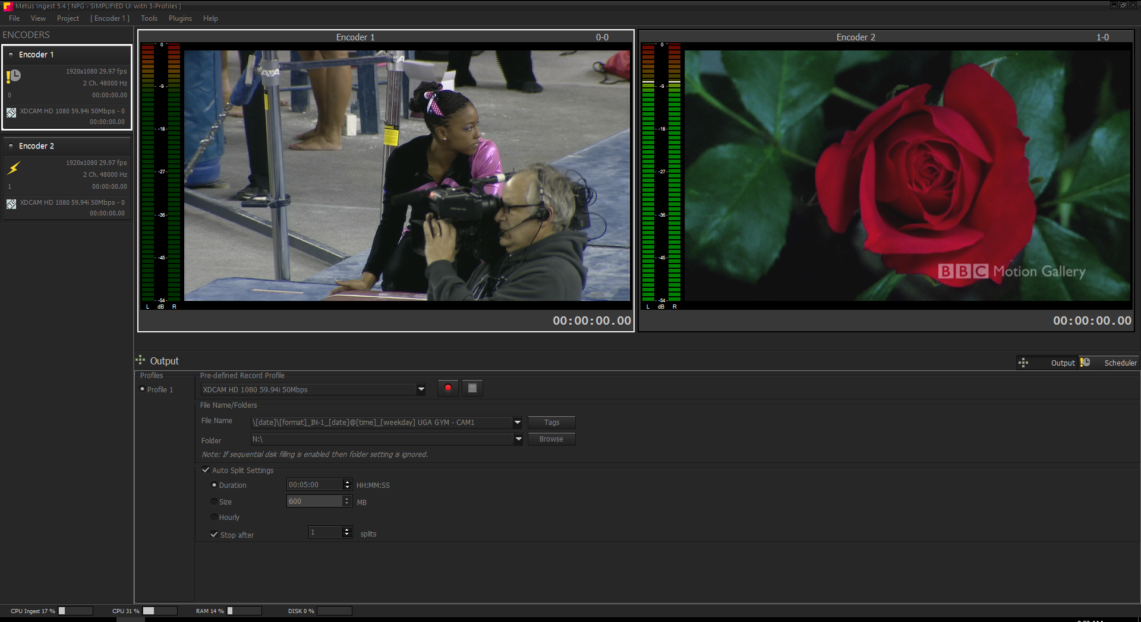
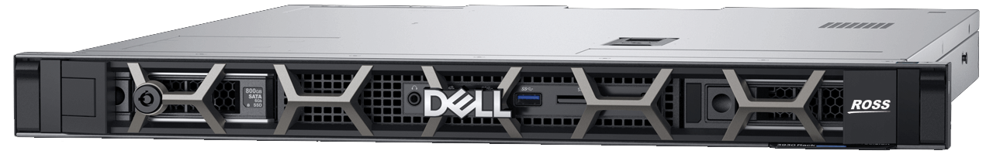
Metus INGEST
This is a Placeholder
This is a Placeholder
This is a Placeholder
Notes:
NEW NOTE

Slide 42
Metus INGEST
User Interface
Notes:
NEW NOTE

Slide 43
Happy Selling!
Notes:
THIS WRAPS UP MY PRESENTATION
THANKS FOR LISTENING AND WATCHING — AND HAPPY SELLING!
WE ARE NOW OPENING THE SESSION
FOR FIVE MINUTES OF QUESTIONS…

