Slide 2
Graphite v3
Just Released in Early April

Slide 3
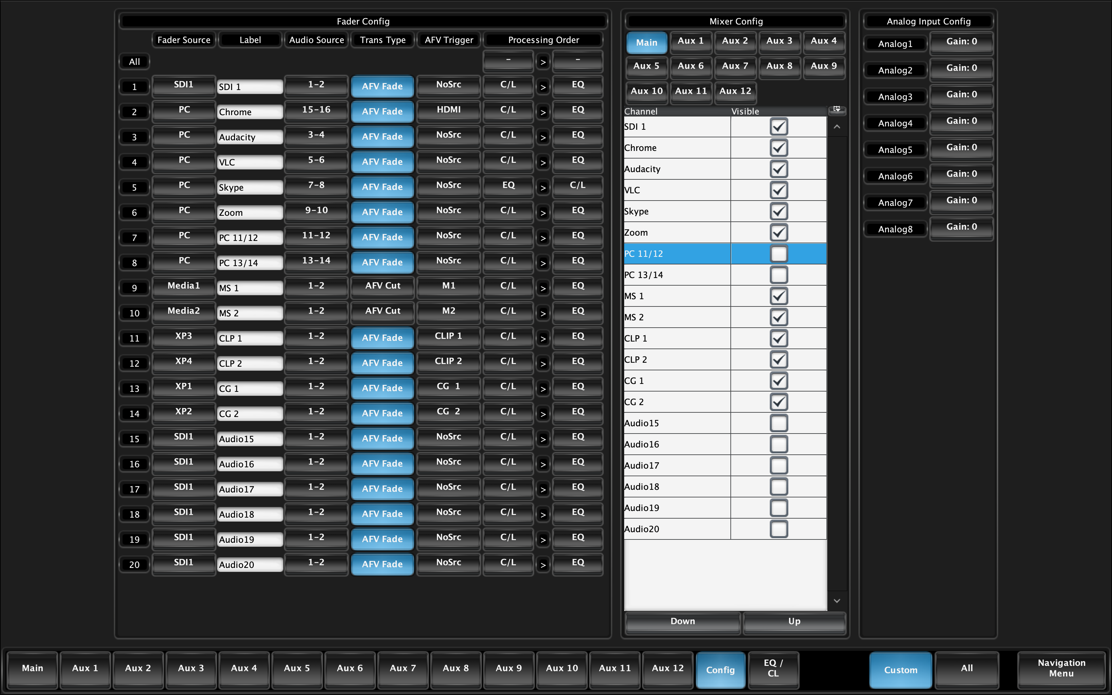
Graphite v3…Audio and more audio
48 Configurable Faders:
With version 3 all of the Faders have moved to the the Configurable Fader type. Each Fader can pick any of the available sources (SDI, XPN, MediaStore, PC Audio and the RAVE ABM Analog or AES) and then any of the Channels within those sources. Example: SDI 5 channels 9/10.

Slide 4
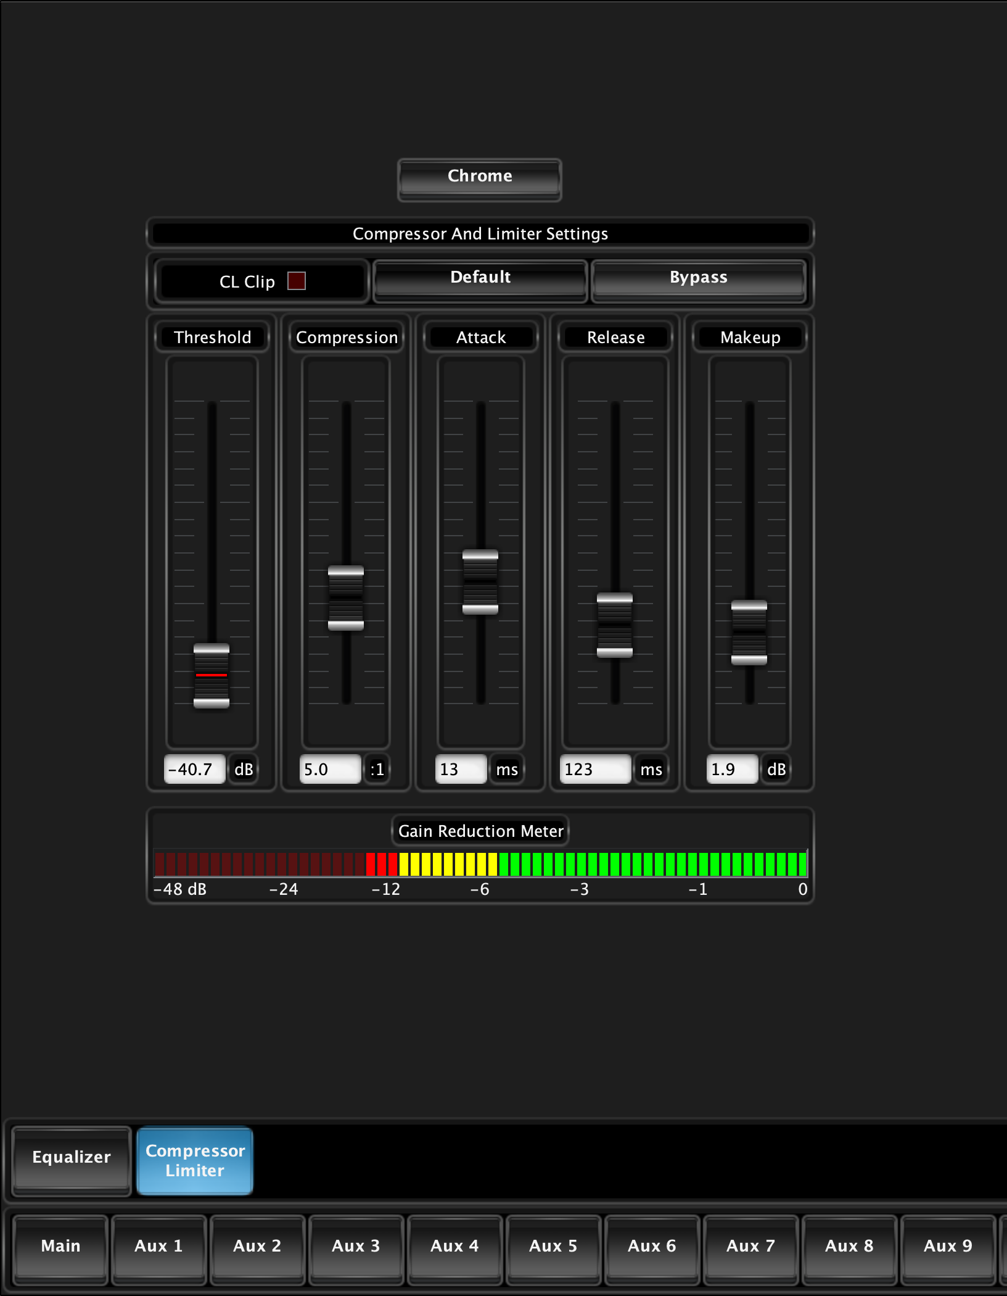
Graphite v3…Audio and more audio
Compressor / Limiter:
In version 2 we introduced the 4 band parametric EQ. Sure enough the requests poured in for adding the Compressor / Limiter. Each Fader has both EQ and CL in v3

Slide 5
Graphite v3…Audio and more audio
EQ and CL Processing Order
With different opinions and application requirements the ability to pick on a fader by fader basis has been implemented.
Each Fader can have either EQ or CL set as the first stage processing. There is also a Global Quick Assign!

Slide 6
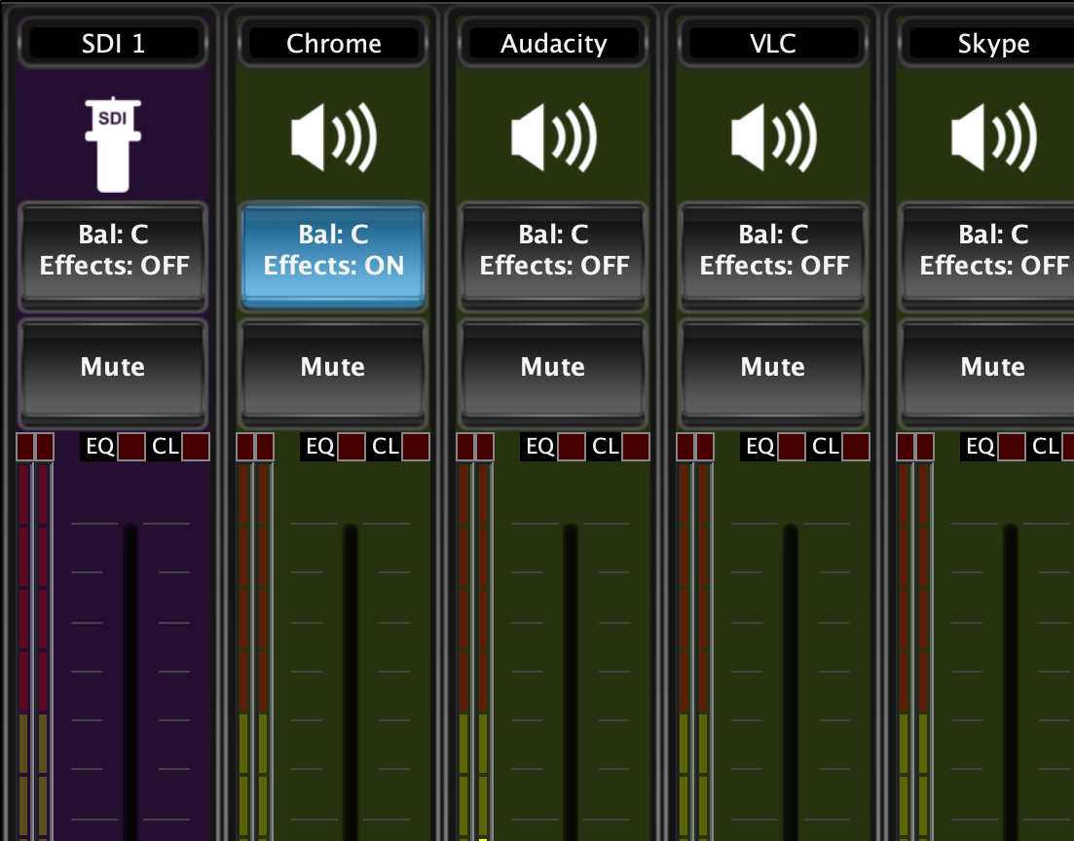
Graphite v3…Audio and more audio
EQ and CL Clip Indicators
Adding more information to the operators visual scan. With these extra indicators on the faders it is clear if clipping is taking place which stage in the pipeline it is happening.
Now if it is in the EQ it can be seen to take corrective action!

Slide 7
Graphite v3…Audio and more audio
Now with 12 Stereo Aux Mixes
More audio to expand production requests!
Aux Mixes are utilized for multiple language feeds, secondary mixes, also heavily tasked for Mix-Minus to feed IFB and Returns to remote contributors.

Slide 8
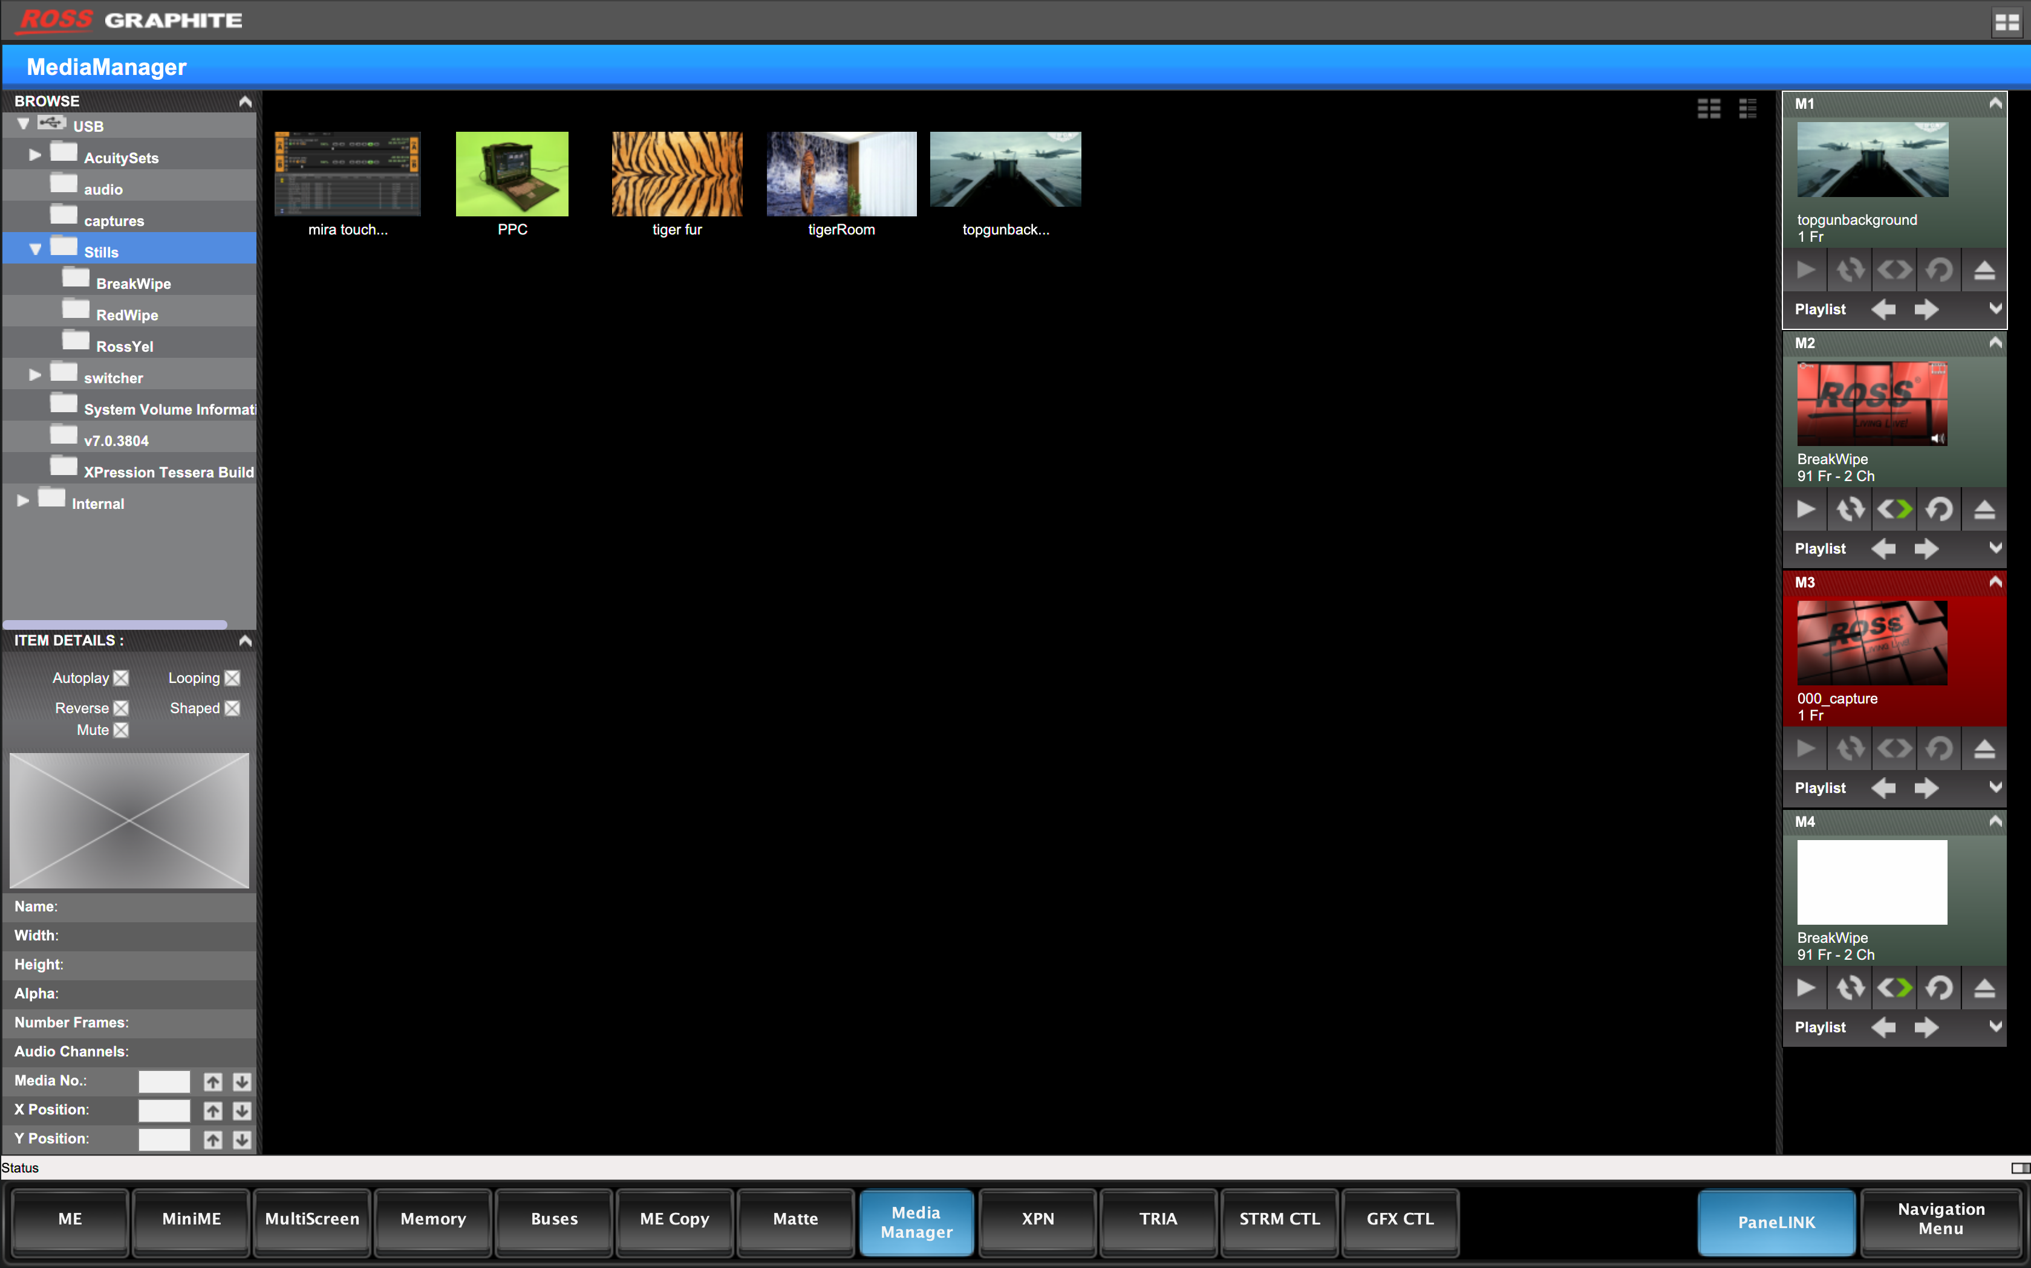
Graphite v3 – DashBoard enhancements
Media Manager in Live Assist
Media Manager is still available in the standalone tab. In addition we have made it available to the Live Assist Tab.
This enables Panel Link to automatically follow to the menu when selecting the MediaStore XPTs!

Slide 9
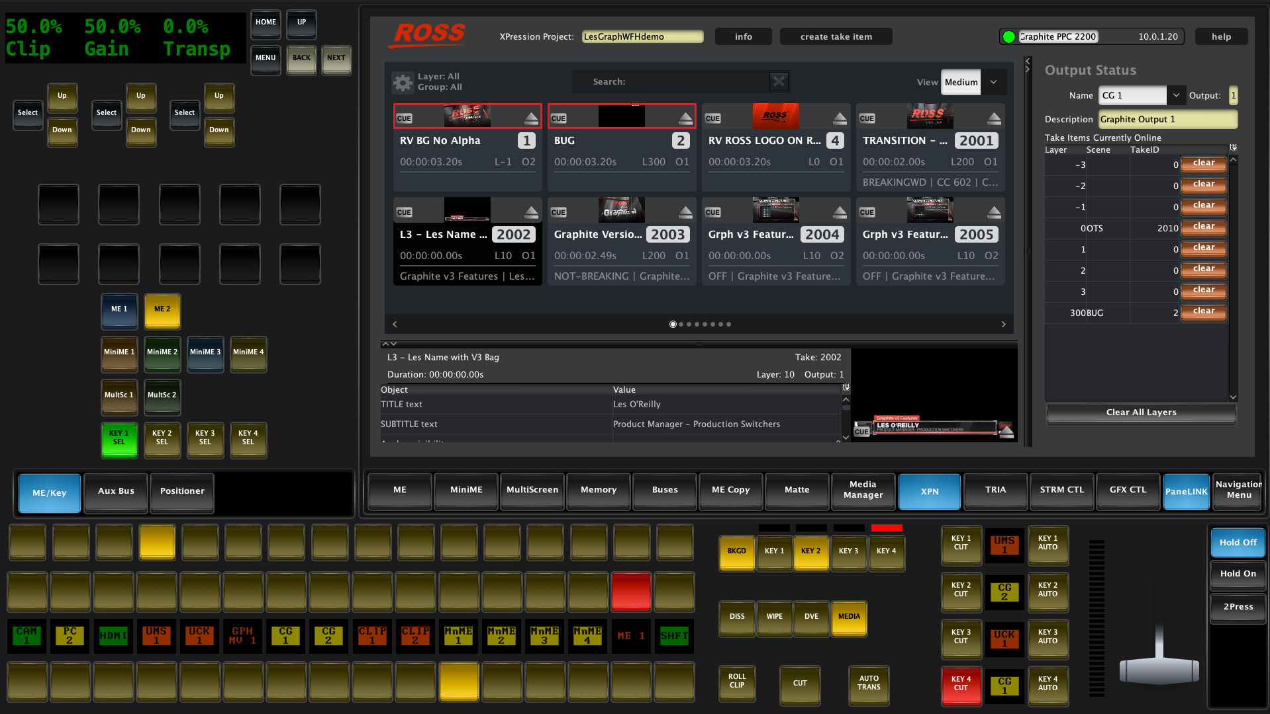
Graphite v3 – DashBoard enhancements
Custom Views in Live Assist
4 x User assignable tabs to assign any device from the DashBoard Tree or user created DashBoard Custom Panels
Associate with Inputs for Panel Link Auto Follow. Example here with the XPression DashBoard Plugin!

Slide 10
Graphite V4
Target Release June 2020

Slide 11
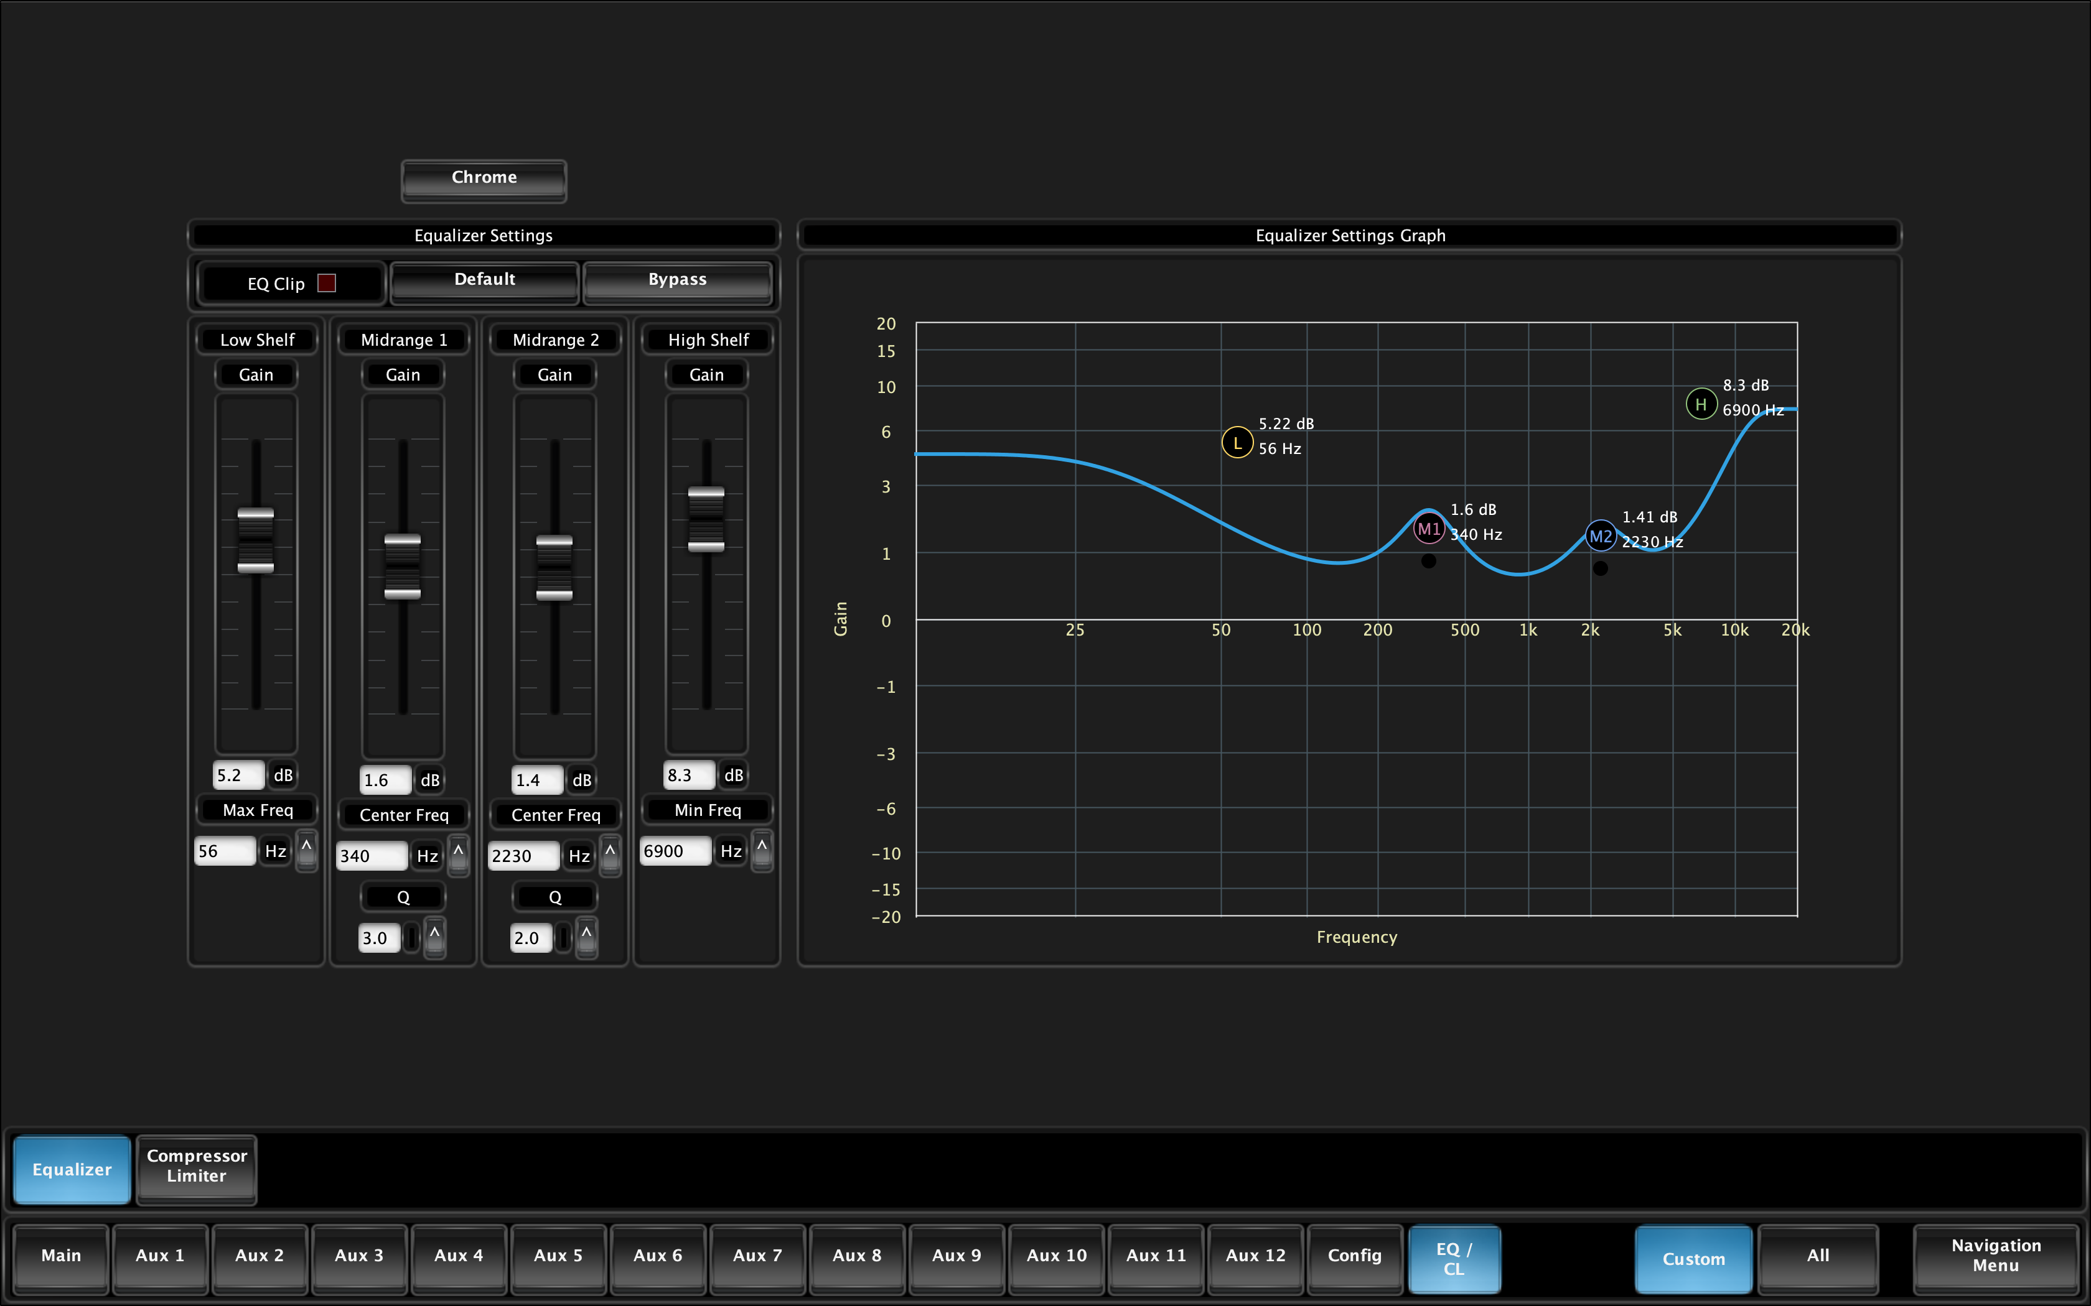
Graphite v4 Audio enhancement
EQ Graph Editor
The Parametric 4 Band EQ now offers a Graphic Representation of the EQ Curve.
Interaction with the Frequency and Q Values is possible with a few clicks of a mouse!

Slide 12
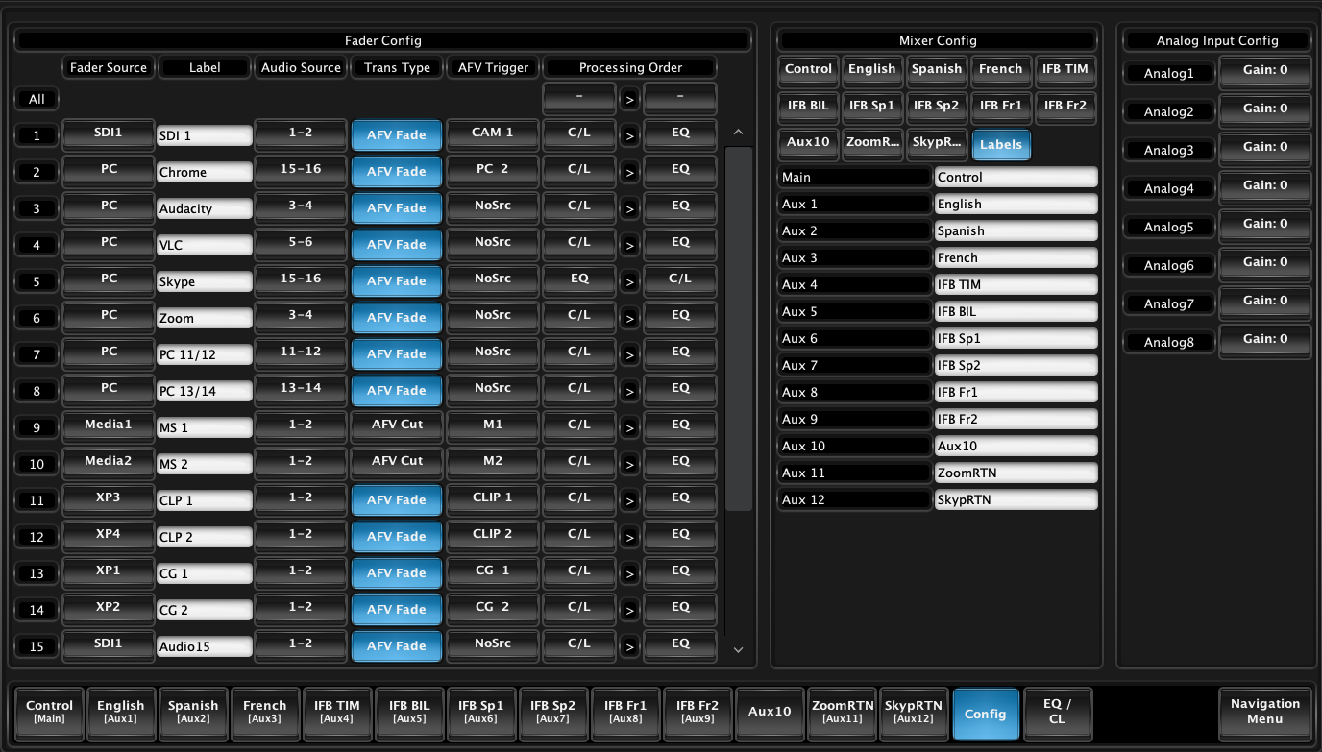
Graphite v4 Audio enhancement
Aux Mix Naming
With 12 Stereo Aux Mixes keeping track of what is in Each is becoming hard!!
Make it easier on yourself and name them!!

Slide 13
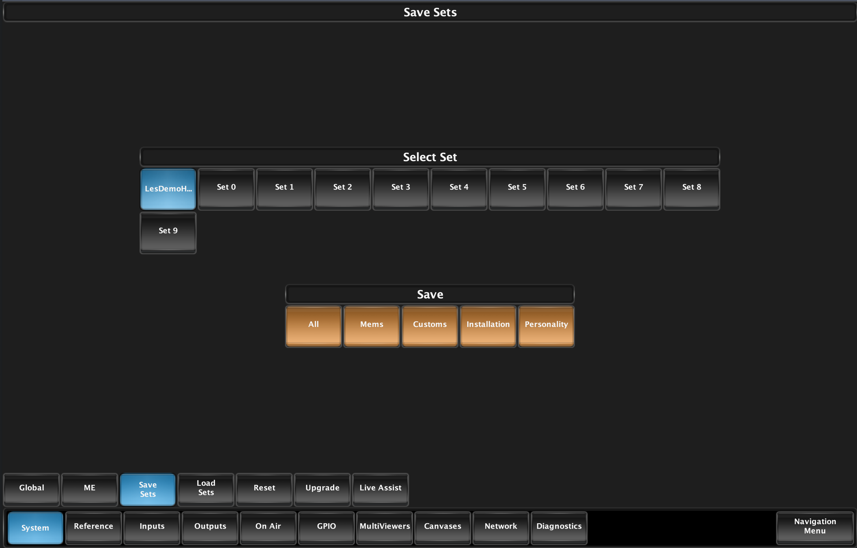
Graphite v4 – DashBoard enhancements
File Based Upgrades, Save and Load Show Files Menu
Drag and drop a new upgrade into DashBoard to Kick off an update.
Save and Load File Sets from the GUI instead of the SoftPanel or hard panel interfaces

Slide 14
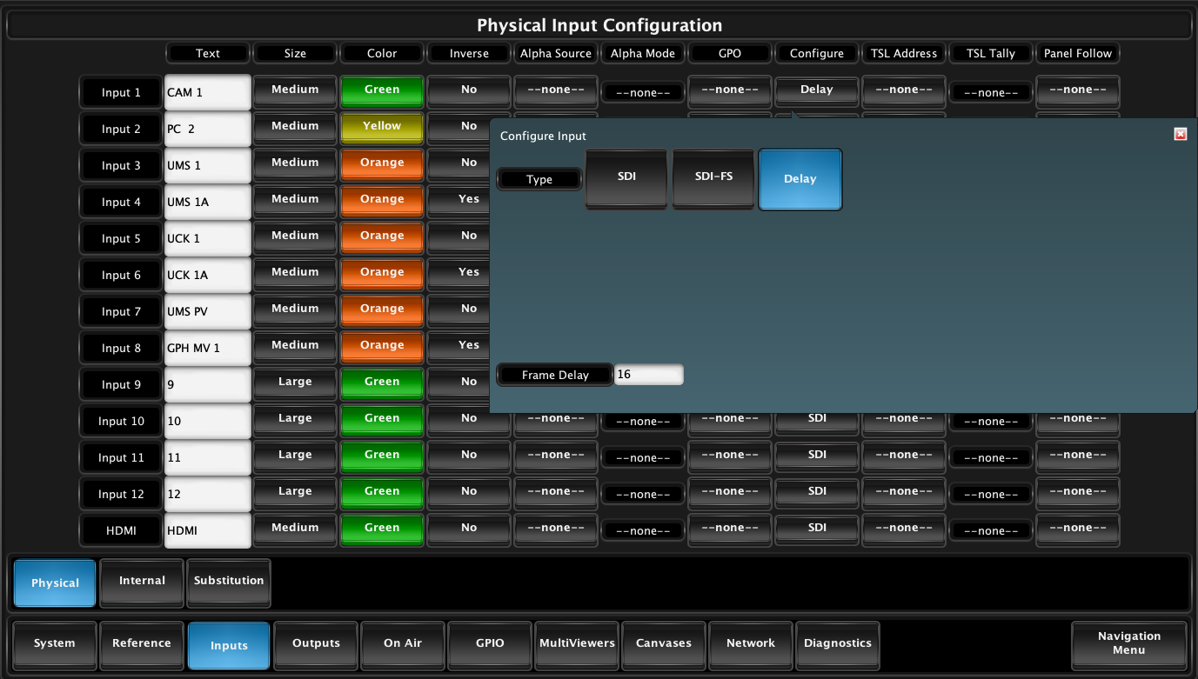
Graphite v4 – Video Processing Addition
Add Frame Delay of up to 16 Frames in all Frame Syncs
The First 6 inputs all have a Frame Sync and Format Convert. A new Delay mode has been added with the ability to tack on additional Delay.
Great for VS and AR to compensate for the matching the Render Time of the Engine!

Slide 15
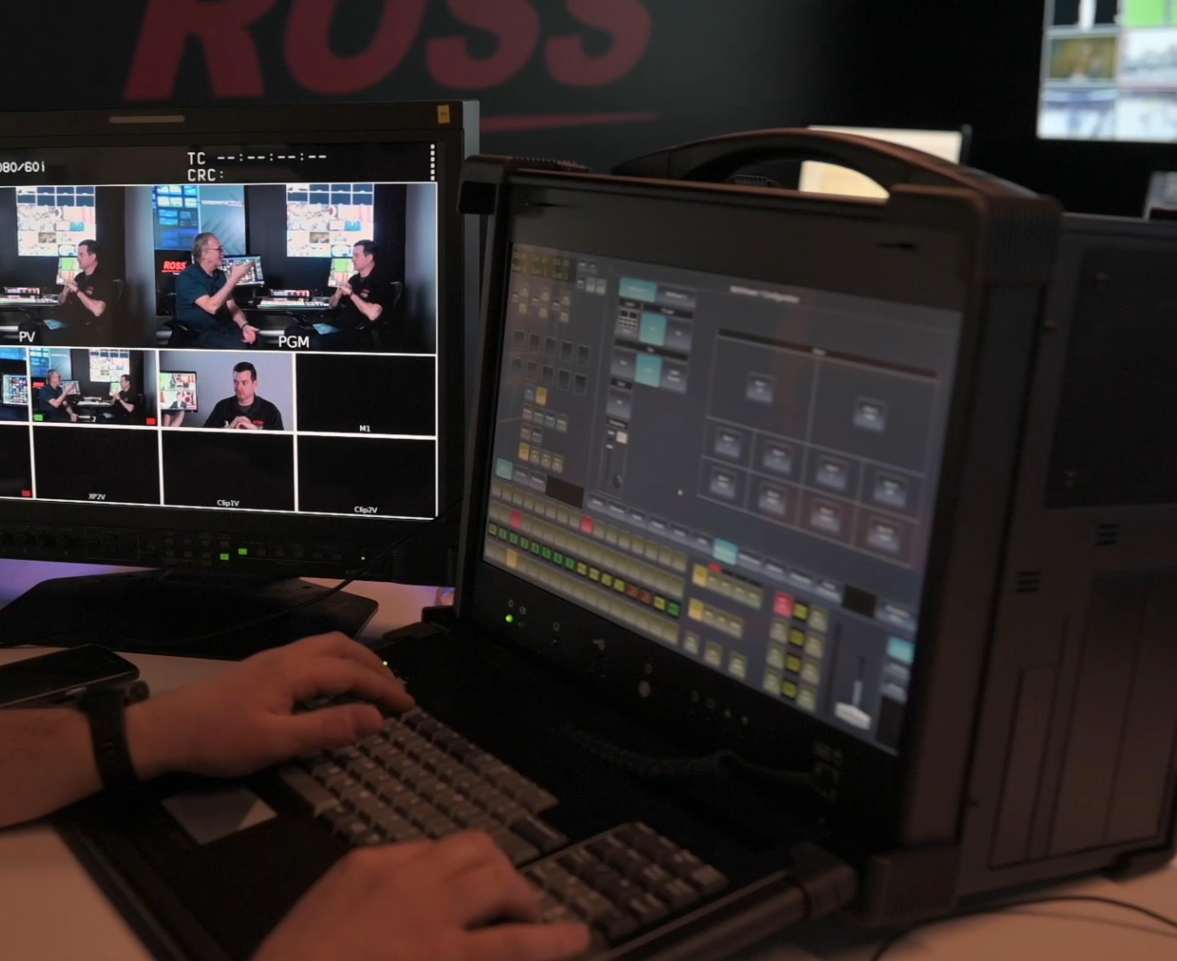
New Product Introduction – Graphite PPC
Up to 2 ME with 4 MiniME
4 2D DVE Floating
6 Frame Sync with Format Converters
2 x 16 Window MVs
RAVE Audio Mixer 13 Stereo Mixes with 48 Faders and SRCs
XPression Motion Graphics with XPression Clips

Slide 16
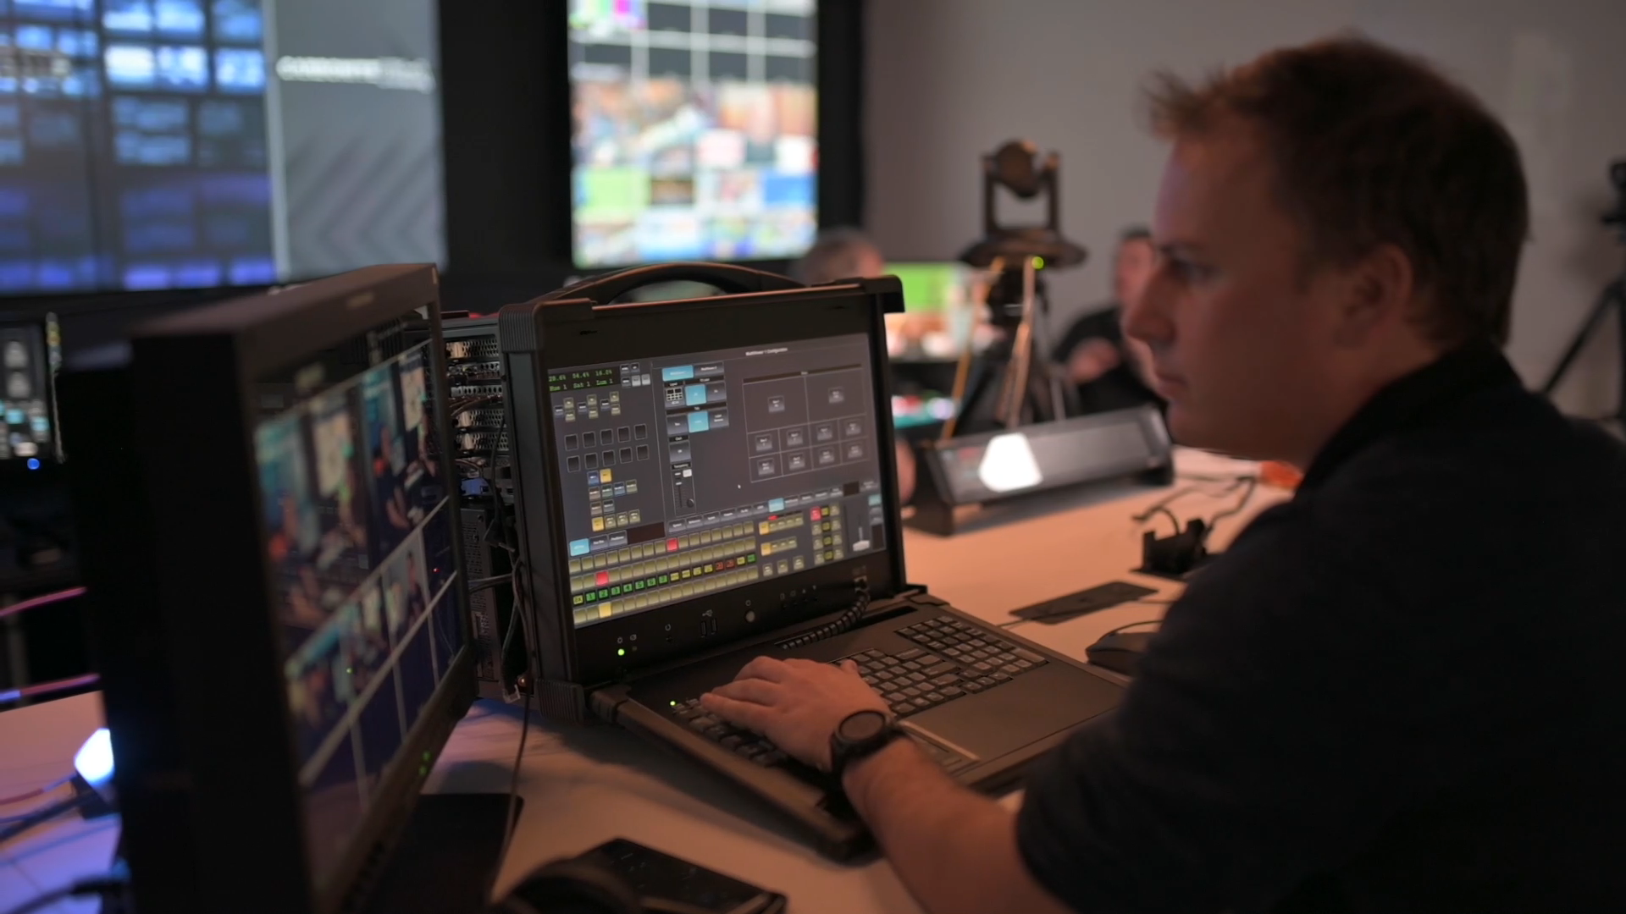
Graphite PPC – Pricing
Starting Pice - $19, 995 USD
Includes:
1 ME with 4 MiniME
4 DVE, 6 FSFC, 4 MediaStores
5 Inputs (4 SDI and 1 HDMI)
8 Outputs (6 SDI and 2 HDMI)
2 Outputs Configurable, 6 Follows or MV on SDI 5/6 and HDMI 1/2
XPression Graphite Prime and Clips

Slide 17
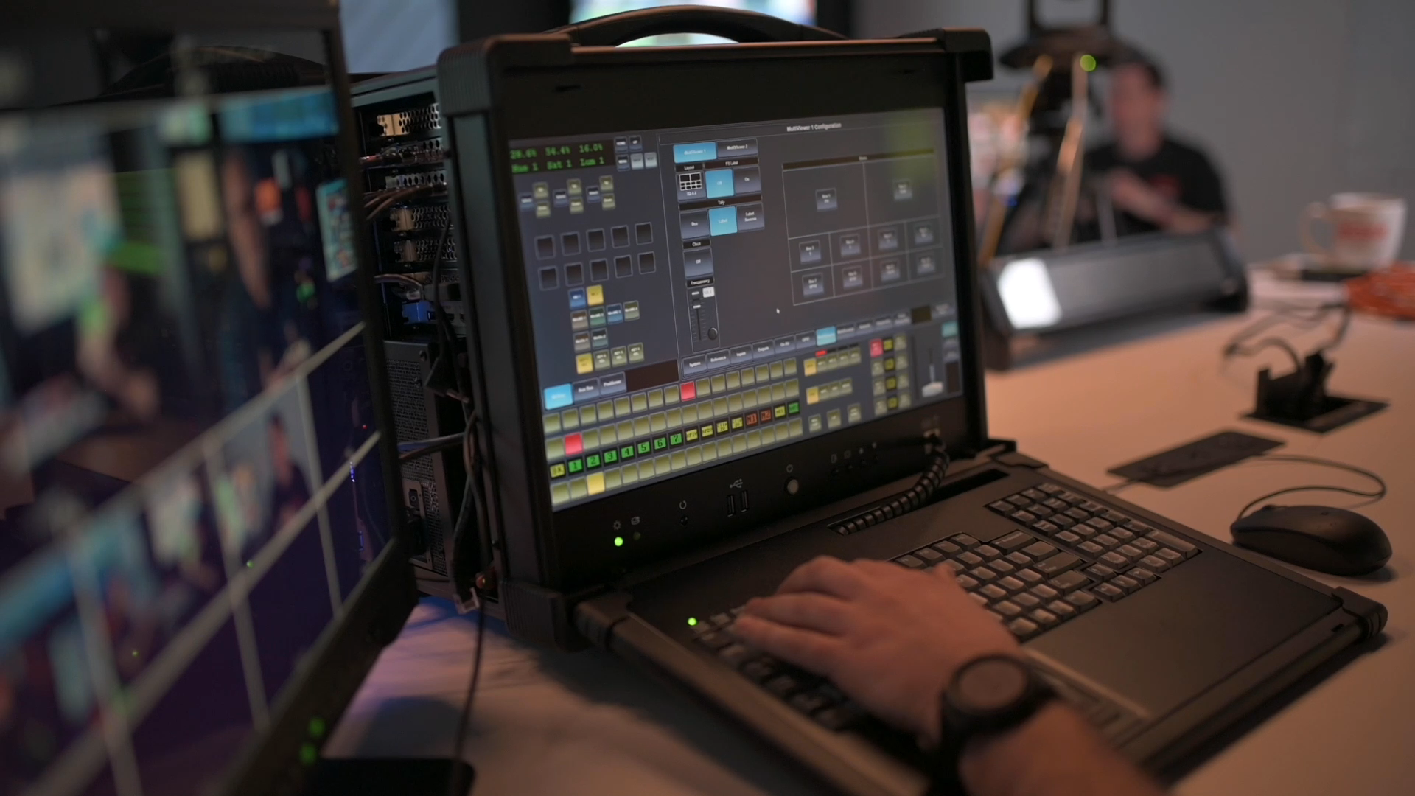
Graphite PPC – Performance
17 Inch 1920 x 1080 Display
Integrated Keyboard, Trackpad and Numeric Keypad
Front USB 3.0
Included Soft Shell case with Handle and wheels
Built in Speakers for Monitoring
Ultra Quite Fan Cooling! Operation in shared space not an issue
1TB SSD M.2 SATA Drive
8 CORE CPU with 16GB DDR4
Nvidia Quadro P2200

Slide 18
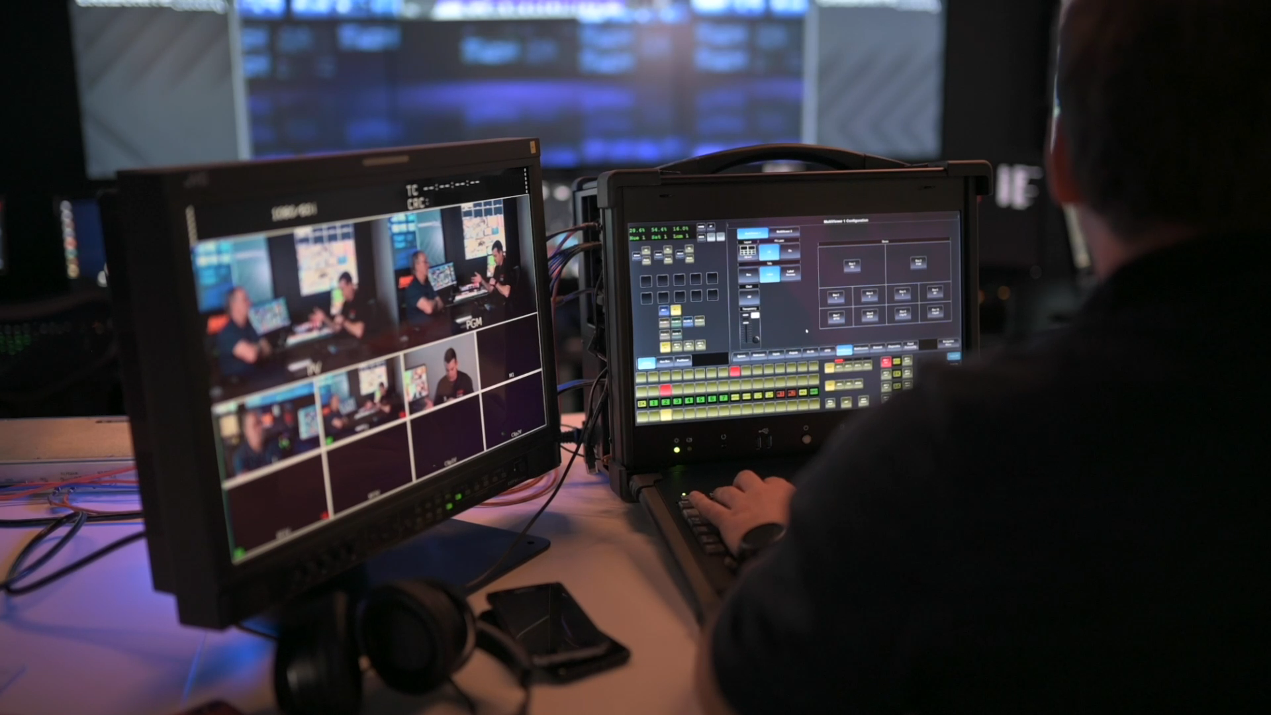
Graphite PPC – Options
Add ME 2 - $5K USD
9 In license (8 SDI, 1 HDMI) - $5K USD
13 In license (12 SDI, 1 HDMI) - $5K USD
9+ Inputs unlocks Output Config
Up to 3 RAVE Audio Breakout Modules (8 An In, 5 An Out, 1 AES IN/Out) each is $3,500 USD
All XPression editions and Options
Max 3 XPN Frame Buffers in 1080p 50/59.94/60. Clip players can be assigned to shared buffers

