Slide 1

Signal
Processing
Alun Fryer
Simon Lacroix
Nathan Phillips
Marc Ravard
15 April 2020

Slide 2

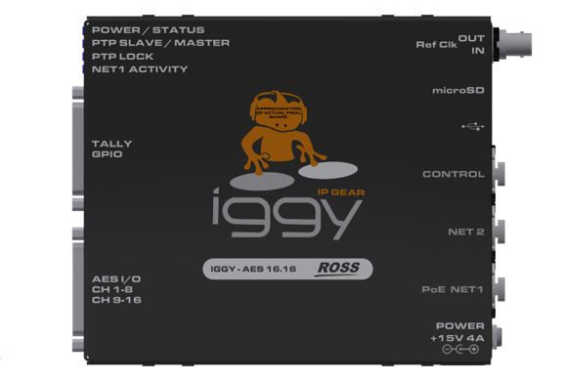






Compact AES67 / ST 2110 Audio-Over-IP Bridge
Flexible AES audio-over-IP conversion wherever you want it
Cost effectively and effortlessly satisfy your AES audio IP conversion needs
AES 16.16 Now Shipping !!!!
IP Bridge that adapts to any environment
Unparalleled density
Broad interoperability
Robust, w/ redundancy in its DNA
$1,895 USD
Notes:
**Nathan

Slide 3
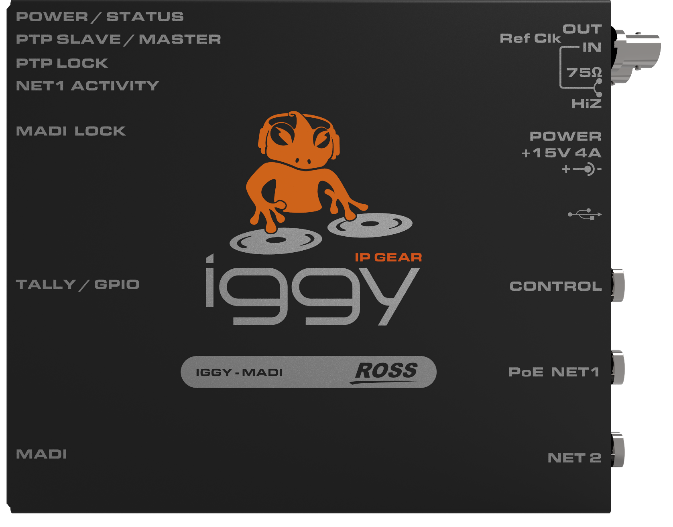


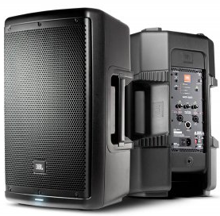
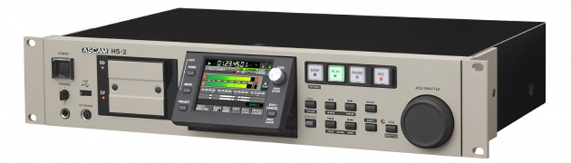
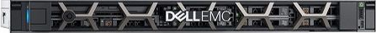
connect your IP audio production
Baseband Infrastructure
IP Audio Production
AES67
MADI
Audio Processor
AES67
IGGY-MADI
AES67
IP Network
AES3
AES67
Audio Console
IGGY-AES16.16
AES67
IP Intercom
EmBER+
GPIO
Control System
Notes:
***Alun***

Slide 4
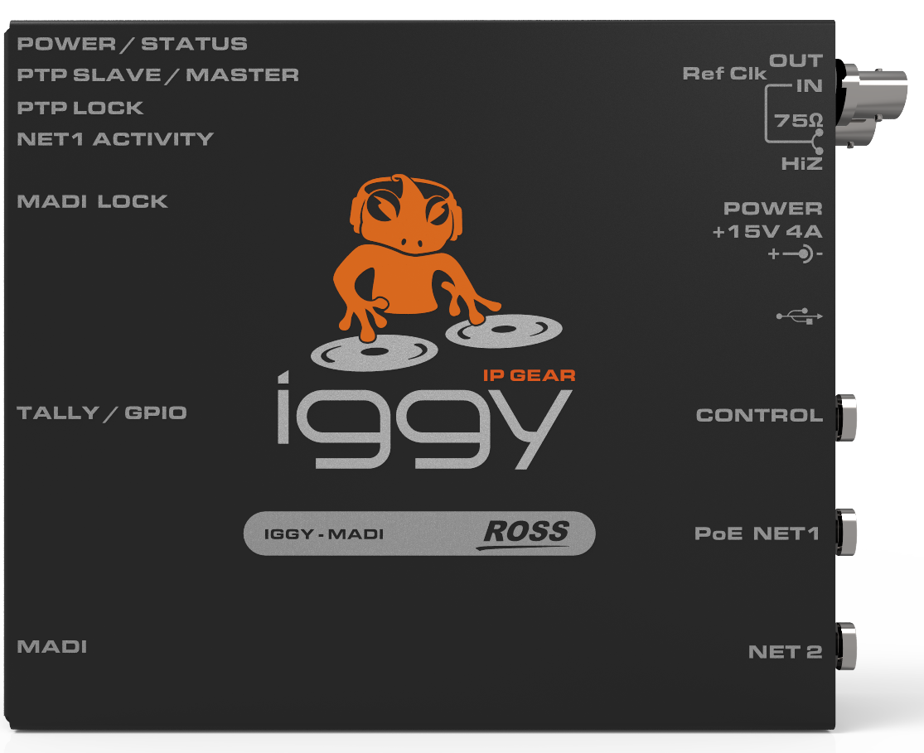

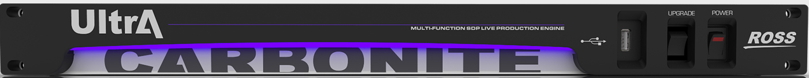
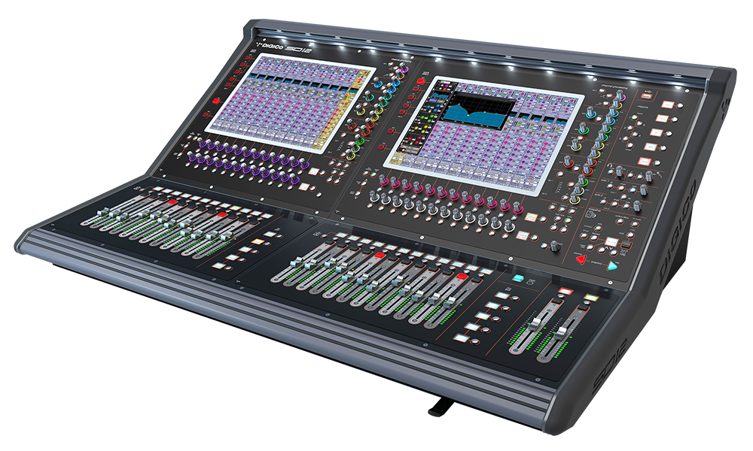
Audio and Tally Trunking
TSL Tally
Tally Controller
Word Clock
Tally
RossTalk GPI
GPI I/O
AES3
AES16.16
RossTalk GPI
Trunk AES67 Audio, Control, GPI and Tally over a single Gigabit Ethernet cable with optional PoE to remote locations
Flypack
Production Switcher
IP Network
Word Clock
AES67
MADI
Tally
Word Clock
GPI I/O
MADI
MADI
MADI
Stage Box
Audio Console
Notes:
**Alun

Slide 5


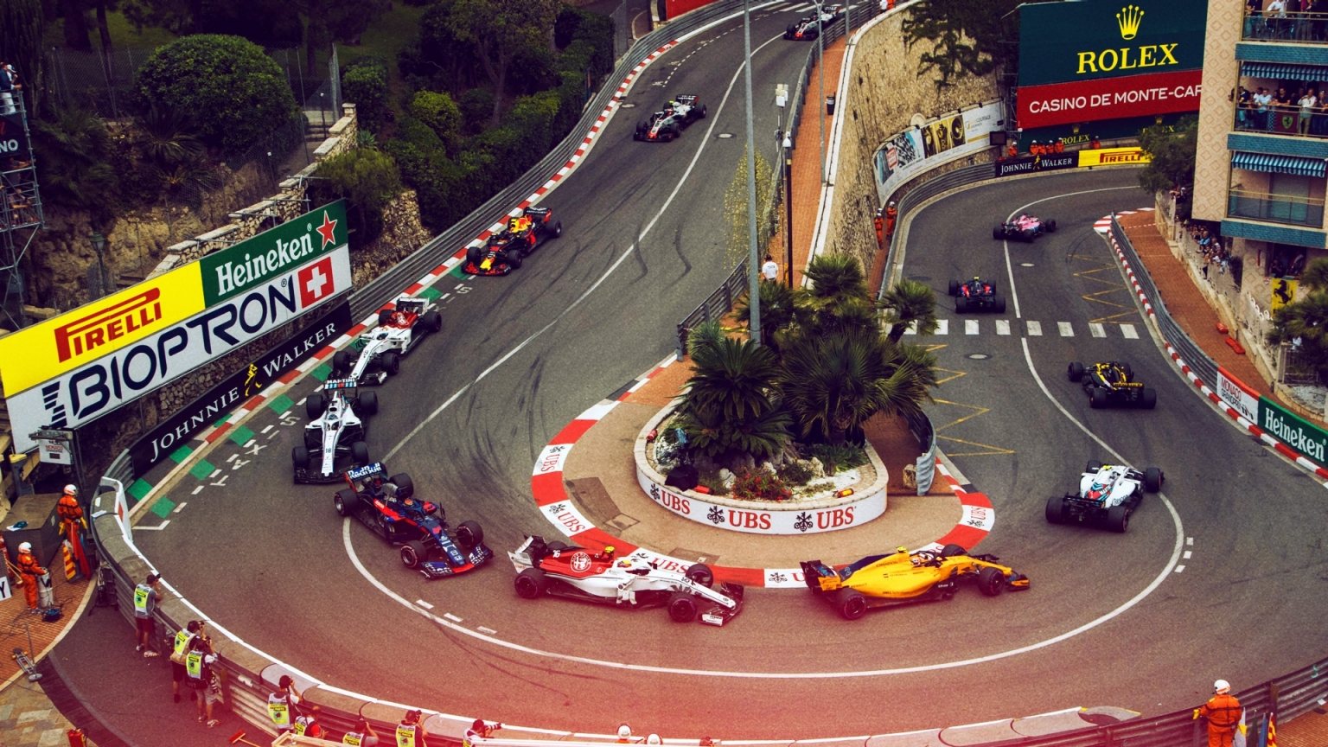
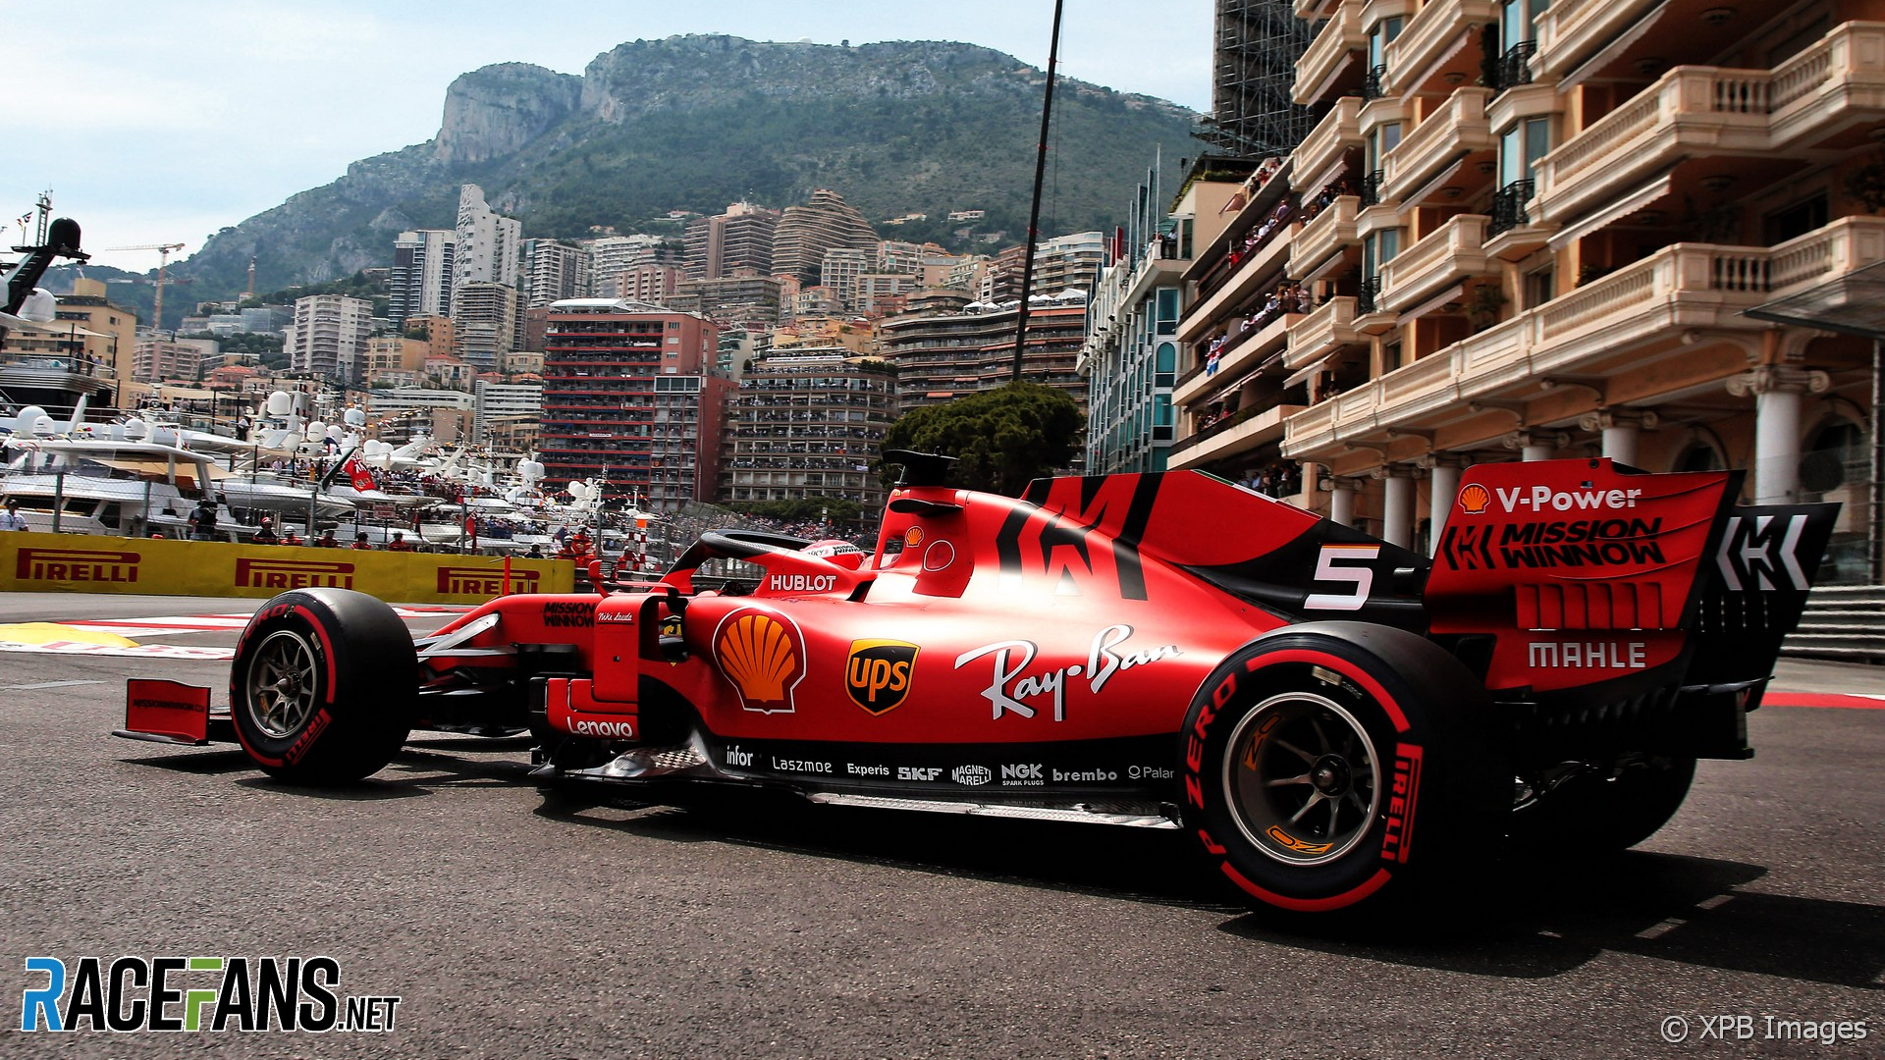
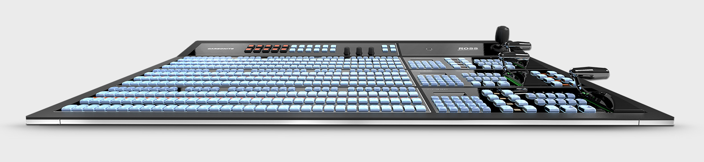
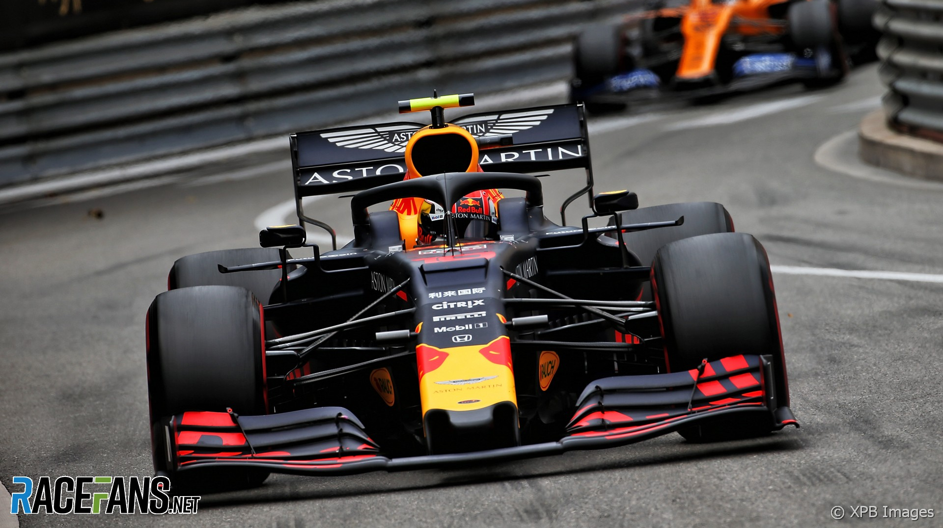

New Production v3.1
Stable and reliable
Resilience with diagnostics
High density and low cost
Proven switcher gateway
Latest release v3.0
Quad Split
Advanced multicast
Notes:
***NATHAN***

Slide 6

OEM AOIP Footprint
Notes:
***NATHAN***

Slide 7

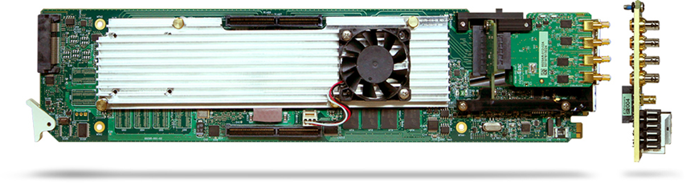
GATOR TOOLBOX
UHD signal processor with high quality linear motion adaptive conversion.
Worry-free any-to-any HD /UHD / HDR conversion in a high-density modular openGear card.
Gator Toolbox Version 2.0 New Features​
Quad-link gearbox in or out SQD​
Discrete AES Embed / De-embed
User Presets
Flexible I/O options including SDI, Fiber, balanced or unbalanced AES
Release date: June 2020​​
Notes:
***SIMON****
Highlight that we add value to HD production (e.g. HDR, FRC, etc.) in addition to UHD applications
A lot of interest in SQD (not available in Ultrix & Carbonite—only 2SI)

Slide 8
GATOR TOOLBOX
UHD signal processor with high quality linear motion adaptive conversion.
Worry-free any-to-any HD /UHD / HDR conversion in a high-density modular openGear card.
4 SDI Out
4 SDI In
8 AES (in/out)
Gator Toolbox UHD Audio Mux / DeMux
8 bi-directional AES – balanced (110 Ω) or unbalanced (75 Ω)
Embed, de-embed, or both!
Rounds out our 12G / UHD processing portfolio
Toolbox has added benefit of Framesync, Gearbox, HDR and more!
Notes:
***SIMON****

Slide 9


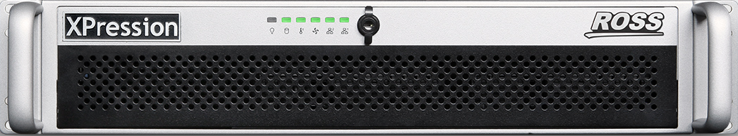
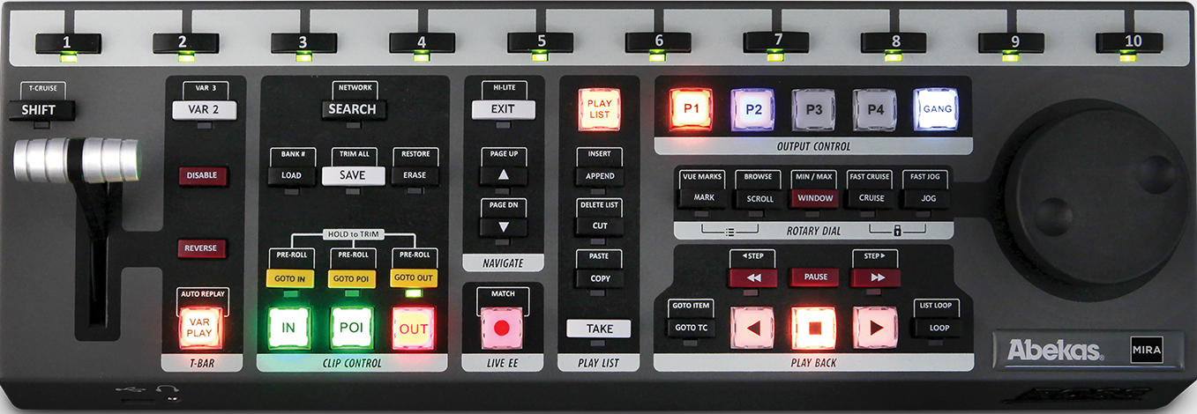

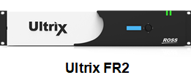
GATOR TOOLBOX
UHD Sports Production Example
Clean Feed
STANDARDS CONVERT
PGM Audio
International Feed
1080p50
UP-CONVERT & HDR
GATOR-TOOLBOX
Program
DOWN-CONVERT
Domestic HD Feed
1080p59
HD Camera
GATOR-TOOLBOX
PGM Audio
XPression 12G
GATOR-TOOLBOX
UP-CONVERT & HDR
DOWN-CONVERT & CC
GATOR-TOOLBOX
Aux
Talent Monitors
1080p59
HD Camera
SQD GEARBOX & HDR
GATOR-TOOLBOX
UHD-SQD Camera
GATOR-TOOLBOX
MIRA Replay
UHD-HDR Camera
UHD-HDR Camera
Fiber
FIBER & FRC
GATOR-TOOLBOX
Remote Feed
Notes:
***ALUN***

Slide 10
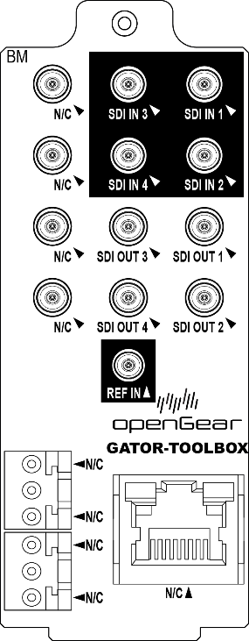
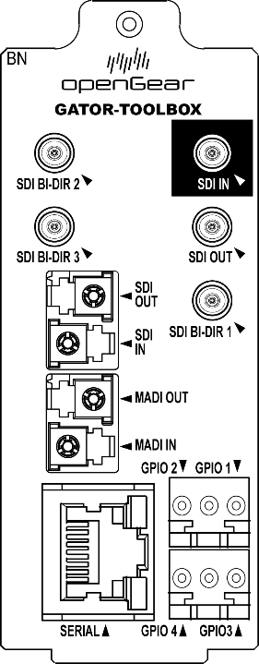
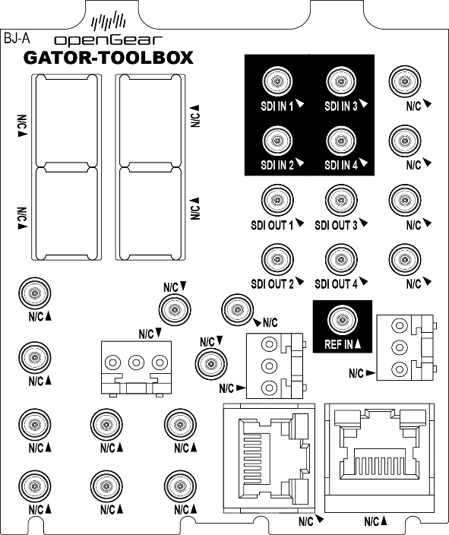
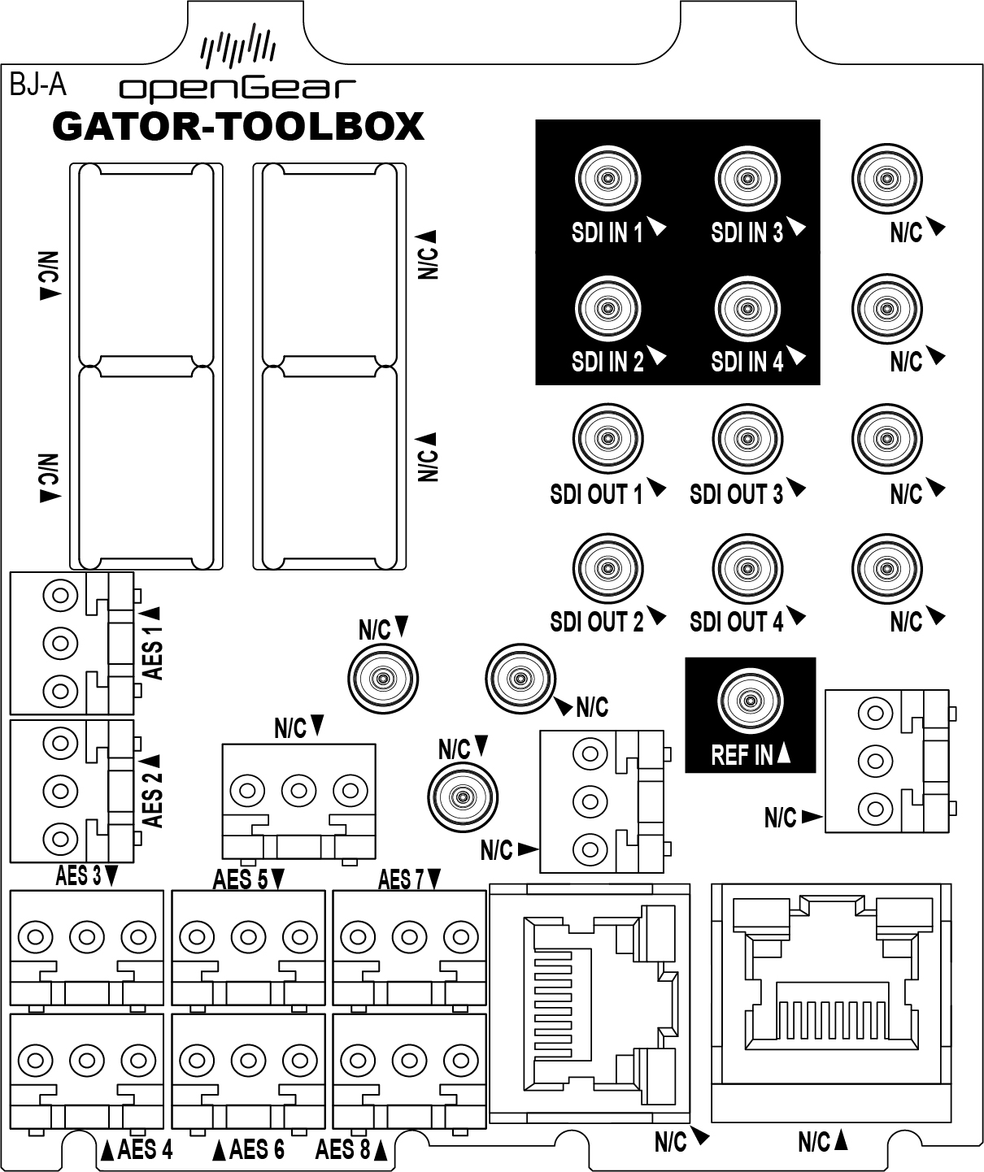
GATOR TOOLBOX
4 Cards Tailored to Your Unique I/O Requirements
Gator-2
4in / 4out SDI
No discrete audio
2 slots
Gearbox in AND out
$4,995 USD
Gator-2F
5 SDI + Fiber
No discrete audio
2 slots
Gearbox in OR out
$4,995 USD
Gator-4A
4in / 4out SDI
8 unbalanced AES
4 slots
Gearbox in AND out
$5,995 USD
Gator-4B
4in / 4out SDI
8 balanced AES
4 slots
Gearbox in AND out
$5,995 USD
10
Notes:
****SIMON****

Slide 11
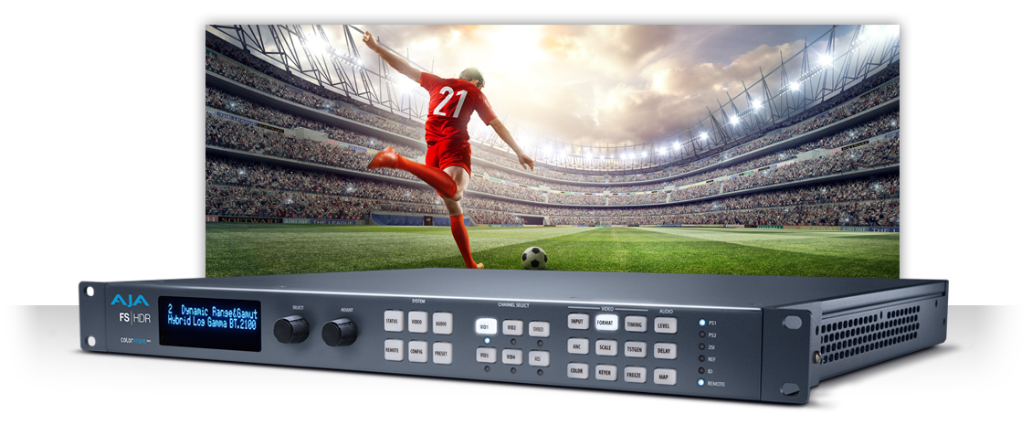

GATOR TOOLBOX
On top of the conversion food chain
Native single link UHD SDI support
No optional SFP module needed
Exceptional Live Production Quality
Advanced Frame rate conversion algorithm
Low latency 2 frame vs 5 in UHD
More Density/IO flexibility
Up to 10 channel per frame using 2 slots variants
AES / UHD SDI and Fiber
Notes:
***SIMON***
AJA: No 12G, no FRC
GV: No external audio support, no FRC, no as many dedicated UHD SDI for DA, No HDR
COBALT: No FRC, lower density (7 cards in OGX)

Slide 12

GATOR TOOLBOX
Standards Conversion Competitive Landscape
Alchemist
$90K++
4K UHD Solutions
MCC-4K
$50K
FRC-9100
$80K
$7500
Money is no Object
Kudos
$12K
FS-1X
$3500
X100
$5K
Terranex
$1350
9902
$5K
You Get What You Pay For
Low Value
12
Notes:
****ALUN****
Add title

Slide 13

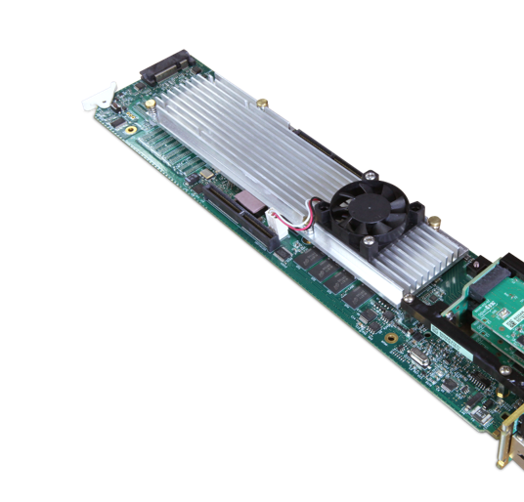

The world's most popular Master Control switcher now in UHD!
MC1-UHD is flexible, scalable and cost-effective
MC1 UHD Master control
12G-SDI Master Control Switcher​ Now Shipping!
Provides program switching & branding in UHD
Adjust your program audio for final delivery
2 External Key/Fill Inputs
2 Animated Logo Generators
Integrates with popular Master Control automation
$9,999 USD
Notes:
***SIMON***
Emphasize 2 key/fill inputs
Essential features needed to brand a UHD channel

Slide 14
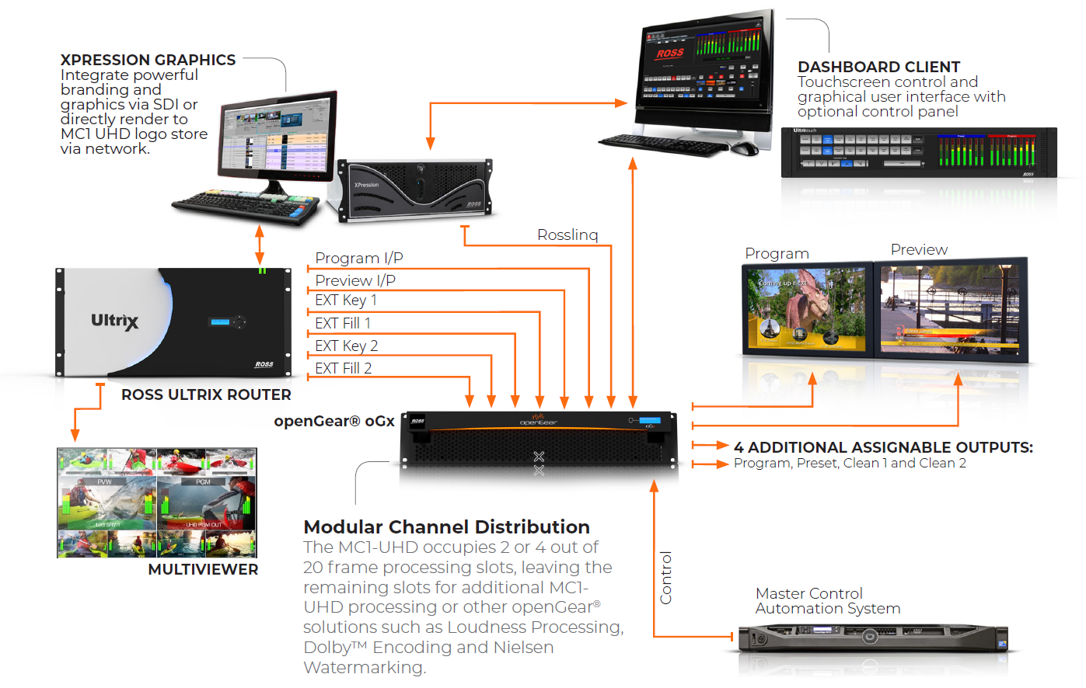
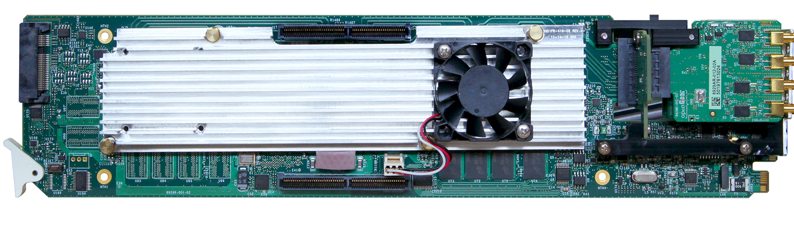
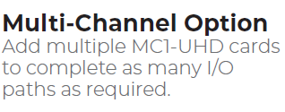
MC1 UHD System > Complete UHD Master Control Solution
Notes:
****SIMON*****
Complete MC1 system is integrated with Ultrix so it can scale to multi-channel or a larger number of source
You can use xpression graphics through SDI or ross link

Slide 15
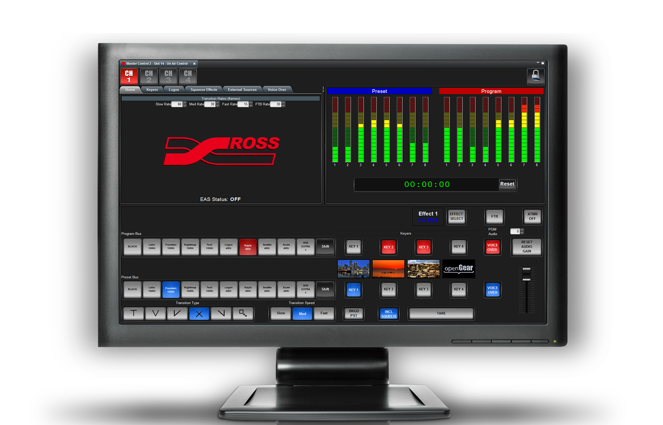

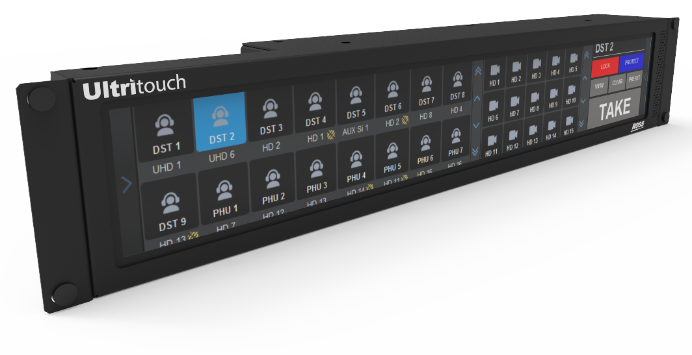
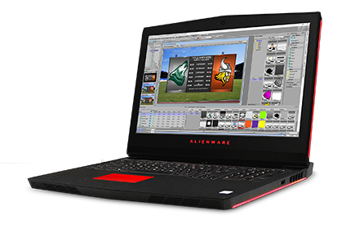

Stand-Alone Branding
Control Options
Remote triggers and CustomPanel via DashBoard
Program In
Program Out
RossTalk
LiveCG
Remote triggers via RossTalk API
RossLinq
XPression LiveCG renders graphics via Rosslinq Network interface
Notes:
***ALUN****
LiveCG License $2562.00 Inexpesive way to get professional still graphics for Branding.

Slide 16


Competitive solutions
 | Masterpiece | UMC-2016M
Keyers | 4 | 3 + 3 Optional | 2 Ext + 2 Int
DVE | 4 | 1 | Roadmap
Audio Mix / Shuffle / Proc | Yes | Yes | Yes
Logo Store | Yes | 3 or 2 w/DVE | 2 Channel
Automation | Morpheus | ??? | Presmaster
12G-SDI I/O | 10 in / 3 out | 18 in / 5 out | Ultrix FR1-16 + Ultrispeed
AES Audio | 4 in / 3 out | 4 in / 2 out | Roadmap
Framesync / UDX | FormatFusion | Input Framesync | No
List Price | $30K USD | $40K+ USD | $25K USD
Panel | $15K USD | $15K USD | $10K (Roadmap)
Notes:
****SIMON****

Slide 17

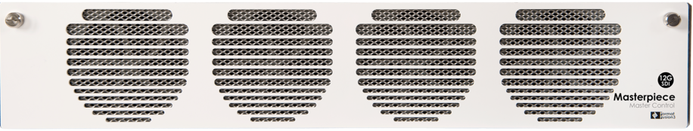
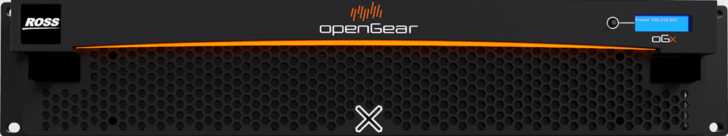
Competition
vs
4x MC1 UHD
1x Ultrix FR1-16
1x HDB-IO
1x Ultrispeed
Masterpiece
8 RU
3 RU
$120K
$63K
Notes:
***SIMON****

Slide 18
Roadmap Q&A
When will MC1-UHD match MC1 Classic feature set?
Will it include DVE?
Will it support hard control panel?
Please don’t make commitments on unreleased features, …but you may use this information in your opportunities.
Notes:
****SIMON****

Slide 19


Enabling the smooth transition to a UHD production environment.
Low CapEx / OpEx and TCO. Less disruptive than IP.
12G-SDI / UHD Solutions
Distribution
Fiber
Frame sync
Format Conversion
Standards Conversion
HDR
Gearbox
Keying
Master Control
Audio Mux / DeMux
Notes:
CBT – 12G is practical, affordable infrastructure. Simple to deploy and understand.
Creative – Allows migration to UHD & HDR,
Business – openGear is a solid investment for HD facilities, and can grow to meet future UHD & 12G requirements
Technical – Move to UHD where IP might not be appropriate. A full selection of UHD/12G-SDI signal processing solutions.

Slide 20
IP EDGE solutions
SDI Gateway
AES/EBU Gateway
MADI Gateway
ST 2110 Monitoring
Hybrid Routing
Notes:
**NATHAN**

Slide 21
Notes:
****MARC****

