Slide 1

RossLive 2020
Chris Kelly, Product Manager – Asset Management & Storage
4/15/2020

Slide 2
THE PROBLEM TO SOLVE?
Notes:
When start every presentation, I start with the problem to solve. It really helps to understand what our customer’s creative, business, and technical challenges are, and how our products attempt to address them. It also helps to know this going in, because we don’t currently address all of those issues, but asking this question gives us good guidance on what our customers are dealing with.

Slide 3
The problem to solve
Our customers have lots of content, generated by many people in many different places. They want their viewers to see that content in a curated way.
How do we help our customers efficiently get their high-impact product to their viewers?
Notes:
I’ve massaged this problem, and question a few times, because it does change over time… or I find I can be clearer. But the root of the issue is our customers have a lot of content, generated by many people in many places. They want their viewers to see that content in a curated way. The question is… how do we help our customers efficiently get their high-impact product to their viewers?

Slide 4
CAPTURE
INGEST
ORGANIZE
EDIT
PUBLISH
ARCHIVE
Notes:
This basic diagram illustrates the steps of the workflow that takes you from newly captured content to a final product. It’s captured by the camera, the essence or video is ingested into storage as an asset, it’s organized into useful groups and tagged with relevant metadata, the raw files are edited down to a final product, and published to its particular playout channel, and then archived for posterity. You’ll notice the concept of “publish” is a unique name, but content is not simply going to playout. It could go to social media or web. It could go to master control to play in an ad break.

Slide 5
CAPTURE
INGEST
ORGANIZE
EDIT
PUBLISH
ARCHIVE
EDIT
PUBLISH
ARCHIVE
EDIT
PUBLISH
ARCHIVE
Notes:
For clarity, it might actually help to illustrate it like this, where there are multiple products. This really gets to the heart of a story-centric workflow. Our customers capture a bunch of content for a particular story or idea, and then generate different versions depending on both the platform AND/OR the broadcast time.

Slide 6

CAPTURE
INGEST
ORGANIZE
EDIT
PUBLISH
ARCHIVE
Notes:
Right now… Streamline News Video Suite only manages one slice of this workflow… and that’s the publishing of the content to be playable in the control room via Streamline Play and Tria News. What we do, we do well, and our customers trust our solution to this end. We do have some answers for other slices with our current offering, but to be honest… they’re not answers that our customers typically find acceptable.

Slide 7
CAPTURE
INGEST
ORGANIZE
EDIT
PUBLISH
ARCHIVE
Notes:
Our goal with Streamline Version 5 is to expand our offering to address ingest THROUGH to publishing. And we’re doing it with the help of our storage partner… Studio Network Solutions.

Slide 8

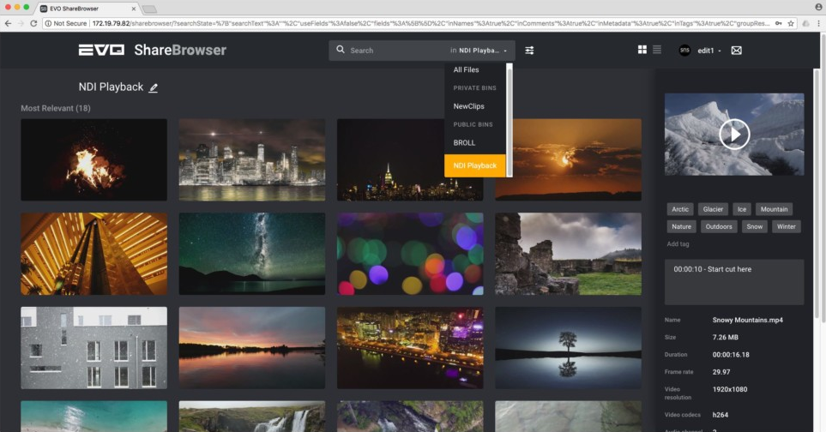
LEVERAGE UTILITIES INCLUDED WITH EVERY
SNS ShareBrowser is one utility that acts as raw video management utility.
NLE Workflows Include:
Premiere Pro CC
Final Cut Pro X
Davinci Resolve
Premiere Pro integrated panel.
Notes:
Every Ross Signature Series EVO Storage appliance includes a product called ShareBrowser. ShareBrowser is a raw video asset management utility which indexes footage needed for post-production. They have established NLE workflows with Adobe Premiere Pro, Final Cut Pro X, and Davinci Resolve. In Premiere Pro, they even have an integrated “panel” which is just another word for a plug-in.

Slide 9
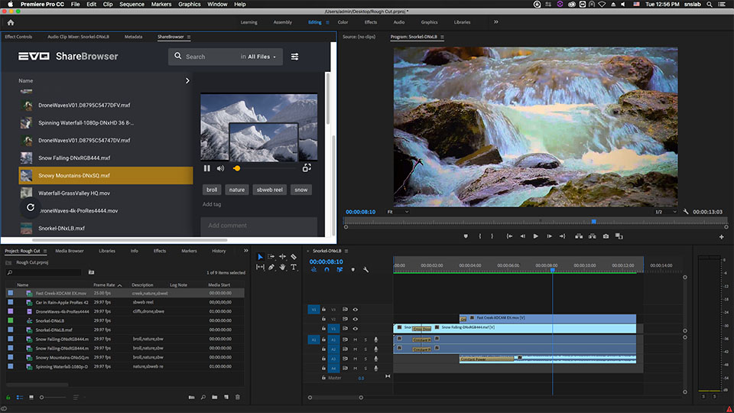
New in Streamline version 5.0!
ShareBrowser integration with Streamline Placeholders
Within Premiere Pro plugin, Editors can:
Organize and Tag Footage
Create Projects for Streamline Placeholders
Edit Content
Render Finished Product directly to Streamline
Status Feedback when video is ready or not ready
Editors can use one application (Premiere Pro) to do all of their work.
Notes:
Our biggest V5 feature is ShareBrowser now integrates with Streamline so an editor can see both their raw content AND their Streamline Placeholders in the Premiere Pro Plugin. This means you can organize and tag your footage in a collaborative way, create projects based on Streamline Placeholders, edit your content, and render your content directly to the placeholder, all within the same UI. When the rendering is complete and Streamline has attached the media, the ShareBrowser plugin will indicate a status that the file is ready for playout.

Slide 10

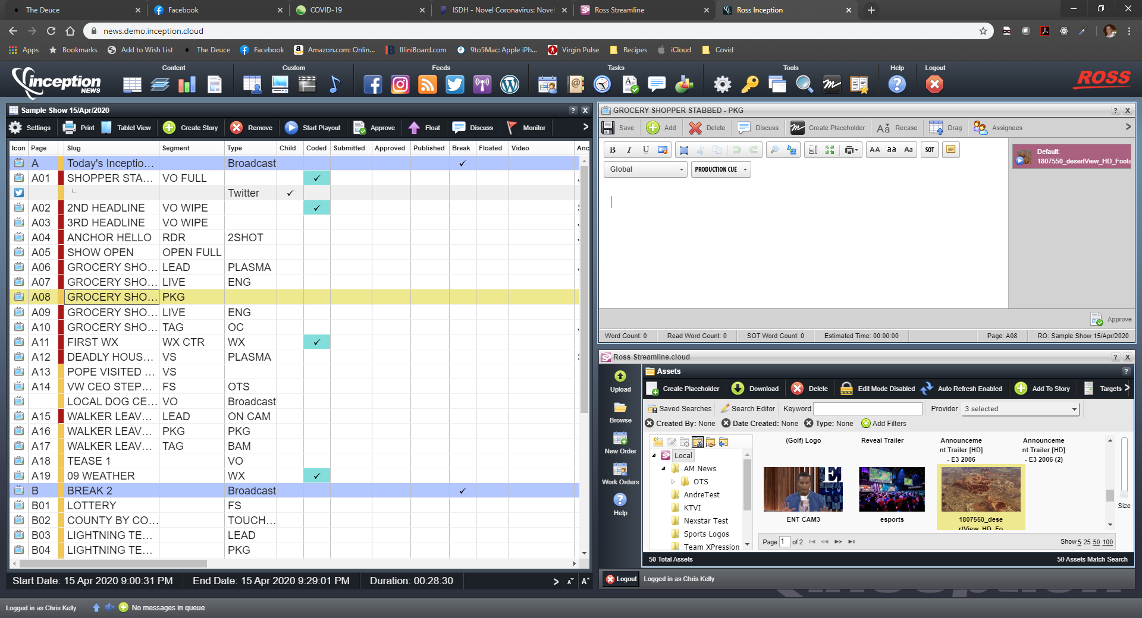
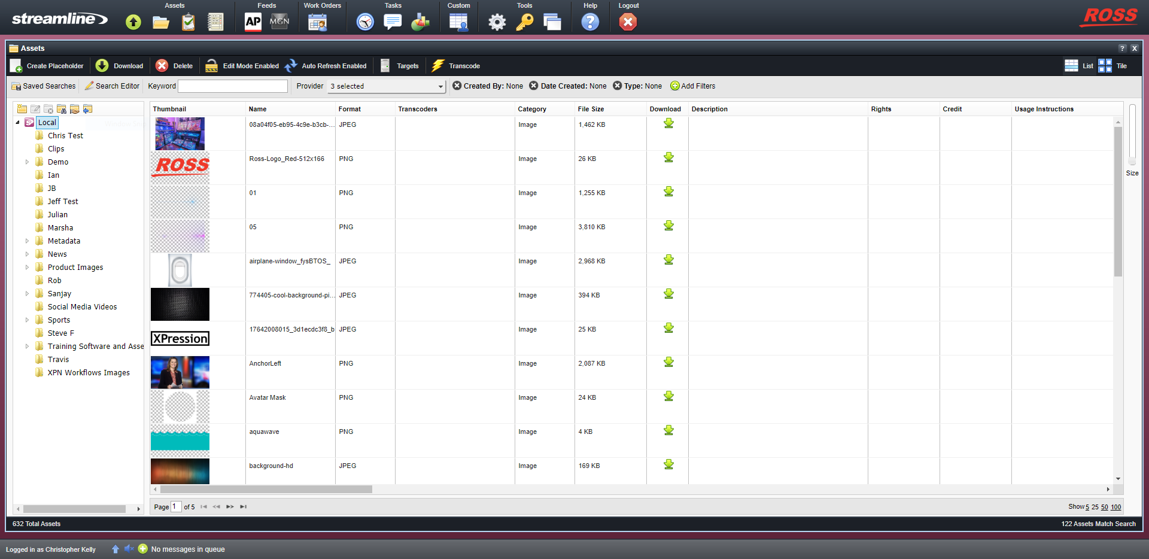
COMPLETEs THE LOOP
Notes:
This completes the loop on a typical workflow, where the producer requests a piece of video through Inception, Streamline registers the placeholder and sends it to ShareBrowser, and the editor edits the requested clip and sends it back to Streamline which then gives the producer feedback that the clip they requested is done.

Slide 11
Streamline version 5.0
Releasing in July.*
* We are relying on SNS for some of this functionality, and are at the mercy of their software release.
Notes:
We expect Streamline Version 5 to release in July, though I mark this with an asterisks as we’re relying on an SNS release, and we’re all in a wait-and-see mode with the global conditions.

Slide 12
SHAREBROWSER COST?
Free.*
* With the purchase of Ross Signature Series EVO Storage
Notes:
When we do release this, it will not change the cost of an existing system. The only requirement is they buy a Ross Signature Series EVO. This is one of many future features that will be exclusive to the Ross offering as opposed to ones that are sold by SNS.

Slide 13
What’s next?
Notes:
I’m very excited about this functionality and our cooperation with SNS to give our customers better, more efficient workflows. So what’s next? If we’re continuing in the theme of How do we help our customers efficiently get their high-impact product to their viewers… one of the key terms we have to focus on there is ‘efficiency’. We’ve improved efficiency in the ShareBrowser integration. But there is so much left to be done. We’re looking to trim busy-work and process-work from our customer’s daily work-lives. The more we trim there, the more time and resources are left for creativity, the key feature to creating High Impact productions.

Slide 14
Workflow automation (NDA)
Workflow Automation takes complex and lengthy tasks, and makes them a single reliable and repeatable task initiated by a trigger.
Workflow Automation is easy. It replaces code or script syntax with easy to understand blocks and connectors.
What are examples of Workflow Automation?
Visual Logic (XPression & DashBoard)
Custom Controls (Acuity & Carbonite)
Rules in Outlook
MacOS Automator
Notes:
One major component we’re missing in Streamline is workflow automation. This isn’t the final “brand name” of the feature… but it captures the essence of what we’re trying to achieve. Workflow automation takes complex and lengthy tasks when done manually step by step, and makes them a single reliable and repeatable task or event, initiated by a trigger. Much of this work can be done with scripting and coding… but it’s not easy. It’s not something an average user could whip up. It needs to be visual, with blocks and connectors, so the user doesn’t need to know syntax.
We use various forms of workflow automation every day. In our own products, Visual Logic for both XPression and DashBoard make programming “easy”. It still requires understanding of logic and data, but it does so in a way that makes it more straight forward and accessible to create complex functions in your graphics and Custom Panels. Going way back, Custom Controls in Ross Switchers are a form of workflow automation, with the ability to tie device controls and switcher events into a single, repeatable function that all users can understand. Even today, when you’re setting up rules in Outlook you’re doing workflow automation, matching certain senders to specific folders so you don’t spend time sorting your mail. For those of you who have used a Mac, there’s an application called Automator that takes everyday functions in the MacOS and allows you to build custom functions that you do manually multiple times a day.

Slide 15
Workflow automation (NDA)
Why is it important?
Assets grow forever. It shouldn’t be a multi-hour job for someone to manage assets in an asset management system. That’s busy work.
How assets should be managed is specific to the customer. There isn’t a 1-size-fits-all feature that we can develop that will make everyone happy.
What do we have now?
A 1-size-fits-all feature called Asset Life Cycle that makes very few people happy.
Notes:
The importance of this feature cannot be understated. One of its primary purposes is Archive. Unless a station shuts down, assets grow forever. For stations that archive, it would be a multi-hour job per day for someone to manage these archived assets. That’s busy work.
When you look at things like the other Ross examples of Visual Logic and Custom Controls, the greatness is in the fact that it’s a canvas for building your own features. We could build an Archive feature, but I’ve found Archive to be something all customers have wildly different opinions on how it should be done. That is not something that will work as a one-size-fits-all feature. In fact we somewhat did that with the Asset Life Cycle feature. Customers found it to be too limiting, which we knew at the time, but implemented anyway because we needed SOME answer. By giving our customers all the handles available to them in the Streamline UI, they can build Archive to meet their unique business and technical goals.

Slide 16
Workflow automation (NDA)
What does this give us that we don’t have now?
A true solution for archive.
We have all the parts
Multiple storage locations
Cloud Storage
Transcode Workflows
We don’t have the logic to let the customer tie it all together and run every day.
Automated deletion.
Users generate a lot of single use clips that are duplicates of existing clips.
Tease Video
National Content
Wasted Space
Notes:
As I mentioned before, this gives us a true archive solution. We’ve had access to almost all the parts of multiple storage locations, cloud storage, and transcoding workflows, we’ve just never been able to tie them all together. We don’t YET have an answer for tape archive, but with the enormity of the storage we’re usually dealing with, almost endless cloud storage solutions, and the size of the files… especially if they’re transcoded to smaller bit-rates, this will suffice for some time. The big thing this will allow us to do is have a process that’s repeatable and triggered with no human intervention.
This will also allow us to allow the system to clean itself. In traditional news-workflows, there is a lot of extra content that’s generated every day that is just a duplicate of a primary video source. That doesn’t need to be archived, and it can be deleted almost as soon as it has aired. Managing the storage so it doesn’t prematurely fill is critical.

Slide 17
Workflow automation (NDA)
What does this give us that we don’t have now? (Continued)
A framework for all emerging technologies
Auto Transcription (AI)
Auto Tagging with Image Detection (AI)
Get out of jail free card for features
Customers can create their own custom workflows that in other products is feature-bloat.
Notes:
Something I’m very excited about is being able to integrate handles into Streamline that take advantage of emerging technologies like AI. Auto transcription can take the spoken word and turn it into text. That’s a process that can take journalist a significant amount of time every day. If that can be done in the cloud, it leaves more time for the journalist to create, and not catalog. Same with auto-tagging. Where is that video of a certain celebrity or even local official? We can send that to the cloud for automatic tagging so we don’t have to do that process manually.
This is a get-out-of-jail-free card for features. We may need to build more handles for the user to tie functions in Streamline together, but once those handles are created, there are many ways they can be used, beyond the original intent.

Slide 18
CAPTURE
INGEST
ORGANIZE
EDIT
PUBLISH
ARCHIVE
Notes:
So if we’re looking at this diagram again, and this is what we can do with Version 5…

Slide 19
CAPTURE
INGEST
ORGANIZE
EDIT
PUBLISH
ARCHIVE
Notes:
…realistically this is what we can do in a Version 6. That’s quite a change in a pretty short period of time. That’s not to say we can’t improve on each of these steps and make them much better as our products progress, but at least we have an answer that our customers will accept.

Slide 20
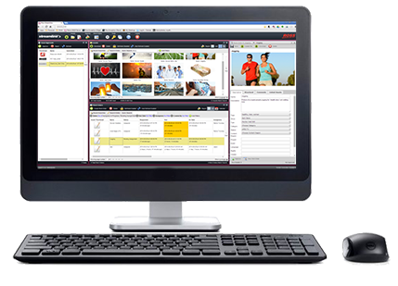
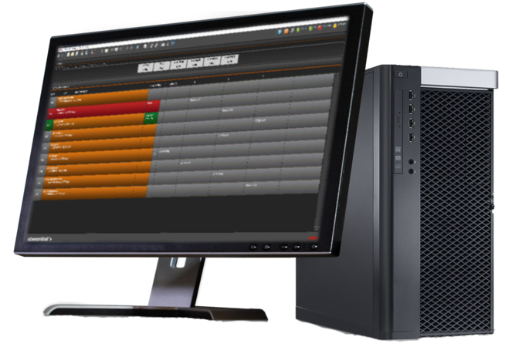





Streamline news video suite
Notes:
Just as a quick refresh, remember that the 4 major components to a Streamline News Video Suite system, EVO, Streamline, Tria News, and Streamline Play. This is everything you need to connect to your MOS enabled NRCS like Inception, and automate that level of your workflow.

Slide 21
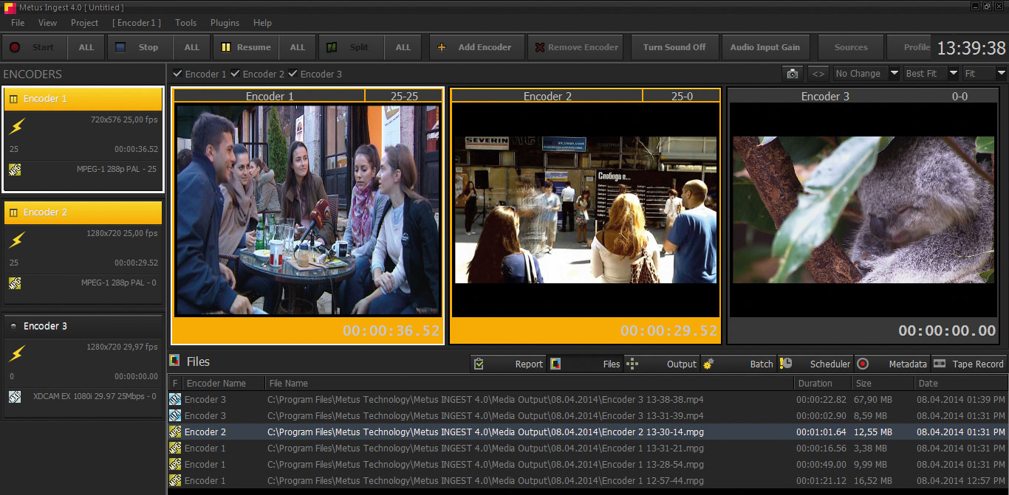

Streamline news video suite
Notes:
There is an optional item called Metus Ingest. It’s a turnkey 2-channel record box to ingest live baseband video feeds. Tria News can record, but it is missing some key features, like recording directly to the EVO storage, recording to the house-codec, scheduled records, and growing file export. Growing file export is key, as it allows the customer to use actively recording content as a source in their compatible NLE. An example is an NBA game that won’t finish by the time the newscast starts. The sports guy can record the entire game, but still use the content to create a clip for their newscast, without interrupting the record.

Slide 22

BROADCAST
Notes:
When talking about potential customers, traditional Broadcast is where a Streamline News Video Suite is found. As I’ve mentioned before, there are competitors that are ahead of us in this space. So when talking to potential customers the perspective of what they’re currently using will dictate if we’re a right solution fit. There are many customers that have no MOS or very old MOS workflows, and they’re looking to upgrade… that’s a target rich environment for us.

Slide 23

EDUCATION
Notes:
Beyond traditional broadcast, education is a very rich market for all of Ross, not just Streamline. Work with Matt Peschau to get the right solution for these customers, though we’ve found that Streamline is a great addition to the newsroom system of choice for most universities, Inception.

Slide 24

CORPORATE
Notes:
Lastly, corporate is a market I’d love to work more in. I’ve mentioned before that MOS is an invention of news production, but it is not ONLY for news production. We’ve found many instances where an in-house corporate production arm could benefit GREATLY from the distributed workflows that Inception, Streamline, OverDrive, and XPression offer. Working with the product teams and the solutions architects, let us help conduct a workflow audit so we can put together a proof of concept on how they can improve their workflow.

Slide 25
RossLive 2020
Chris Kelly, Product Manager – Asset Management & Storage
4/15/2020
Notes:
As always, you all know how to reach me. I’m happy to talk through any of the concepts I’ve discussed today, and how we can make our customers love us even more. Thanks!

