Slide 1
Inception
Ross Live 2020 Sales Training
Jenn Jarvis, Product Manager – Editorial Workflow
April 15, 2020

Slide 2
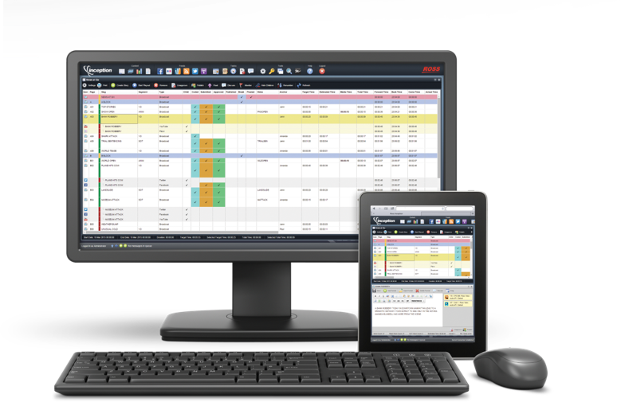
Inception – a quick look back
V14 released in late 2019
Re-architected customization options for grids, calendars and forms
Ability to push data from one piece of content to another
Assign a story to a user
Flexible timer options for news and sports applications

Slide 3

Inception – a quick look back
Servus TV Launch (Red Bull)
About a year of development
Delivered in 3 stages
Customer-built SDK app
Customer-built language package
Unprecedented customization
Months of workflow consultations
Key reference site

Slide 4
Inception – a look at the present
We don’t expect customers to do a heart transplant in a time of crisis. But for those who are able to start a discussion, we’re ready.
Inception is inherently “Work From Home” ready.
A customer’s ability to engage in conversation may depend on their vertical.
News – Need to listen for pain points and frustration – FUTURE OPPORTUNITIES!
Sports – Potential for focused evaluations.
Corporate – Increasing need and opportunity.
Academic – Business as usual.
We have the ability to do full demos and trials.

Slide 5

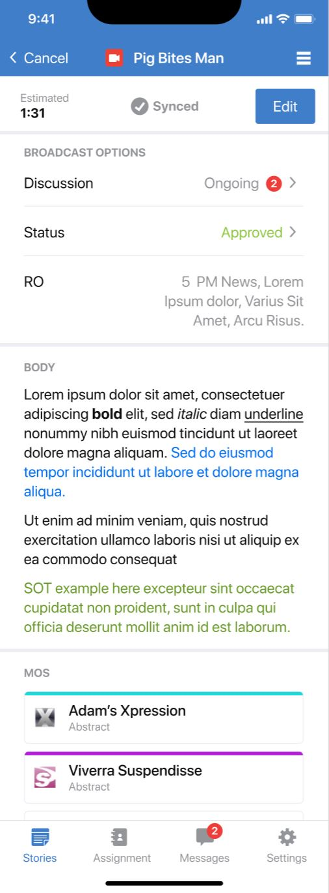
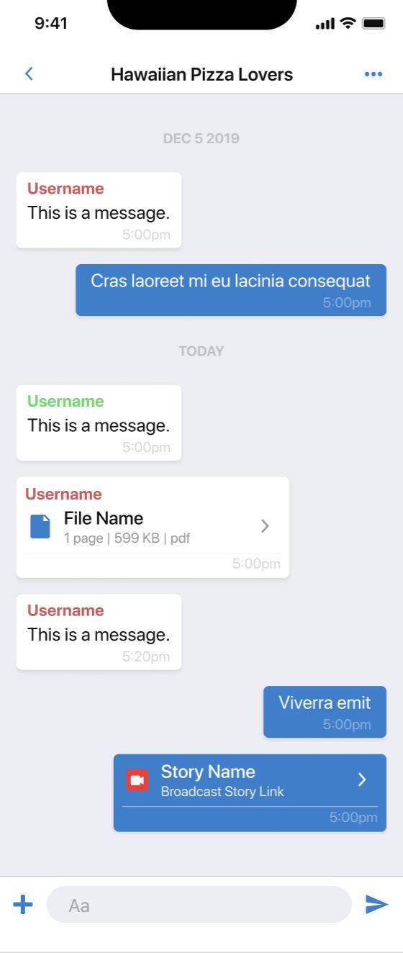
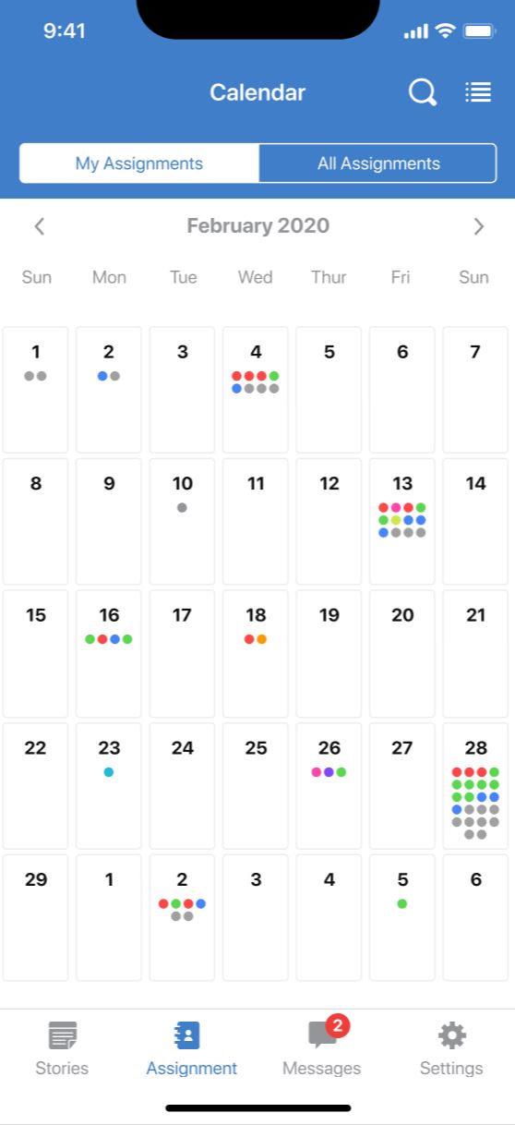
Inception – a look to the future

Slide 6
Inception – a look to the future
Inception Mobile App is in development!
Not a public announcement – just a sneak peek!
Check with product team before discussing with customers!
Focuses on the Journalist experience.
Stories – Creation and editing
Messaging – Centralizes communication
Assignments – Planning and research
For iOS and Android
Beta testing in July with select customers.
Release scheduled for September 2020

Slide 7
Inception - summary
Recent Past
Helping customers take advantage of powerful product growth.
Successful launch at Servus TV (Red Bull) showcases new flexibility.
Present Focus
Listening to customers and for those who are able to engage, creating a tailored and powerful demo experience.
Near Future
TOP SECRET Mobile app is in the works. Stay tuned for more details!

