Slide 2


What’s new
OverDrive 19.3 and Caprica 6.3

Slide 3


Slide 4
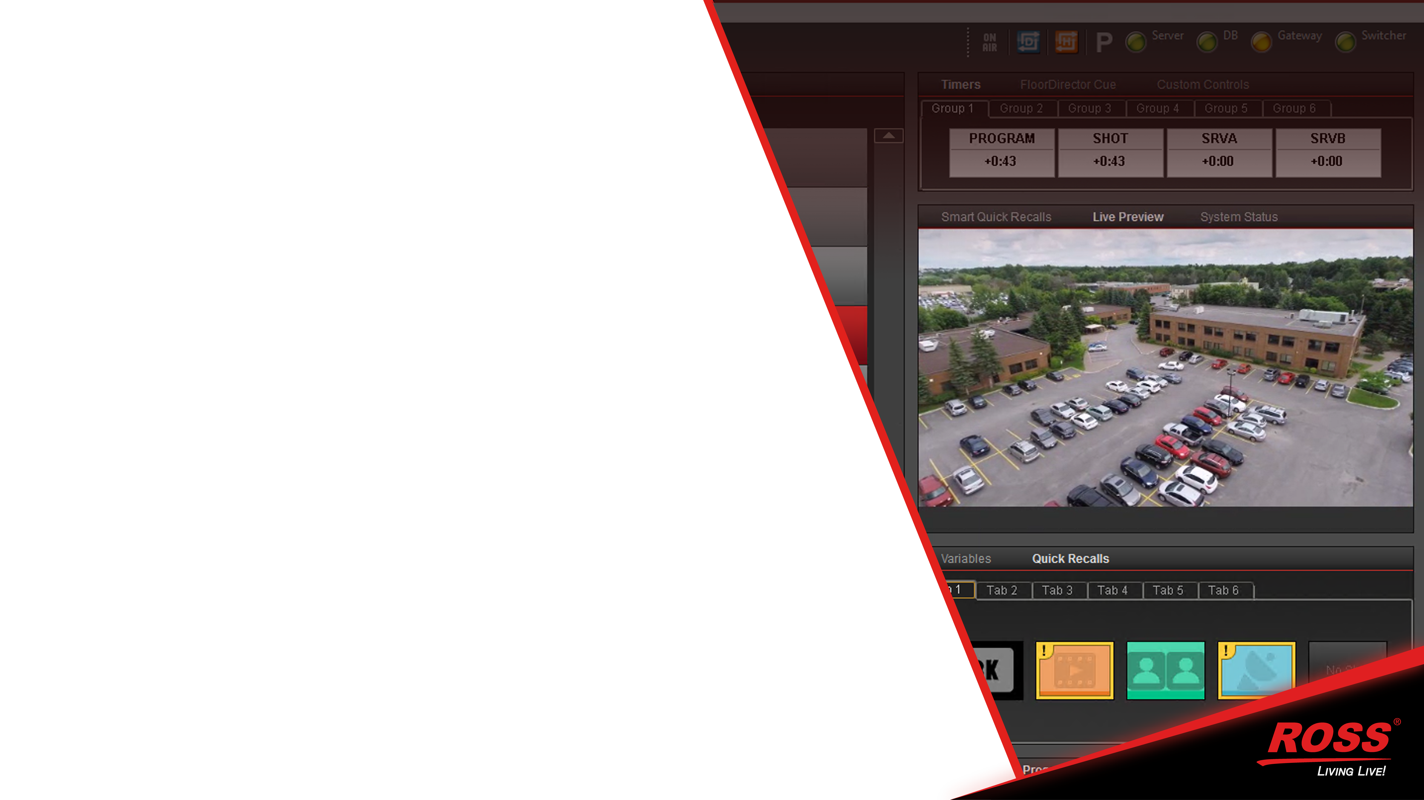

WHAT’s New
| OverDrive 19.3 + Caprica 6.3
Live Preview (NDI)
Interact and view live sources relevant to your current action. Reduce the time spent hunting for video sources on a multi-viewer
Any NDI source
See Preview from the switcher
Graphics Preview
Router Output for remote checks
Each client (including CodingClient) can have its own feed
Use any customer supplied NDI streaming/encoding device

Slide 5
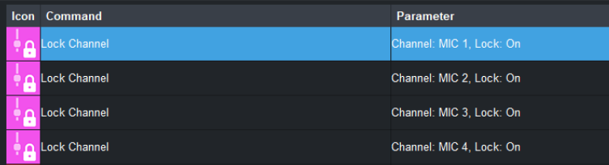
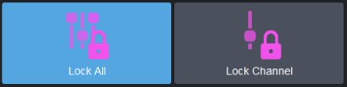
What’s new
| OverDrive 19.3 + Caprica 6.3
Audio Locks
Added functionality to help in breaking news and interview situations.
CustomControl Event that locks individual faders from “Automated” commands.
CustomControl Event that locks all open faders from “Automated” commands.
CustomControl Event that un-locks individual or all locked faders.
SideSlide and DirectControl adjustments are allowed.
Template Additional Audio, AFV and QuickPicks are disregarded when locks are active.
Faders are automatically pinned in DirectControl when locked

Slide 6
What’s new
| OverDrive 19.3 + Caprica 6.3
On-Set Displays

Slide 7
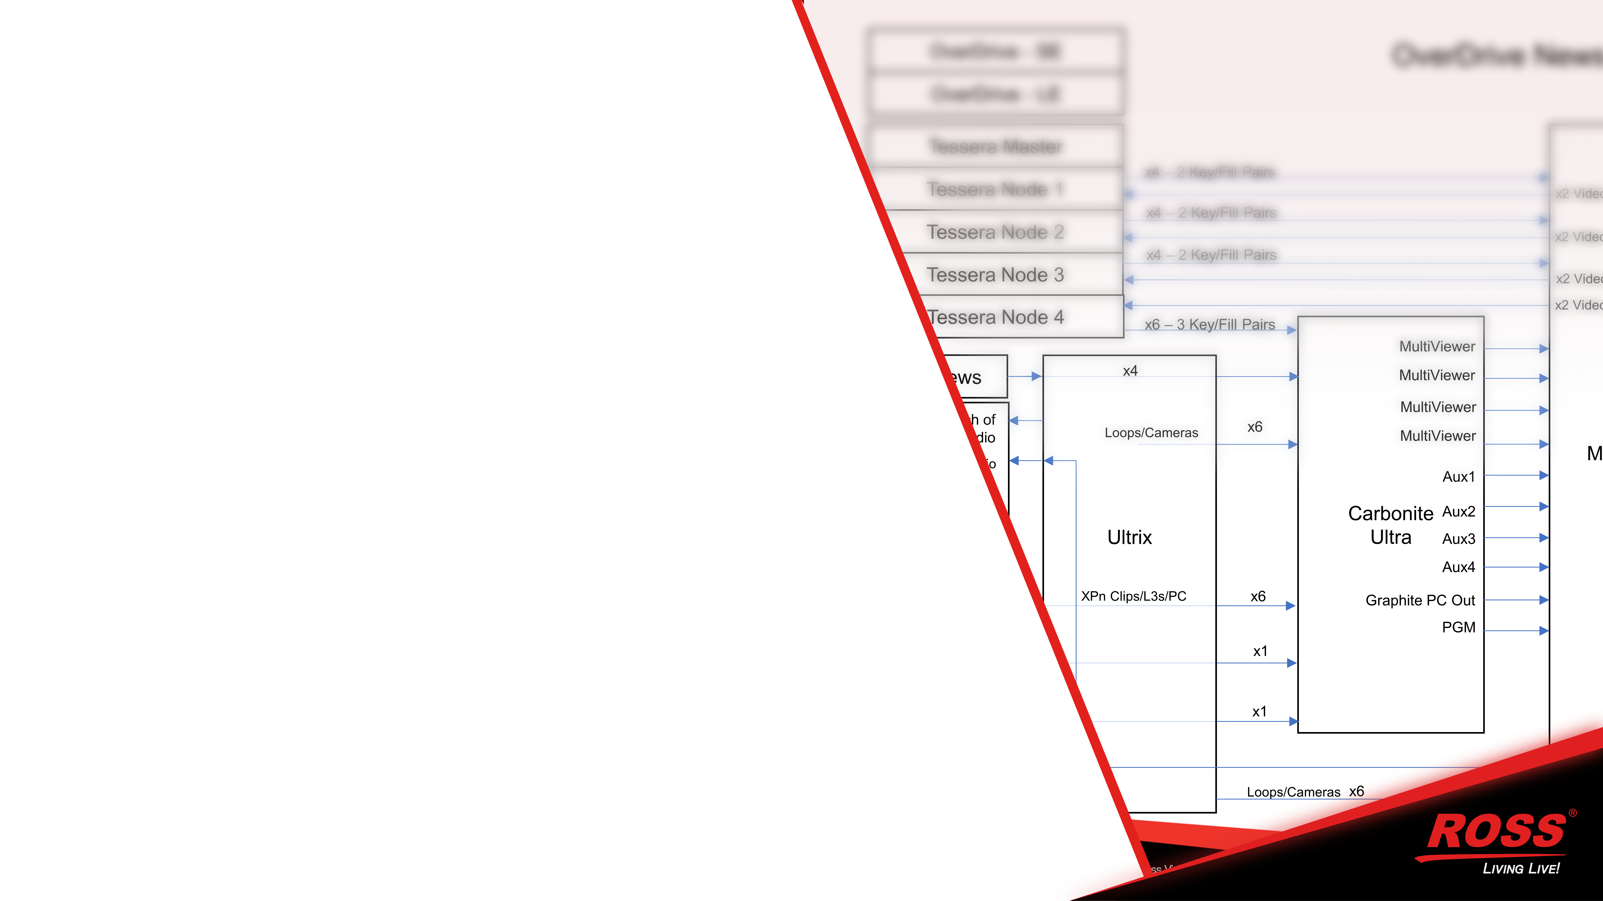
What’s new
| OverDrive 19.3 + Caprica 6.3
On-Set Displays
We have improved the ability to control external devices that populate on-set displays.
Virtual Keyers and Inputs in Caprica allow for up to 32 devices to be controlled by a single template while not using any primary switcher resources.
CustomControl events that know the status of the system and directs commands to devices without user intervention or complicated logic. (Bus based CC events)
Removes the need for complicated templates and CustomControls and switcher tricks.

Slide 8
What’s new
| OverDrive 19.3 + Caprica 6.3
On-Set Displays

Slide 9
What’s new
| OverDrive 19.3 + Caprica 6.3
On-Set Displays

Slide 10
What’s new
| OverDrive 19.3 + Caprica 6.3
On-Set Displays

Slide 11
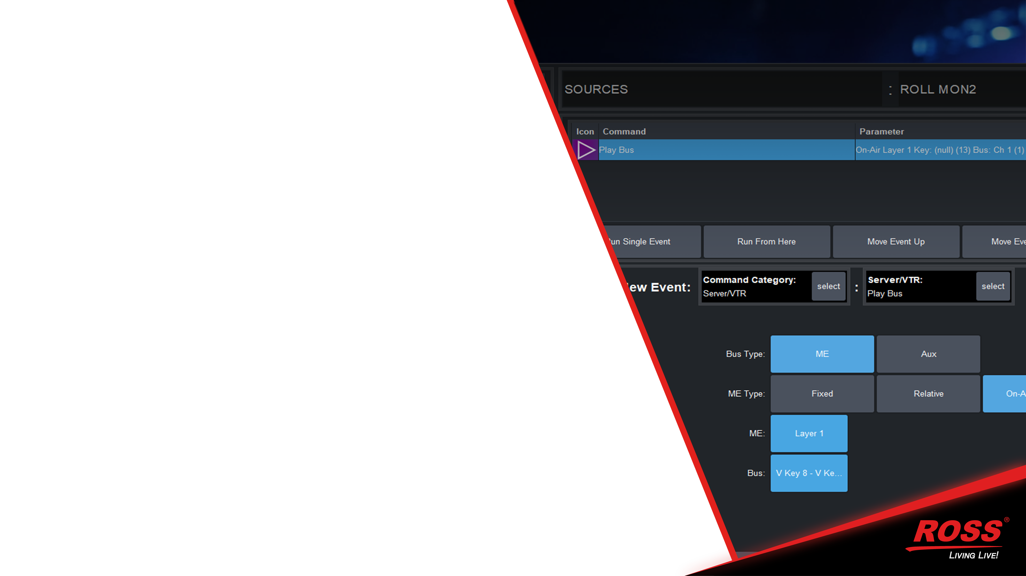
What’s new
| OverDrive 19.3 + Caprica 6.3
On-Set Displays
We have improved the ability to control external devices that populate on-set displays.
Virtual Keyers and Inputs in Caprica allow for up to 32 devices to be controlled by a single template while not using any primary switcher resources.
CustomControl events that know the status of the system and directs commands to devices without user intervention or complicated logic. (Bus based CC events)
Removes the need for complicated templates and CustomControls and switcher tricks.

Slide 12
What’s new
| OverDrive 19.3 + Caprica 6.3
On-Set Displays

Slide 13
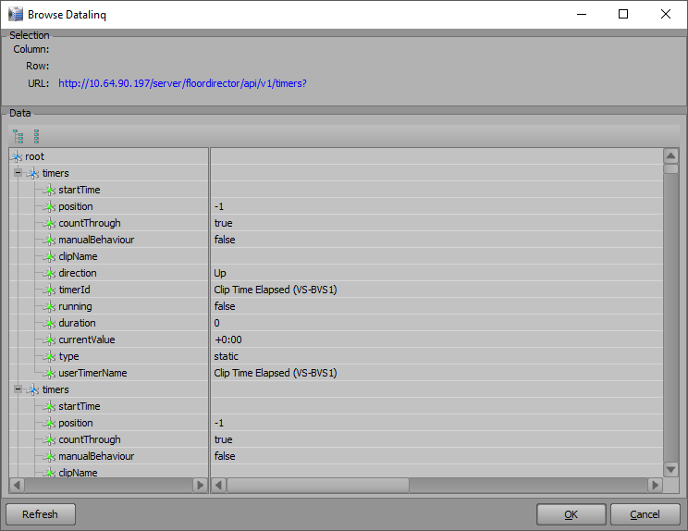
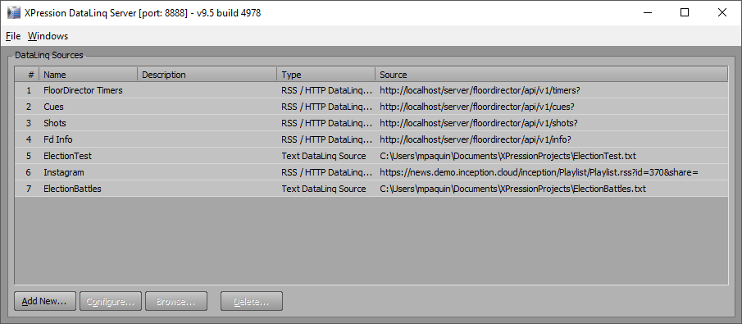
What’s new
| OverDrive 19.3 + Caprica 6.3
XPression Integration - FloorDirector

Slide 14
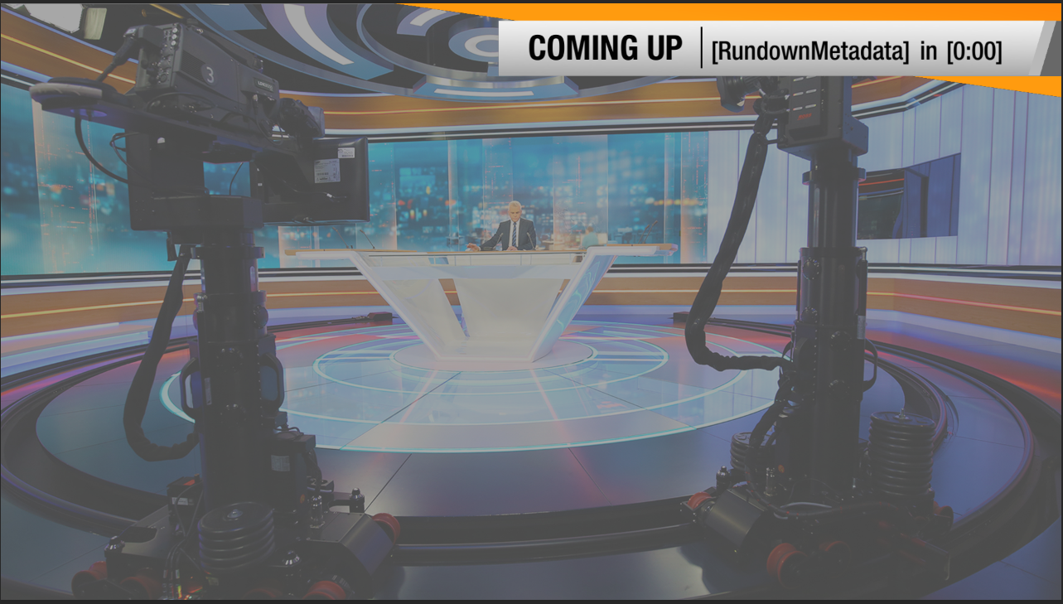
What’s new
| OverDrive 19.3 + Caprica 6.3
XPression Integration - FloorDirector

Slide 15
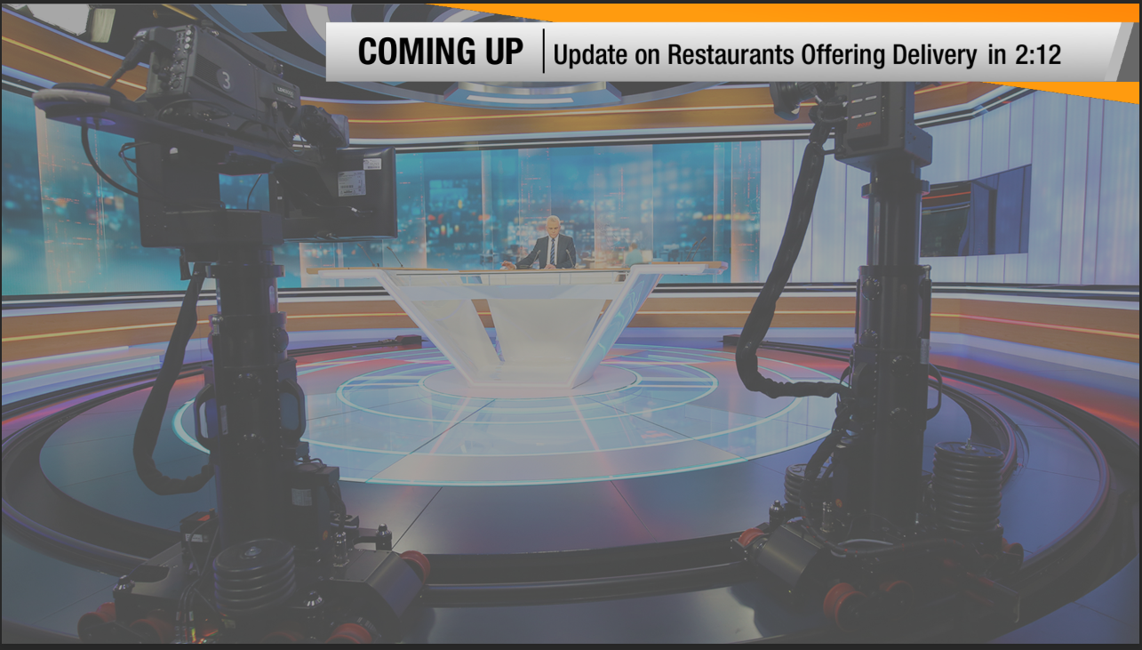
What’s new
| OverDrive 19.3 + Caprica 6.3
XPression Integration - FloorDirector

Slide 16
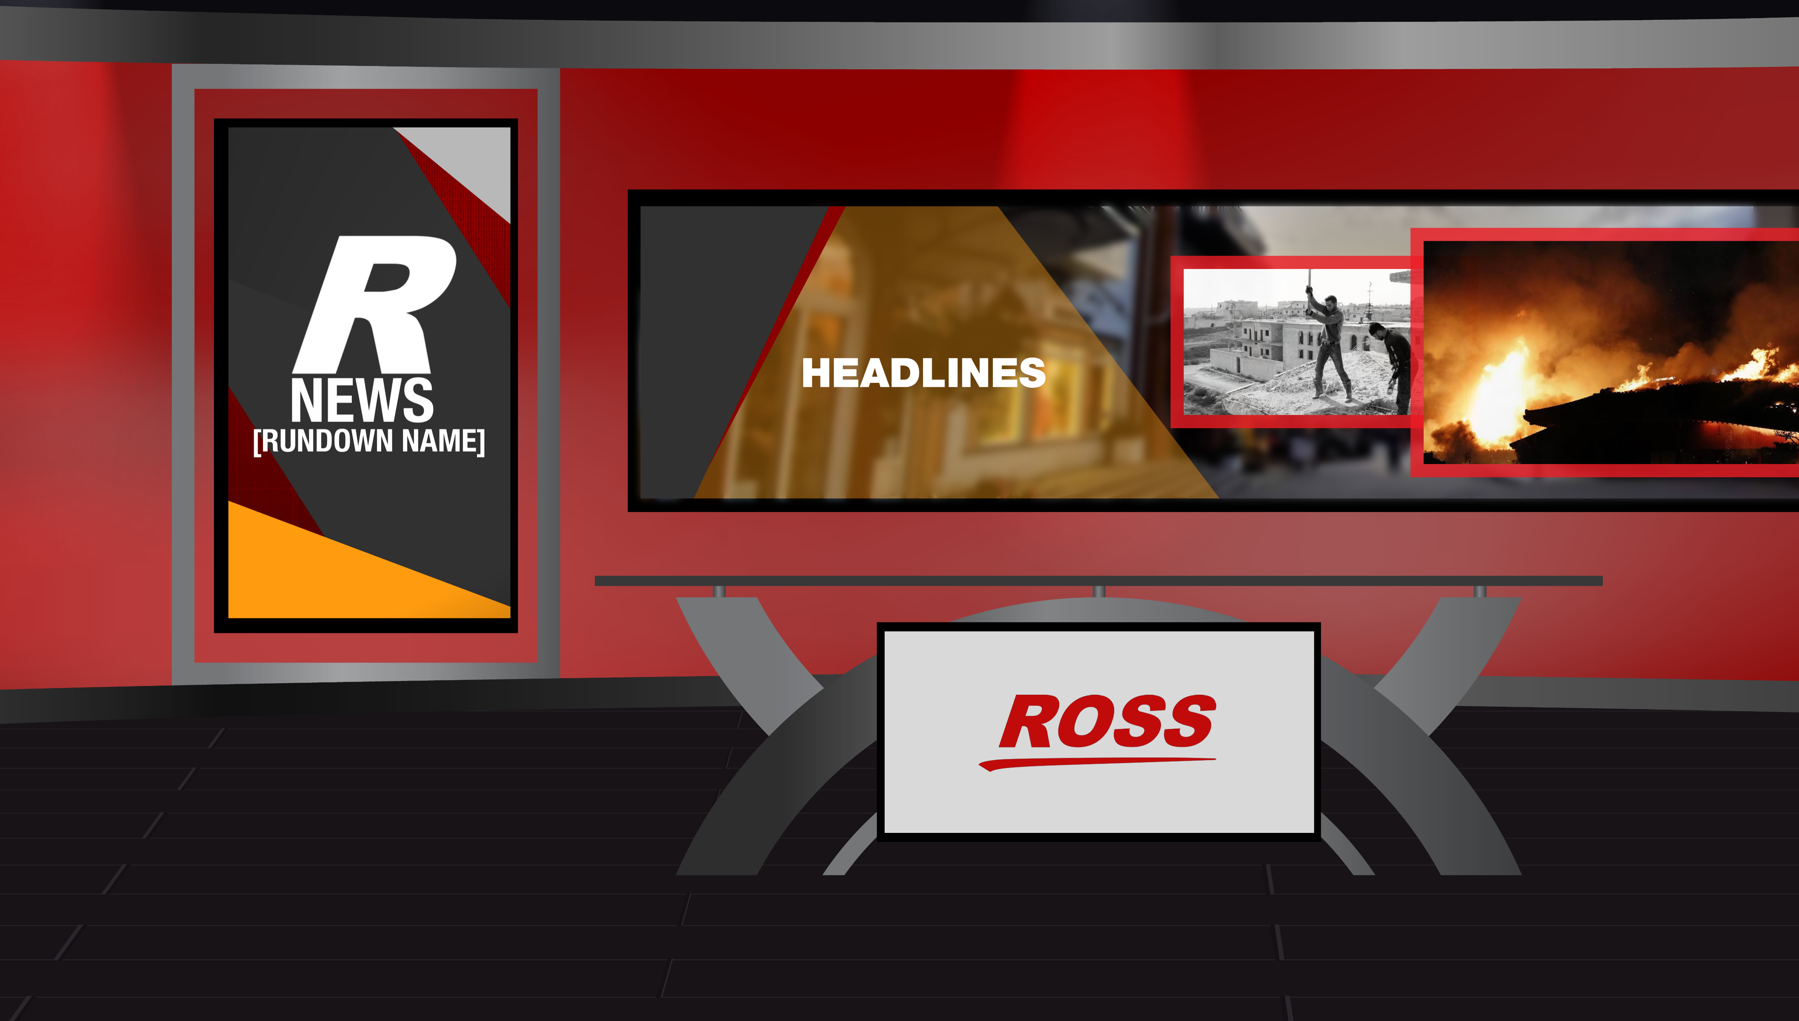
What’s new
| OverDrive 19.3 + Caprica 6.3
XPression Integration - FloorDirector

Slide 17
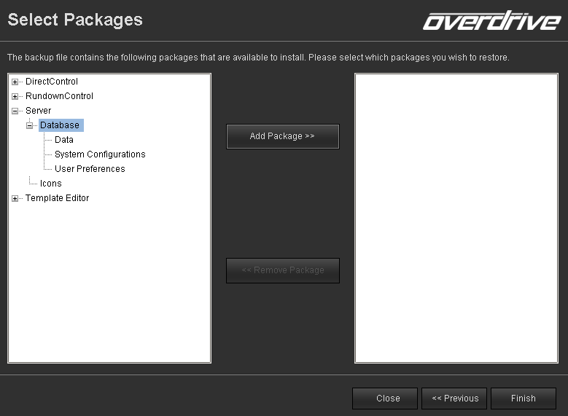
What’s new
| OverDrive 19.3 + Caprica 6.3
Increased Scalability
The ability to use new Virtual Inputs and Keyers allows for the ability to create scalable plans for disaster recovery and redundancy.
Controlling Acuity with Caprica + these new features allow that a show built on a large switcher like Acuity, can be moved to a room with a Carbonite, and these new features reduce the impact to on-set displays and device control.
Improved ability to selectively restore template databases, user configurations and settings to move configurations from room to room.

Slide 18
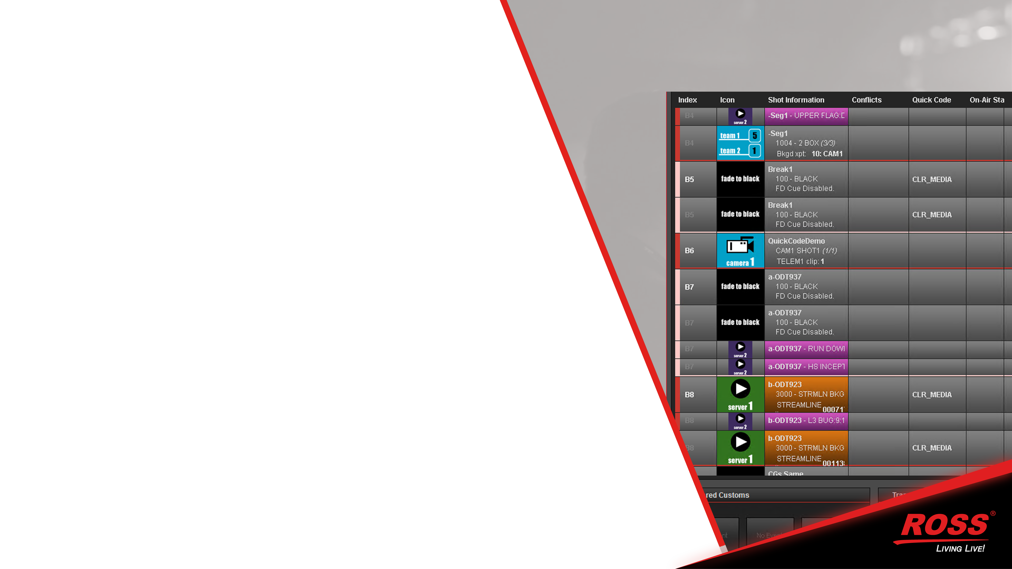
What’s new
| OverDrive 19.3 + Caprica 6.3
Minor Improvements with major impacts
(in a good way)
We’ve added the ability to customize the way you see stories in RundownControl.
CG timing updates to an on-air a story are dynamically updated.
New Default Icon set
Restart ALL services from Web UI (including Jetty/web server)

Slide 19
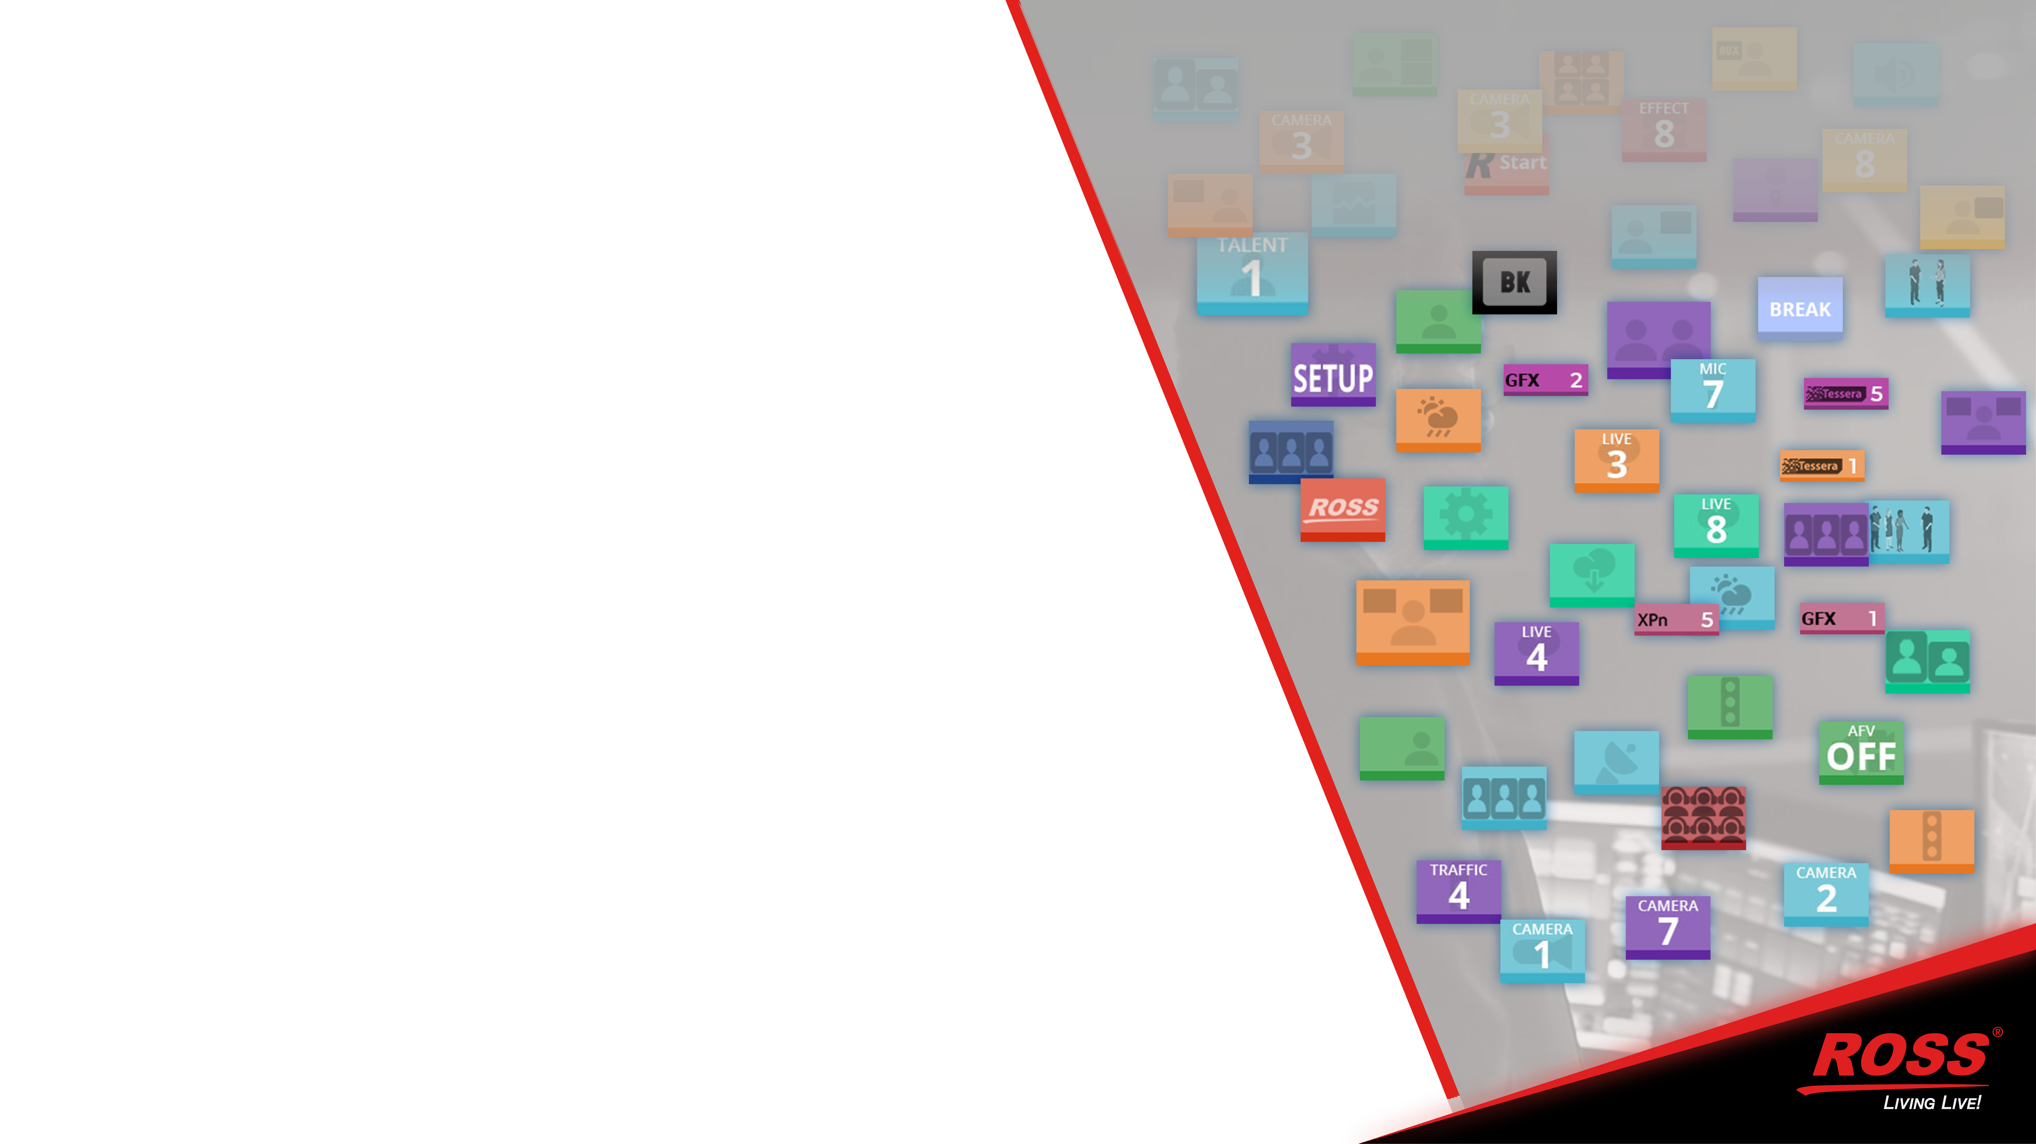
What’s new
| OverDrive 19.3 + Caprica 6.3
Minor Improvements with major impacts
(in a good way)
We’ve added the ability to customize the way you see stories in RundownControl.
CG timing updates to an on-air a story are dynamically updated.
New Default Icon set
Restart ALL services from Web UI (including Jetty/web server)

Slide 20
What’s new
| OverDrive 19.3 + Caprica 6.3
Minor Improvements with major impacts (in a good way)
Caprica UI revamped for DashBoard 9 and Aura.
New CustomControl to send messages to logs and RundownControl
Support for CUE command with XPression (added for use with Tessera)
Ability to name Audio channels or use names sent by mixer.
Extended RossTalk commands – allows custom DashBoard panels to invoke CustomControl events. Use visual logic and build CustomControls as “smart” as you want.
Currently limited to Switcher and Video Server events and a few other commands, list is being expanded every sprint.

Slide 21
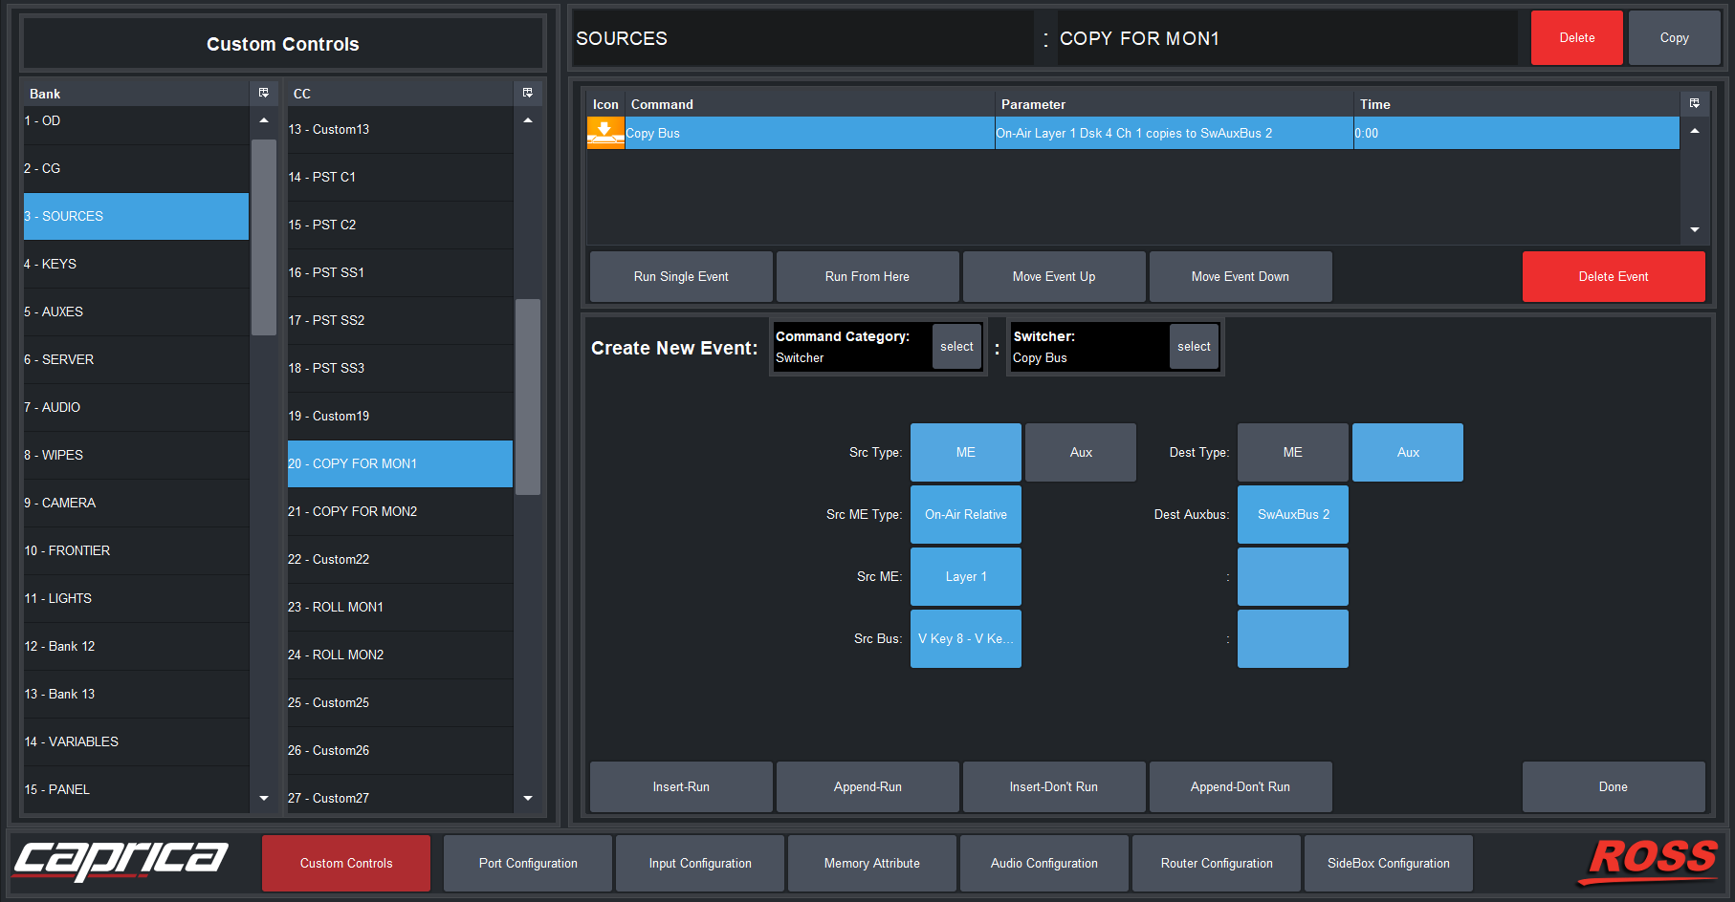
What’s new
| OverDrive 19.3 + Caprica 6.3
Minor Improvements with major impacts (in a good way)
Caprica UI revamped for DashBoard 9 and Aura.
New CustomControl to send messages to logs and RundownControl
Support for CUE command with XPression (added for use with Tessera)
Ability to name Audio channels or use names sent by mixer.
Extended RossTalk commands – allows custom DashBoard panels to invoke CustomControl events. Use visual logic and build CustomControls as “smart” as you want.
Currently limited to Switcher and Video Server events and a few other commands, list is being expanded every sprint.

Slide 22
What’s new
| OverDrive 19.3 + Caprica 6.3
Minor Improvements with major impacts (in a good way)
Caprica UI revamped for DashBoard 9 and Aura.
New CustomControl to send messages to logs and RundownControl
Support for CUE command with XPression (added for use with Tessera)
Ability to name Audio channels or use names sent by mixer.
Extended RossTalk commands – allows custom DashBoard panels to invoke CustomControl events. Use visual logic and build CustomControls as “smart” as you want.
Currently limited to Switcher and Video Server events and a few other commands, list is being expanded every sprint.

Slide 23
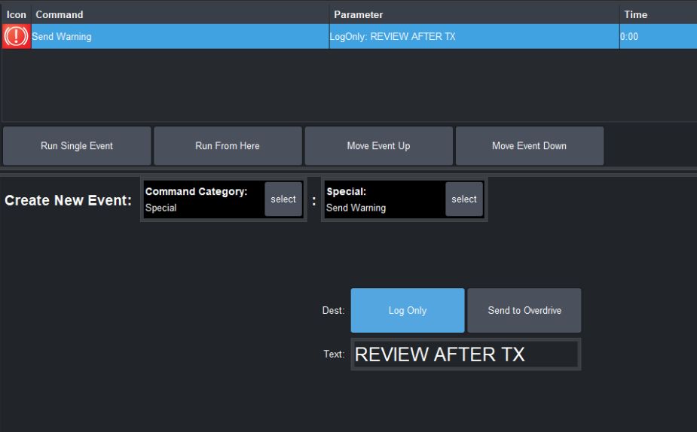
What’s new
| OverDrive 19.3 + Caprica 6.3
Minor Improvements with major impacts (in a good way)
Caprica UI revamped for DashBoard 9 and Aura.
New CustomControl to send messages to logs and RundownControl
Support for CUE command with XPression (added for use with Tessera)
Ability to name Audio channels or use names sent by mixer.
Extended RossTalk commands – allows custom DashBoard panels to invoke CustomControl events. Use visual logic and build CustomControls as “smart” as you want.
Currently limited to Switcher and Video Server events and a few other commands, list is being expanded every sprint.

Slide 24

What’s new
| OverDrive 19.3 + Caprica 6.3
Minor Improvements with major impacts (in a good way)
Caprica UI revamped for DashBoard 9 and Aura.
New CustomControl to send messages to logs and RundownControl
Support for CUE command with XPression (added for use with Tessera)
Ability to name Audio channels or use names sent by mixer.
Extended RossTalk commands – allows custom DashBoard panels to invoke CustomControl events. Use visual logic and build CustomControls as “smart” as you want.
Currently limited to Switcher and Video Server events and a few other commands, list is being expanded every sprint.

Slide 25
What’s new
| OverDrive 19.3 + Caprica 6.3
Minor Improvements with major impacts (in a good way)
Caprica UI revamped for DashBoard 9 and Aura.
New CustomControl to send messages to logs and RundownControl
Support for CUE command with XPression (added for use with Tessera)
Ability to name Audio channels or use names sent by mixer.
Extended RossTalk commands – allows custom DashBoard panels to invoke CustomControl events. Use visual logic and build CustomControls as “smart” as you want.
Currently limited to Switcher and Video Server events and a few other commands, list is being expanded every sprint.

Slide 26
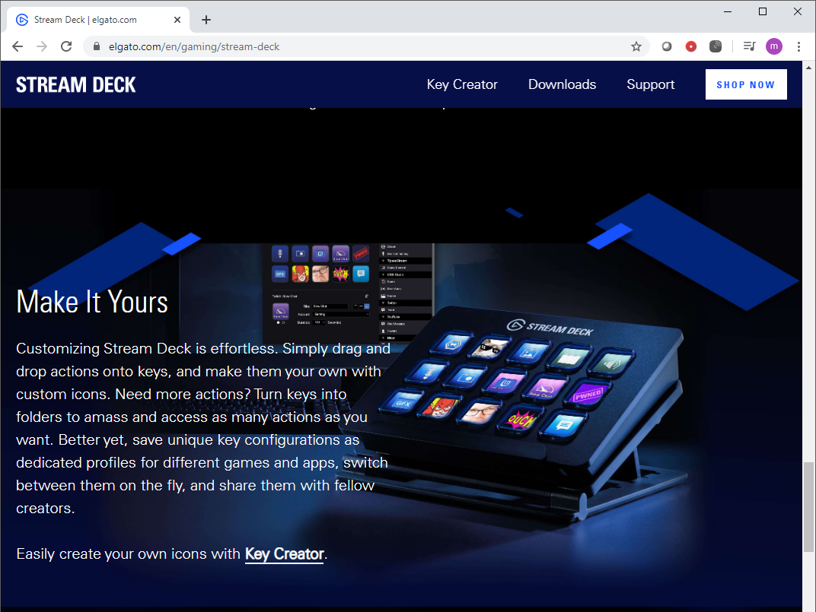

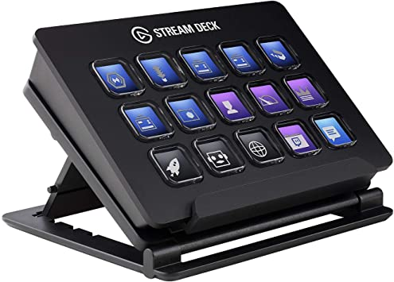
What’s new
| OverDrive 19.3 + Caprica 6.3
STREAM DECK
Created a Caprica specific plugin (Similar to the ones made for XPression and Graphite).
Allows for low cost shot boxes.
Useful for presenters, producers, and “at home” production – (more later).
Our SideShots are powered and connected to the network, these are connected to the client PC via USB.

Slide 27
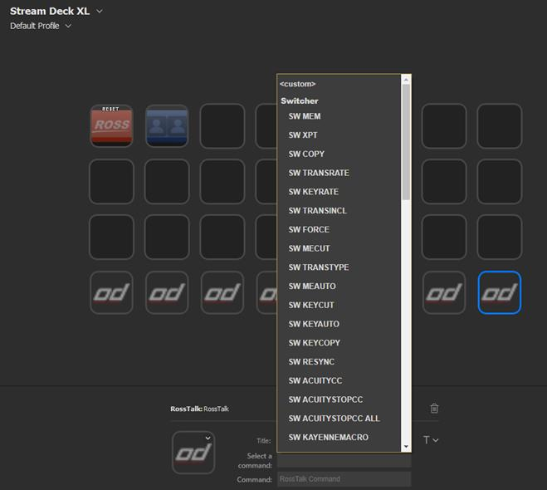
What’s new
| OverDrive 19.3 + Caprica 6.3
STREAM DECK
Created a Caprica specific plugin (Similar to the ones made for XPression and Graphite).
Allows for low cost shot boxes.
Useful for presenters, producers, and “at home” production – (more later).
Our SideShots are powered and connected to the network, these are connected to the client PC via USB.

Slide 28
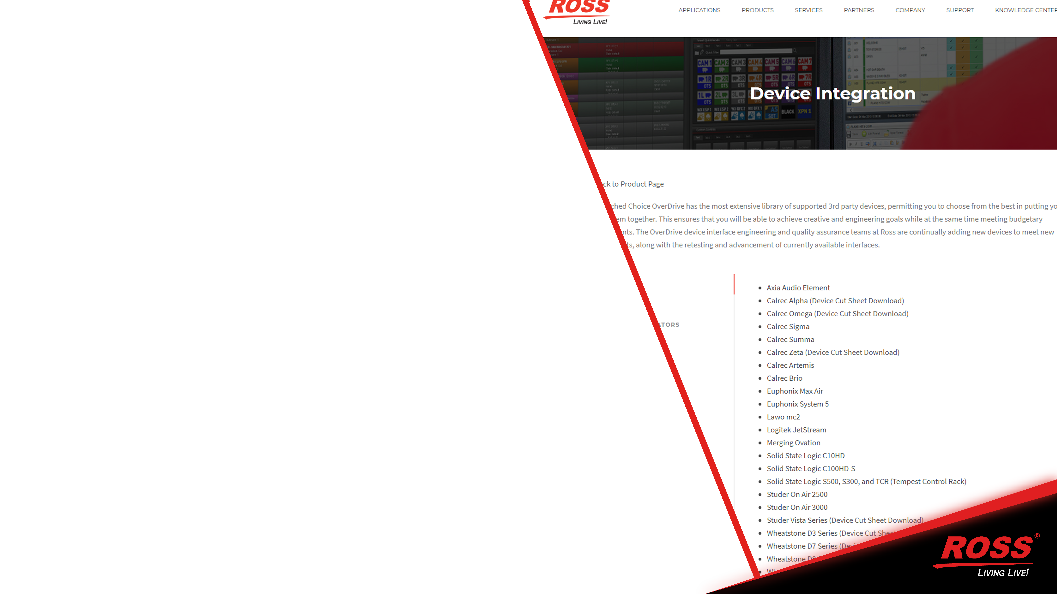
What’s new
| OverDrive 19.3 + Caprica 6.3
New Devices Added
Lawo PowerCore (Ruby) through Ember+
Trigger Play! – Audio player
Support for Graphite 3.0 (support for audio mixer changes)

Slide 29
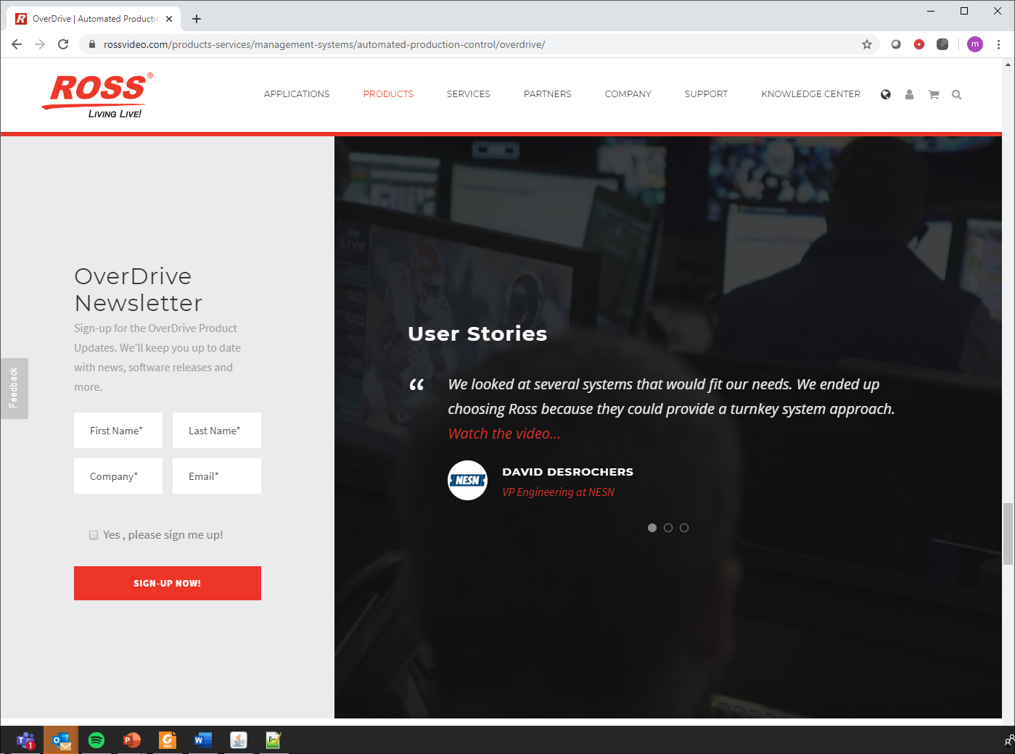
What’s new
| OverDrive 19.3 + Caprica 6.3
Product Updates
Email blast to subscribed members.
You need to sign up.
We send out a quick note to all subscribers about all releases and updates… even bug fixes.

