Slide 1
ROSSLIVE | News workflow solutions
Shawn Snider, Nikki Renoit, Jack Horry, Carole Pigeard
April 15, 2020

Slide 2
News workflow solutions
| Introduction
The decision to purchase newsroom products is often not made by an engineering manager or technical project team.
The decision is often deferred to the end users.
Do you know what everyone does in a newsroom?
Notes:
[SHAWN]

Slide 3

Notes:
[JENN]
Let me introduce some really key players in a news organization.
There goal is to be accurate fast and ahead of the competition.
There is also some pressure to be unique in the way the news is presented.
Introduce this slide we will repeat this at the end to make the point that we only really reach out to 3 of these people “production crew, graphic designers, and minorly video editors.”

Slide 4
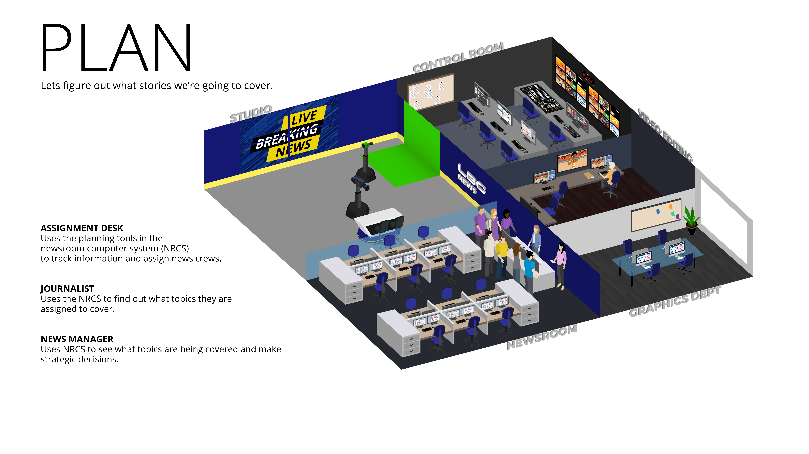
Notes:
[JENN]
The planning stage is vital in any news organization. Information and collaboration is the key to any news story, or topc.
Exiting diary of events as some are planned months in advance.
UK elections happening at the moment planning to follow politicians, get drat or outlined speeches choosing from an array of pr events.
Need to understand the implications on covering all the story’s on offer as they need to be balanced by uk law

Slide 5
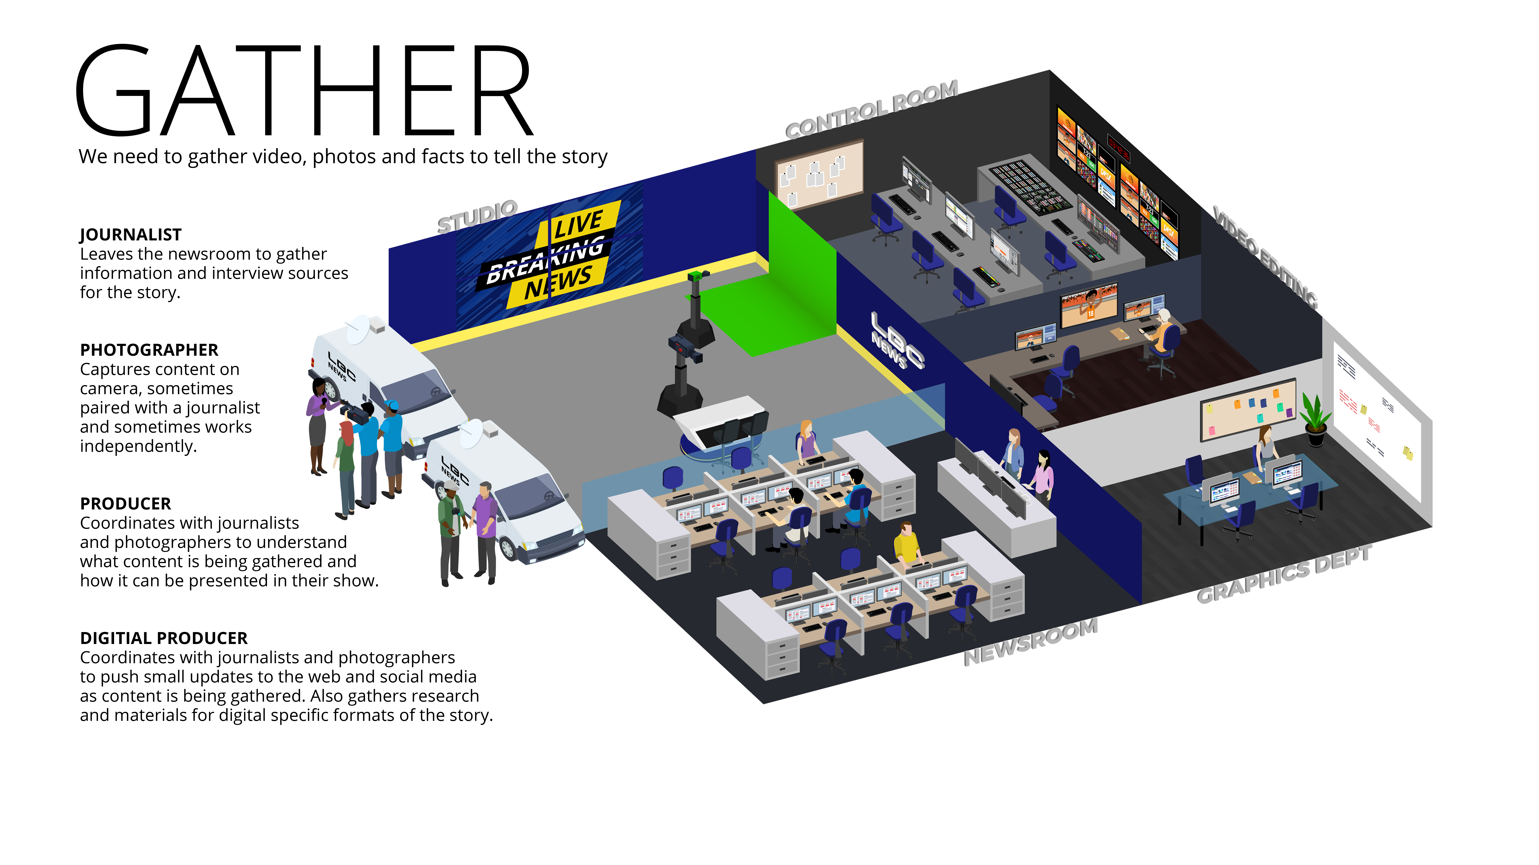
Notes:
[JENN/CHRIS]
On the back of the planning the production is mobilized to film and gather content.
Content can be produced by the organization or gathered from news services.
A lot of metadata is created in this phase: log’s of feeds, key speech lines, data for graphics
Archives can be looked into from MAM
Social Content harvested (In Chile for example they use Reporteros Ciudadanos, Citizen Reporters)
Planning and Gathering apples to all outputs (digital, radio, etc)
Newer tools like inception have the assignment manager to assist in this process. This replaces endless diary items on a excel sheet or worse in dummy rundowns

Slide 6
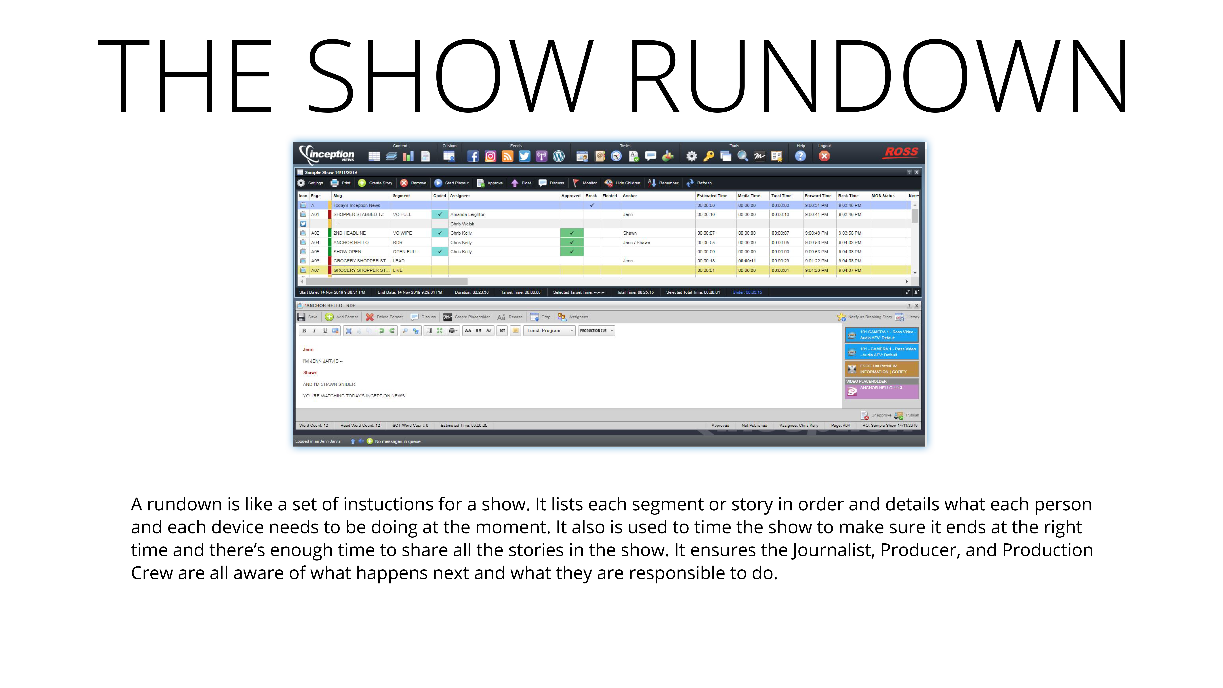
Notes:
This is the source of truth. Anyone can find this find the index number and have an instant overview on what is happening.
This is also the common thread between all the NRCS”s they all have to have this functionality.
Not only the software but the way information is inputted is a very important to the organization
How functional a newsroom is can be found by looking at how this operates
Stories and running orders can be used many many times in very different outlets

Slide 7
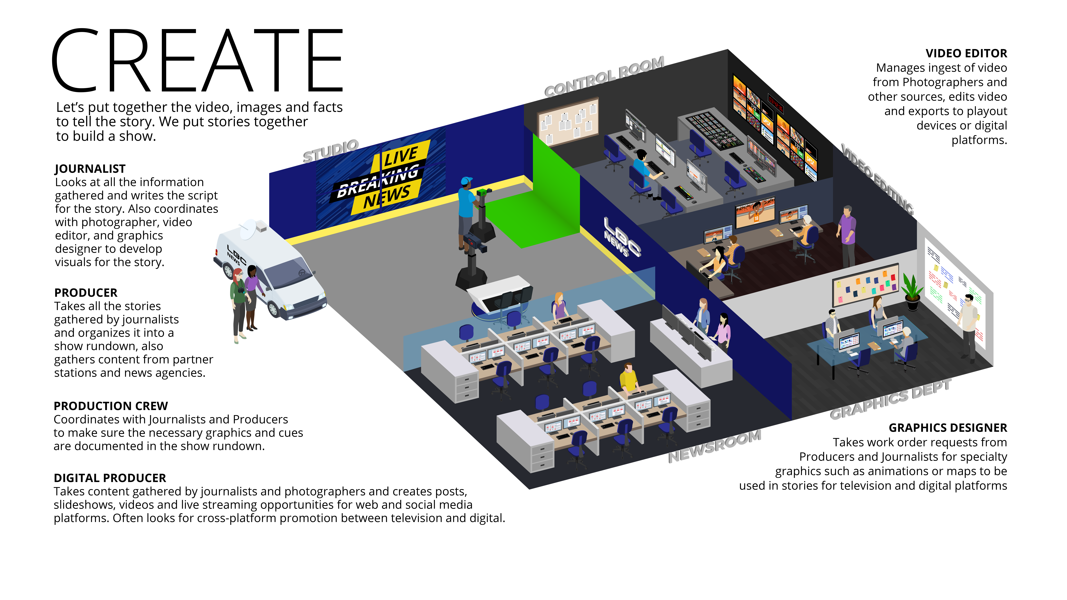
Notes:
This is the phase the tools really come into play and storys stat to take shape. The key here is the metadata gathers is now starting to be harvested by video editors and graphics designers.
Tools come into play

Slide 8
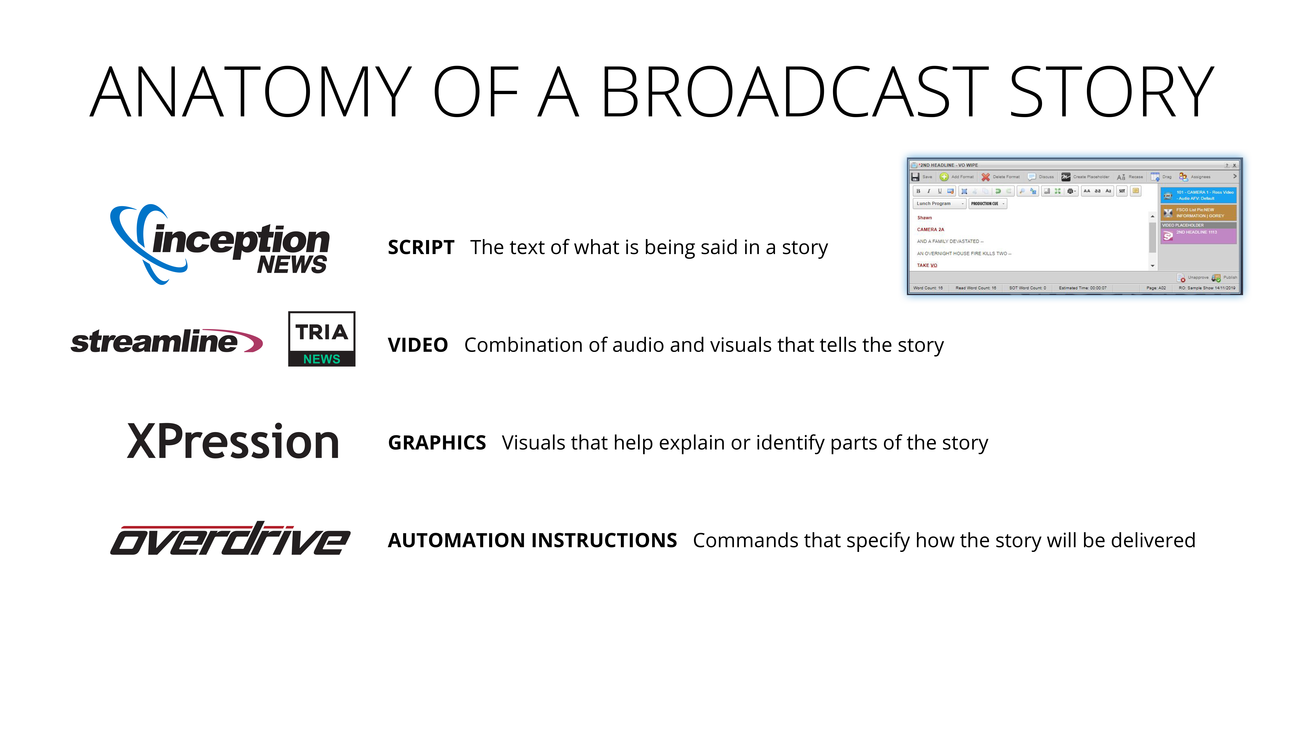
Notes:
Inception hosts the script and the mos objects to put everything in one place.
There can be 100’s of story’s in an hour.
Putting the speed of these story’s in context It’s the –equivalent of finding 50 opportunities, shaping them, and sending the past the PO stage to the commissioned trained state in a day

Slide 9
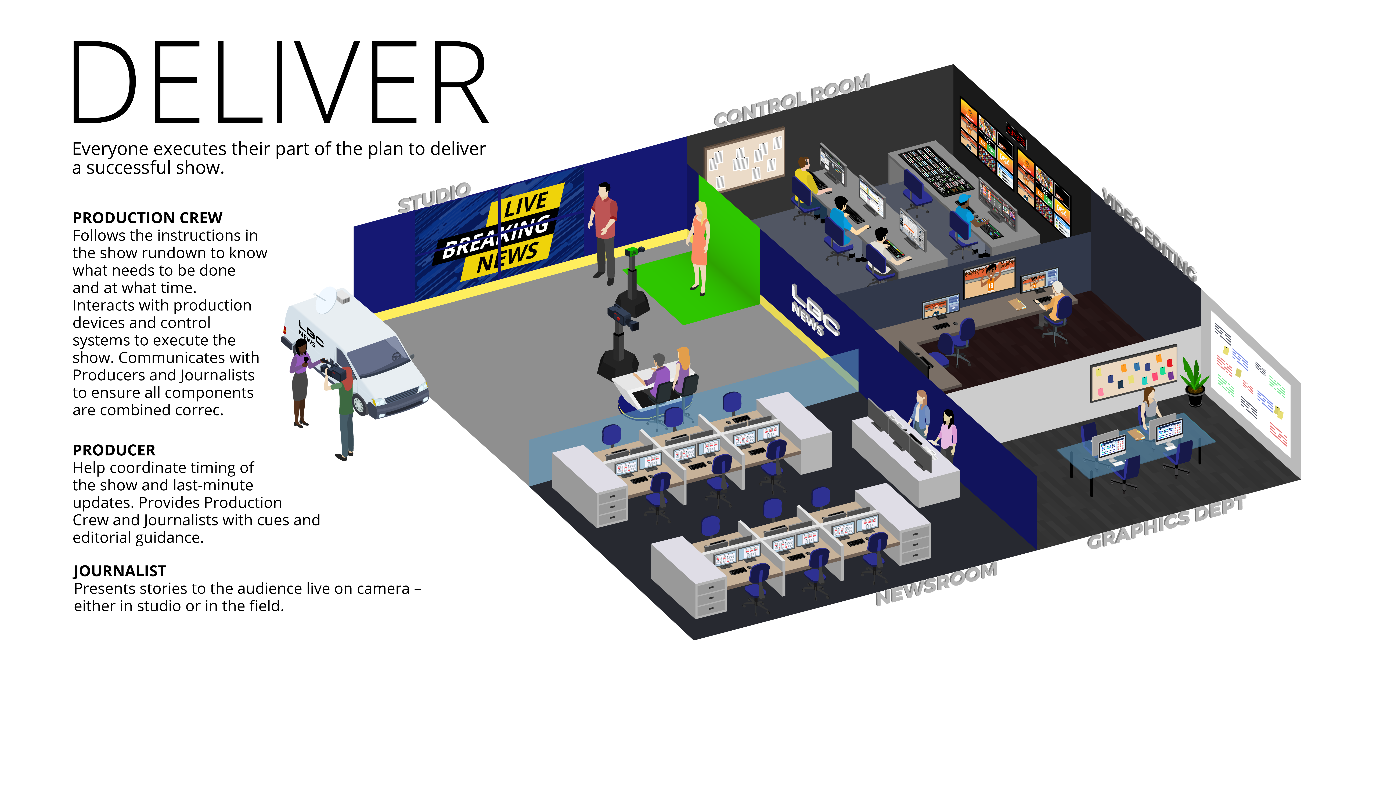
Notes:
This is the bit we all see. The end results, the pressure of delivery
If the planning gathering and creation of the storys and rundowns was done well the production should be slick.
Sometimes there is a perceived level of chaos at this stage which is often created

Slide 10



News workflow solutions
| Competitive Landscape
Solution Component |  | VizRT | Dalet | Avid | GV | BitCentral | NxtEdition
Media Asset Mgmt. – Graphics
Media Asset Mgmt. – Video
Graphics
Automated Production Control
Social Media Publishing
NRCS
Video Server Playout
NLE Editing Platform
3rd party NLE Integration
New products, too early to know the impact

Slide 11
News workflow solutions
| Value Messaging
Creative
Deep integration allow producers to easily create more engaging multi-platform content.
This integrated workflow improves collaboration, communication and efficiency within your teams.
One number to call for help – with best in class support.
Automated solution allows you to produce more content, with fewer people in the control room, in a more consistent fashion.
Flexible buying models - on-premise or SAAS.
Easy to install and use, works out of the box. Fewer training and integration days on-site (versus heavy customization required with competitive solutions)
Solution is almost entirely virtualizable.
Uses industry standard protocols and fully supports third party devices.
Business
TECHNICAL

Slide 12
News workflow solutions
| What to remember
The end users often play a vital role in the decision-making process and can make or break an opportunity.
Ross can provide a unified solution for fully automated or traditional production workflow or integrate with an existing customer solution.
Continuous effort to expand the workflow under the Ross brand through partnerships with third party companies, such as Metus for ingest, or SNS for storage.
The solution continues to evolve and improve – major development investment for Ross with an expansive roadmap.
Flexible implementation model, on-site (hardware), on-site (virtualized), or SAAS.
The solution goes beyond news – works well in live and sports-based productions as well.

