Slide 1
XPression 10.0
Sales Training Presentation
Patrick Twomey
April 14th, 2020

Slide 2



XPression Version 10
Notes:
This spring for Ross Live | 2020 I would like to announce XPression Version 10. While there are a lot of new features and functionality added to XPression 10, I would like to focus on
[CHANGE]

Slide 3

XPression Video Codec UPDATE
XPVC 2
Fully rewritten, fast, multi-threaded UHD, HDR & Wide Color Gamut video codec
Adds support for 10-bit Video files
Video and Key support in one file
Backwards compatible with existing XPression video assets
Older Video assets do not need to be re-encoded
Software codec, not hardware dependent
Available starting with XPression Version 10
Notes:
The new XPression Video Codec Update This adds:
- HDR and Wide Color Gamut for video assets
Support for 10-bit video files
This new codec is backwards compatible with older XPression Video Codec assets
Since this is a SOFTWARE-BASED CODEC, and not hardware dependent like other vendors, customers do not need to replace hardware
This will become available with XPression version 10 and released this summer
[CHANGE]

Slide 4

XPression Video Codec UPDATE
XPVC 2
Provides Video Asset support to UHD/12G XPression workflows
BACKWARDS COMPATIBLE
Will read original XPression Video Codec files
Older XPression Projects will still work using the new codec
All new files created with it will be in the new codec format
Notes:
…the new codec provides support of video assets in our UHD/12G configurations
This is backwards compatible with assets created using the original XPression Video codec
Old assets do not need to be re-encoded to work in version 10, with the new codec
All new XPression Video assets created with the new Codec are not compatible with prior versions of XPression since they will be in the new codec
(if you want the old codec for creating content for older versions of XPression, don’t install the new codec on your creation systems
[CHANGE]

Slide 5
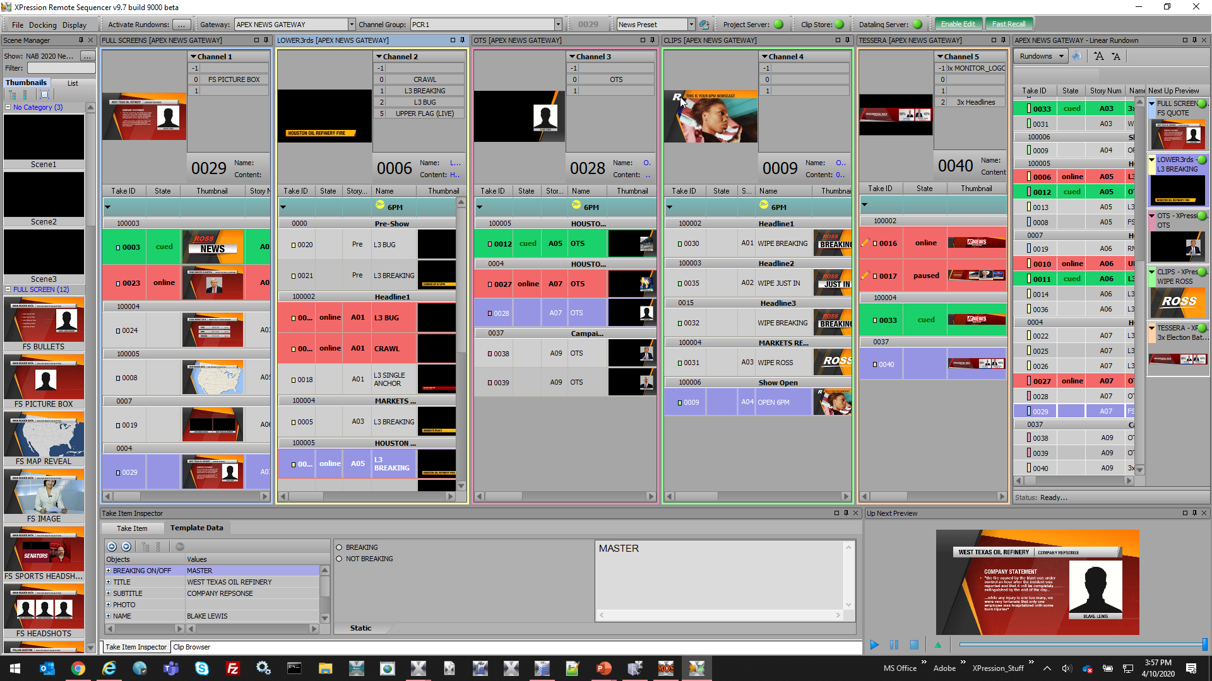
XPression Remote Sequencer
Notes:
Who remembers last year when we introduced XPression Remote Sequencer for Version 9.0?
…well we added some new tricks!
[CHANGE]

Slide 6
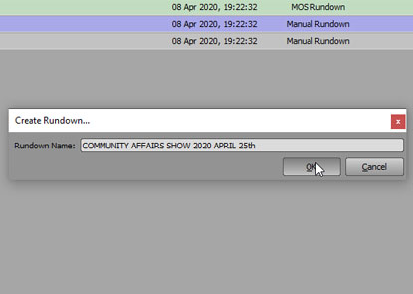
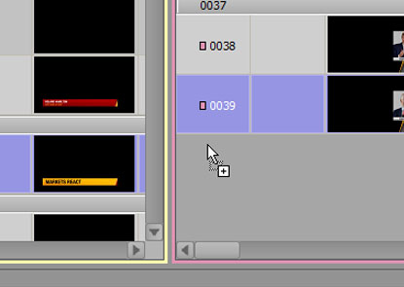
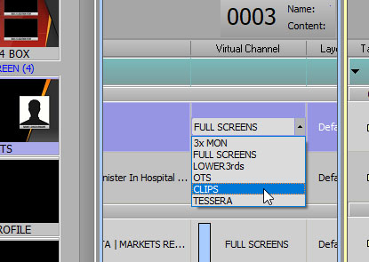
XPression Remote Sequencer
Create New Rundowns
Create Remote Sequencer rundowns without a NRCS. Shows without a newsroom computer can now be part of the workflow.
Create New Take Items
Add new scenes, without a MOS newsroom, using the Scene Manager, which is linked to the Project Server. Keeps all engines in sync with each other.
Modify Existing MOS Objects
Change assets in the rundown, and even move them to another channel. With Project Server, all engines are in-sync.
Notes:
With Version 10, Remote Sequencer users can not create new rundowns, without any MOS objects in them
Add new Take Items, using the project Server content shown on the left side panel
Change the virtual frame buffer assignment of any Take ID in the rundown to another channel
[CHANGE]

Slide 7
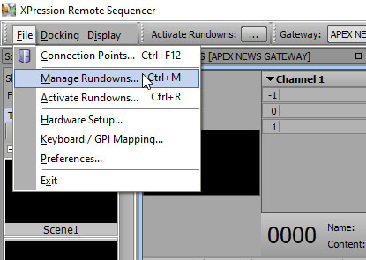
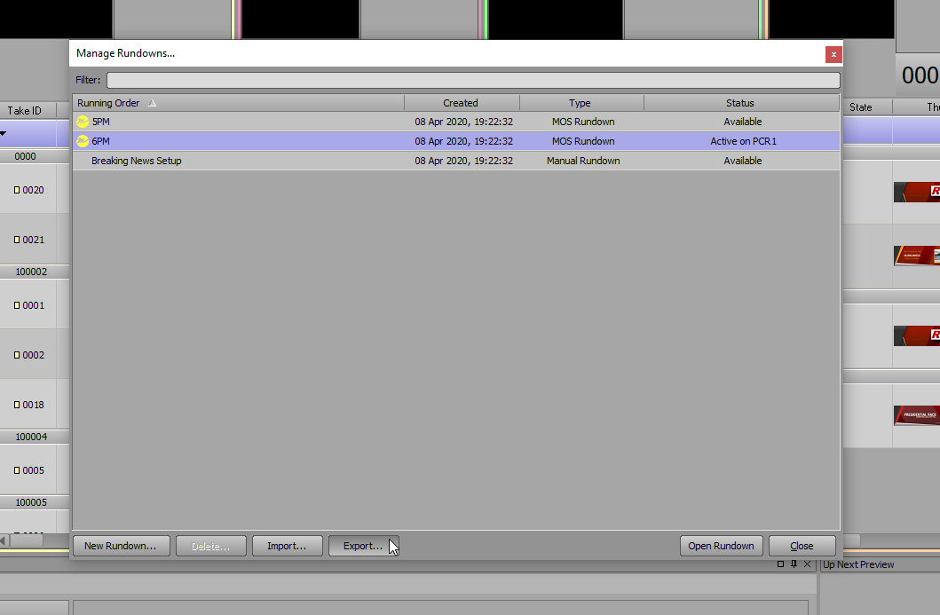
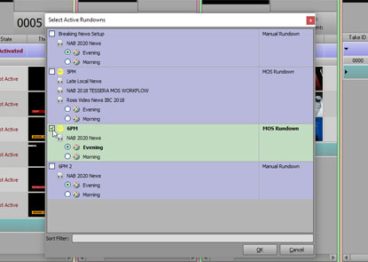
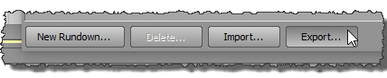
XPression Remote Sequencer
Manage Rundowns
A new interface that allows users to Create, Import and Export Rundowns in Remote Sequencer
Import/Export and New Rundowns
Create new rundowns from scratch, without a MOS newsroom system.
Export rundowns for later or even export a MOS rundown for later use.
Activate Rundowns
build or modify a rundown on Remote Sequencer without activating it. Working “offline, and not loading it on the playout engines
Notes:
Remote Sequencer users can now
MANAGE rundowns, which includes
IMPORT, EXPORT and Create New Rundowns
Activate only the rundowns you want active, so you can build new rundowns without actually putting them onto the XPression engines, if already in use
[CHANGE]

Slide 8
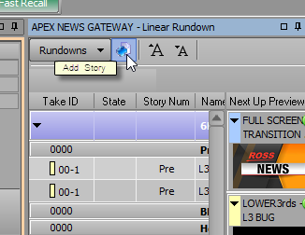
XPression Remote Sequencer
Add Story
Add Story groups into the Remote Sequencer rundowns to separate Take Items in a rundown like newsroom users would.
Notes:
Remote Sequencer users can now
Add stories to the Remote Sequencer Rundowns, to emulate grouping Take Items in a rundown like a newsroom user would do it
[CHANGE]

Slide 9
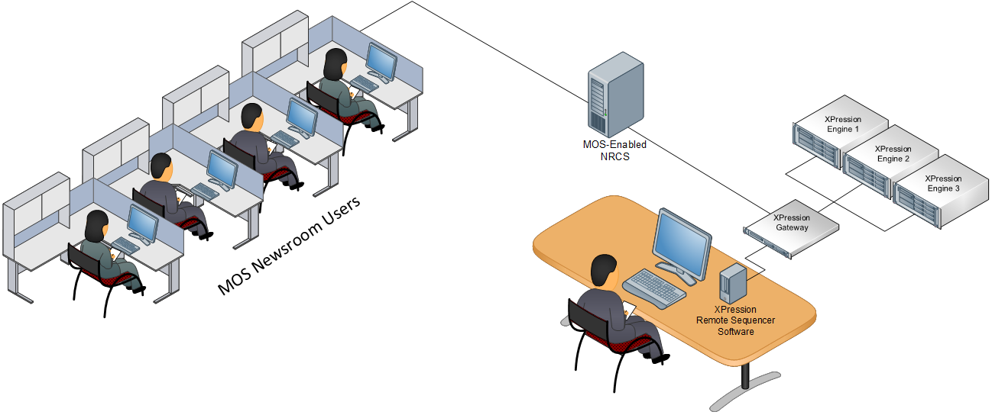
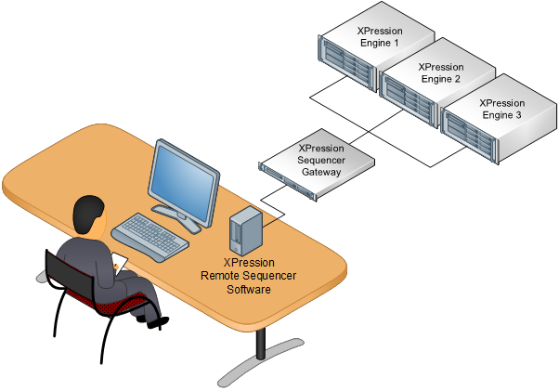
XPression Remote Sequencer
Mixed Workflows
Create rundowns in MOS and Manual workflows
Interchange content
Remote Sequencer User is empowered to build or make changes
Notes:
Use the Version 10 Remote Sequencer in a mixed configuration where rundowns come from the MOS Newsroom
Modify a MOS rundown, and save it for later use…
…add additional Take Items to the rundown or modify MOS objects for accuracy… before air
Note, that there is a permission setting to allow users to modify MOS Objects, if desired.
[CHANGE]

Slide 10
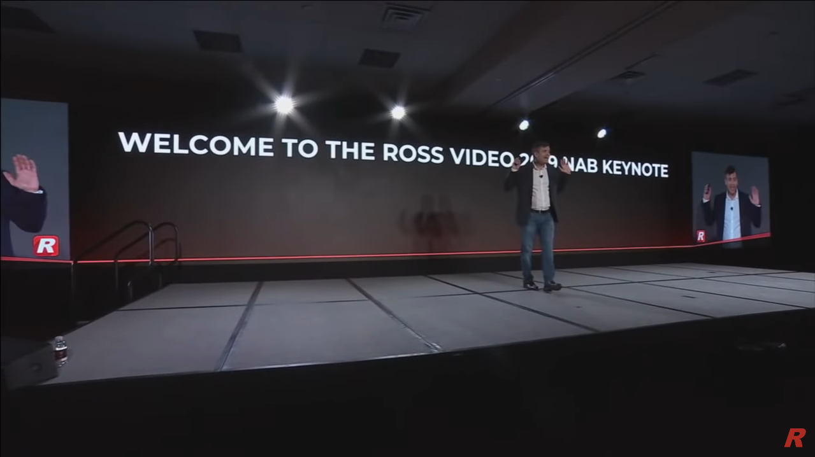
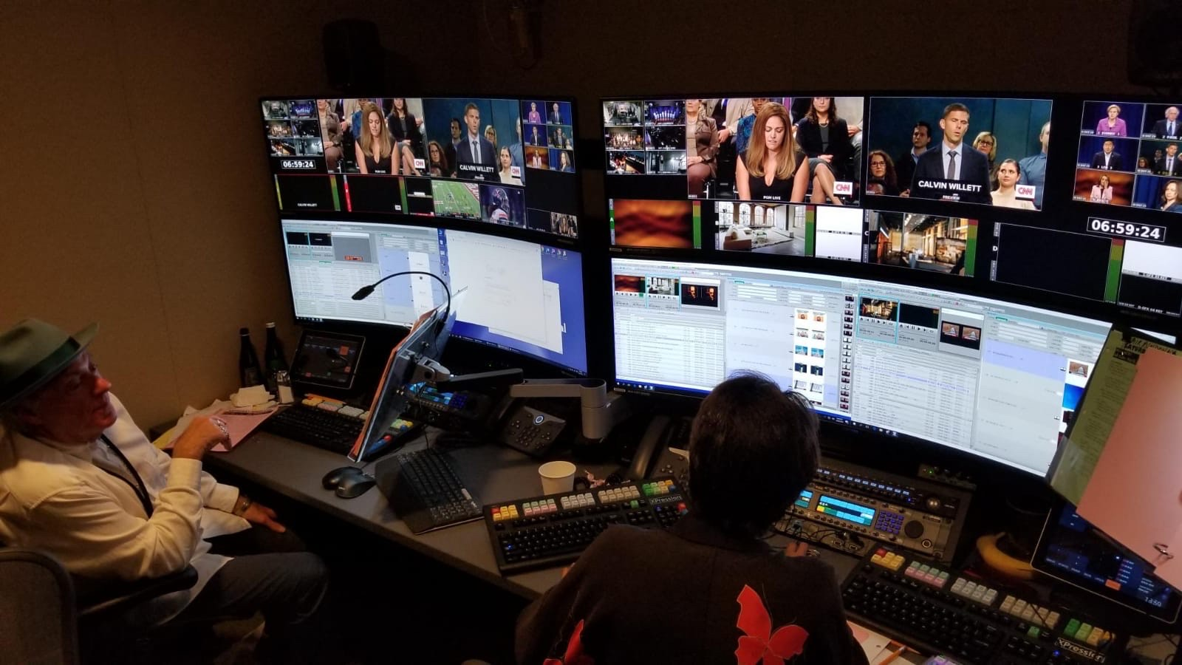


XPression Remote Sequencer
Shows that could use it
▼ Entertainment Shows (multiple engines/operators)
▲ Corporate Presentations
▲ Talk Shows
▲ Awards Shows
Notes:
With Version 10, Remote Sequencer workflows can now be used for even more types of productions, that don’t require a MOS enabled newsroom
Think about Corporate presentations, Entertainment shows with multiple engines (and operators), Awards shows and Talk shows.
[CHANGE]

Slide 11
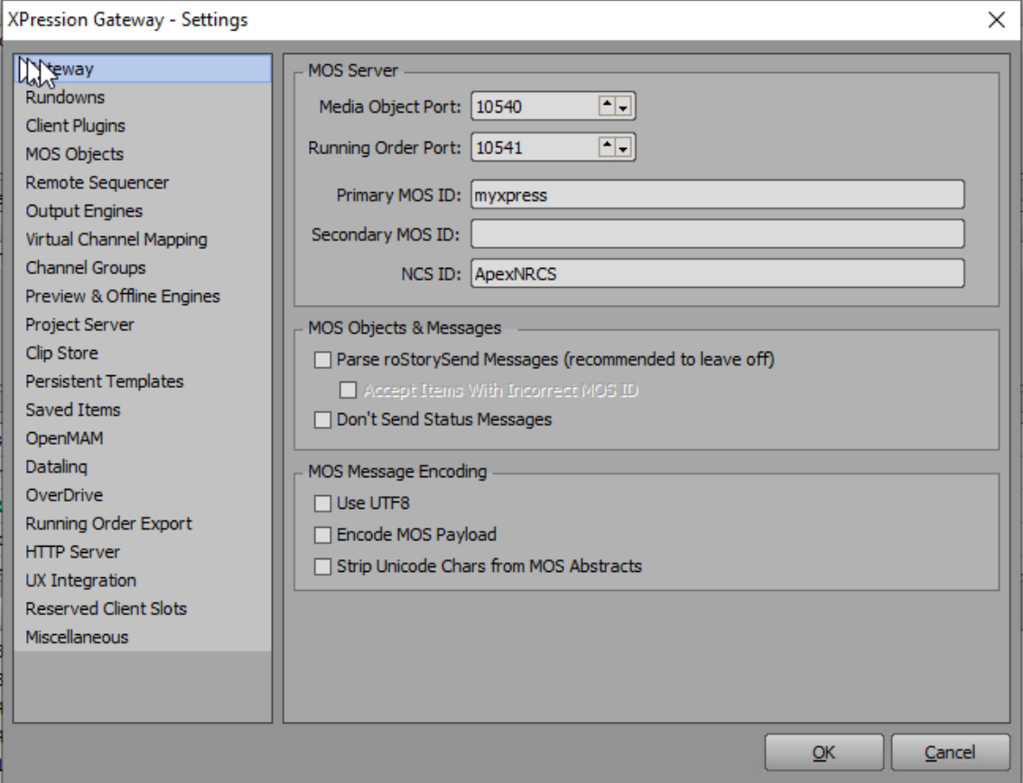

XPression Remote Sequencer
Using the Traditional XPression Gateway
Functionality fully supported using XPression Gateway
Mix MOS and Manual rundowns
Create offline copies of MOS rundowns with manual updates
Build rundowns for shows that don’t use MOS Newsrooms
Keep the control room playout workflow consistent between MOS and non-MOS shows
Uses Project Server to keep all engines in-sync
Notes:
The updates to Remote Sequencer starting in version 10 are compatible with the existing XPression MOS workflows, but does require an XPression Project Server to keep all the engines in Sync
[CHANGE]

Slide 12
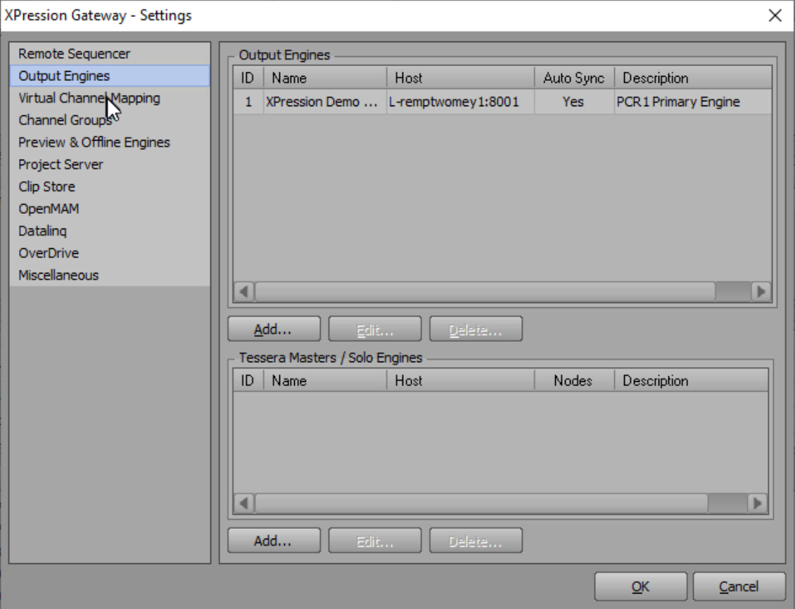

XPression Sequencer Gateway
Special Non-MOS Edition of XPression Gateway
Special edition of the XPression Gateway for Non-MOS users
Removed MOS NRCS connectivity
Removed MOS and NLE Client Connectivity
Build rundowns and stories right in the Remote Sequencer
Playout connecting to multiple XPression engines, including Tessera
Connect to OpenMAM sources like Streamline or XPression Maps
Uses Project Server to keep all engines in-sync
Notes:
However, Ross Video is introducing the XPression Sequencer Gateway license for Version 10
This is the same hardware and software used by MOS enabled newsrooms, but we have removed
MOS NRCS connectivity
MOS Client access
NLE Client access
Users can still create new Take Items
Users still can access OpenMAM services
Users can control multiple XPression engines, including Tessera or Tessera SE workflows
XPression Project Server is needed, and can be installed as Software only on the same hardware as the XPression Sequencer Gateway
[CHANGE]

Slide 13
XPression Remote Sequencer
Manual Workflow Only
Create rundowns in Remote Sequencer
Save money on NRCS costs
Provide control of more than one XPression device at a time
Notes:
The Sequencer Gateway allows Manual Workflow Only
Create rundowns in Remote Sequencer
Save money on NRCS costs
Provide control of more than one XPression device at a time

Slide 14
XPression Sequencer Gateway
Special Non-MOS Edition of XPression Gateway
Special Edition of the XPression Gateway which enables you to, without requiring a MOS newsroom environment:
Use the XPression Remote Sequencer to:
Add and edit Take Items
Schedule Take Items for playout
Save, edit and recall rundowns
No MOS or NLE server or client functionality (but could be upgraded in the future)
Requires Project Server functionality to allow users to browse for Projects and select templates
Available as HW+SW bundle or as an à la carte software purchase
Notes:
The Sequencer Gateway allows one operation to control multiple XPression engines from one UI
Create New Rundowns
Remove the overhead of a Newsroom System to create rundowns
Control more than one engine from the same UI
[CHANGE]

Slide 15
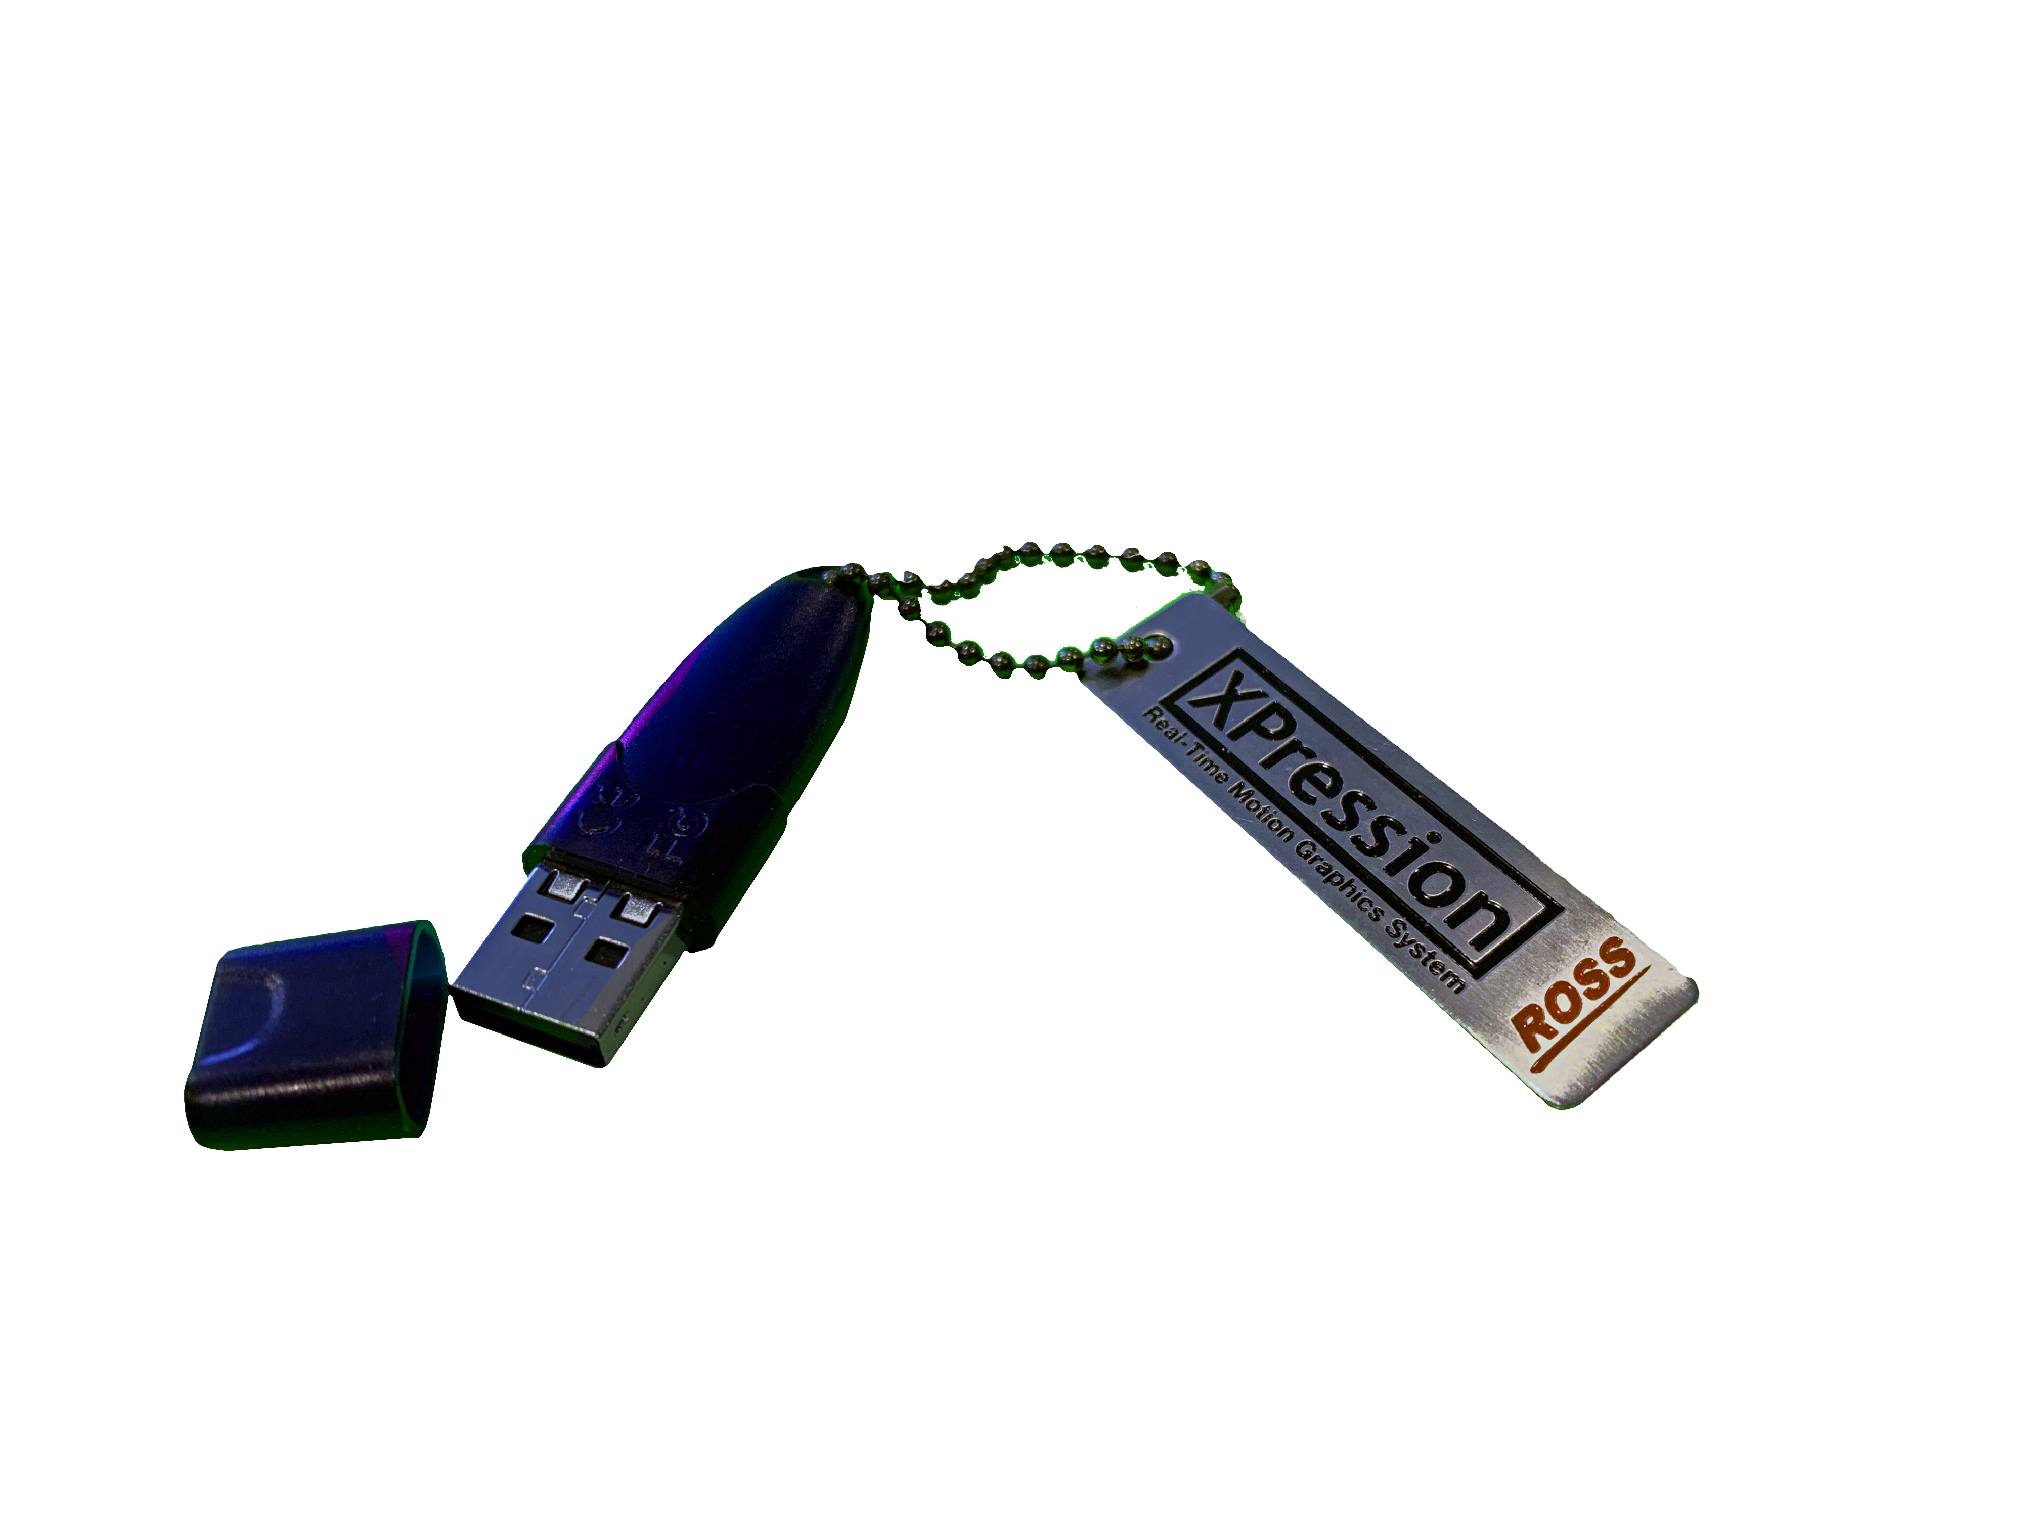
XPression Sequencer Gateway
Hardware and Software Bundle
XPN-SGW-HW-SW-M8
Bundled configuration includes:
XPression Sequencer Gateway Software
XPression Offline Render Engine Software
XPression Gateway Hardware
Limited Time Offer – 1x XPression Remote Sequencer Software only - included
XPression Project Server Required, not included
Customers with existing XPression Project Server can repurpose
Customers purchasing XPression Project Server can install it on the same hardware as the XPression Sequencer Gateway
Notes:
A bundled configuration Includes
XPression Sequencer Gateway Software and license
XPression Offline Render Engine software and license
XPression Gateway hardware
For a limited time, it will also include the XPression Remote Sequencer Software and license
For a cost of $14,350 (USD)
This configuration requires an XPression Project Server, which can be an existing installation, or a new installation of
XPression Project Server Software only for $10,250 (USD)

Slide 16
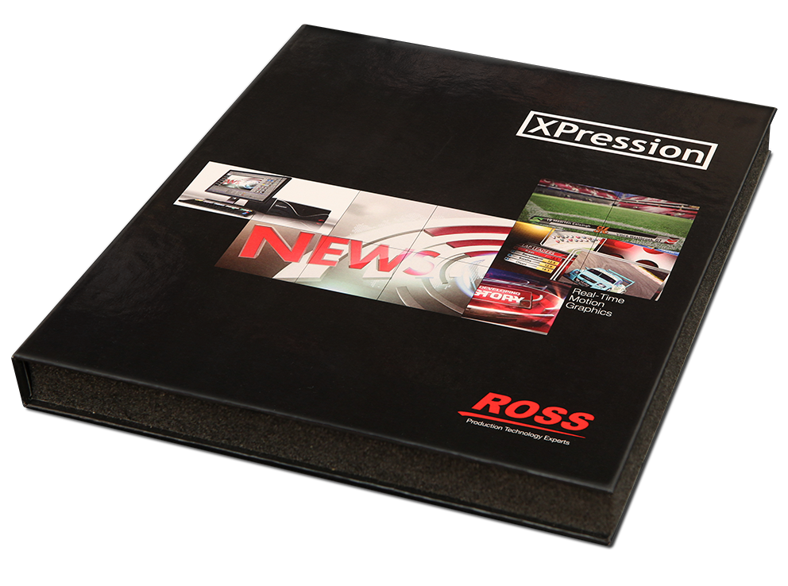
XPression Sequencer Gateway
Software Only Configuration
XPN-SGW-SW
configuration includes:
XPression Sequencer Gateway Software
Not Included:
XPression Offline Render Engine Software
XPression Project Server Required, not included
Customers with existing XPression Project Server can repurpose
Customers purchasing XPression Project Server can install it on the same hardware as the XPression Sequencer Gateway
Remote Sequencer License is not included
Notes:
Customers wishing to build their own hardware can purchase the XPression Sequencer Gateway software for $5,125 (USD)
To add the offline render engine will be $5,125 (USD)
To add the Remote Sequencer is $5,125 (USD)
To add the XPression Project server is $10,250 (USD)

Slide 17

What if I want to upgrade to a full MOS workflow, later?

Slide 18
XPression Sequencer Gateway
Software Only Configuration
XPN-SGW-UPG
Software upgrade from XPression Sequencer Gateway Software to XPression Gateway
Adds MOS Newsroom connectivity
Adds MOS and NLE Client connectivity
MOS and NLE clients sold separately
Notes:
An Upgrade to add in the MOS newsroom connectivity is only $5,125 (USD)

Slide 19
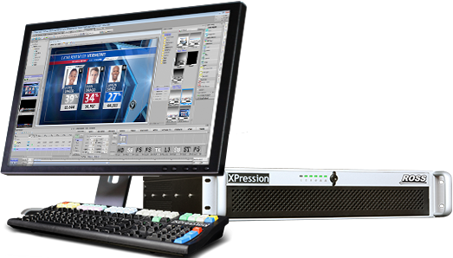
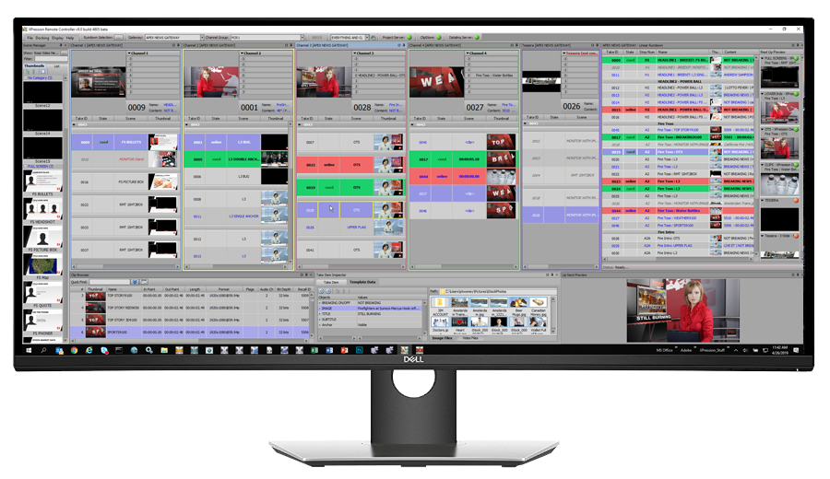







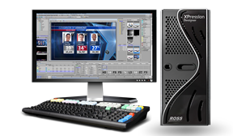



XPression Sequencer GATEWAY
XPression Engine(s)
XPression openMAM Devices
XPression Maps Server
Streamline Server
XPression Sequencer Gateway
With Project Server (SW Only)
XPression
Remote Sequencer
Client
XPression Design Workstation
Notes:
Here is what that topology would look like.

Slide 20

Alston Elliot
Notes:
…next, I want to talk about an exciting new relationship for Ross Video: Alston Elliot, whoi you might know better as A-E GRAPHICS
[CHANGE]

Slide 21

AE Graphics | aegraphics.tv
World-wide leader in sports graphics design, services, and equipment provider
Looking to make a change and address requests from their customers
Needed the right project to get their feet wet on XPression
Notes:
As you can see from their list of customers, AE Graphics is a world-wide force in sports graphic design, services and as an equipment provider.
They are looking to make a change in their business and address growing customers requests for… XPression
They came to Ross at IBC 2019, looking for the perfect project for learning XPression
We all agreed, they needed a very demanding customer to force them to learn XPression
That customer: Ross Video.
[CHANGE]

Slide 22
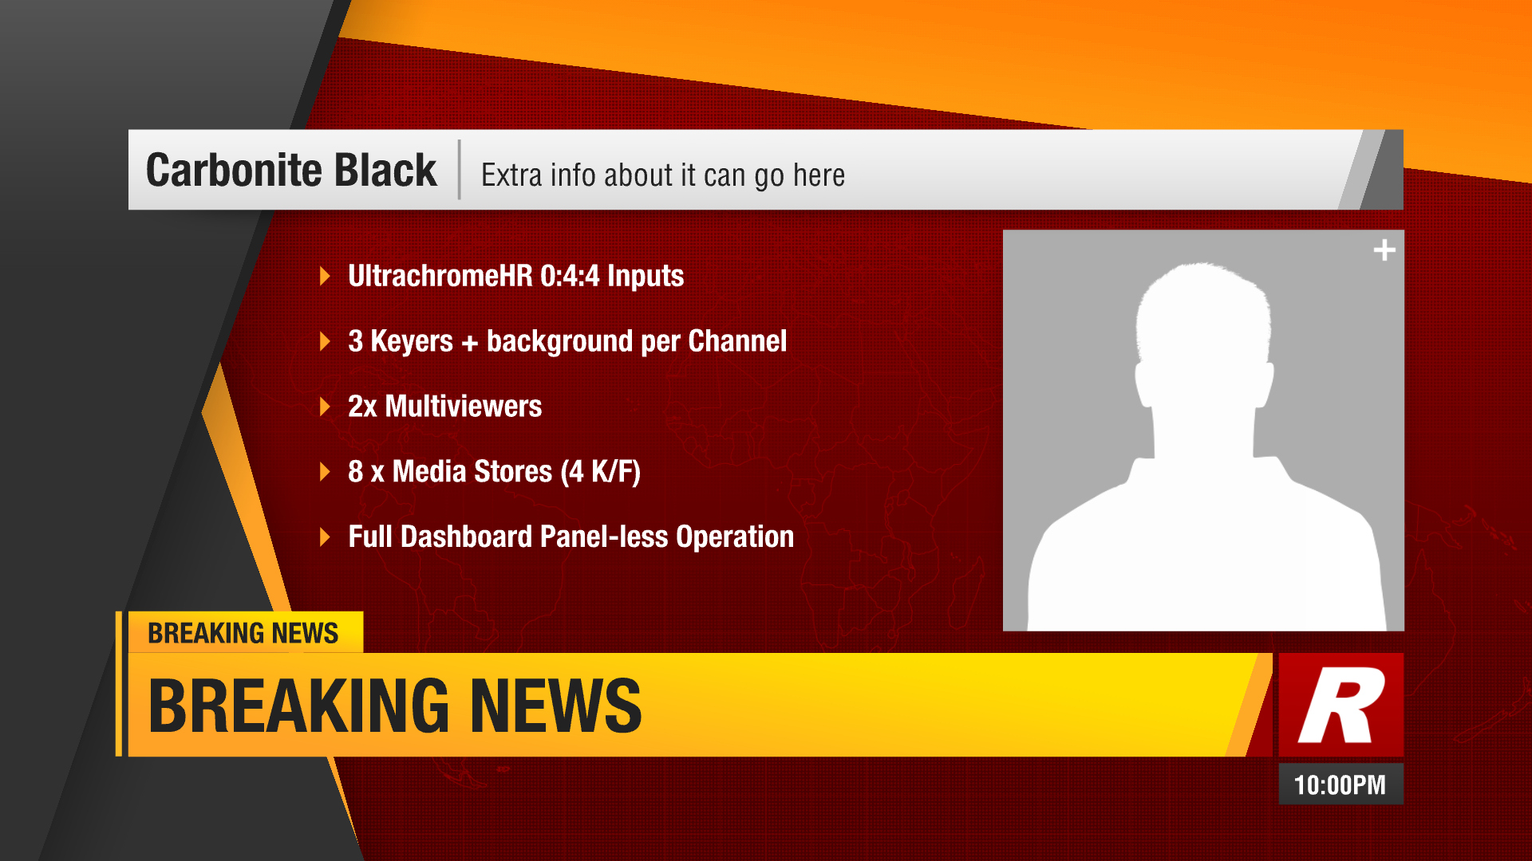
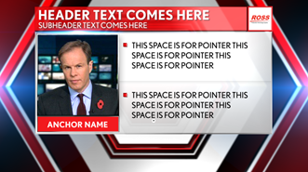
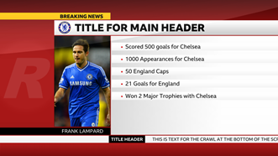
AE Graphics | aegraphics.tv
Design Concepts for Ross Live | 2020
Notes:
We invited AE Graphics to create the NAB 2020 graphics package for XPression, and they prepared several example design looks for us
Their teams from around the world took part in an internal design contest to create a new design for what is now know as
ROSS LIVE |2020
[CHANGE]

Slide 23
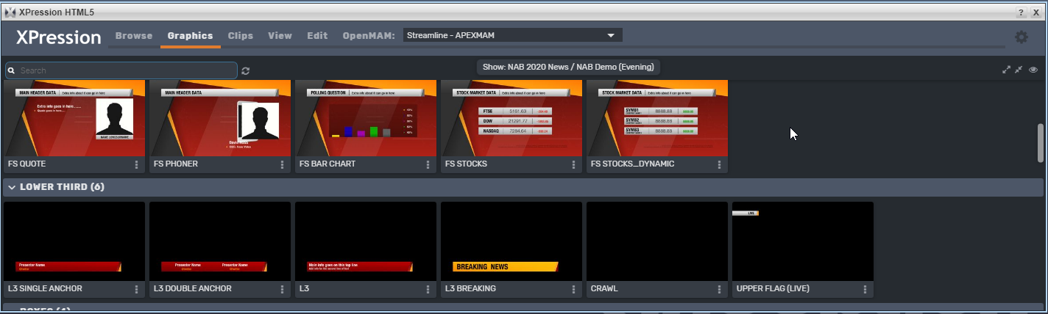
AE Graphics | aegraphics.tv
Design Concepts for Ross Live | 2020
Alston Elliot and Ross Video signed an MOU in December 2019
Trained for 5 days in mid-January 2020 with Simon & Julian
Delivered working XPression scenes in February 2020
Minor touch-ups by Ross Video
Works to re-skin with past two XPression Packages
Notes:
A little bit of detail for you
We finally got a memorandum of understanding signed in late December 2019
We sent in Ross trainers to work with AE Graphics in the UK, for only 5 days
AE Graphics delivered a working package for the DTE build outs, in early February 2020
Simon and Adam Wisniewski provided some touch-ups during the Trade Show pre-build and then shared it out to all the product lines
There is even a way to customize the highlight coloring to work within the Ross Video Global branding of XPression content used for trade shows this year
Keep watching this space, since there will be more

Slide 24
Notes:
Welcome to Elections 2020
[CHANGE]

Slide 25
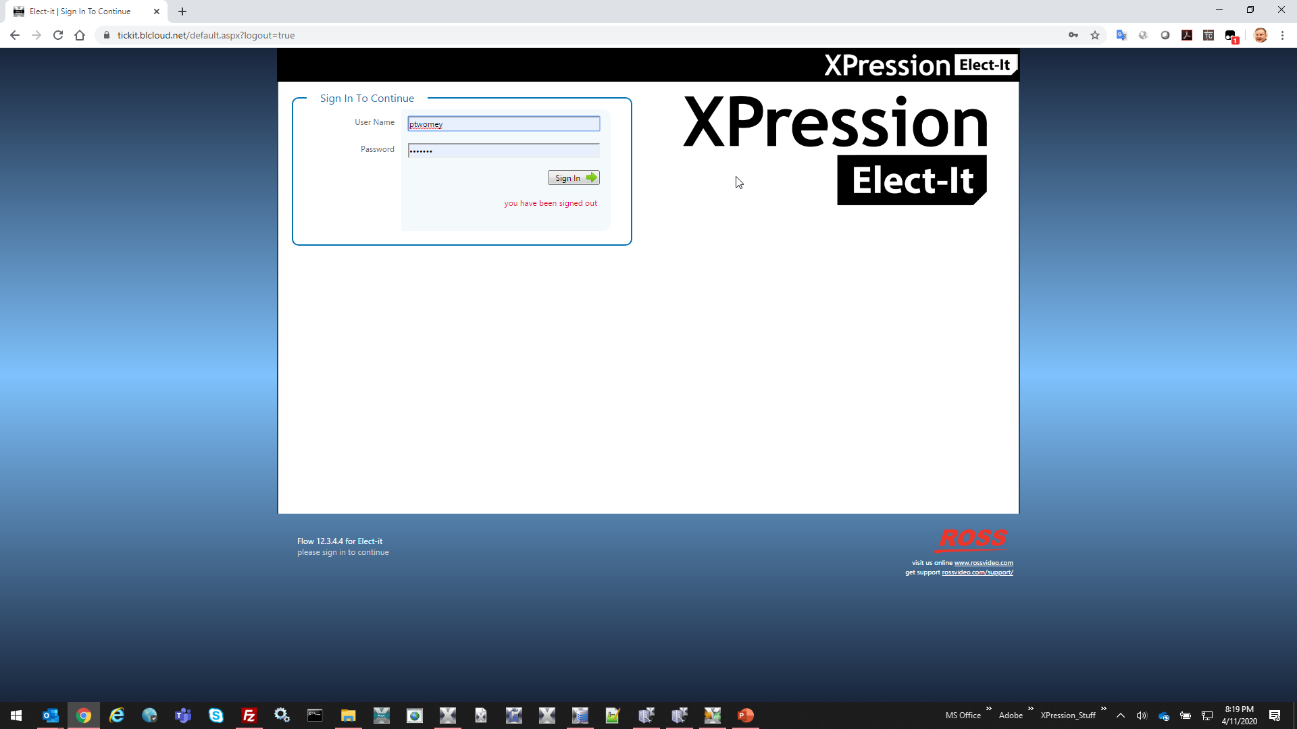
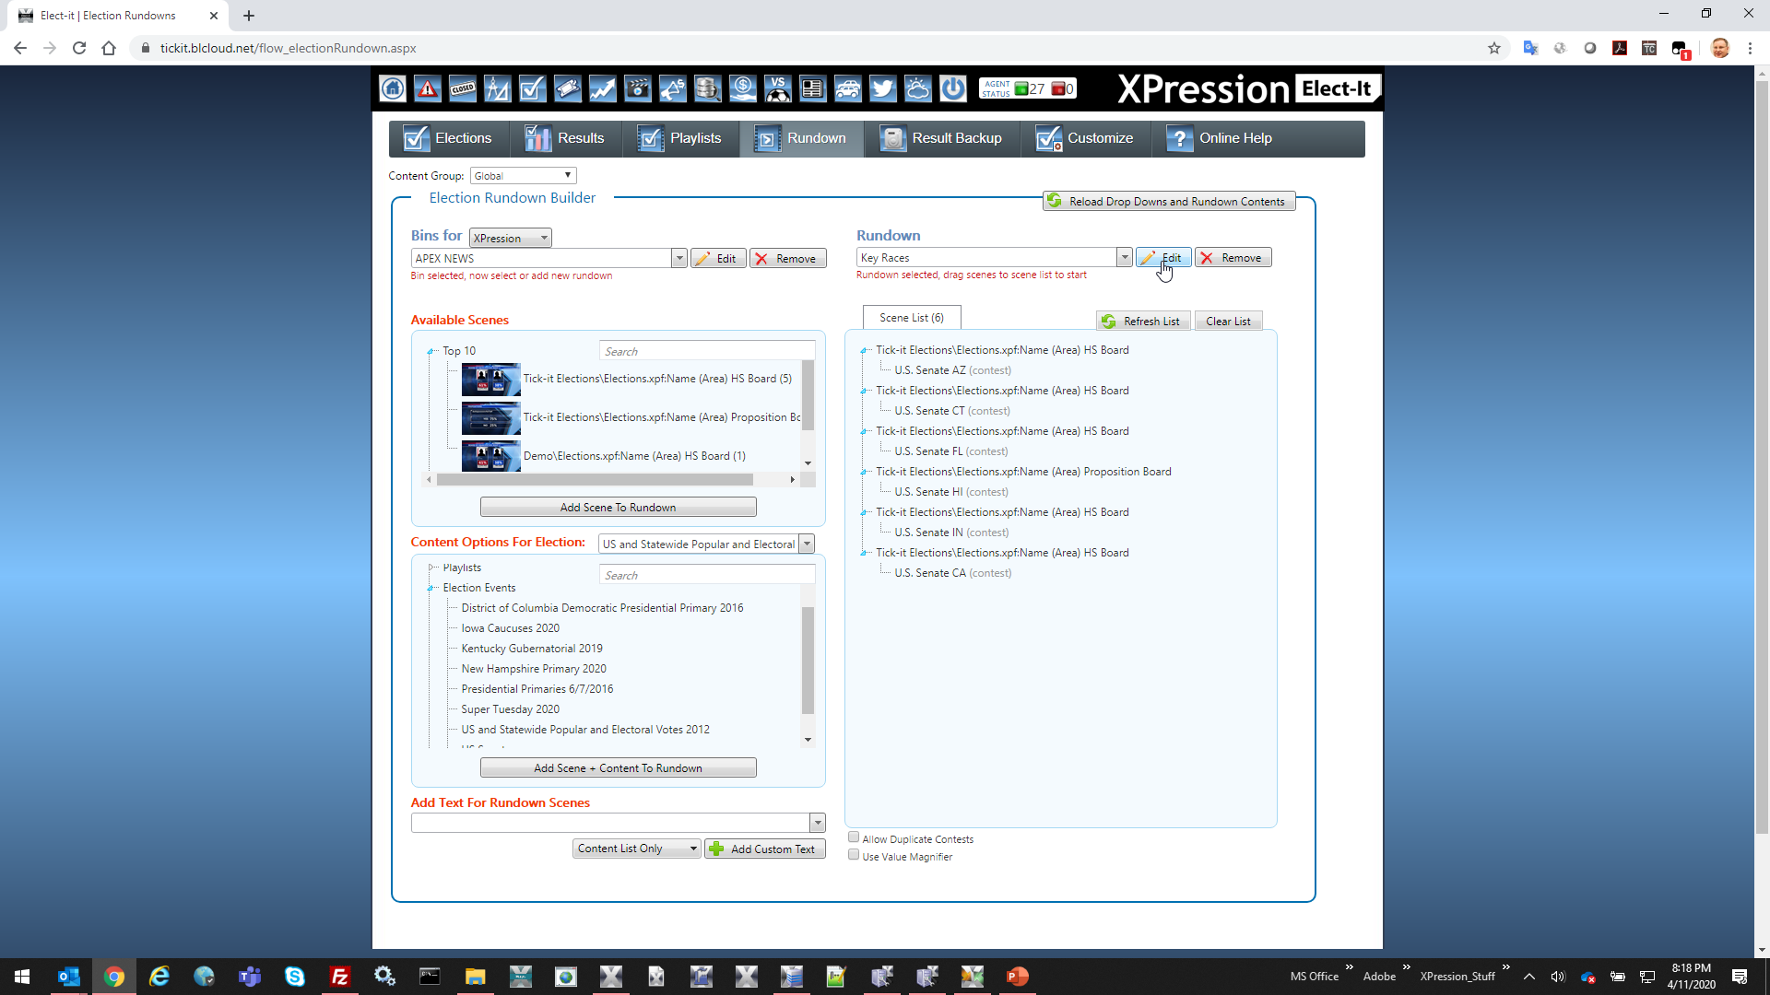
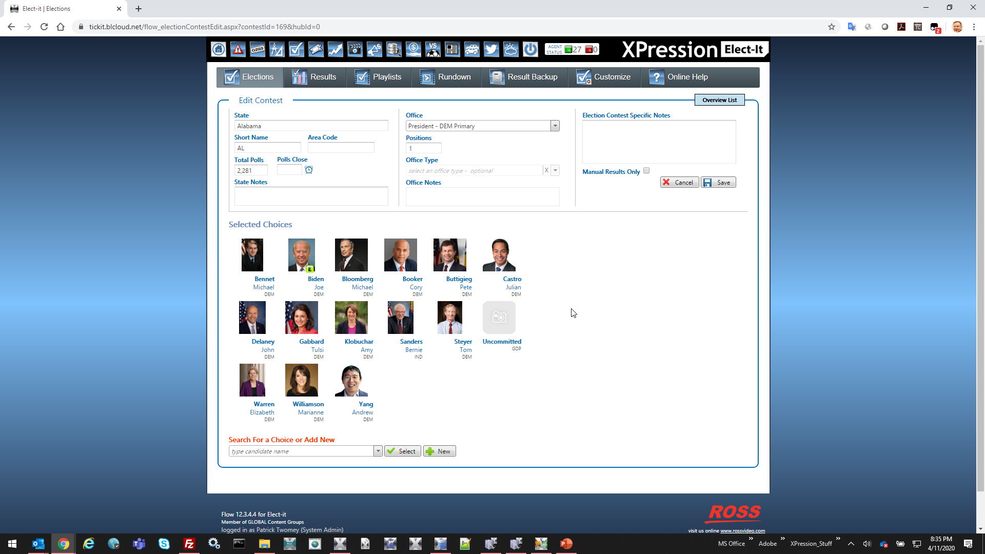
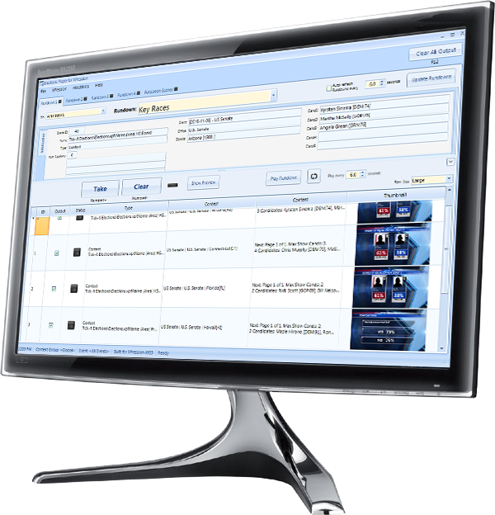
XPression Elect-It!
Pre-built and Configured Elections Graphics Packages Available
Completely integrated elections system for your entire station
Share formatted election data on XPression, Voyager, web, and mobile
Drives tickers, full-screens and lower-third results
Web-based interface for creation, monitoring and analysis of Election contests
Journalists create playlists from contest data populated from trusted election data sources
XPression Elect-It! Player for playout operator in the control room
Notes:
Ross Video XPression Elect-it! is your completely integrated elections solution.
Formatted data that can be shared across all the platforms for your station. On-Air, On-Line and mobile outlets that you are licensed for your with your data providers.
Integrate with Ross Video DataLinq™ to get real-time data feeds into XPression, Voyager, and other platforms
Uses XPression’s robust API to feed and control XPression graphics for full screen, ticker, lower-thirds and more
Use the web-based interface to review data, set up race results displays for ticker and in-studio production
The XPression Tick-it! Player is used to control playout from the control room, leaving the hands-on decisions for real-time results into your program
[CHANGE]

Slide 26


XPression Elect-It!
Your total Election Night coverage solution
Let your staff collaborate on elections no matter their role or location
Web-based user interface
Build rundowns in Elect-it! and share across the network for review and approval
Accessible anywhere on your network
Parsers for your election data providers
Notes:
Integration with trusted data providers like AP Elections Wires and Decision Desk HQ
Allow your staff to view and analyze data in real-time, using a web browser
They can build rundowns at their desk, or anywhere they can get a web browser to review races
[CHANGE]

Slide 27


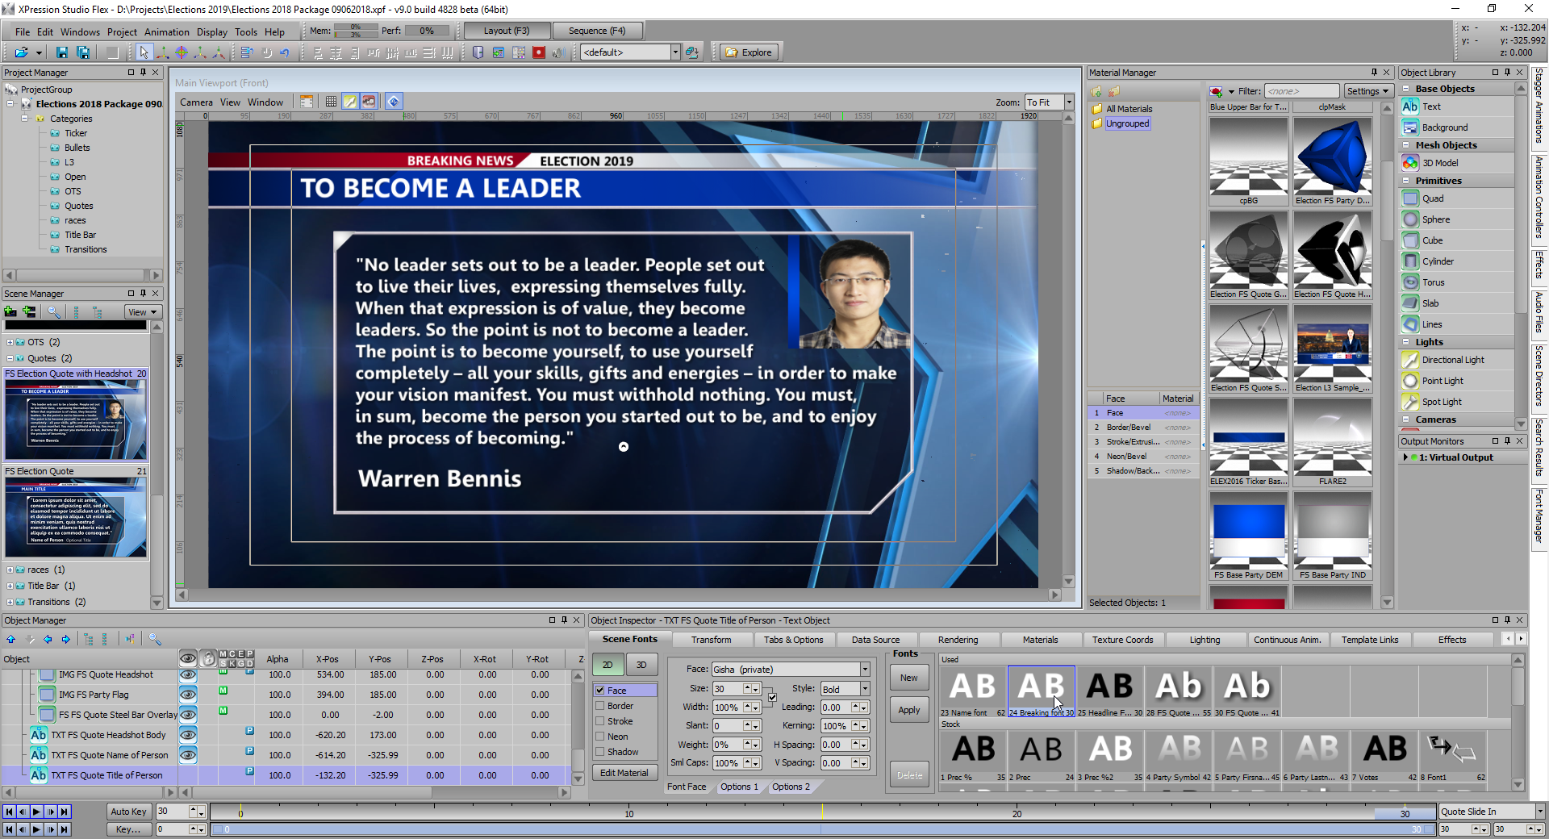
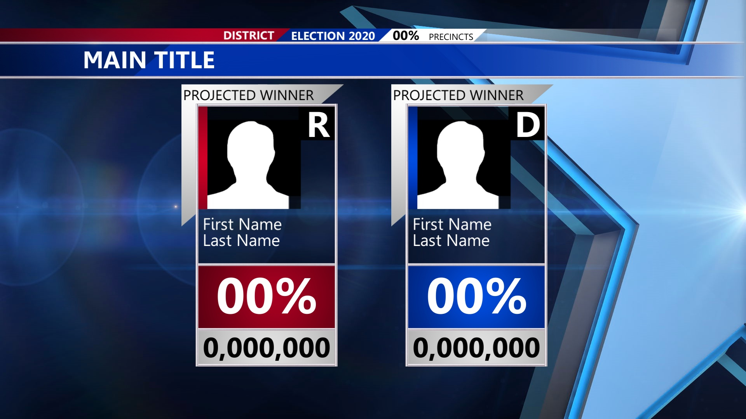
XPression Elect-It!
Pre-built and Configured Elections Graphics Packages Available
Can be purchased with a fully integrated election graphics package from Rocket Surgery
Bundled with Elect-it! Core Server and Rocket Surgery FLARE for a complete election night solution
Additional Election Projects available
Notes:
There is even a package to get an entire elections graphics package along with XPression Elect-it! for a turnkey election night solution
Choose the bundled package to include the FLARE graphics package from Ross Video’s Rocket Surgery team
[CHANGE]

Slide 28
XPression Elect-It!
Pre-built and Configured Elections Graphics Packages Available
XPN-ELECTIT-CORE-SW-HW-BDL
An XPression Elect-it Core Server and Rocket Surgery FLARE election graphics package for XPression
XPN-ELECTIT-CORE-SW-HW
The XPression Elect-it Core Server
Notes:
Here are the two options
The XPression Elect-it Core SW-HW-with Rocket Surgery graphics $22,250 (USD)
Or if you want to build your own graphics, and not use Rocket Surgery the cost is $19,750 (USD)
That is a $2500 add on to get a turnkey elections solution from Ross Video, that you know works with XPression Elect-it!
[CHANGE]

Slide 29
What if I want to upgrade to a full Tick-it! solution, later?

Slide 30
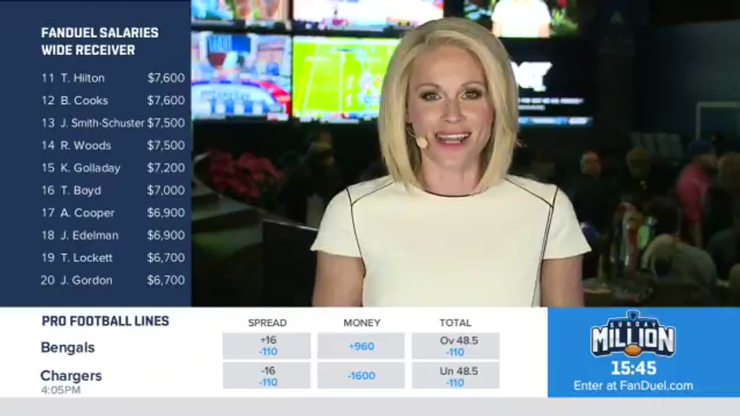


XPression Elect-It! to XPression Tick-it! Upgrade
A solution which can grow with your station’s needs
XPN-ELECTIT-TICKIT-CORE-SW-UPG
Upgrade to an XPression Tick-it! Server from Elect-it! to gain even more functionality
Software only license upgrade to server
Additional CHANNEL licenses not included

Slide 31
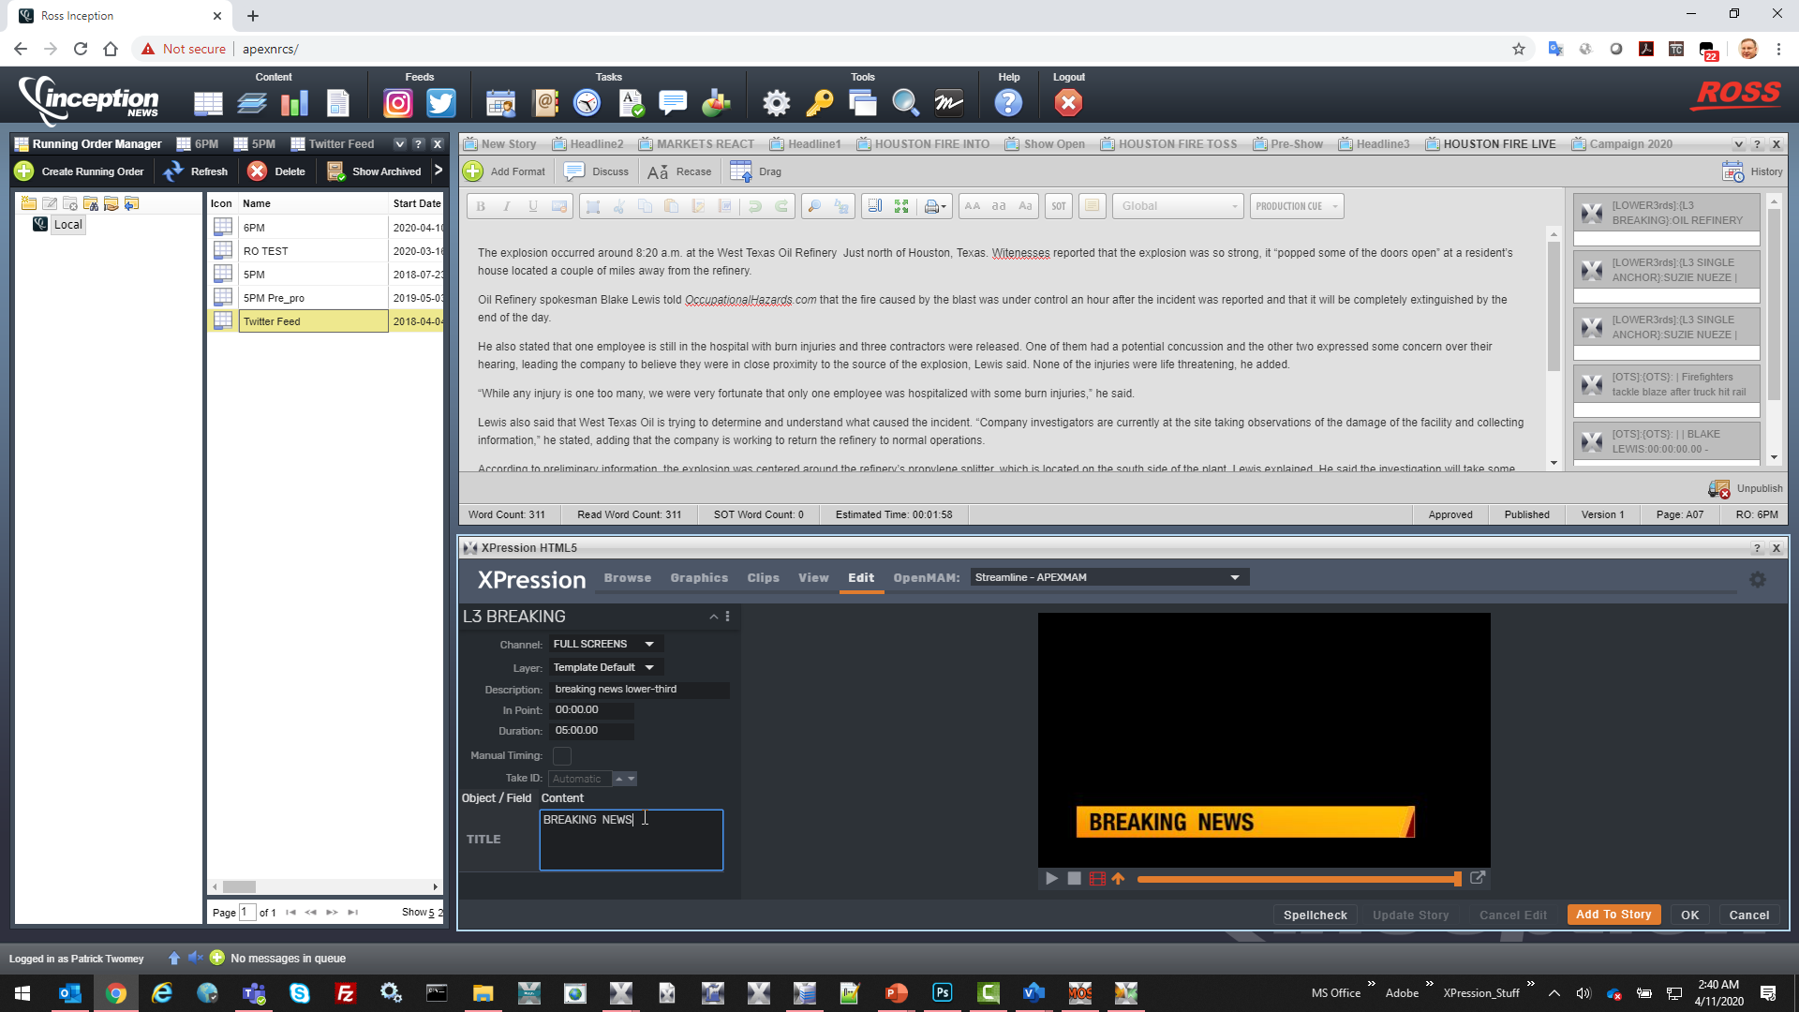
XPression MOS HTML5 Update
Notes:
Next, let’s talk about the Ross Video XPression HTML5 MOS workflow.
We have been busy adding in functionality to the XPression HTML5 plugin to help manage the switch in newsroom systems that support HTML5 workflows, like Ross Video’s own Inception Newsroom system.
[CHANGE]

Slide 32
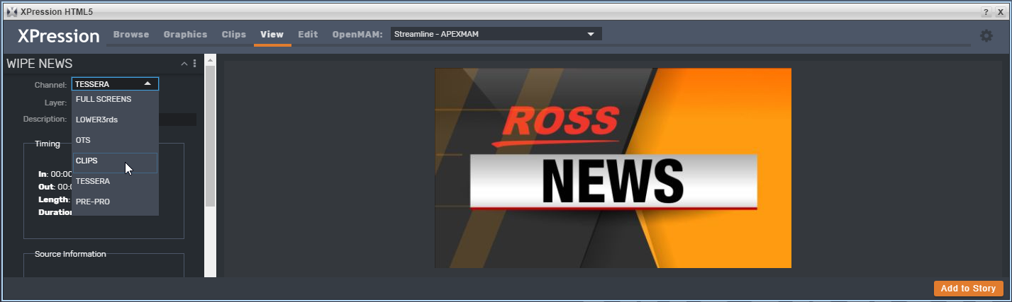

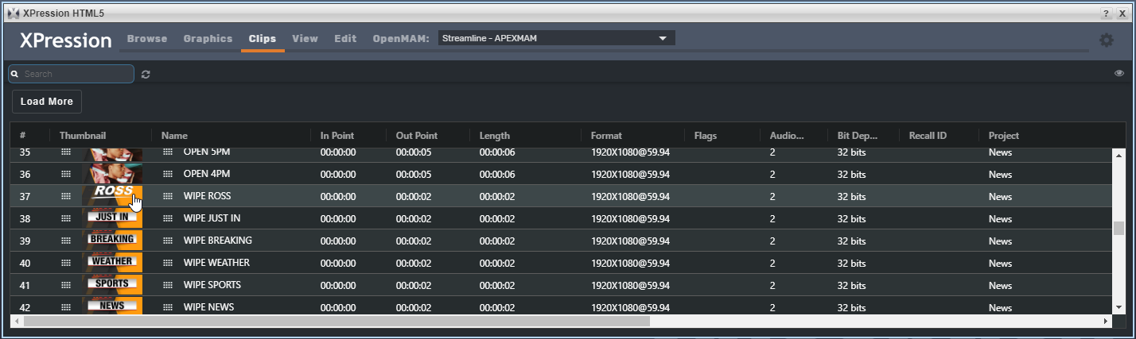
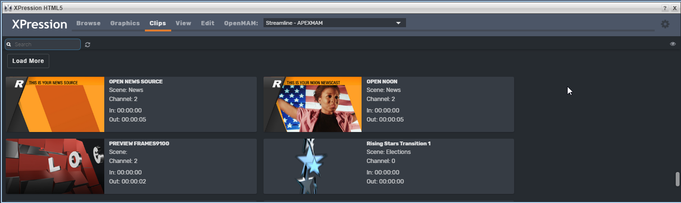
XPression MOS HTML5 Update
Preview
Table View
Grid View
Notes:
Most recently, XPression Clips has been added into XPression Version 10’s HTML5 MOS plugin.
See your clips in a thumbnail view or list view. Preview them before adding them into your scripts
[CHANGE]

Slide 33
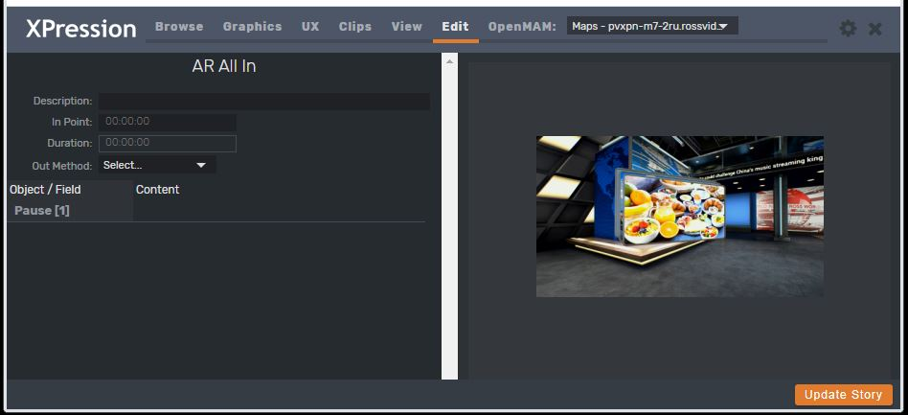


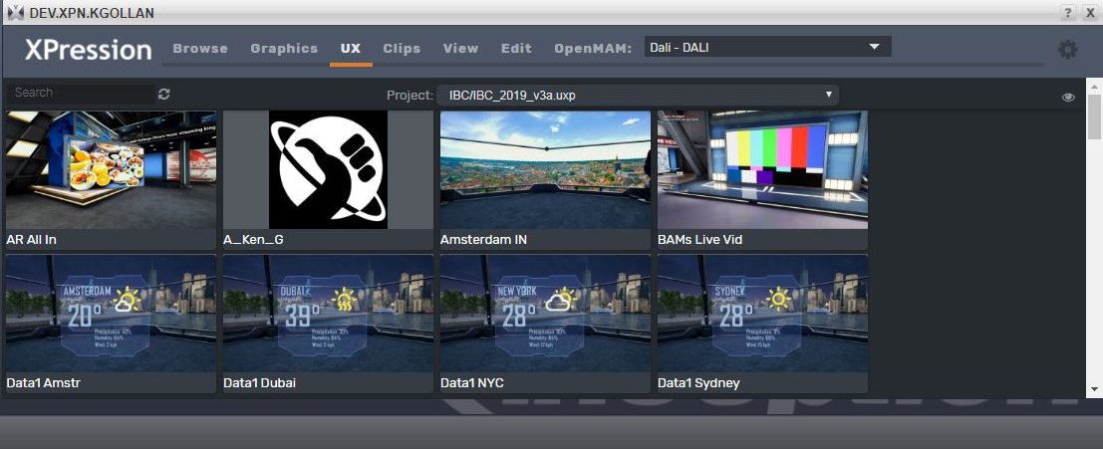

XPression MOS HTML5 Update
Notes:
The Ross Virtual Solutions UX tools also have been moved into the XPression HTML5 plugin, to allow your team to drag-and-drop virtual sets and Augmented Graphics into the rundown.
[CHANGE]

Slide 34
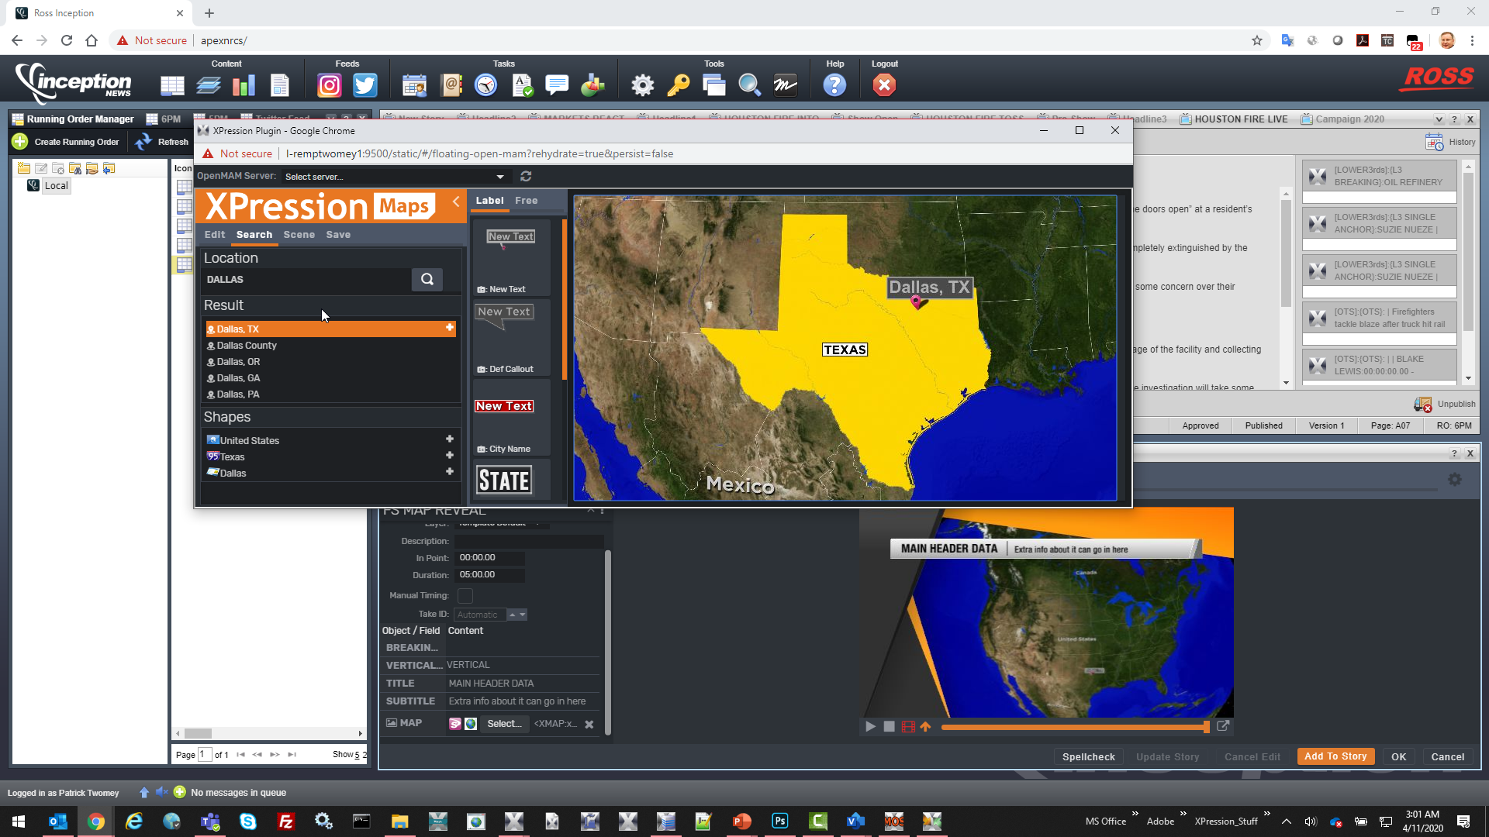
XPression MAPS PLUG-IN as HTML5
Notes:
XPression Maps also has been working on an HTML5 version of the MOS plugin. This now brings the entire XPression MOS workflow into the hands of the journalist. Regardless of platform.
[CHANGE]

Slide 35


XPression MOS HTML5 workflow
XPression Clips, Maps and UX parts of the HTML5 plug-in extends XPression MOS workflow as fully cross-platform
Important for educational customers and bring-your-own-device newsrooms
Perfect for “Stay-in-place” workers
Allows for a complete MOS workflow with only a URL and maybe a VPN connection
Notes:
Finally one vendor has created a completely cross-platform self-service graphics platform. In the last month, our customers have found that remote users with the highest level of access and the lowest level of software installations were most functional and caused the least amount of disruption.
Having a full MOS workflow as an HTML5 solution keeps them on-line and working uninterrupted. A high efficiency model if there ever was one.
[CHANGE]

Slide 36
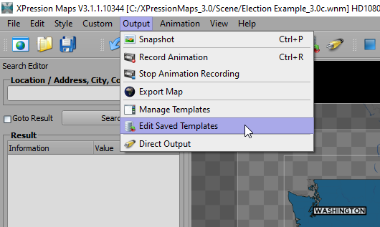
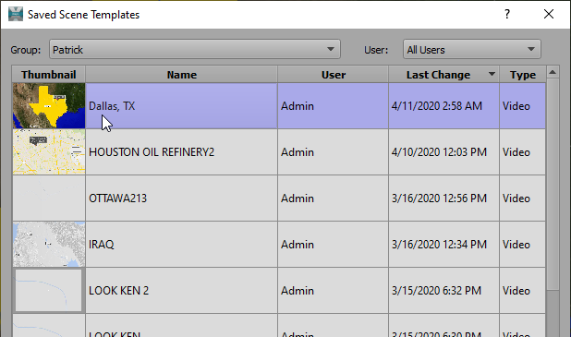
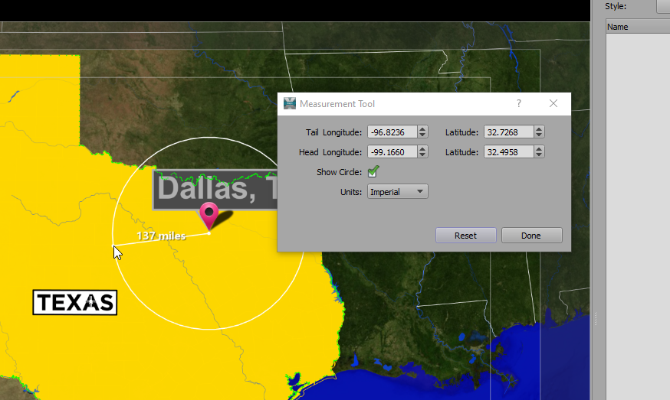
XPression Maps 3.1
Edit Saved Templates
Allows an Artist to access “saved” MOS created Maps on Maps Server
Lets an Artist collaborate with newsroom users to add content/complexity
Manage Saved Templates
Artists can review and delete unused or outdated map scenes on the Maps Server
Measurement Tool
Set a radius point and drag-and-drop to find out distance from one location to another
Notes:
Let’s go back to XPression Maps for a minute
While there is a desire to get journalists to create very extensive animated maps, we have a different way to look at it. Imagine of the journalist could pick a map template, plot the final destination , and ask an artist for help? Well, there is a way to do that, now.
Edit Saved Templates allows an artist to see the saved work on the XPression Maps Server and then moake modifications to it and save it back. This allows the journalist to review and approve the Maps animation before adding it to the rundown.
Managed Saved Templates allows the artist to review all the saved maps in the server and weed out the unrequired ones.
Measurement tool allows an artist to select a point on the map and measure from the central point to the outside edge. This allows the artist to accurately determine the distance between two points or set a radius of an affected area.
[CHANGE]

Slide 37
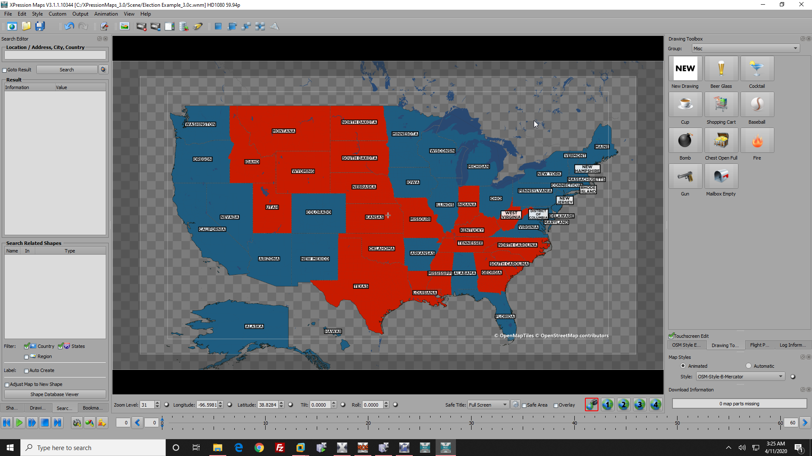
XPression Maps 3.1
Moving Shapes
Allows Designers to “move” Hawaii and Alaska for USA Maps
Required for Election or data visualization maps
Transparency
Several customers asking for transparent background to key over video
Notes:
For the US customers, it is now possible to MOVE shapes, to get HAWAII and ALASKA onto Maps for representation of all of the states on one screen
This also coincides with the ability to create transparent backgrounds for times when you want to take the outputs of XPression Maps and superimpose it onto another background
This has become a common request, worldwide, for making highly focused Maps, that are displayed on topical backgrounds, rather than part of as maps display.
[CHANGE]

Slide 38
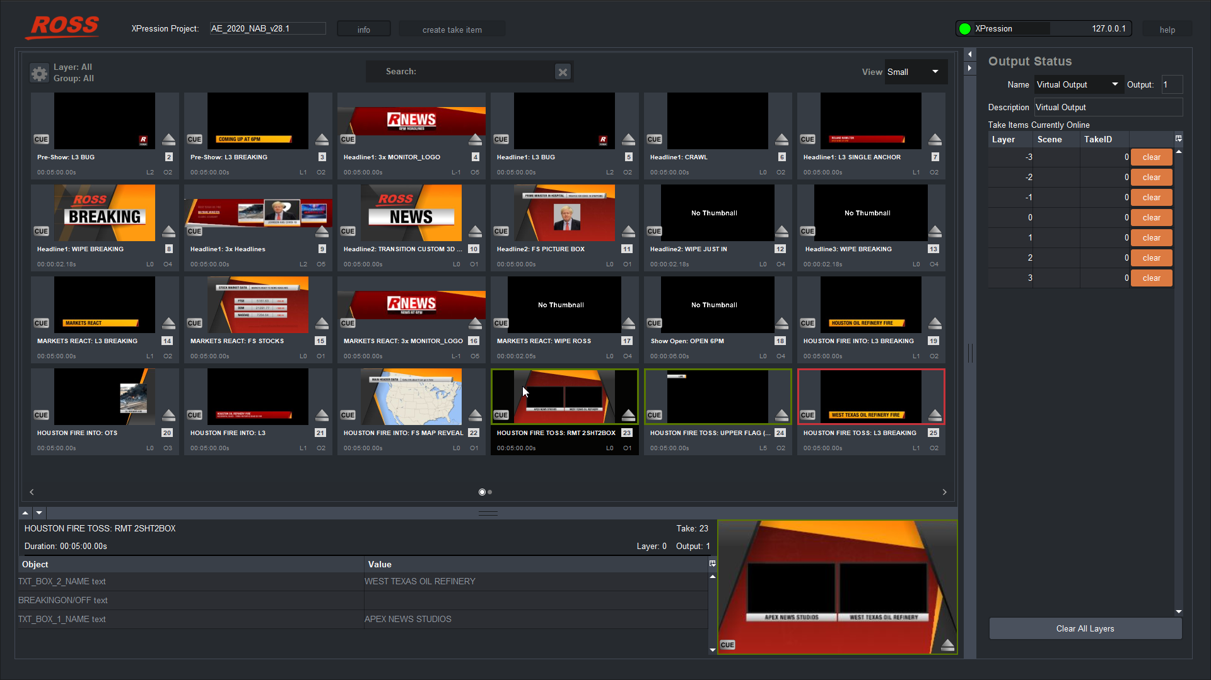
XPression Dashboard API
DASHBOARD API
Simplified playout UI for Sequencer in XPression Studio and Graphite
Allows non-technical staff to operate XPression visually
Extends remote operation over internet (with VPN), without a dongle, using Dashboard
Offers ability to modify or add Take IDs to rundown
Notes:
As we talk about simplification in the XPression workflows, we need to talk about the XPression Dashboard API.
This simplified version of the XPression Playout UI shows the contents of the sequencer of one XPression Studio or Graphite engine.
Designed to be unintimidating to a casual no-operator, The XPression Dash API has appeal in that market. As a Dashboard tool, it doesn’t require n XPression license on the computer running Dashboard, but it does require the XPression engine that it connects to, to be licensed for it.
This means that customers who need to remotely control an XPression engine can do so, using Dashboard on a Windows or Mac computer, even across the internet. Connection to their remote XPression Studio engines using a VPN means that customers can control playout from anywhere. No extra dongles.
[CHANGE]

Slide 39
XPression Dashboard API
Starting with XPression Version 10, the Dashboard API will be included FREE with XPression Studio
The API does not work with Prime, BlueBox or other editions of XPression
The Dashboard API will allow remote or “Stay at home” staff to control XPression Studio over the internet (with VPN access), when using Dashboard
This is not a retroactive offer and not extended to versions prior to XPression Version 10
Notes:
Starting with XPression Version 10, XPression Studio will include the Dashboard API for free
The Dashboard API shows the content of the XPression sequencer, so unfortunately, the XPression Dashboard will not work with BlueBox. Since Prime does not support API, it will not work with XPression Prime systems, either.
Since the Dashboard API is part of the XPression license, the change will be made in the XPression licensing starting with Version 10. It is not retroactive to prior versions of XPression.
[CHANGE]

Slide 40
Recap of XPression at Ross Live|2020
XPression Video Codec with support for HDR, WCG and UHD
XPression Remote Sequencer Updates
XPression Sequencer Gateway for non-MOS workflows
AE Graphics as a new provider of XPression content
XPression Elect-it! Server and XPression Elect-it! bundled with Rocket Surgery election graphics
XPression HTML5 plugin to include Clips, UX and Maps
Dashboard API will be free in version 10 for XPression Studio owners
Notes:
XPression Video Codec with support for HDR, WCG and UHD
XPression Remote Sequencer Updates
XPression Sequencer Gateway for non-MOS workflows
AE Graphics
XPression Elect-it! and XPression Elect-it! bundled with Rocket Surgery election graphics
XPression HTML5 plugin to include Clips, UX and Maps
Dashboard API will be free in version 10 for XPression Studio owners

Slide 41
XPression Version 10
Notes:
Thank you for your time, as we introduce you to XPression version 10!
- We expect to deliver the final version by July 2020.
[CHANGE]

