Slide 1

Internal Ross Video Sales webinar
Gideon Ferber, Director of Ross Virtual Solutions
14 April 2020

Slide 2

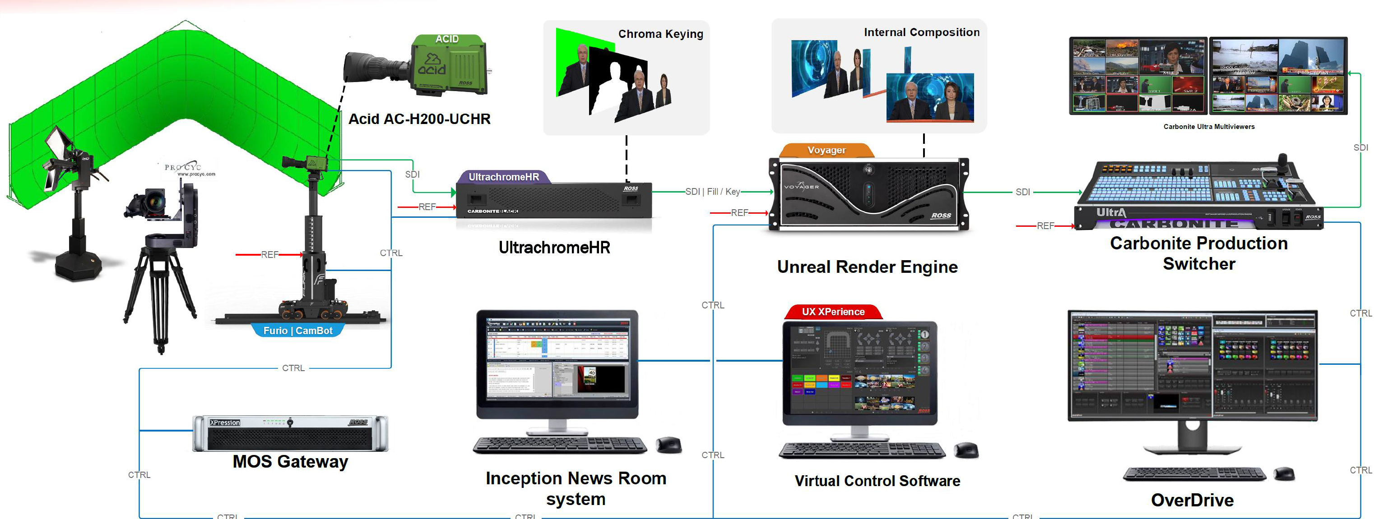
UX 5.1 – Workflow Improvements
The problem our biggest advantage in the VS/AR market is our connectivity and workflow integration. We need to maintain the edge we have.
The solution Improve our workflow offerings!
License dongles
HTML 5.0 MOS Plugin
Improved MOS workflow tools
Unicode Support
New nodes in UX visual logic
Price Zero. All these features are included in UX and the workflow tools at their regular price.
Bonus we have added lens curve for the Panasonic AW-UE150 PTZ camera and can work with it seamlessly. Great solution for customers on a budget. We can use the Web quadrant in UX to open the Panasonic web interface and control their cameras from within the same main UI

Slide 3
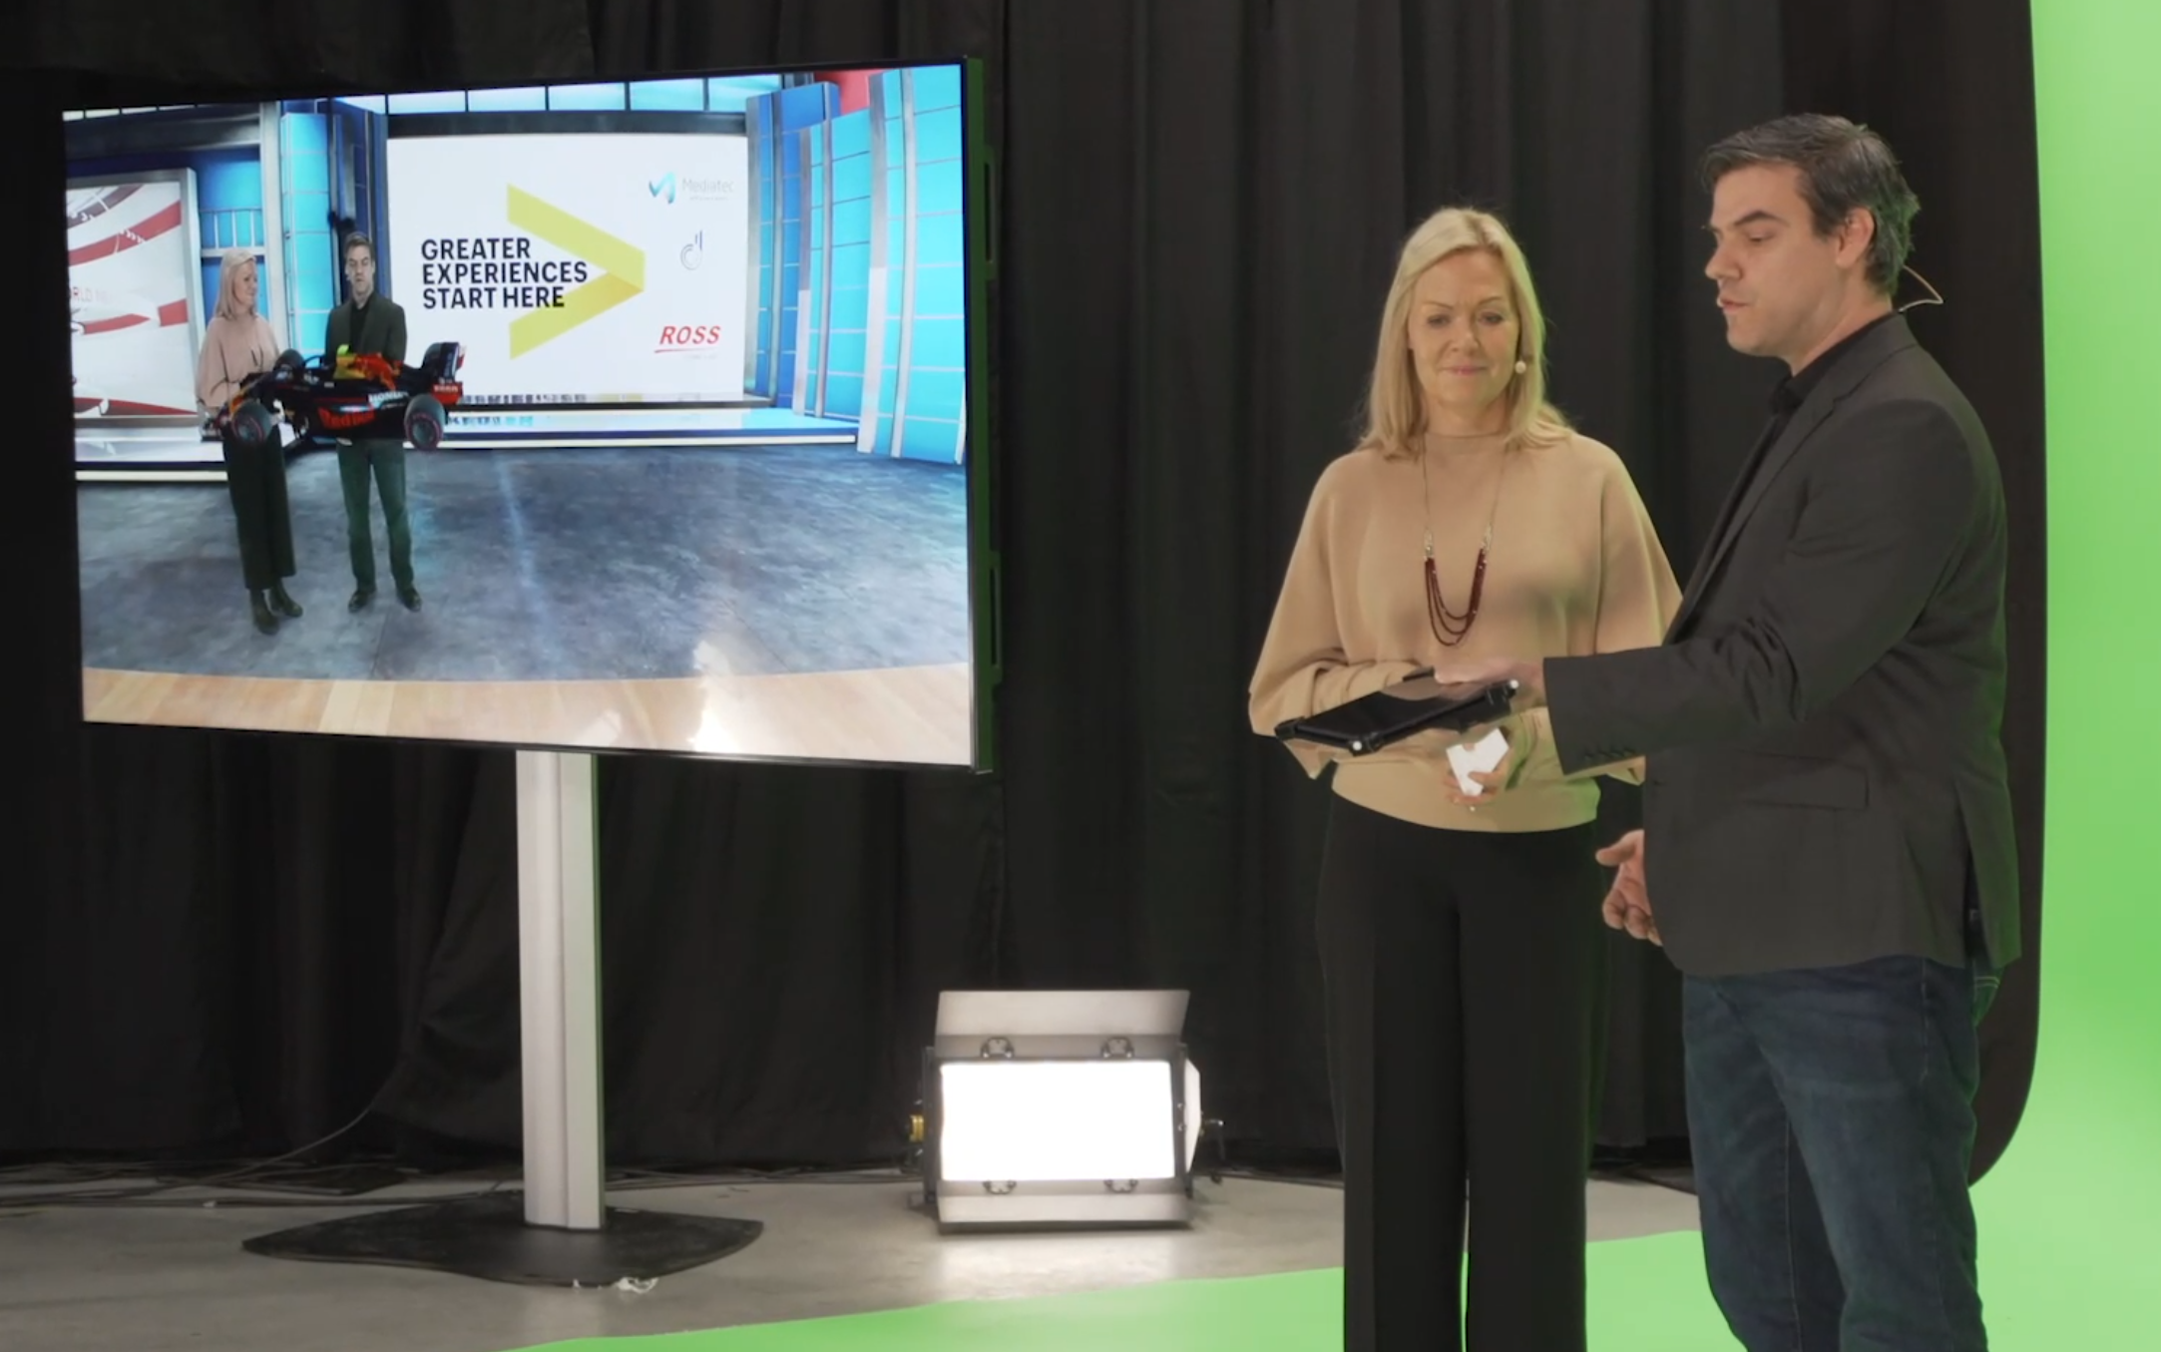
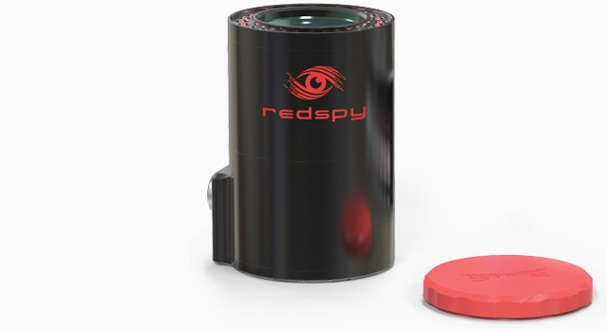

UX 5.1 – Workflow Improvements
The problem we need a way to track talents and objects in the studio, to better adjust the input plane, and to create interactions with the talent.
The solution we added support for Stype’s Follower. Stype Follower uses infrared markers to track either a point or a surface in space.
Talent tracking
Object tracking
Talent interaction
Price Zero. All these features are included in UX and VCC at their regular price.
Bonus The combination of Stype Follower and Voyager is a powerful one, as it allows us to track the talent, and position the input plane of the talent in the Voyager scene. This way, the talent can walk around 3D objects in real-time.

Slide 4

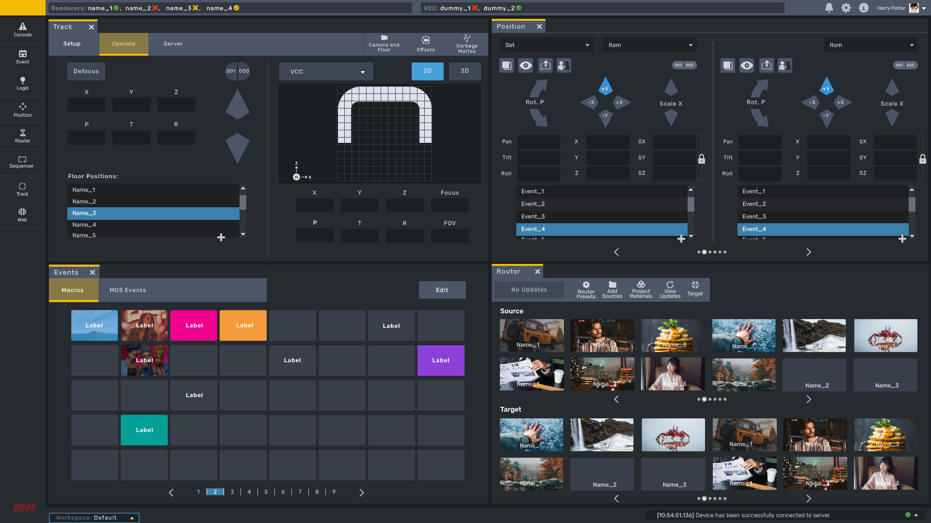
uX 6.0 – EARLY BIRD SNEAK PEEK
The problem Improve UX customizability, and prepare it for future development and integration
The solution Redesign the UI and add a LOT of features!
Price Zero increase. We are just nice people.
Bonus Planned release – July/August 2020

Slide 5
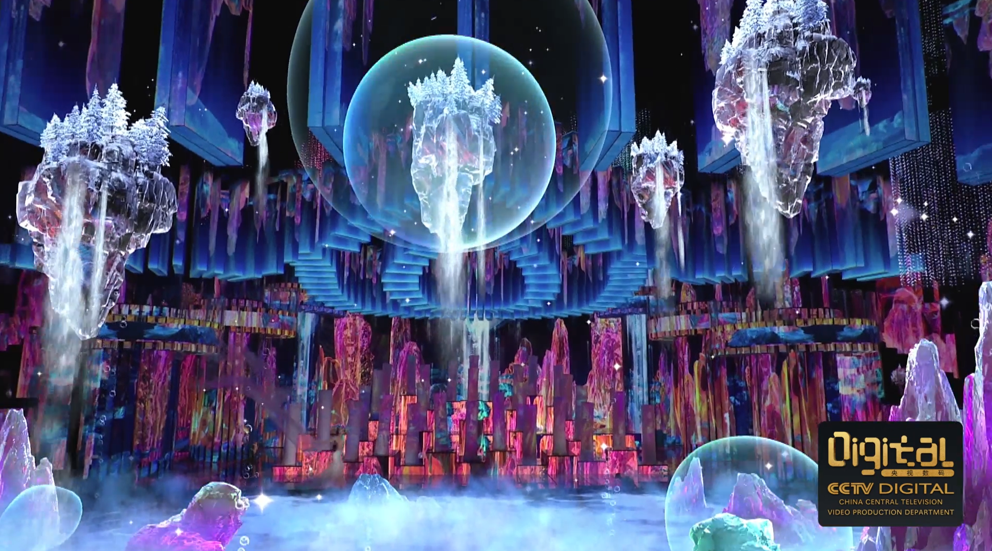
Voyager 3.1– Workflow improvements
The problem Improve UX customizability, and prepare it for future development and integration
The solution
HDR 1000PQ, HLG and BT2020
Voyager Designer license
Price HDR is included by default in the Voyager license.
Voyager Designer – RVS-VOY-DES-0001 5,125 USD List
Bonus CCTV used Voyager for their spring gala. The production used 12G, Single link, HDR signal, and lasted for 6 hours.

Slide 6
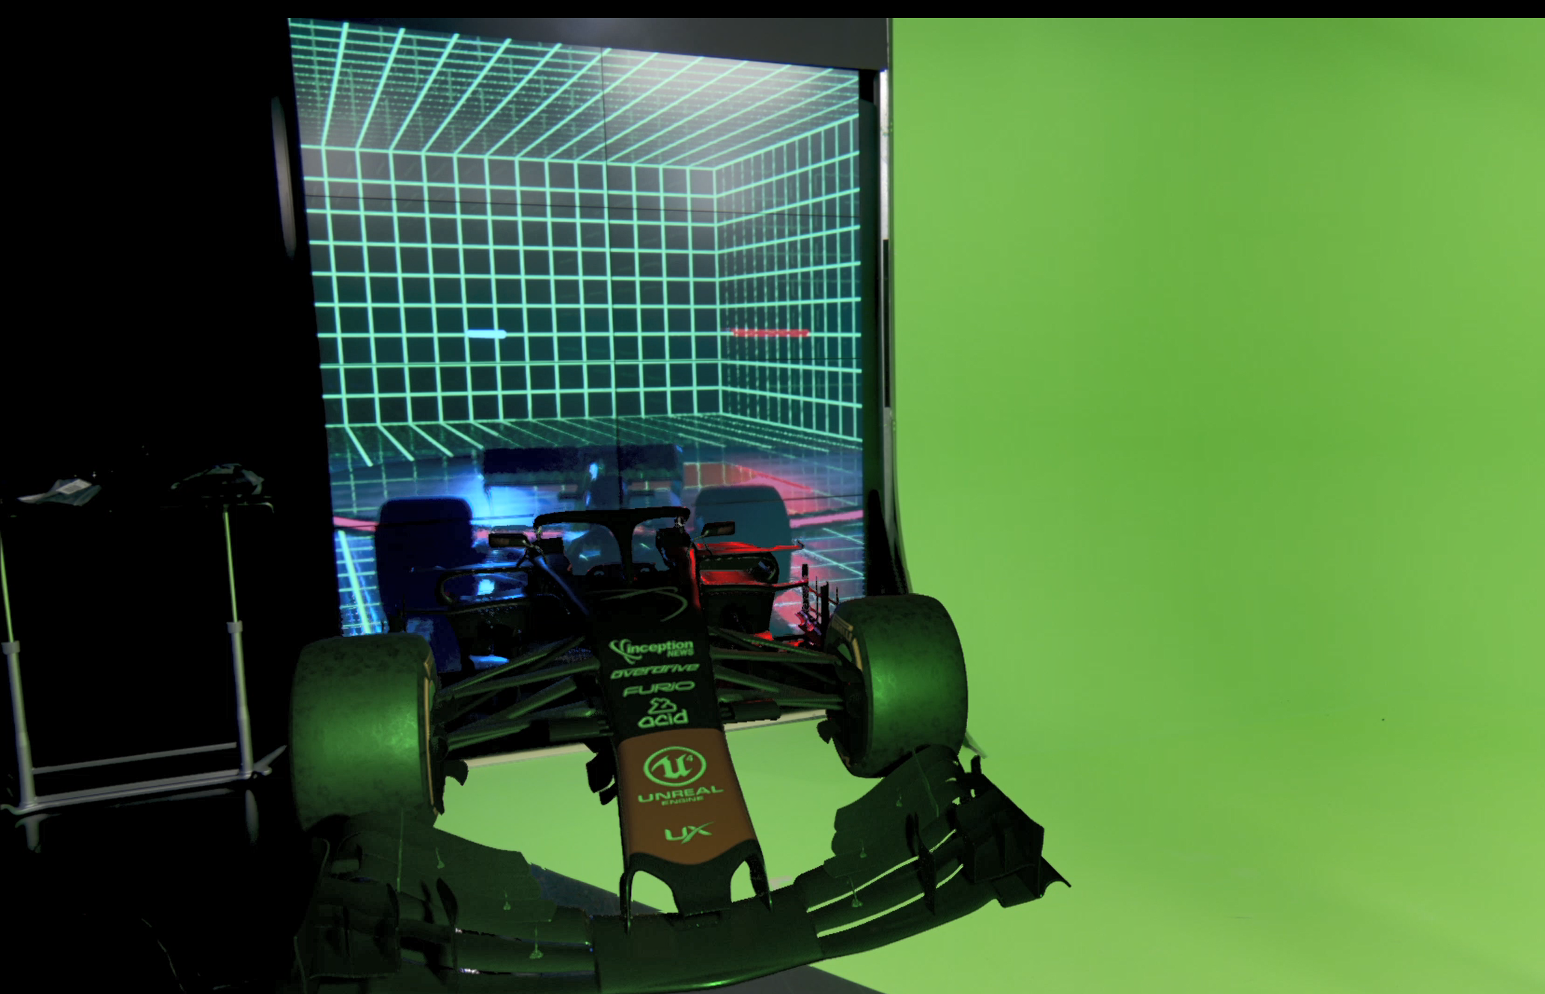
Voyager 3.1– Workflow improvements
The problem Improve UX customizability, and prepare it for future development and integration
The solution
Portal View
Price HDR is included by default in the Voyager license.
Voyager Designer – RVS-VOY-DES-0001 5,125 USD List
Bonus

Slide 7
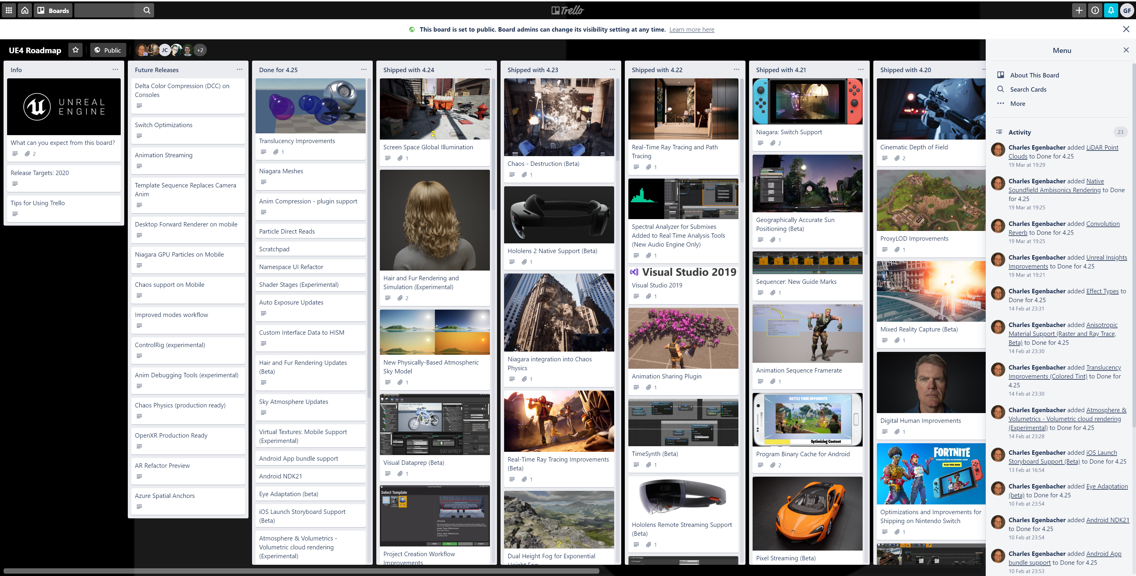
Voyager 4.0 – Workflow improvements
The problem Epic Games keep developing the Unreal engine, adding features and capabilities that our competitors benefit from
The solution adapt to the latest technologies available
Adapt Voyager to Unreal 4.25
Support for multiple composition layers
Support for 3D models (meshes) to represent the green screen (“positive” masking), garbage mattes (“negative” masking), and background garbage mattes (giving “depth” to background feed in AR)
Integrated AR and VS workflows
Price As before – its included in the price!
Bonus Unreal 4.25 includes Epic’s first attempt at an internal chroma keyer. Knowing Epic, it might not be amazing from the get-go, but they will keep throwing resources at it until it will. Then, we’ll integrate with it as well.

Slide 8

Marketing Materials
SharePoint RVS marketing package: https://rossvideoltd.sharepoint.com/:f:/s/proddev/virtualsolutions/Eqy3p2oHlVdFg3-MBXULLuMBQaKE8JmtyaEGn1BEMl_pqQ?e=AoYfCk
RVS 2020 Showreel: https://www.dropbox.com/s/qqzykps7k4kn2og/RVS_Showreel_2020_3.mp4?dl=0
RVS Video repository: https://www.dropbox.com/sh/4f0ml5v42c0mr8m/AACJOHKtrTQbgL4a0sPBCSTZa?dl=0

