Slide 1
PIERO SPORTS GFX
PG-13, Internal Ross Video Sales Force
Vincent Noyer, Director of Sports Analysis
14 April 2020

Slide 2

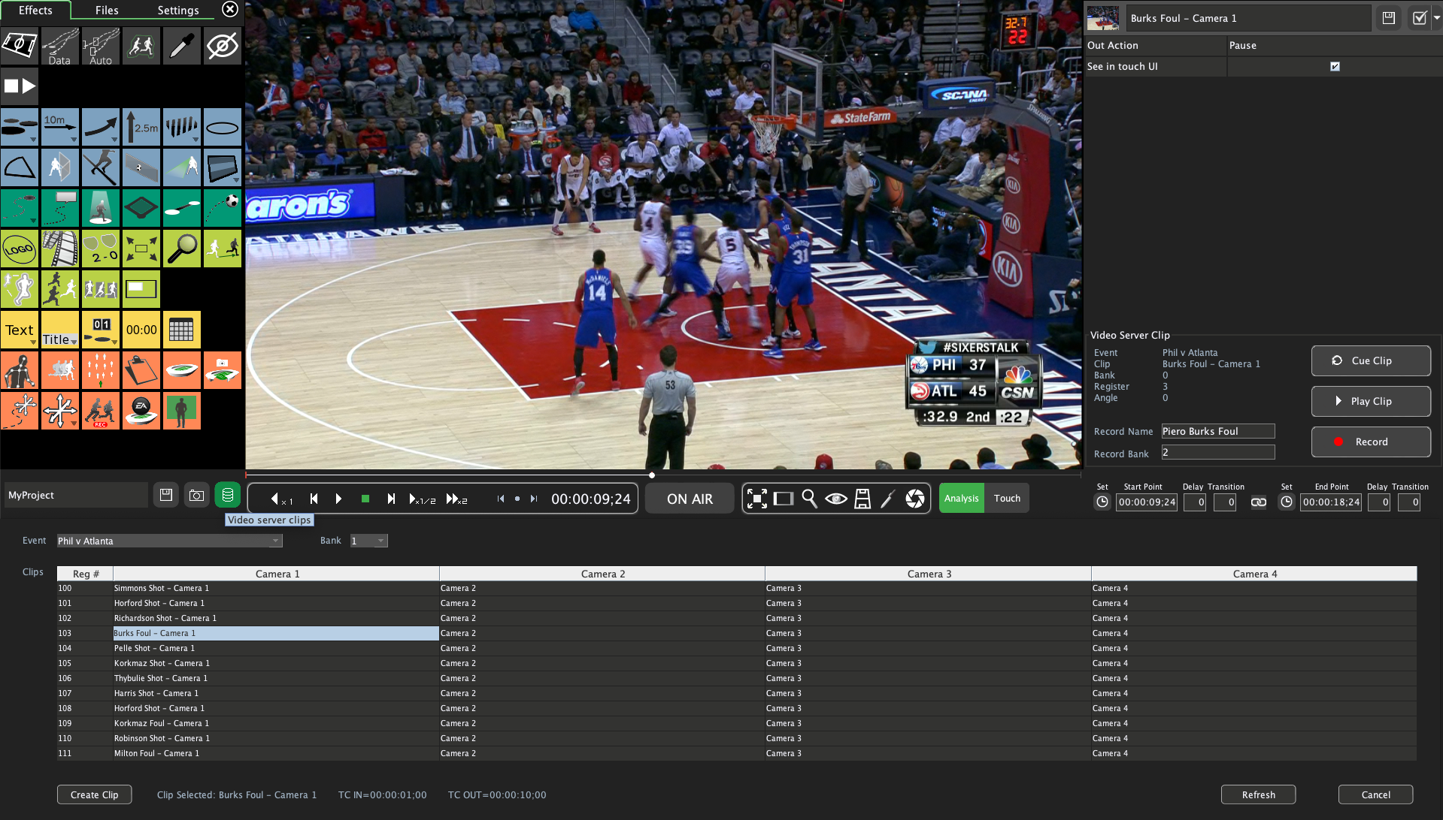
MIRA integration
The problem customers looking for a cost-efficient Replay Server + Telestrator.
Our main competitor Viz Libero can record SDI video and clip within their solution.
The solution tighter integration with the Mira+ to get the best of both worlds.
PIERO can now load, rename and record clips on the MIRA natively.
Saves space in OB truck deployments.
A MIRA Surface controller is required.
Price 2RU M8 AJA $12k, Piero license $39k/year | MIRA+ AVC-6 $55.9k, MIRA Control Surface $6k
Bonus it is now possible to recommend the MIRA+ instead of an EVS XT, Grass K2, AJA KiPro, Dreamcatcher and SAM LiveTouch to existing customer looking to replace ageing replay servers.
PIERO remains compatible with SonyBVW, VDCP and AMP protocols.

Slide 3
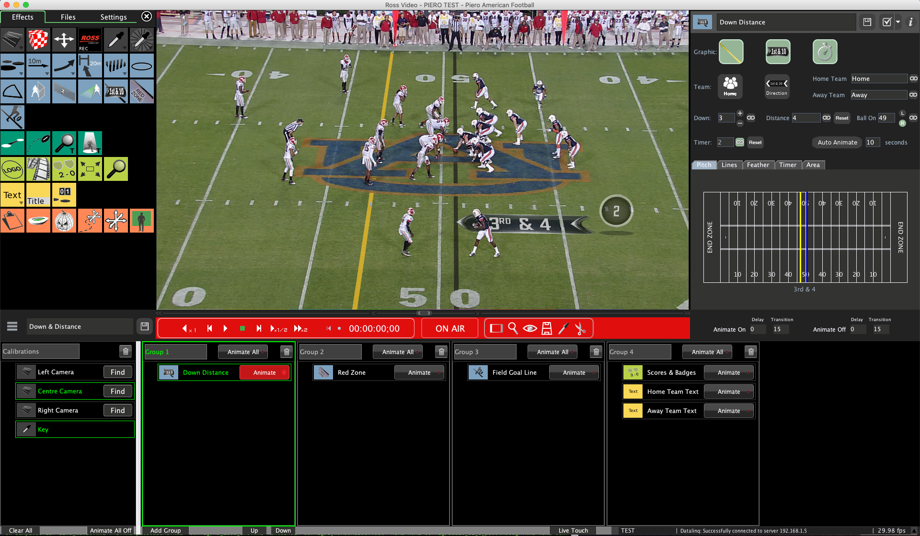
PIERO Live down & distance solution
The Problem Compete with Chyron’s Virtual 1st and Viz/SMT for American Football live productions
The Solution extend PIERO Live to handle pitch crown, 3in 1out workflow and support both Encoded and Optical Camera tracking.
Add all the required graphical effects: Feather, Line, Red Zone, Field Goal line etc.
Price 2RU M8 AJA $12k, PIERO Live license $25k/year
Bonus PIERO ghost preview, internal keyer ,virtual advertisement, ‘AR’ data visualization and all available analysis effects.
PIERO Live v1.0 graphics are better than Chyron Virtual 1st and slightly below what SMT puts out on the NFL.

Slide 4
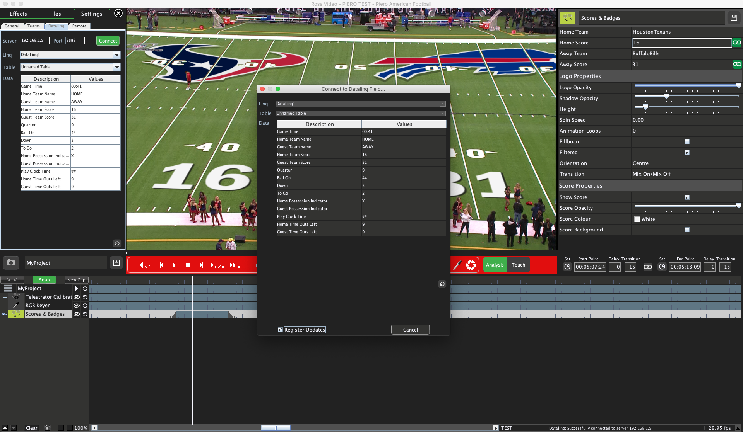
Datalinq integration
The Problem display live results for American Football game.
The Solution implement Datalinq into PIERO Broadcast and PIERO Live. Use existing effects to display scores and badges tied to field.
Bonus the integration can be extended to support Aussie Rules, Basketball and any sports and suppliers compatible with Datalinq. Play Clock and other data driven effects are within reach.

Slide 5

New Brochures Available
PIERO Broadcast
PIERO Live
PIERO Club

