Slide 2
ULTRIX
Ross Live
Todd Riggs
April 2020

Slide 3
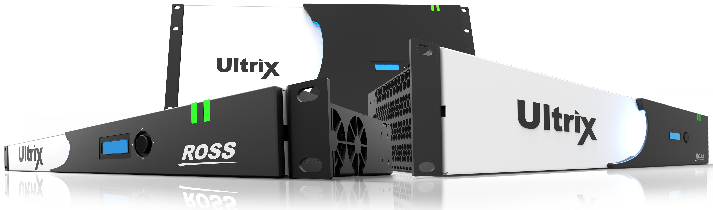
WHY WAS ULTRIX BUILT?
SmartFabric
Benefits to our Customers:
Reduction in Capital Expense
Reduction in Operational Costs
Simplified and more tightly integrated user experience to increase productivity
Better flexibility for more creative productions
Simplified troubleshooting and maintenance for technical staffs

Slide 4
ULTRIX 4.2.0

Slide 5
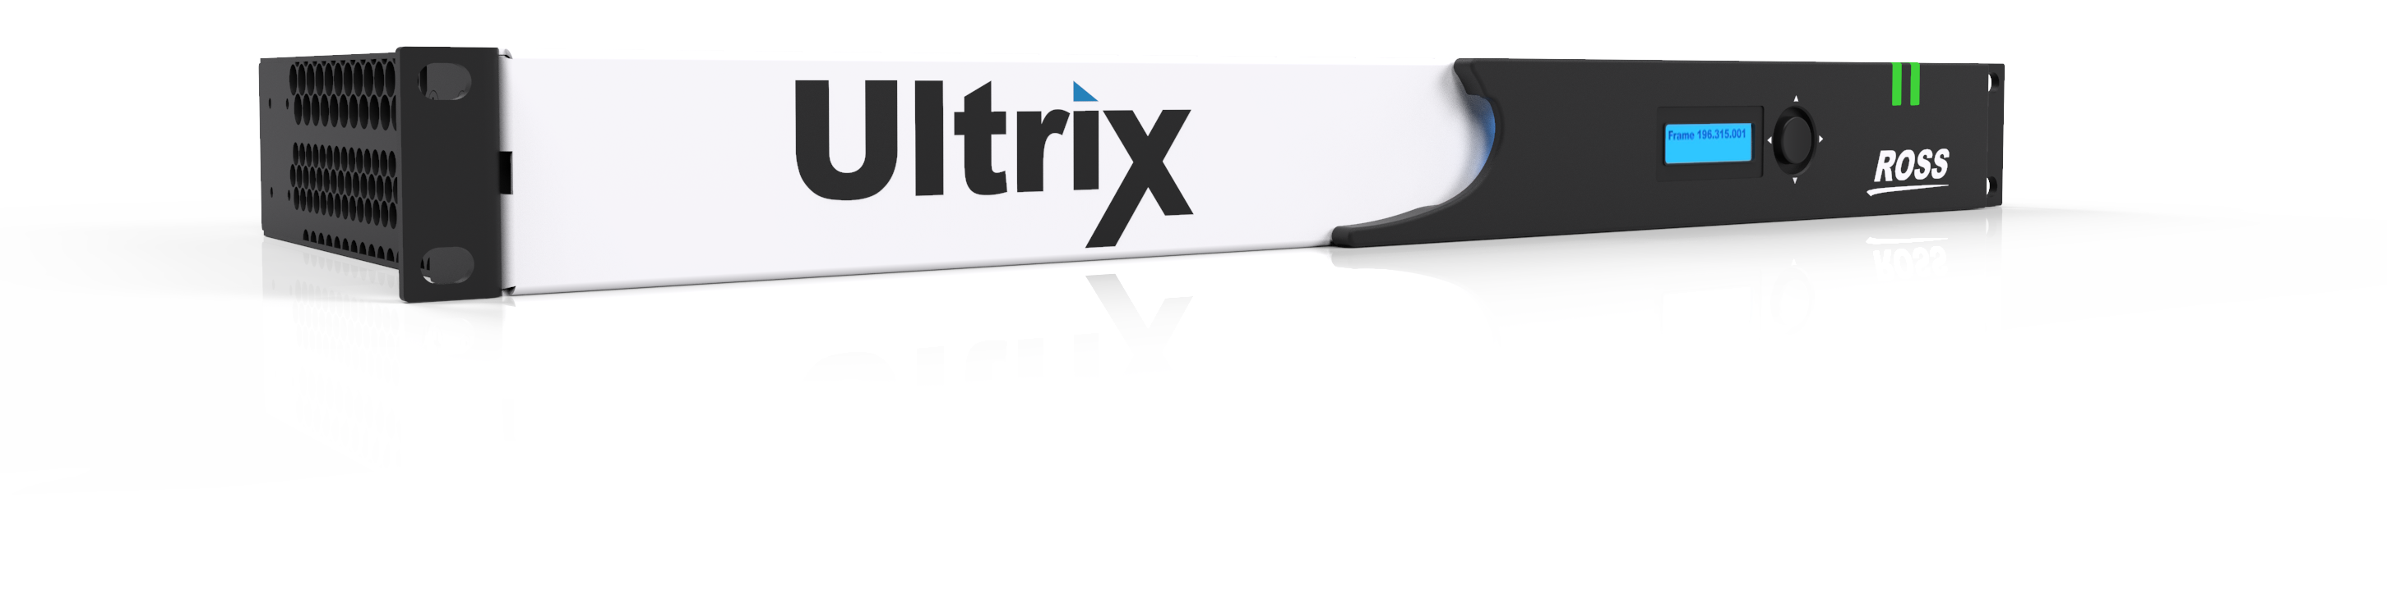
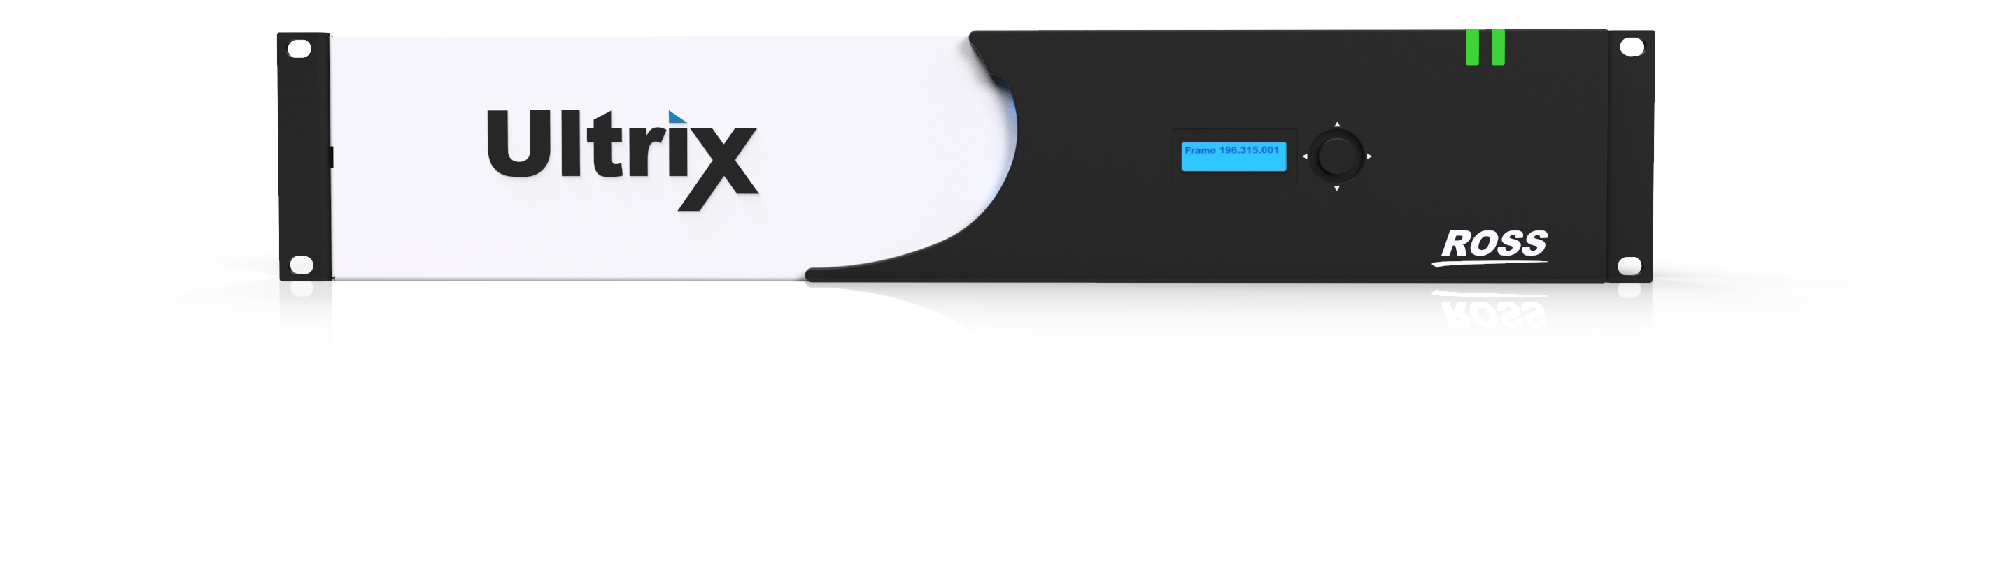
ULTRIX 4.2.0
NEW VERSIONS
New Firmware Highlights:
ULTRIX-SFP-IO
ULTRISYNC-UHD
ULTRICORE-TLX

Slide 6
New 1RU & 2RU Frames
ULTRIX NEW STYLE
New Style Frames:
Uses current I/O boards
Same price as existing frames
Now supports Omnicooling
Support for Ultrix-IP-IO boards

Slide 7
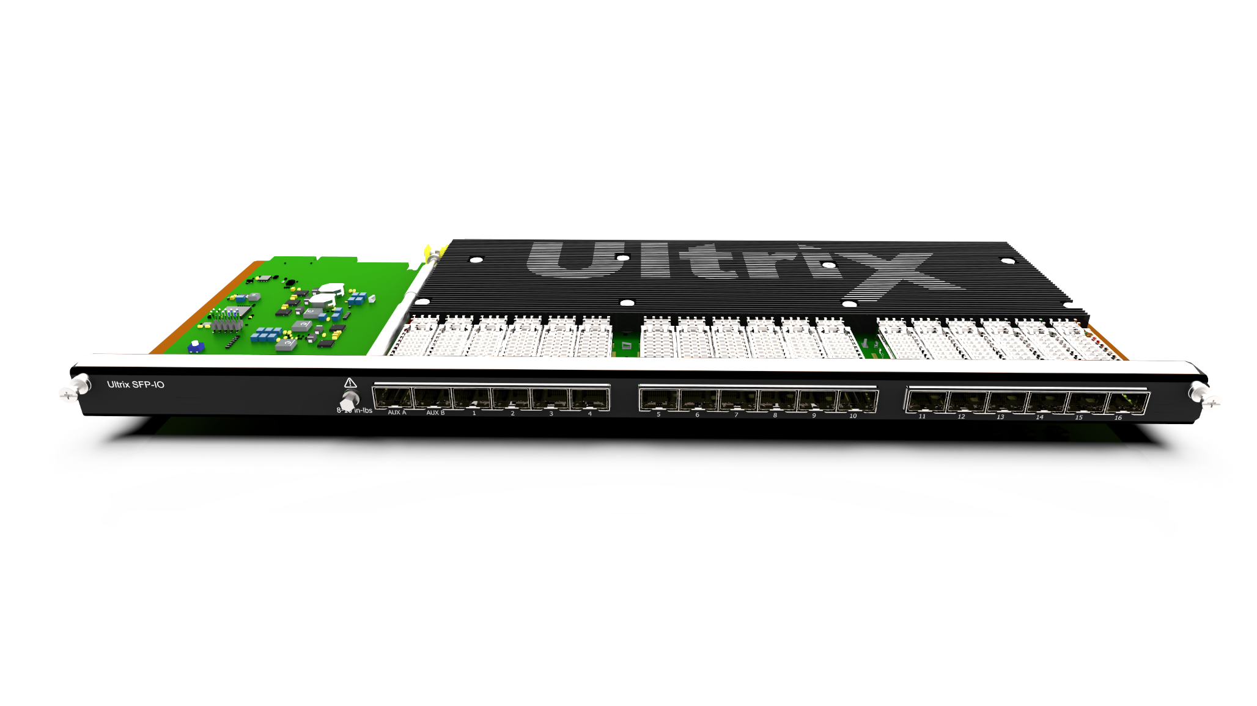
ALL SFP I/O MODULE
ULTRIX-SFP-IO
Key Features:
ALL the same cool, powerful features as HDIOB
16 SFP Cages for standard video SFP’s
2 SFP Aux Port cages for Video/MADI connections
Works in:
ULTRIX FR5
ULTRIX NS
LIST PRICE: $10,000 USD

Slide 8
sfp-io Applications
ULTRIX-SFP-IO
Focus Areas:
Customers who need flexibility
Large fiber deployments
UHD systems (especially where cable distance is important)
Great compliment to tie-lines for remotely connected / distributed solutions
More HDMI In/Out

Slide 9

Software Enabled UHD Frame Syncs

Slide 10
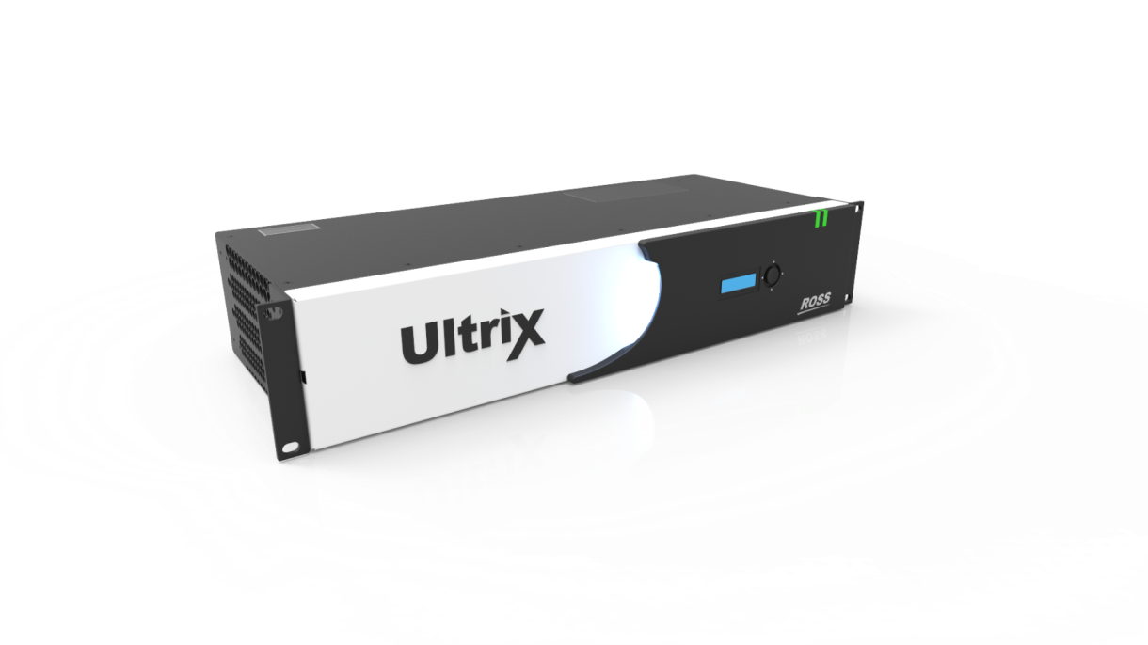
Ultrisync-UHD
Key Features:
New License (in addition to standard frame sync license)
Software enabled assignable 12G Frame synchronization
Selected inputs available for 12G license (up to 3 per I/O module)
Note: standard 3G license available on every input
Up to ½ second variable audio delay PER MONO CHANNEL!
List Price: $800 USD

Slide 11

Tie Line Control Manager

Slide 12
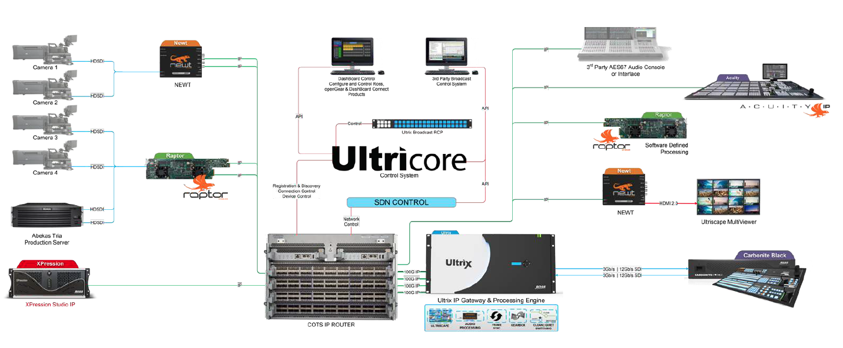
Tie Lines, a Refresher
Sophisticated control software to automatically manage routes between multiple frames
Simplifies user control
Single switch request to make route across multiple frames
No requirement for specific system design or architecture

Slide 13
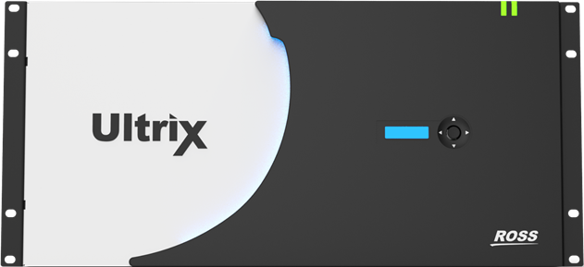
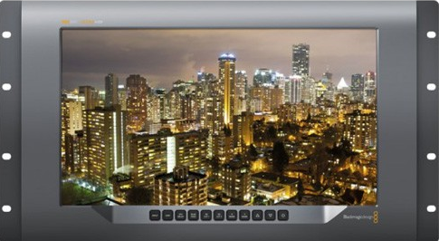
System with no Tie Line Management
Scenario: Manual Tie-Line management
Operator first selects upstream destination (tie-line one) and then selects local source (camera one)
On downstream router, operator then selects local destination (monitor 1) and then selects the incoming local source (tie line 1) as the local source
NOTE: Requires multiple switch requests and an understanding of the system configuration by the user/operator
Upstream Router
Downstream Router
Display
Camera
Tie line 1
Monitor 1

Slide 14
TIE LINE CONTROL MANAGER LICENSE
ULTRICORE-TLX
ULTRICORE-TLX
Optional Tie-Line Manager license for Ultricore-BCS
Supports shortest-available, multi-hop automatic path finding
(NOTE: breakaway audio routing not yet supported)
Works in conjunction with Ultrix-IP / Ultricore-IP to route SDI or IP Video seamlessly
Allows tie-lines between all supported router types (Ultrix, NK, supported 3rd party matrices)
Connect between sites or expand system I/O
Simple, DashBoard based tie-line configuration and status/monitoring GUI (table based)
List Price: $9000 USD

Slide 15
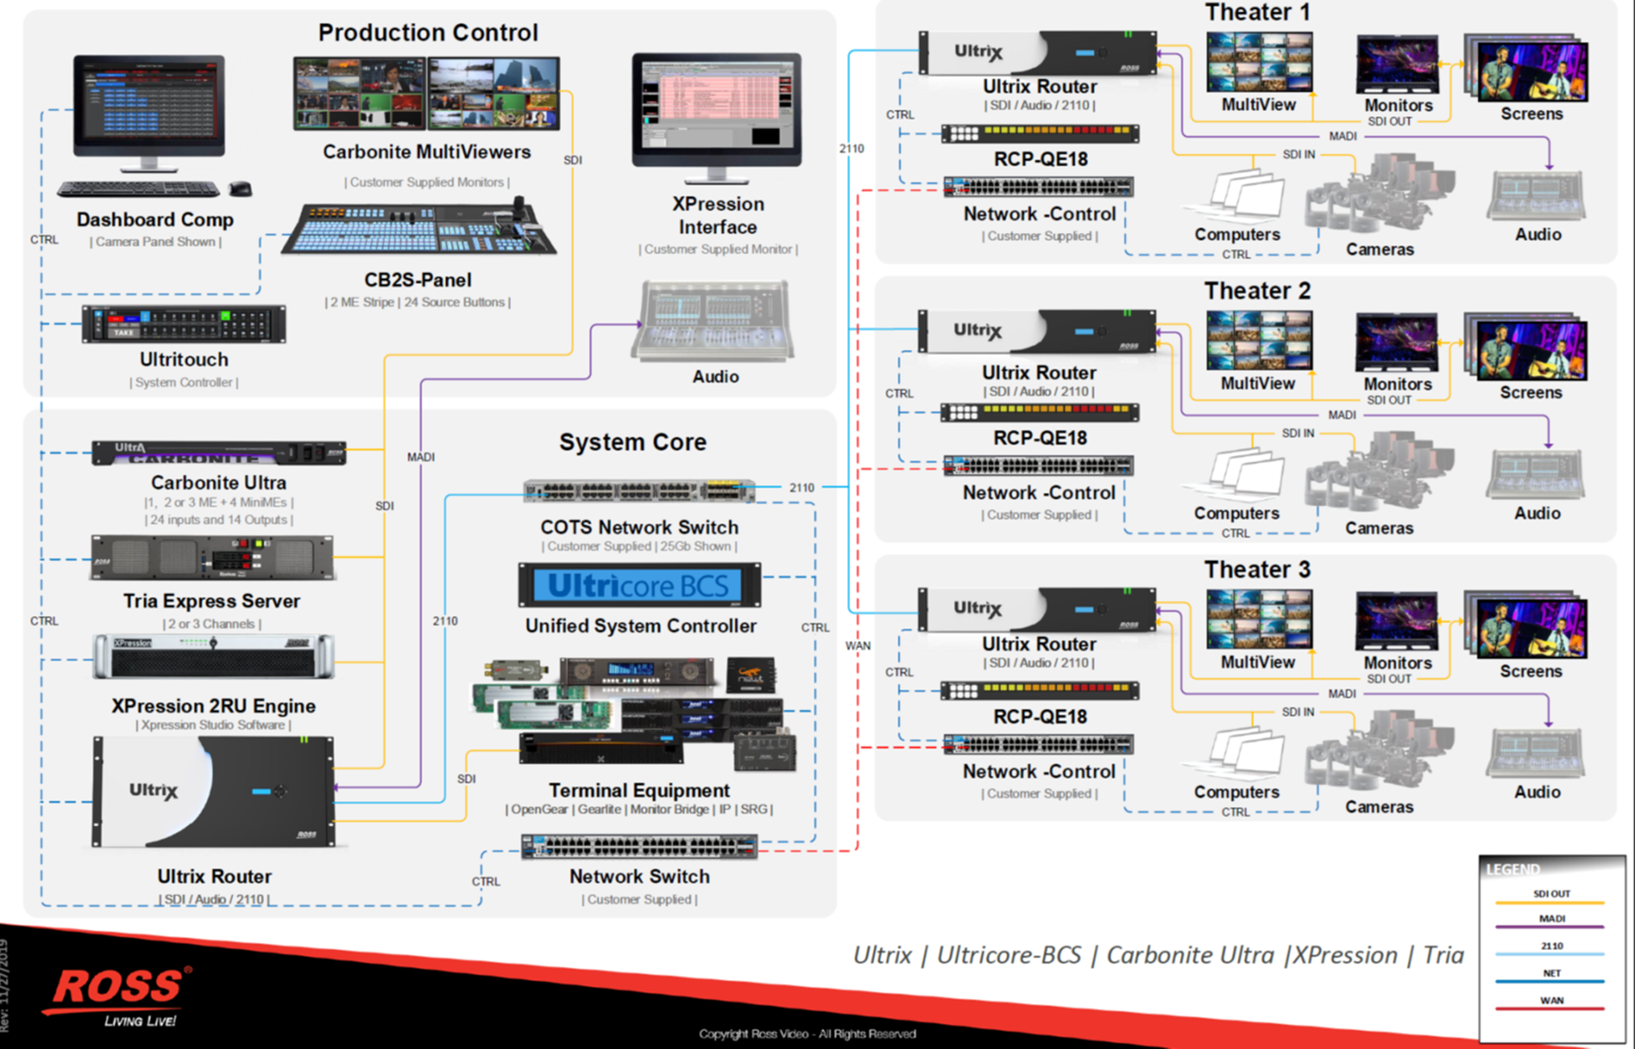
DISTRIBUTED SYSTEMS – real world EXAMPLE 1
IP as interconnect links
“Blocking” design
Reduces cost
Not as flexible
Highlights complimentary advantages of ULTRICORE-IP and ULTRICORE-TLX

Slide 16
DISTRIBUTED SYSTEMS – real world EXAMPLE 2
Fiber as interconnect links
“Blocking” design
Reduces cost
Fiber backbone makes for easy implementation
Not as flexible
Highlights use of ULTRICORE-TLX

Slide 17
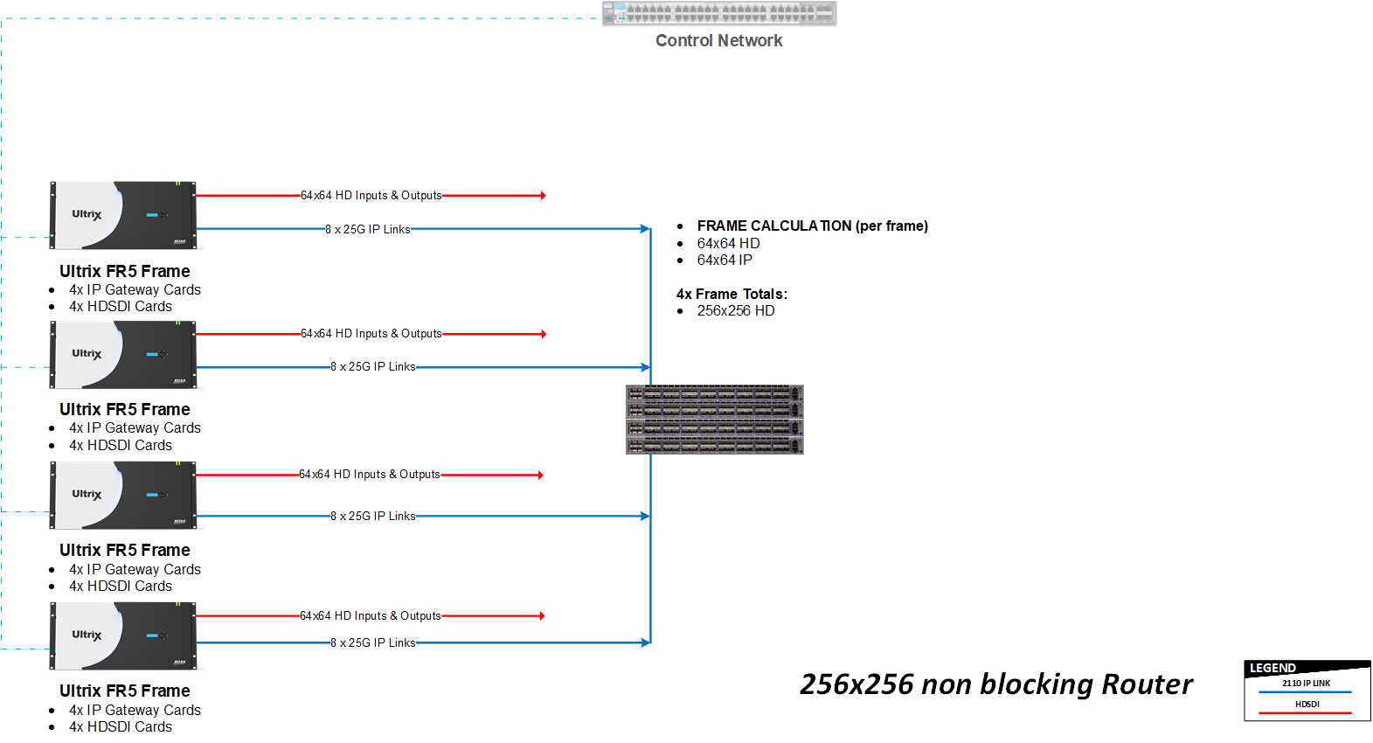
DISTRIBUTED SYSTEMS – IP Interconnect EXAMPLE
IP as interconnect links
“Non Blocking” design
Most flexible
Expensive
True decentralized routing
Highlights use of both ULTRICORE-IP and ULTRICORE-TLX

Slide 18
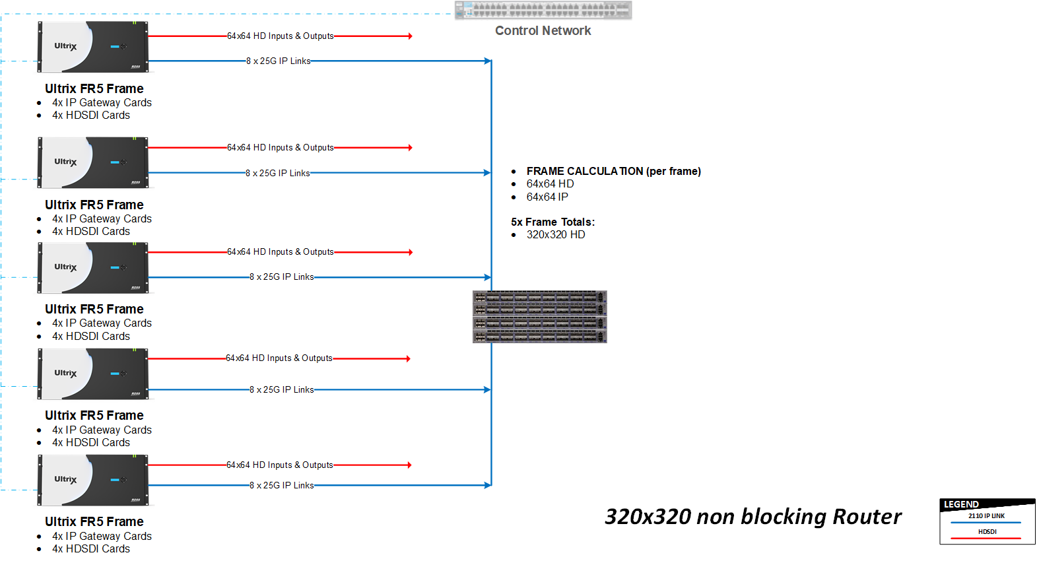
DISTRIBUTED SYSTEMS – Expansion example
IP as interconnect links
Add I/O simply by adding additional frames
Single frame chassis superior in many applications, but will always be limited by internal crosspoint size

Slide 19
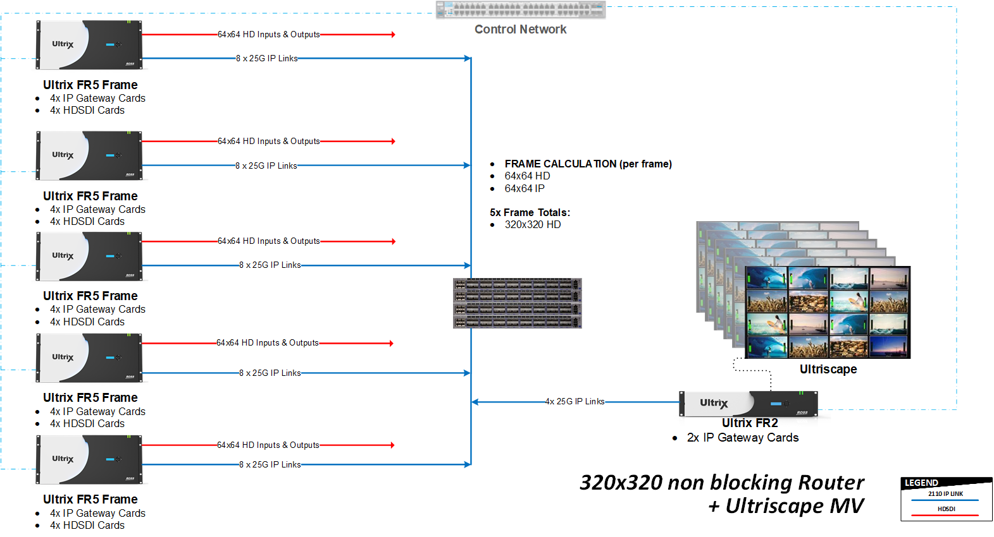
DISTRIBUTED SYSTEMS - Remote MV EXample
IP as interconnect links
Access to all 320 sources
Frames do not need to be all the same size

Slide 20
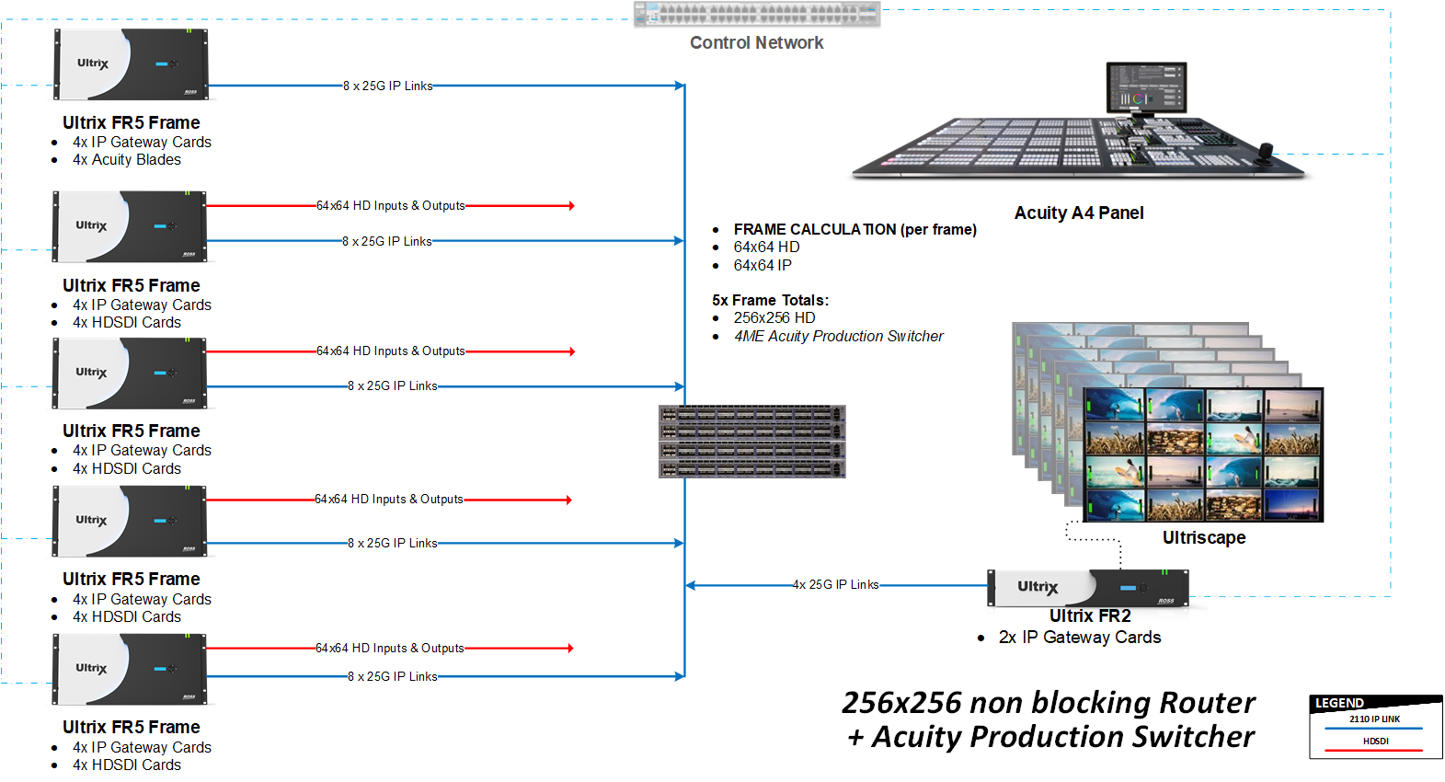
DISTRIBUTED SYSTEMS - RTR’s and Beyond
IP as interconnect links
BAFR router + completely integrated switcher (another Pete Ross Acronym)
Highlights complimentary advantages of ULTRICORE-IP and ULTRICORE-TLX

Slide 21
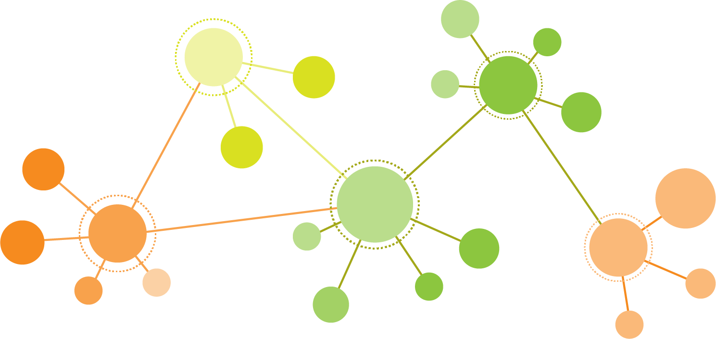
GUIDANCE/Summary ON SELLING ULTRICORE-TLX
Enhancement for most systems with multi-frame / distributed connectivity
Supports tie-lines between Ross and 3rd Party routing systems
Does not require IP → Can be used for baseband, fiber, hybrid, or IP systems
(however, this is where IP really shines)
Build virtual router systems BIGGER than 160x160
(Please engage Connectivity Product team to help vet these opportunities)

Slide 22
THANK YOU AND QUESTIONS

