Slide 1


Slide 2
Upping Our Game
Corporate Marketing Summit January 2019
Edited for Marketing Matters June 2019

Slide 3
Welcome

Slide 4
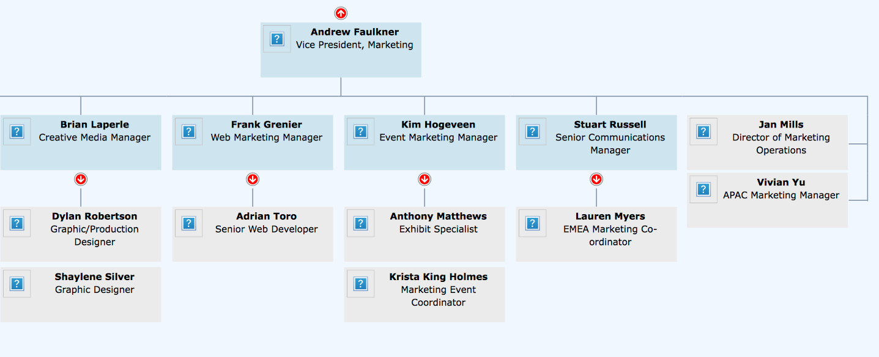
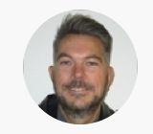
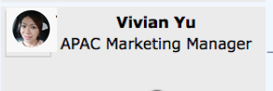
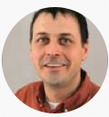
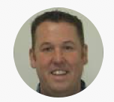
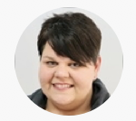
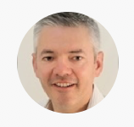
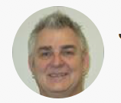
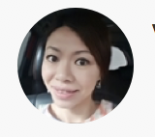
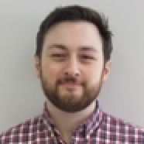
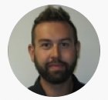
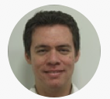
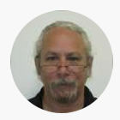
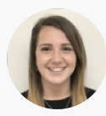
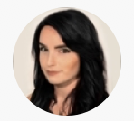
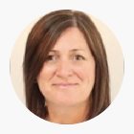
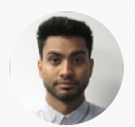
Corporate Marketing | Organized for Success
Frank Grenier
Digital Marketing Manager
Jan Mills
Director of Marketing Operations
Patrick Brannen
Content Manager
Open
Team Lead, Demand Generation
Dhiren Sondagar
Digital Marketing Specialist
Visit us in our new home at 65 Auriga Drive

Slide 5
Corporate Marketing | The Value Add…..
Create, promote and defend the corporate brand/values
Ensure consistency in corporate messaging and tone
Effectively and efficiently communicate Ross value proposition/products/services in a language that resonates with the customer
Provide/support tools that allow others to fulfil the corporate vision & mission
Provide specialized “best-in-class” creative services
Help fill and qualify leads for the the lead gen. funnel
Nurture leads (cold to warm, cold to hot)
Help drive corporate strategy/vision/mission
Centralized Market Research and Competitive Intelligence

Slide 6

Mission Statement
Corporate Marketing creates and promotes the Ross Video brand and a shared passion for live production.

Slide 7
Desired Outcomes
Greater understanding of group strengths and interdependencies -building trust
Greater understanding of interdependencies and trust developed with MPMs
Adoption of Corporate Marketing productivity tools and processes
Fun, excitement and heightened comradery
~90% of RWTM content developed
~90% of FY19 Corporate marketing plan developed

Slide 8
Format
Presentations that focus on our process
Information/training sessions
GEO plans
Preparation/discussion time (to work on plans and pre MPM ”workshop” planning sessions
Prepare for sessions with MPM’s) MPM ”workshop” planning sessions
Everybody participates!
If it is not working for you –find a way to make it work!

Slide 9

 | Marketing FY19 KO Meeting Schedule: 28th January 2019
 | Monday |  | Tuesday |  | Wednesday |  | Thursday |  | Friday
 | Subject | Leader | Subject | Leader | Subject | Leader | Subject | Leader | Subject | Leader
9:00 AM | Welcome | Andrew | MPM Pep. / Kim |  | Switchers | Nigel | Marketing Ops. | Jan | Ross Solutions Brandon
9:30 AM | Keynote | Jeff Moore | Signal Conditioning | Nestor |  |  | Market Communications | Stuart
10:00 AM |  |  |  |  | Collaboration Tool | Frank | Website | Frank
10:30 AM | Break |  | Break |  | Break |  | Break |  | Break
11:00 AM | Pragmatic Foundation | Andrew | Virtual | Gideon | Lightning | Greg | Social Media | Dhiren | Planning
11:30 AM | Integrated Marketing | Andrew |  |  |  |  | Lead Gen. | Jeff
12:00 PM | Lunch |  | Lunch |  | Lunch |  | Lunch |  | Lunch
12:30 PM
1:00 PM | Q1 Score Card | Andrew | Planning |  | Creative Brian/Shaylene/Dylan |  |  |  | Planning
1:30 PM | APAC Plan | Viv | XPression | Bas
2:00 PM | Break |  |  |  | Break |  | NAB | Kim/Anthony | Break
2:30 PM | EMEA Plan | Lauren | Break |  | Rocket | Jim | Events | Kim/Krista | Planning
3:00 PM | Business Partners | Alex | Inception | Jenn/Shawn |  |  | Break |  | Wrap up | All
3:30 PM | Sports & Live events | Kevin/Stacy |  |  | Dashboard | Mike | Camera Motion Systems | Bruce
4:00 PM | LATAM/Oceana Plan | Adrian/Andrew | Planning |  |  |  |  |  | Close
4:30 PM | MPM Meeting -Expectations |  |  |  | Connectivity | Mark/Todd | Planning |  | Free
5:00 PM | Close |  | Close |  | Close |  | Close
6:00 PM | OPMA (www.OttawaPMA.org) |  | Axe Throwing (https://batlgrounds.com/axe-throwing-ottawa/) |  | Free |  | Mandarin Chinese Buffet (https://mandarinrestaurant.com)
Please join my meeting from your computer, tablet or smartphone.
https://global.gotomeeting.com/join/918047245
You can also dial in using your phone.
United States (Toll Free): 1 877 568 4106
United States: +1 (571) 317-3129
Access Code: 918-047-245
First GoToMeeting? Let's do a quick system check:
https://link.gotomeeting.com/system-check
Instructional/Training
Updates
MPM Stakeholder meeting
Process Focused / Update
Planning/working sessions

Slide 10


Team Life Cycle? | where is Our Team
Recognize where we are in the Life Cycle of OUR team –it is often iterative and you may pass through the stages multiple times
  Depends upon tasks faced, external factors and team history!
Working in teams is NOT easy
It is “Life skill” and a MUST for World Class Execution
forming
storming
norming
performing
adjourning
https://www.mindtools.com/pages/article/newLDR_86.htm
http://openvce.net/sites/default/files/Tuckman1965DevelopmentalSequence.pdf
Notes:
Team Stages
Original Source: Developmental sequence in small groups.
Tuckman, Bruce W.
Psychological Bulletin, Vol 63(6), Jun 1965, 384-399.
Recent treatment:
Mind Tools website: https://www.mindtools.com/pages/article/newLDR_86.htm
Forming
In this stage, most team members are positive and polite. Some are anxious, as they haven't fully understood what work the team will do. Others are simply excited about the task ahead.
As leader, you play a dominant role at this stage, because team members' roles and responsibilities aren't clear.
This stage can last for some time, as people start to work together, and as they make an effort to get to know their new colleagues.
Storming
Next, the team moves into the storming phase, where people start to push against the boundaries established in the forming stage. This is the stage where many teams fail.
Storming often starts where there is a conflict between team members' natural working styles. People may work in different ways for all sorts of reasons but, if differing working styles cause unforeseen problems, they may become frustrated.
Storming can also happen in other situations. For example, team members may challenge your authority, or jockey for position as their roles are clarified. Or, if you haven't defined clearly how the team will work, people may feel overwhelmed by their workload, or they could be uncomfortable with the approach you're using.
Some may question the worth of the team's goal, and they may resist taking on tasks.
Team members who stick with the task at hand may experience stress, particularly as they don't have the support of established processes, or strong relationships with their colleagues.

Slide 11
Team Roles
Before we start, WE MUST AGREE
  A recorder (write down the path & highlights)
  A time keeper (how long is left? milestones? agree time required / extensions before?)
  A facilitator (has everyone contributed, did they speak enough?)
  A reporter (who will speak for the team?)
  An organiser (who will manage practicalities and logistics?)

Slide 12
Team Roles
Corp. Marketing Meetings
MPM Meetings
Recorder: Kim
Time Keeper: Frank
Facilitator: Stuart
Reporter: Brian
Leader: Andrew
Recorder: Lauren
Time Keeper: Jan
Facilitator: Kim
Reporter: Stuart
Organizer/Chair: Andrew
https://blog.lucidmeetings.com/blog/who-does-what-defining-meeting-roles

Slide 13
Report Cards and Moving Forward

Slide 14
Playbook
| ask why?
Internal audit: core competencies of the group, processes and tools
Understand stakeholder requirements
Conduct gap analysis (train/hire)
Develop group vision/mission
Set group and individual S.M.A.R.T objectives - Marketing Score Card
Document and baseline
Execution and communicate
Continuous improvement

Slide 15
The Challenge | the Opportunity
MPMs
Exec.
Multiple “internal” stakeholders
  Many voices many practices & processes
  He / She who shouts loudest
  Old boy/girl networks
  Work on “sexy stuff”
  Tends to unidirectional communications
Corp. Marketing needs to scale, and “up its game” to keep up with rest of the organization and to have a voice
  Improve efficiency
  Prioritize around business imperatives
  Define Interface channels and protocols
  Add value beyond the creative –be a trusted advisor
  Tend to bidirectional communications
HR
MPMs
MPMs
Corporate Marketing
Exec.
FG
MPMs
SS
AT
VY
JM
DS
JL
AF
MPMs
MPMs
BL
SR
LM
DR
KH
KKH
MPMs
AM
MPMs
MPMs
MPMs
Vert.
Exec.
MPMs
MPMs

Slide 16
What will we be when we grow up?
Where are we now?
Best in class Corporate Marketing
At the start of the journey
  very much WIP
We will make mistakes
  too much process, too little process...
  too much reporting too little reporting…
  inappropriate tool selection...
Denial –tried it before, done it before…
  change is necessary
  embrace it, own it, be an agent for change
Driven by metrics
  results focused not task focused
Guided by processes
  consistency and legacy
  you can’t improve what you don’t measure
Consult and Commit mentality
  encourage input and opinions but once a decision is made get behind it!
No one is greater than the team
Communicate
  no surprises…
Think from the outside in
Continuous Improvement

Slide 17
The RACI Chart | Corporate Marketing
Responsible Accountable Consulted Informed
Used as a communication tool to inform ownership
Area | Andrew | Brian | Stuart | Jan | Frank | VIV | Kim
Creative | RACI | RA | CI | cI | I | cI | cI
Communications | RACI | CI | RA | cI | CI | cI | cI
Videography | RACI | RA | CI | cI | I | cI | cI
Events | RACI | CI | CI | cI | I | cI | RA
Digital Marketing | RACI | CI | CI | cI | RA | cI | cI
Operations | RACI | cI | cI | RA | cI | cI | cI
EMEA | RACI |  | RA | cI | I |  | cI
APAC | RACI | CI | CI | cI | I | RA | cI
LATAM | RACI | CI | CI | cI | I | I | cI
Everyone has an input
Those that have RA make the final decision
Lower case means consulted informed etc. for relevant items
If in doubt consult / over communicate
You can delegate –but ultimately Leadership team accountable/responsible

Slide 18
To Fail to Plan….
Three New Initiatives
Stakeholder meetings
Stakeholder meetings
Integrated marketing campaigns
Solution focussed campaigns
  30 minute meetings held monthly
  Review progress against approved campaigns
  Rolling road map view

Slide 19
Is to Plan to Fail!
Integrated Marketing Campaign
Solution Focused Campaigns
Campaigns will be managed as a project and have an appointed project manager
Each campaign will have a clear set of objectives, clear target audience(s), a start date, a commitment date, defined timed elements and a duration with agreed Metrics of success
Campaigns will be driven from the objectives outwards, meaning the objectives and target audience will dictate the media vehicles used
Also Integrated Marketing Campaigns but with focus on solutions
Solution Focused Campaigns will be anchored by major events like trade shows or an advertisement placement and will leverage multiple media resources (depending upon the objectives and target audience)
Solution Focused Campaigns will be scheduled throughout the year
Product lines will be offered the opportunity to contribute as and when they are able (product availability, timing etc.)

Slide 20
Productivity
Rhythm
Project Management
Weekly 1on1 between managers and their reports
Weekly scrum meetings (Marketing Leadership Team)
Monthly Review with Team Awesome
QBR
FY KO
Think in terms of campaigns and projects NOT tasks
Use freedcamp for campaign/project management
Use freedcamp for meeting minutes
Use freddcamp for collaboration
100% use and visibility across Corp. Marketing for ALL campaigns/projects NO exceptions*
  *If a project only involves you and nobody else you can use whatever you want)

Slide 21
FY19 Initiatives | Report Card
On Track
Progress but not completed
No/Limited Progress
Corporate Website Translation (Mandarin / Spanish / French) (SEO juice)
Zendesk and Single Sign-On (complete)
Increased pre-show promotion / awareness
Improved lead capture experience and results at NAB
Improved follow up on leads and ROI for each event
Increased number of keynote speaking slots around shows
Integrated campaigns (starting with PIVOTCam-SE)
Increased focus on case studies and testimonials (videos where possible)
Focus on SEO and SEM
Automate lead qualification for sales
Leverage efficiencies within HubSpot & SFDC​
Targeted lists for lead nurturing
Create thought leadership content

Slide 22
Q1 Plan | Report Card
On Track
Progress but not completed
No/Limited Progress
Continue to meet with key stakeholders
Formalize internal reporting / communication channels
  Bi-weekly status report/Bi-weekly huddle
Formalize external/stakeholder communications
  Bi-weekly Status reports/Monthly huddle
  Quarterly Corporate Marketing Newsletter
  Develop and review MARCOM plan
Integrated marketing Go 2 Market planning tool
  Corporate Marketing capability menu
  Style guide
  Editorial / events calendar
Refine Value Proposition tool
NAB Planning
Publish PTS Brochure
Ross Way to Market draft
HR recruitment drive
Ross Insider issue/plan

Slide 23
The Ross Way to Market (RWTM)
Unifying document for Ross Marketing community
Sets expectations, roles and responsibilities (Pragmatic Framework and RACI charts)
Common lexicon and common understanding
Documents what we do and how we do it (Process Documents)
Complements and integrates with RWTS
The Pragmatic Institutes’ course/framework will be adopted (where it makes sense)

Slide 24

Pragmatic Marketing
Improving Product Management
and Marketing

Slide 25

Why Pragmatic Institute?
Industry standard for best practices in product management and product marketing
  20+ years; 8,000 companies; 125,000 attendees
Satisfied customers
  90% rate courses “essential” or “very useful”
  80% of business comes from word-of-mouth referrals
Thought leadership
  Publications read by more than 250,000 every year
  Instructors all have VP-level experience in technology companies

Slide 26
Foundations
Attended Foundations course December 2018
Foundations provides an overview of the entire Pragmatic Marketing Framework
Covers all the activities needed to build and market successful products
Great resource: website and Quarterly Magazines
www.PragmaticMarketing.com
©1993-2018 Pragmatic Marketing, LLC™

Slide 27

Common Challenges
Teams are in the weeds
Products aren’t performing ?
There are too many competing priorities
There are inconsistencies across departments and units
Plans are unclear and ever-changing
Roles and responsibilities are undefined

Slide 28
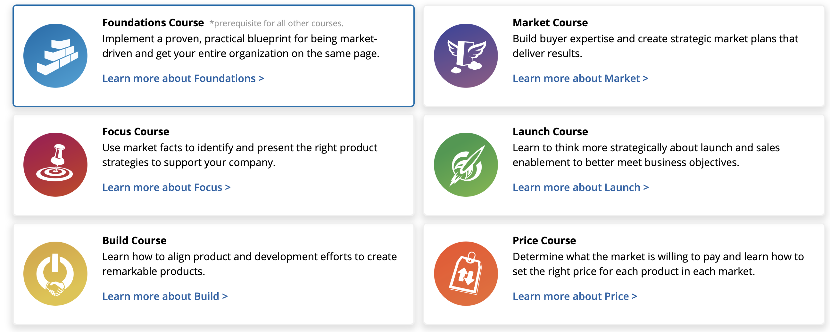
Courses

Slide 29
Pragmatic Marketing Framework
Business
Plan
Positioning
Marketing
Plan
Covers all key marketing elements/roles
All boxes need to be covered
Hand over between boxes / functions critical
RACI exercise?
Market Problems
Market Definition
Pricing
Buyer
Experience
Revenue
Growth
Win/Loss Analysis
Distribution Strategy
Buy, Build
or Partner
Buyer Personas
Revenue Retention
Distinctive Competencies
Product Portfolio
Product Profitability
User
Personas
Launch
Launch
STRATEGIC
MARKET
FOCUS
BUSINESS
PLANNING
PROGRAMS
ENABLEMENT
SUPPORT
TACTICAL
Competitive Landscape
Product Roadmap
Innovation
Requirements
Awareness
Awareness
Sales
Alignment
Programs
Asset
Assessment
Use
Scenarios
Nurturing
Nurturing
Content
Operations
Stakeholder
Communications
Advocacy
Events
Advocacy
Sales
Tools
Events
Corp. Marketing?
Corp. Marketing?
Measurement
Channel Training
Channels
©1993-2018 Pragmatic Marketing, LLC™
0518
Notes:
Could conduct audit, see whop does what?
What are the holes
RACI

Slide 30
Pragmatic Marketing Framework
Covers all key marketing elements/roles
All boxes need to be covered
Hand over between boxes / functions critical
RACI exercise?
Business
Plan
Positioning
Marketing
Plan
Market Problems
Market Definition
Pricing
Buyer
Experience
Revenue
Growth
Win/Loss Analysis
Distribution Strategy
Buy, Build
or Partner
Buyer Personas
Revenue Retention
Distinctive Competencies
Product Portfolio
Product Profitability
User
Personas
Launch
STRATEGIC
MARKET
FOCUS
BUSINESS
PLANNING
PROGRAMS
ENABLEMENT
SUPPORT
TACTICAL
Competitive Landscape
Product Roadmap
Innovation
Requirements
Awareness
Sales
Alignment
Programs
Asset
Assessment
Use
Scenarios
Nurturing
Content
Operations
Stakeholder
Communications
Advocacy
Sales
Tools
Events
Corp. Marketing?
Measurement
Channel Training
Channels
0518
©1993-2018 Pragmatic Marketing, LLC™
Notes:
Could conduct audit, see whop does what?
What are the holes
RACI

Slide 31
The RACI Chart
 | Box | Corp. Mark. | MPMs | TPMs | Exec. | Ops. | Sales
MARKET | Market Problems | ?? | ?? | ?? | ?? | ?? | ??
 | WIN/LOSS Analysis | ?? | ?? | ?? | ?? | ?? | ??
 | Distinct Competitiveness | ?? | ?? | ?? | ?? | ?? | ??
 | Comparative landscape | ?? | ?? | ?? | ?? | ?? | ??
 | Asset Assessment | ?? | ?? | ?? | ?? | ?? | ??
FOCUS | Market Definition | ?? | ?? | ?? | ?? | ?? | ??
Responsible Accountable Consulted Informed
Used as a communication tool to inform ownership

Slide 32
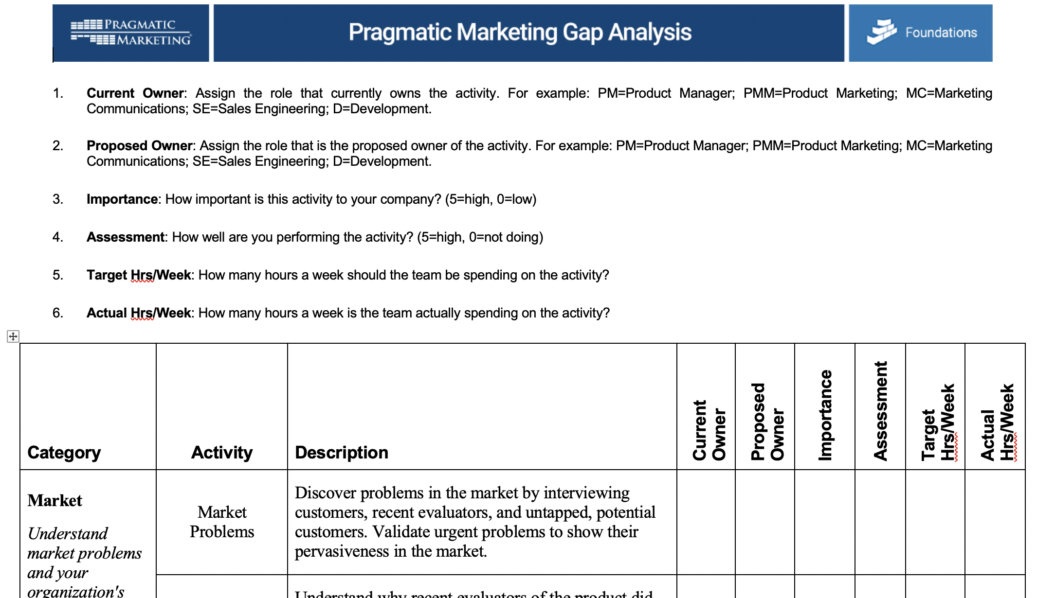
Pragmatic Gap Analysis

Slide 33
Find Market Problems | Identify things relevant to key Persona’s
The building is full of Product Experts
  YOUR company needs Market experts
Sources for input
  Not just THE customer; sales, sales consultants, R&D, technical support groups, user groups, executives, MPMs, sales support, network groups, neighbors, competitors, suppliers, trade shows
Find the quiet 80%
Buyer and user Personas –speak their language
Demonstrate RO for buyer Personas and Solve problems for user personas
Technical
Business
Creative
Ross Personas

Slide 34
The Answer to most of your questions is not in the building
Consult widely –not just within the group, building or industry
Cool Aid

Slide 35

Communicating the Value Proposition
Pragmatic
RWTM
Product Name: ____
Persona and Market Segment ______
Problem
  There is a problem in the industry today Solution
  The ideal solution to this problem is …
Positioning Statement (25 words or less)
Product Description (50 words or less)
Problem orientated features: List 1 to 5
Product Name _____
Launch Date ______
What is this product? / What does it do?
Features / benefits: List 1 to 3
What is the application / how will this be used / who is it for?
Why did we build this product?
What problem does it solve?

Slide 36
Writing A Problem Statement
Bad Example
Good Example
“The rear gate of the SUV shall open to 108 degrees and close completely through remotely controlled actuators via a key fob button or in car button/switch”
“Chris the consumer needs to open and close the rear gate of the SUV in the parking lot when their hands are full and it is raining”

Slide 37
Pragmatic Market Segment
CUSTOMERS
EVALUATORS
POTENTIALS
PAST
PRESENT
FUTURE
A group of customers that share a common set of problems
Customers of Ross
  See through the Ross lens
  Might tells us what we want to hear
  Tendency to “over” listen
Potentials
  May be in adjacent verticals not currently served or underserved
Evaluators
  Open to new solutions including alternative solutions
Customers of Competition
  See through the Competitors lens
  Consider switching costs

Slide 38
Affinity Mapping
Problem 1
Problem 2
Problem 3
Problem 4
Use an Affinity Map to synthesis many inputs into a single problem statement

Slide 39
Affinity Mapping | Example
Problem | Problem Orientated Feature | Features
Problem Group 1 a)..b)..c).. | Common Solution | Solution Features
Problem Group 2 a), b), c) | Common Solution | Solution Features
Problem | Problem Orientated Feature | Features
a) Reporting product status? b) What project tasks are due? c) Indicate the project delay | Include a Status View | Outlook front-end Ad-hoc web-based query of current enhancement status

Slide 40
Segmentation Worksheet Questions
Pragmatic Market Segment
Common problems
Personas (Buyers and User)
Demographic (Fit)
  Type of business, industry, Revenue, employees, language….
Technical Profile (Fit)

Slide 41
Solutions Matrix
Plot your products on the Solution Matrix.
Plot your competitors’ products on the grid.
Use the Solution Matrix:
  With development when assessing the incremental level of technology investment to put into your products compared to the relative value (positive impact) for the market
  When interviewing the market to understand how your product will improve their operations
  To position your products against the competition
  To price your products
  To position a product portfolio
  To determine sales channel strategy
STRATEGIC VISION
WHY?
DEPTH OF INVESTMENT
UTILITY
NO BRAINER
IMPACT TO CUSTOMER

Slide 42
Pragmatic Rule(s)
An Outside-in approach increases the likelihood of product success
The answer to most of your questions is not in the building
If the product Team doesn’t do its job, other departments will fill the void
The building is full of Product experts. Your company needs market experts
Win/Loss should be done by someone not involved in that sales effort
Your opinion, while interesting is irrelevant
Only build solution for problems that are URGENT, PERVASIVE and that the market will PAY you to solve
Positioning focuses on the problems you solve
Creative a separate positioning document whenever the personas’ problems are different
Name the product after positioning is completed

Slide 43
Preparing for MPM Meetings

Slide 44
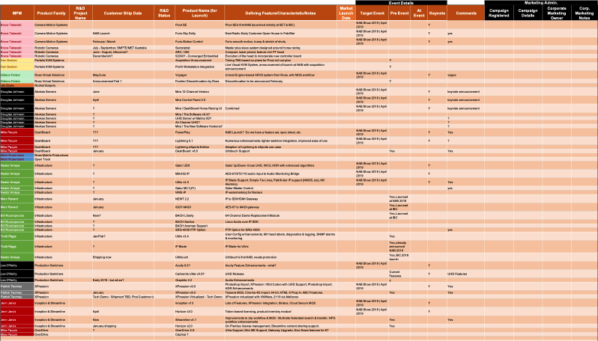
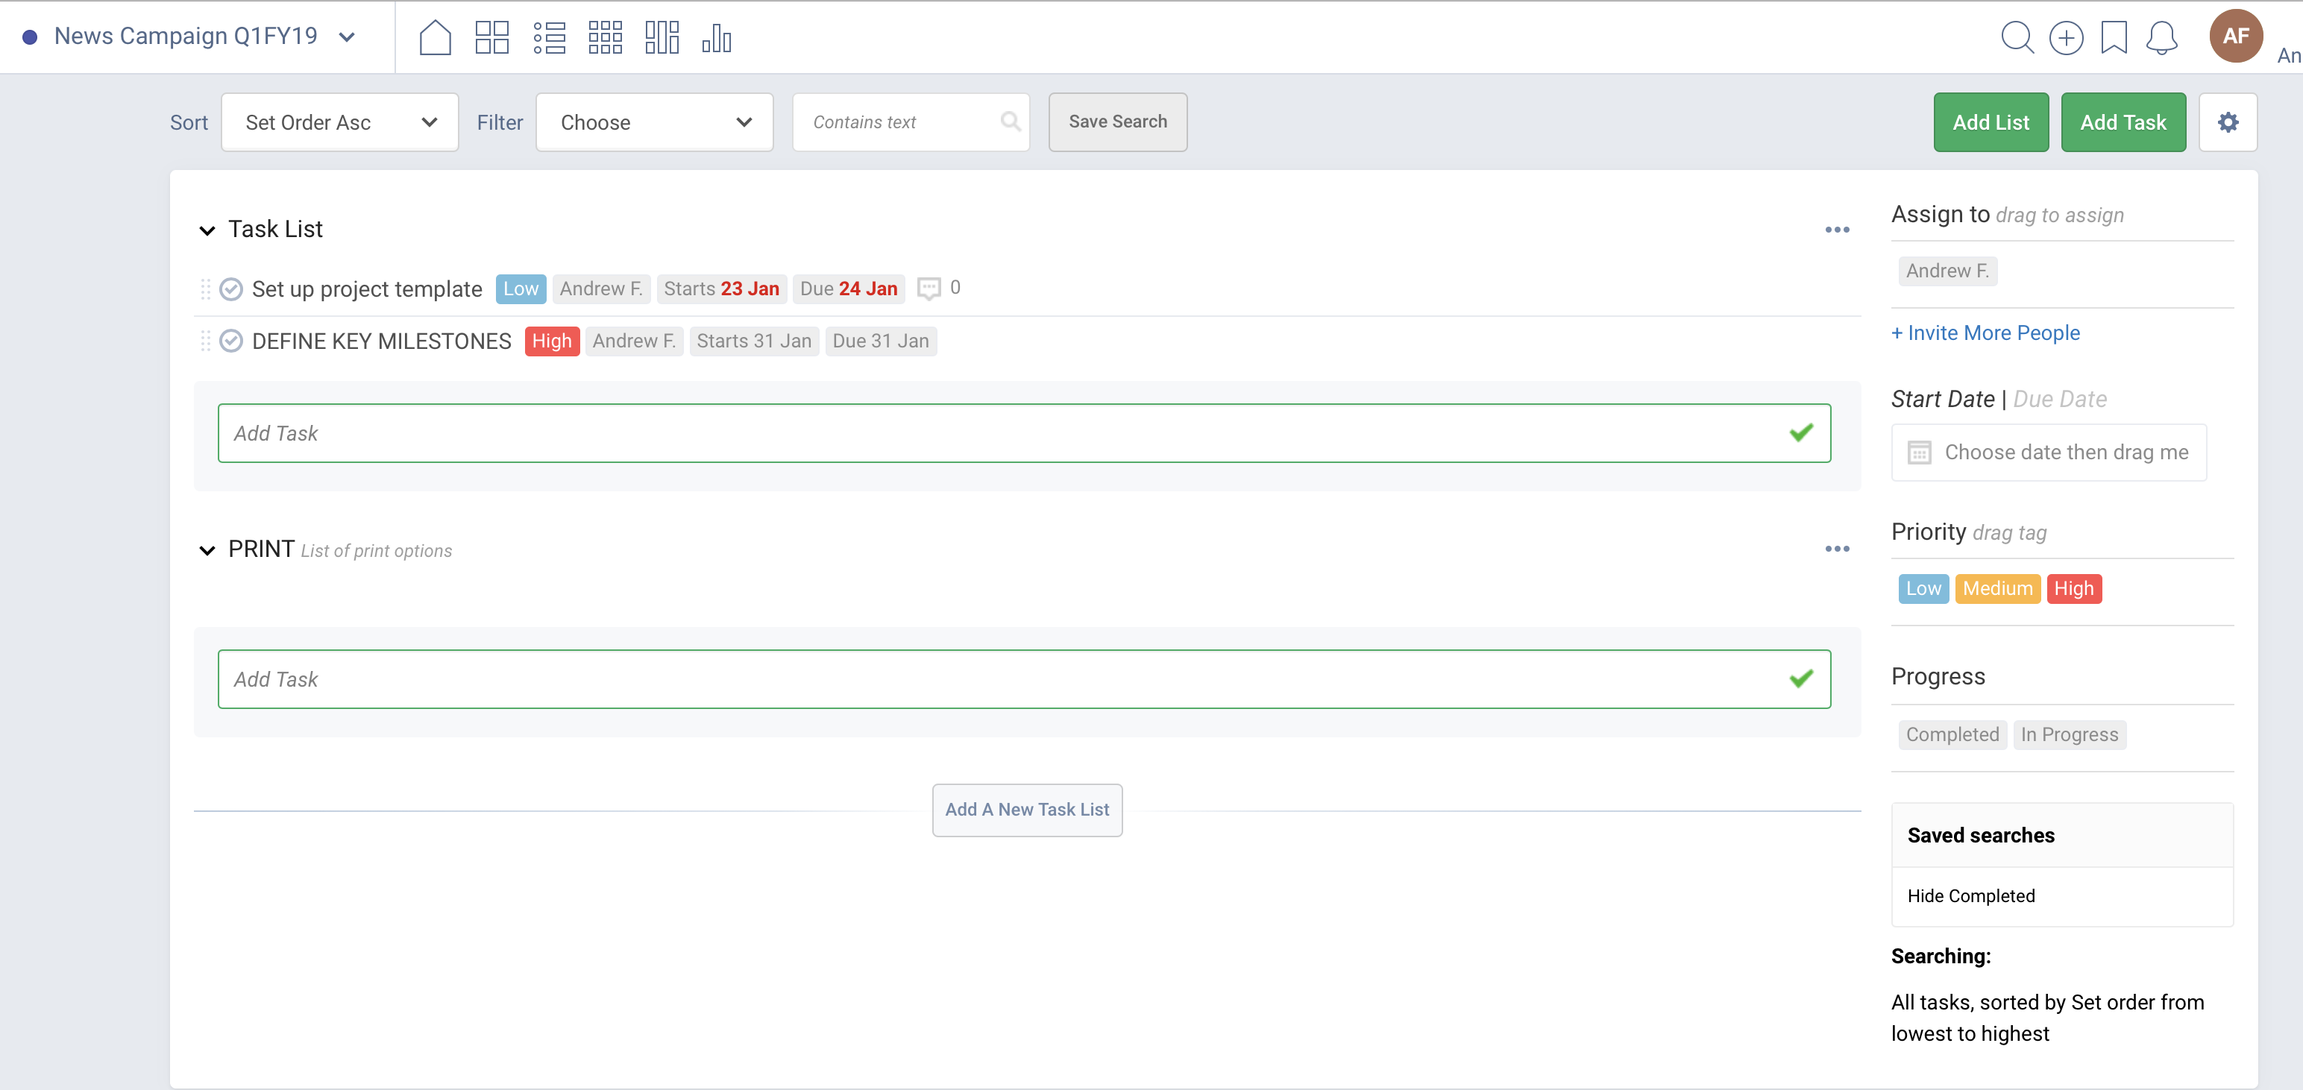

MPM Product Planning
Capture Product Roadmap and Launch Details
Register a Campaign
Capture the Value proposition(s)
Plan a Campaign
Review Campaign “Formally” at monthly Stakeholder meetings
Corporate Marketing provide Campaign Management (using FreedCamp)
’Input’ Tab
‘RWTM’ Tab

Slide 45
Team Roles
Corp. Marketing Meetings
MPM Meetings
Recorder: Kim
Time Keeper: Frank
Facilitator: Stuart
Reporter: Brian
Leader: Andrew
Recorder: Lauren
Time Keeper: Jan
Facilitator: Kim
Reporter: Stuart
Organizer/Chair: Andrew
https://blog.lucidmeetings.com/blog/who-does-what-defining-meeting-roles

Slide 46
Process for MPM Meetings
Set out process
Team Roles
Discuss any GEO requirements involving product line
Overview of Product Roadmap
Overview of Product Launch Plans
Complete spreadsheet
Assign Project Owner
Agree on next actions, set formal review dates and follow-up meetings

Slide 47
Video’s

Slide 48


How Great Leaders Inspire Action
Simon Sinek
http://www.ted.com/talks/simon_sinek_how_great_leaders_inspire_action?utm_source=tedcomshare&utm_medium=referral&utm_campaign=tedspread

Slide 49

Video ("The Art of Innovation.") | Guy Kawasaki
Guy Kawasaki at TEDxBerkeley 2014: "Rethink. Redefine. Recreate." His talk is titled "The Art of Innovation."
  https://youtu.be/Mtjatz9r-Vc

