Slide 1


Slide 2

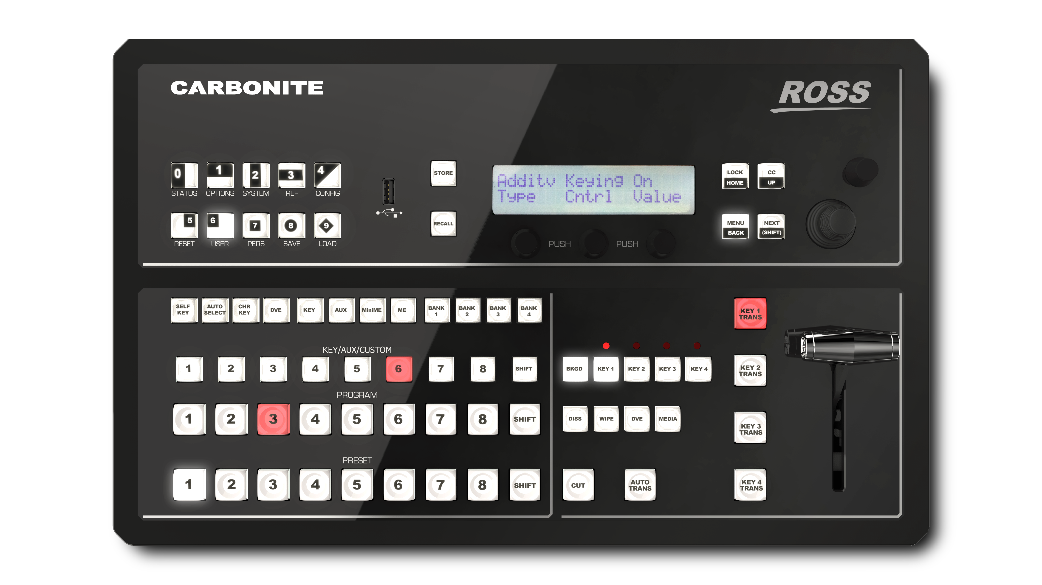

Carbonite Black Solo Overview
Carbonite Black Solo is packed full of features that deliver incredible video production horsepower in an amazingly compact and affordable package.
Solo is simple to setup and use. It provides the same intuitive panel ergonomics and superior production efficiencies as the bigger Carbonite Black models.
The same control capabilities are also provided via the included DashBoard software panel that can be used as a secondary control point in conjunction with a Solo hardware panel or as the primary control surface for the 1RU processing engine.
Solo delivers a professional grade feature set with DVE functions, media stores, auxiliary buses, integrated multi-viewers, production software tools, advanced chroma keying, and range of I/O types.

Slide 3
Carbonite Black Solo Benefits
Do More
Unprecedented production power in a super compact frame and panel
Offers the same tough components, and comprehensive design philosophy, features, and operations from the well proven Carbonite line of production switchers.
Different configurations including an all in one device, or a 1 RU frame that can be controlled from soft and/or hard panels provides flexibility for a wide variety of environments.
Invest Safely
Ross is well known as one of the best value brands in the industry*
Lifetime technical advice by telephone and email is included- forever!
A platform approach with a growth path that adds new features via no charge software upgrades
Choose Wisely
Carbonite is backed by Ross- a solid company committed to production switcher development with a 40+ year history.
Ross ships the greatest number of small to mid-size production switchers – this popularity makes it easier to hire and retain operations staff
Choose great support - Ross annually receives among the highest ratings for customer support*

Slide 4
Primary Capabilities of Carbonite Black Solo
Intuitive interfaces and a significant level of operational control provide you with a new level of production efficiencies.
A choice of combined panel and switcher electronics or separate panel and rack mount processing frame
Full production control via convenient DashBoard software based control panel GUI, with no hardware panel required
Simplify system settings, and access to graphic elements with a powerful DashBoard live production control interface and media browser
Seamlessly create and run an entire production perfectly every time from a simple touch screen application

Slide 5
Primary Capabilities of Carbonite Black Solo
A professional grade feature set offers the capabilities of a much larger switcher for you to deliver imaginative and dramatic productions.
Unique MiniME effects modules are available in a pool to be assigned anywhere in the system for additional dissolves and key layers independent of ME resources to create more sophisticated productions looks
Distributable system-wide 2D DVE channels that incorporate intelligent resource management to store and recall scenes, meets production demands that typically require a larger switcher
For more compelling productions, multiple media player channels are available system-wide to directly play out stills, logos, and animated graphics which can even be enhanced with audio
Powerful processing forms the foundation of a platform with the flexibility to handle a range of requirements with advanced keying and effects, and multi-format production in HD and SD.

Slide 6
Primary Capabilities of Carbonite Black Solo
System extensibility offers complete production system solutions that make your integration and operation highly cost effective.
Fully integrated MultiViewer with selectable layouts for choice of border, tally and UMD label display for each source; make monitoring simple and reducing costs
Studio solutions are made complete by adding motion graphics and video playback systems along with unmatched device control of systems such as robotic cameras and audio mixers. All Carbonite systems ship with an XPression LiveCG software license to provide production graphics. If the deployment also includes a separate XPression Go, Prime, or Studio system- it can be used as an additional Designer seat
Deliver compelling multi-screen production without the need for complex and expensive multi-screen image processors

Slide 7
Complete and Cost-Effective Solution
Standard Features:
9 Inputs (6 SDI and 3 HDMI)
6 Outputs (5 SDI and 1 HDMI)
1 Digital Audio Output
1 ME with 4 Keyers plus Transition Keyer
2 MiniME™ modules with 2 Keyers
Two channels of 2D DVEs
UltraChrome™ Choma Keying
Four Media-Stores with audio for animations and stills
6 Assignable frame sync/ format conversion
10 input MultiViewer, with multiple layout choices
DashBoard LiveAssist™ GUI with MediaManager™
ViewControl production assist
MediaWipes™ Animated Transitions
MemoryAI™ recall to preview
Custom Control Macro's
Parallel Talley, Serial Tally, and GPIO
Device control: RossTalk, AMP video server, Pbus, Camera Robotics & Yamaha Mixers

Slide 8
Easy to Use Solution
Convenient Rapid Operation
    Single Touch Wipe Patterns
    Single Touch 2D DVE Effects
    Single Touch MediaWipe TransitionsTM
    Memory Recalls with Memory AI™ and Effects Dissolve Modes
    Custom Control Macros- Repetitive Complex events with a single Button!
Intuitive Auto-Follow Menus, and DashBoard PanelLink
Panel Glow – all buttons can be viewed in darkened environments
Consistent operation with other Ross Video Live Production Switchers

Slide 9
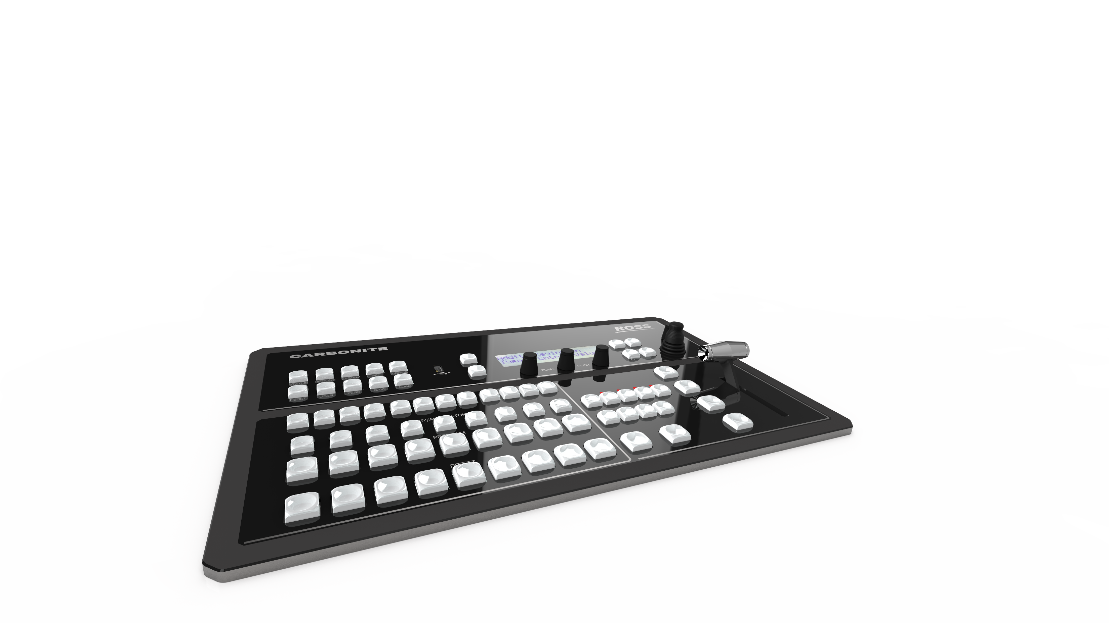
Powerful, Reliable, and Tough Solution
Compact form factor choices:
  All in one unit
  1 RU Chassis
  Separate hardware control panel
Tough Metal Construction
Extensively “Shake” Tested
High Quality 2 Axis Positioner
High Quality 30-Bit LED Buttons
Locking Power Cord Retainers
Legendary Ross Fader, Guaranteed for Life

Slide 10
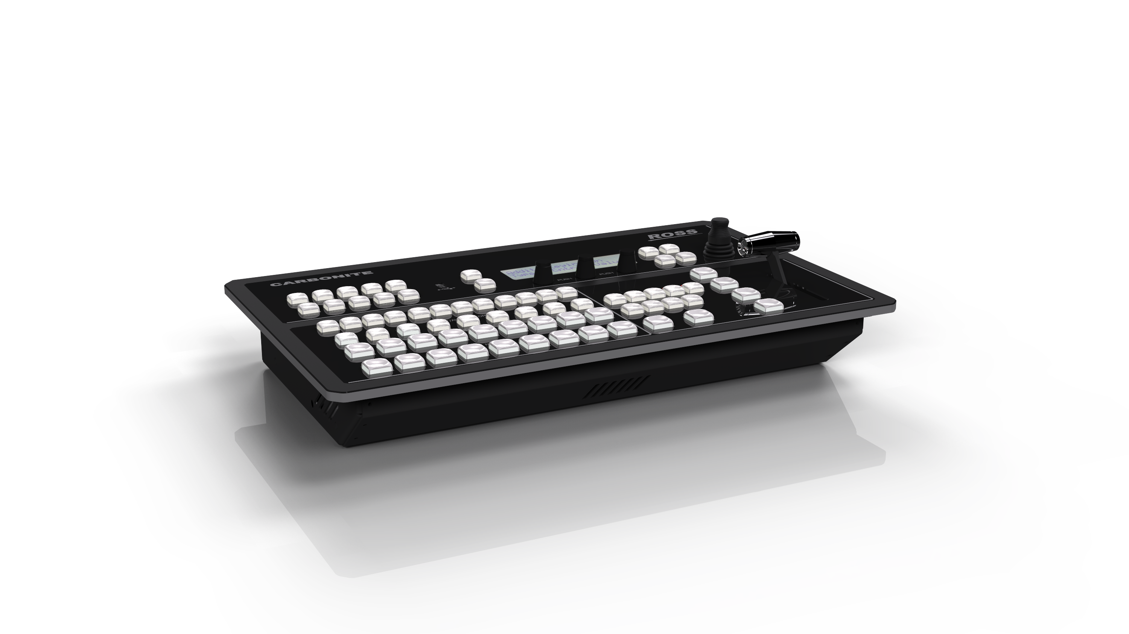
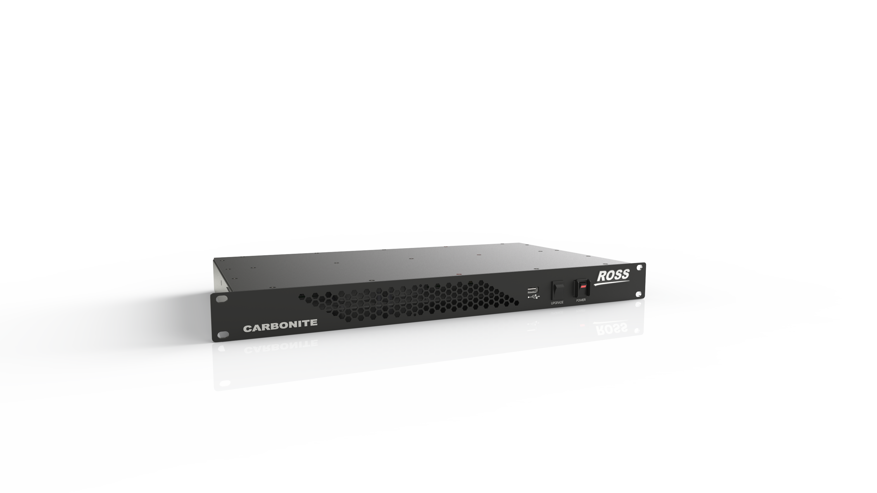
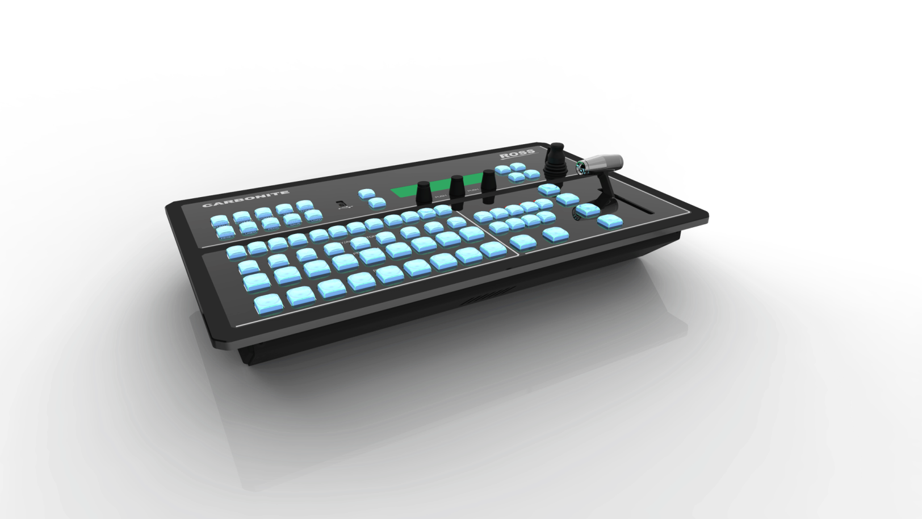
Three Versions
All In One Electronics and Panel
1 RU Frame with SoftPanel
Separate Hardware Panel
  CB9 Panel with same layout
  Ethernet connection to frame
  Can work with in tandem with SoftPanel or additional CB9 panels

Slide 11
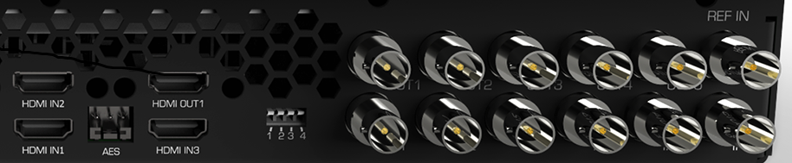
Powerful Inputs
6 SD/HD-SDI BNC Inputs
3 HDMI Inputs
6 Assignable frame sync/ format convertors with Up/Down conversion capability
Additional Frame Syncs with 2 MiniME’s
  Media Store Channels can be allocated as Frame Syncs from the panel

Slide 12

Powerful Inputs
6 Internal Sources
  4 MediaStore™ Channels for Still and Animation play out. Dual Video plus Alpha or 4 Video Channels. 4 GB total of RAM Cache loaded from USB or Ethernet FTP transfer. Support for .WAV audio as either associated to Video or Audio Only play out.
  1 Black source
  1 Wash generator source (2 Color with Pattern Mix)

Slide 13
Outputs
5 SD/HD-SDI BNC Outputs
1 assignable HDMI Output
1 AES Digital Audio Output
  10 input MultiViewer selectable from HDMI output or SDI Output 5

Slide 14
Powerful Keying
  4 powerful keyers with luma, linear, Chroma and DVE key types as well as an additional 5th hidden keyer for animated Media Wipe and DVE transitions. Advanced pattern generators are available for wipes, pattern masks and color washes.
  2 Mini ME each include an independent Mixer and 2 Keyers: 1 standard Keyer and 1 specifically for DVE boxes. Each MiniME 'floats' and can be used anywhere in the signal path
  1 UltraChrome chroma keyer that can be assigned to any Keyer in the system

Slide 15



UltraChrome™
Patented UltraChromeTM Features:
  Superb Keying
  Blue Spill Elimination
  Intuitive Fine Tuning
Bad Lighting Tolerant
Auto Chroma Key
Advanced Image Analysis

Slide 16

2 MiniMEs Included
  Up Stream Keying
  Down Stream Keying
  MultiScreen Production

Slide 17
MiniME Up Stream Keying
  Pre-Chroma Keying
  Pre-Over the Shoulder
  Pre-Lower Third/Burns
  Or Combinations

Slide 18
MiniME Down Stream Keying
  DVE Squeeze of PGM
  Discrete Branding
  LBAR Systems
  Multi-Streams/Dual Feeds

Slide 19
MiniME for MultiScreen
  Screen Spanning with Bezel Compensation

Slide 20
MiniME for MultiScreen
  2 Projector System

Slide 21
High Quality Effects
2 Channels of 2D DVE
  For DVE box Picture in Picture
  For DVE background or background plus keyer transitions
  Adjustable Horizontal and Vertical Crop
  Adjustable Border with Matte and Softness
  Adjustable Aspect Ratio
  Adjustable Box or Pattern Mask
  Adjustable Size from 0-500%
2 Versatile Wipe Generators
    Includes Diamond, Circle, and Diagonal Wipes
    Pattern Multiplication and Pattern Rotation
    Soft edges and matte filled borders
    One for Wipe Transitions
    One for Color Washes and Pattern Masks

Slide 22
Exclusive MediaWipesTM
  Animation Wipe Transitions utilizing the built in MediaStore™ Channels
  Dedicated 4 GB for loading Animations from USB using channels 2/4 of the MediaStore. Internal embedded audio from a .WAV Multichannel file is supported. Assign individual GPOs to each Media item with Pre/Post Delay. Trigger audio effects from external devices like a Digicart if preferred
  Uses the built in Transition Keyer. No ME Keyer resources are tied up
  Utilizes Ross Video JLAW principle that all transitions should work “Just Like A Wipe”

Slide 23
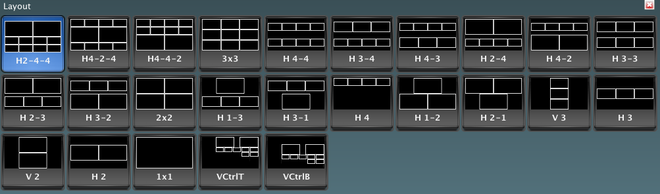
10 Input MultiViewerTM
  MultiViewerTM Key Features:
    External and Internal Sources follows assignable to any Window
    29 user selectable window layouts to chose from
    HD Output Layouts when in SD Mode
    Red (On Air) and Green (On Preview) Tally Indication, Tally Box or Border indication
    Aspect Ratio marker indication, see 4x3 safe!
    Source Mnemonic Labels with Adjustable Transparency, Location and FSFC Indication
    Time Clock with Size and Color selections

Slide 24
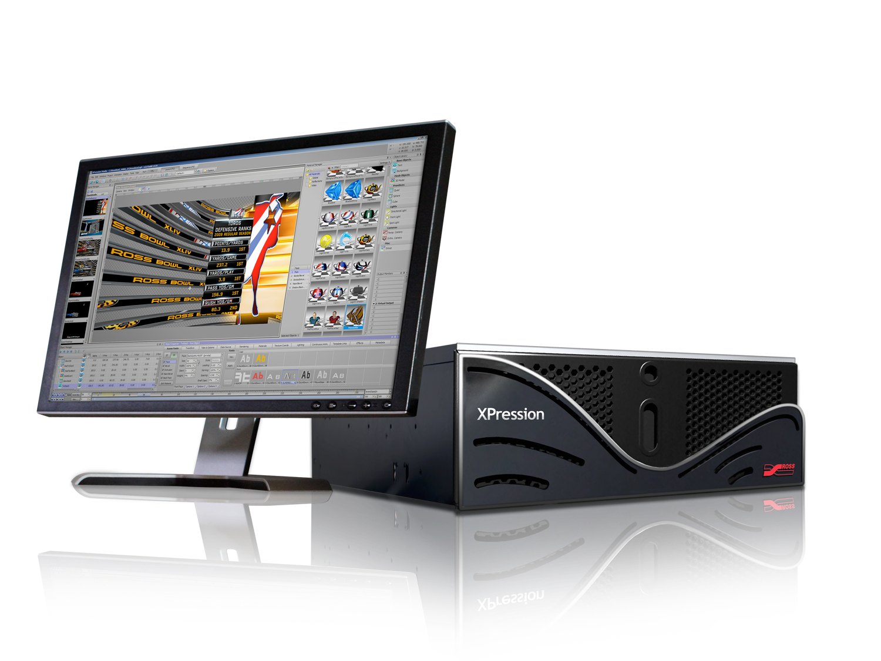
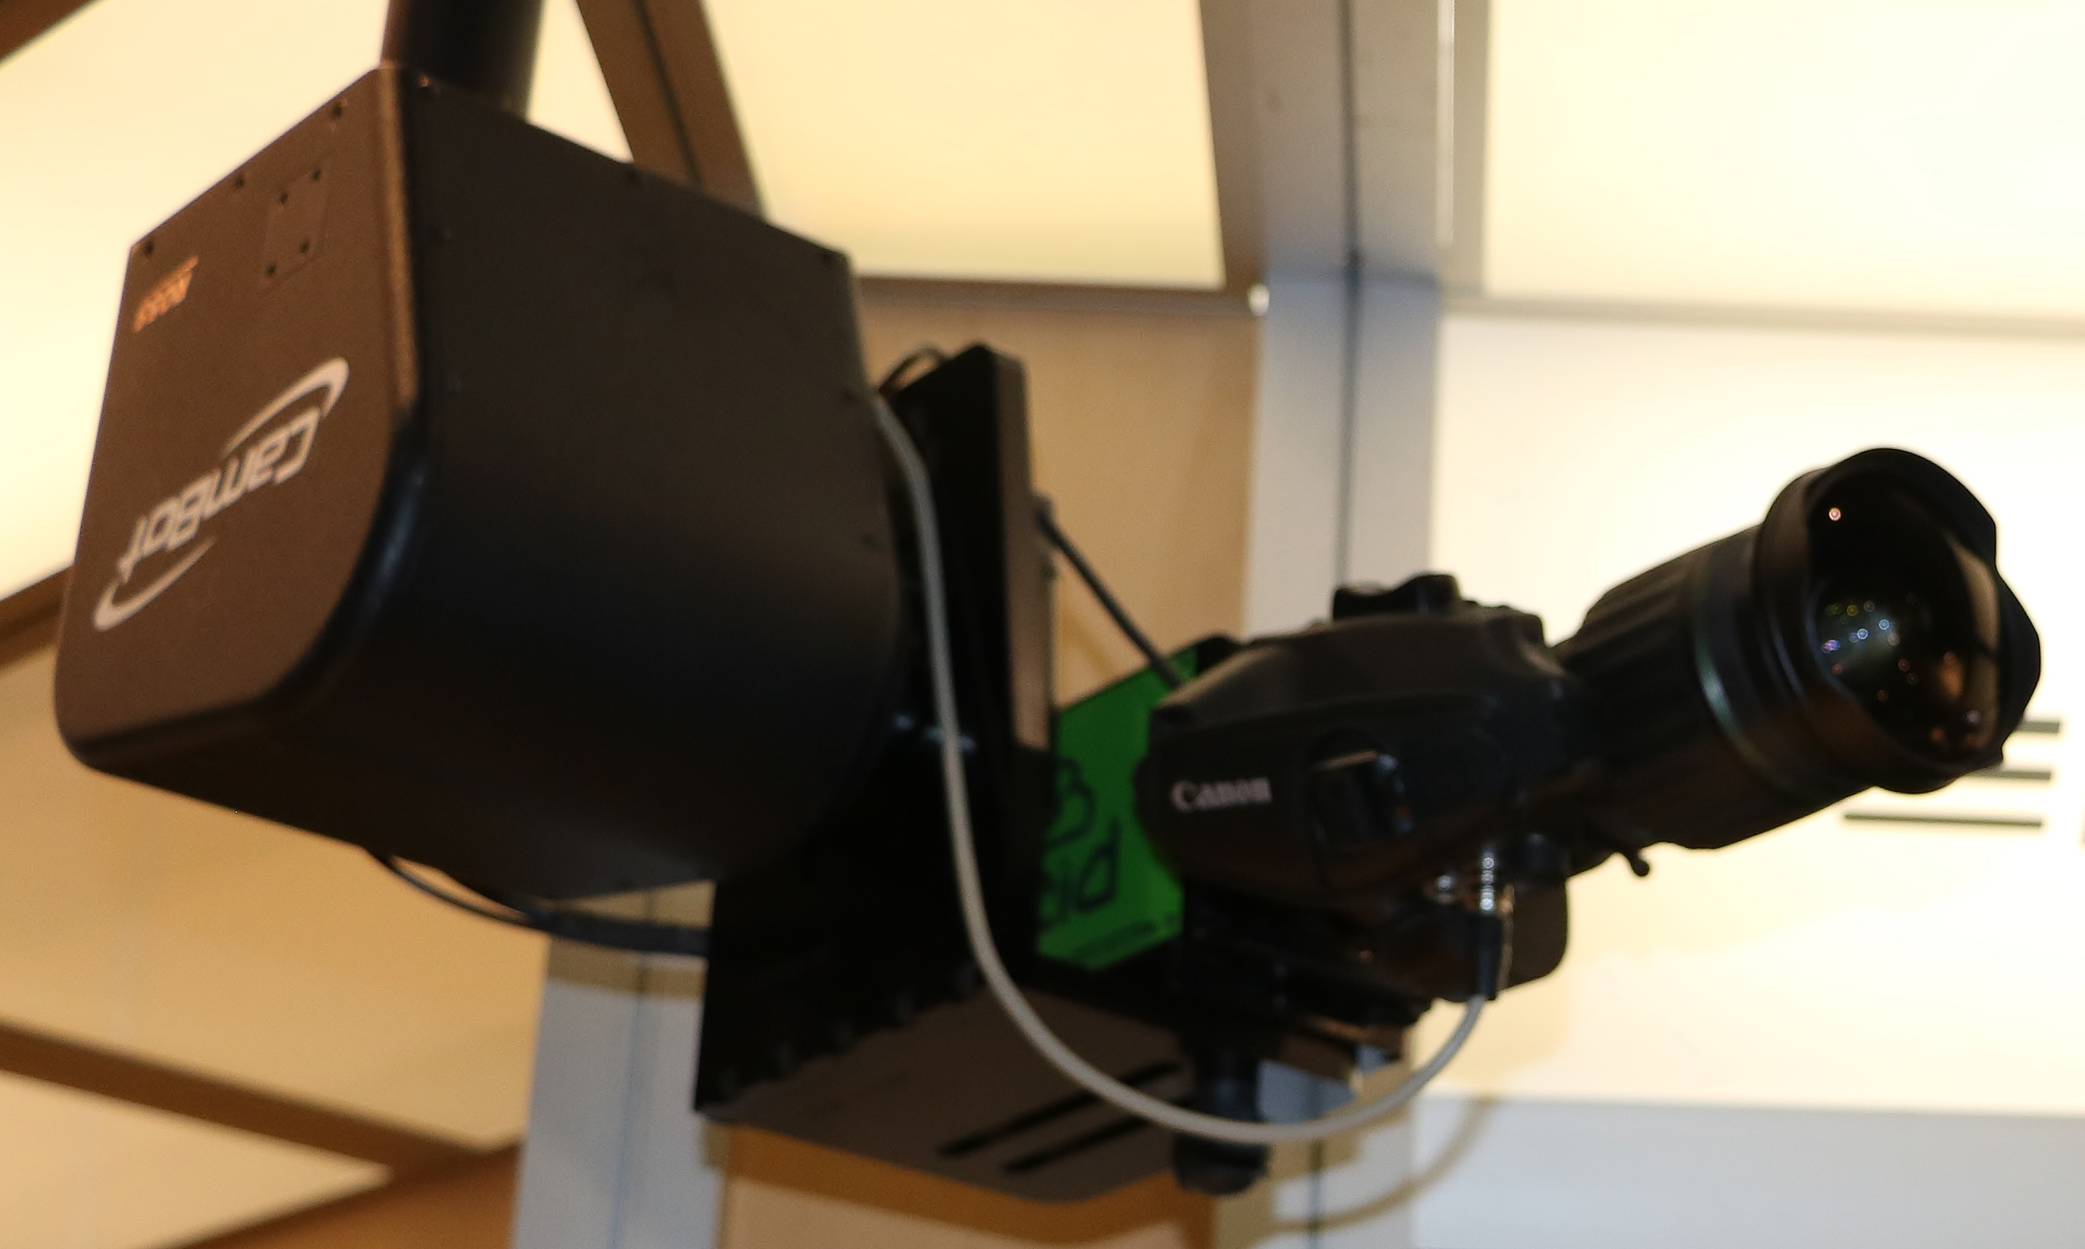

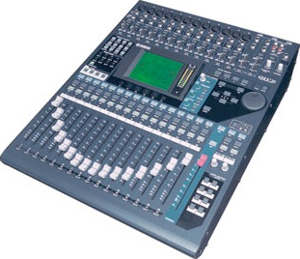
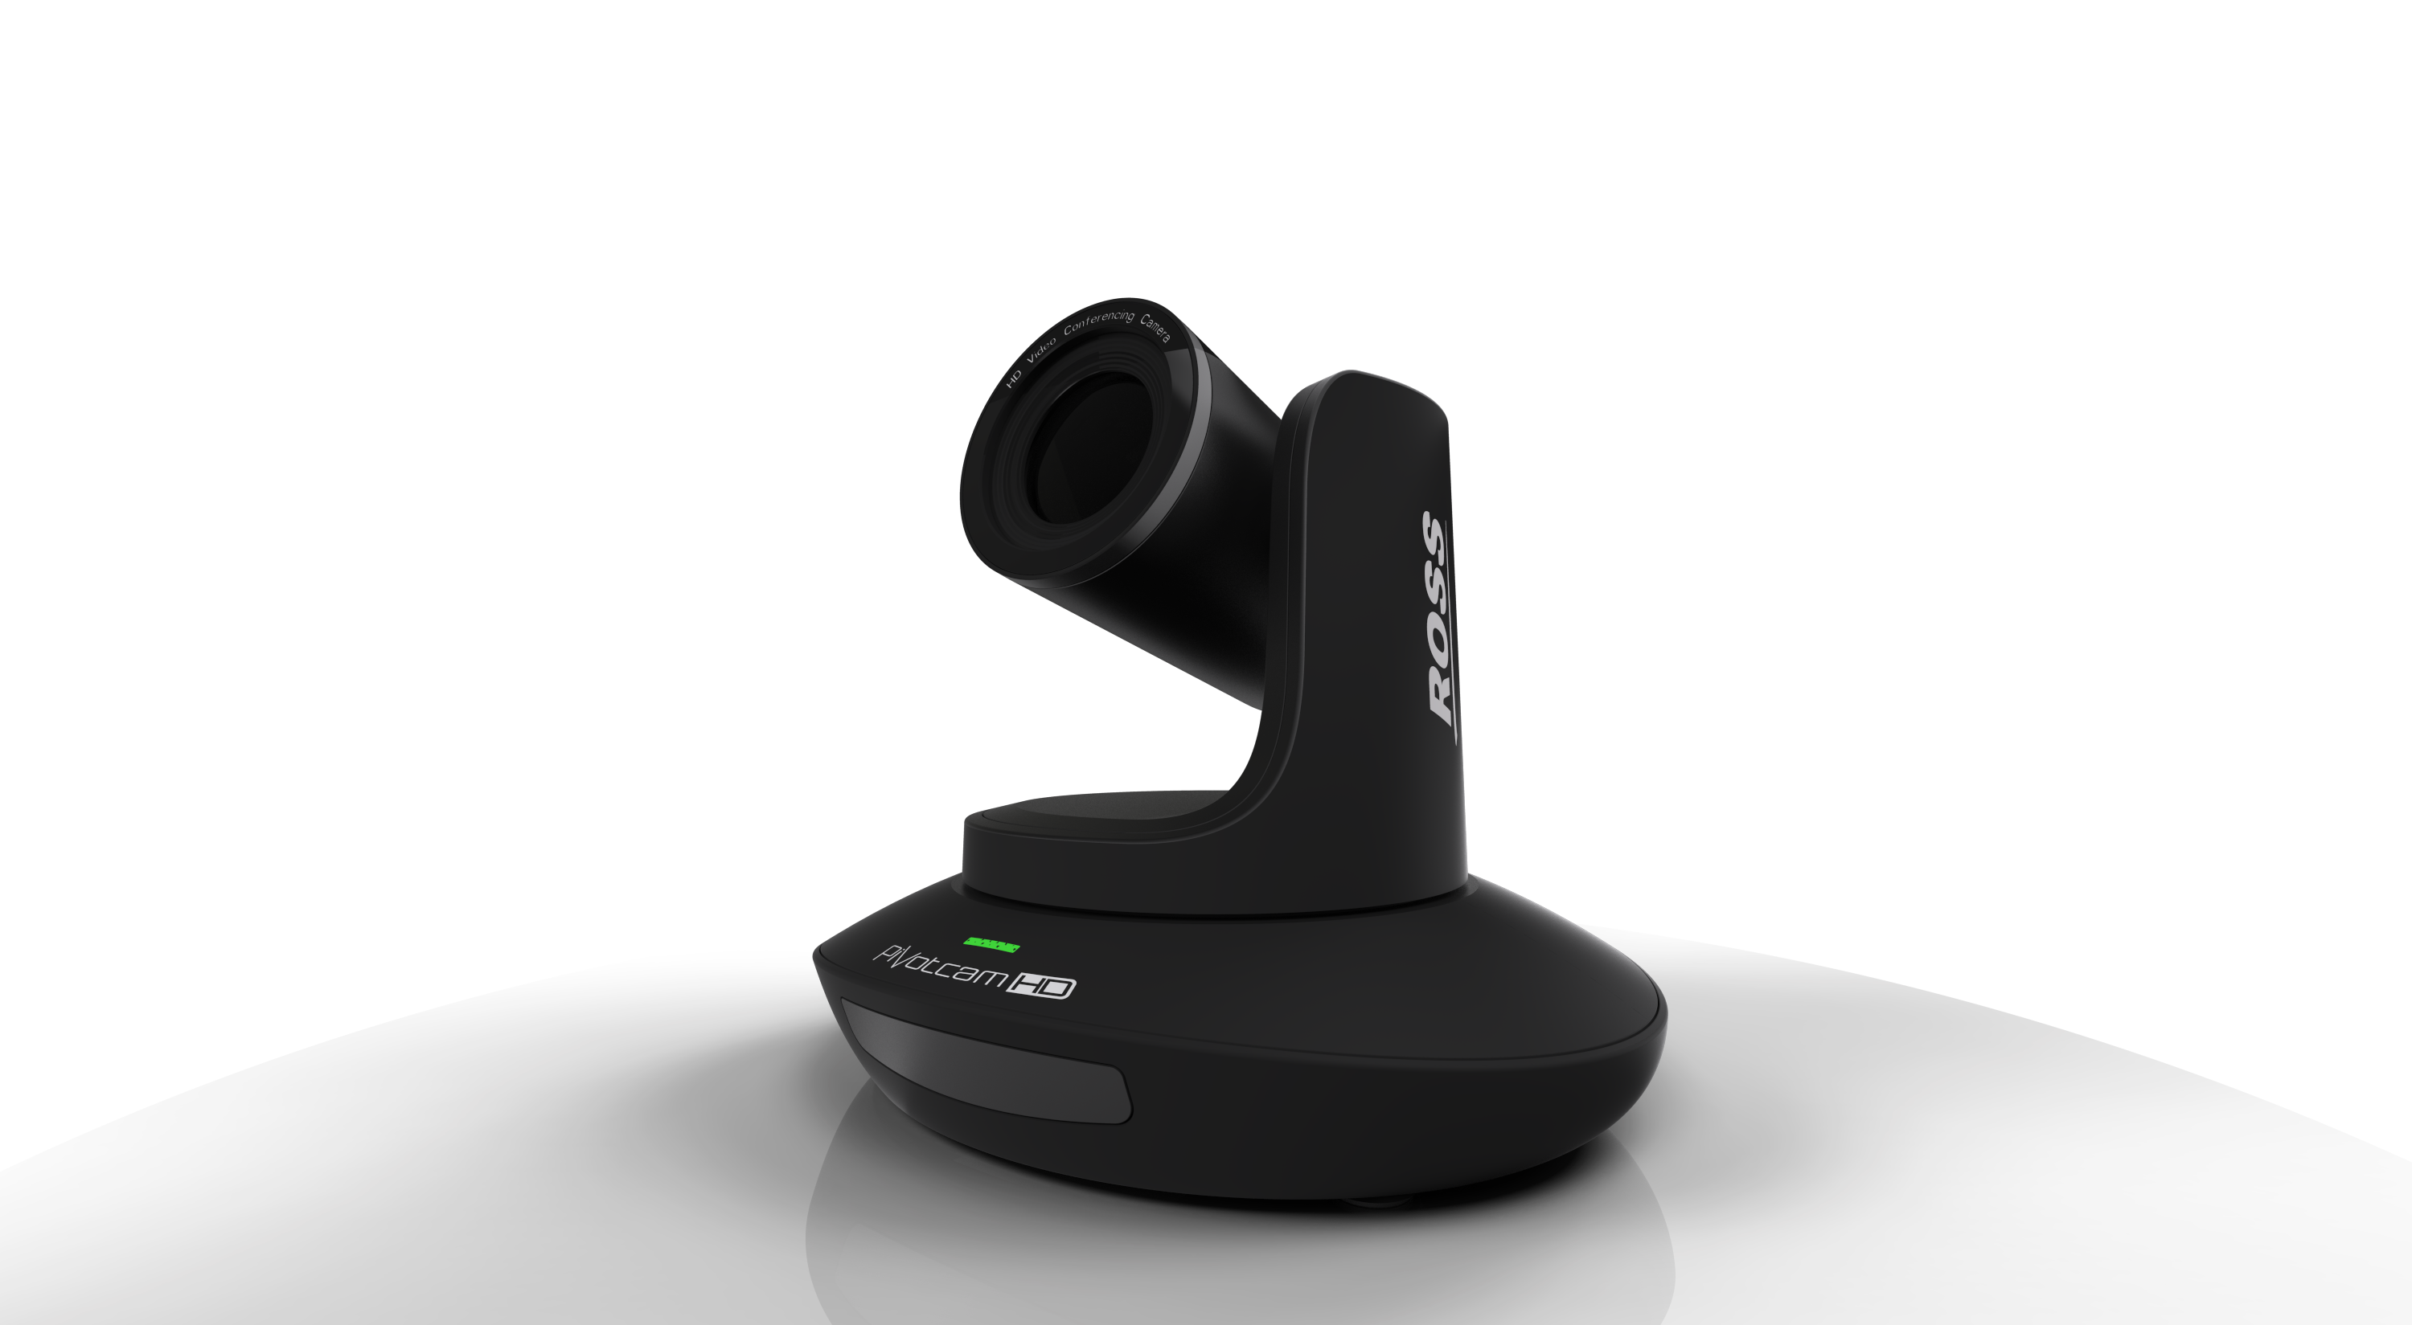
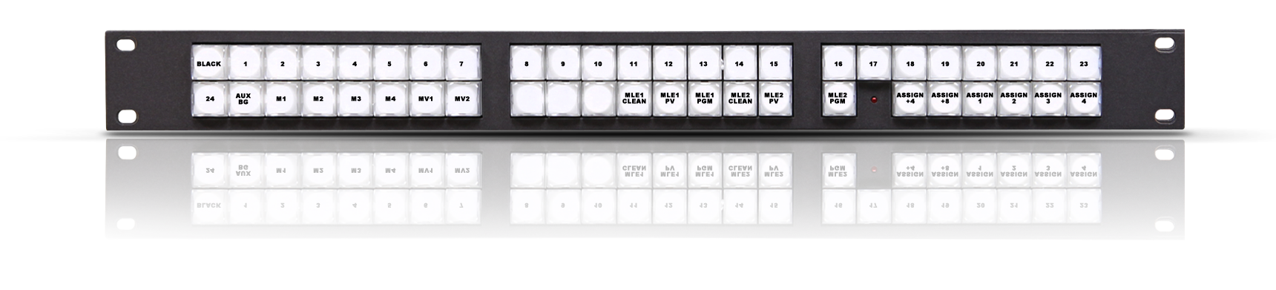
External Device Control

Slide 25
External Interfaces
  Carbonite Black Solo leverages Ross Video IP
    Sony VISCA and Canon BU Series Camera Control (PTZIF and Shot Recall/Store)
    Ross CamBot Shot Recall only
    Video Server Control via AMP (TCP/IP), PBUS or GPO with Roll Clip!
    Graphics System Control via RossTalk (TCP/IP)
    Yamaha Audio Follow Video (01V96 and DM1000)
    TSL UMD Protocol v3.1 (TX only. Sends UMD and Tally info to external systems)
    Remote AUX Panels and Router Panel support
    Audio Server, Video Server and other Devices via GPOs with Pre-Rolls!

Slide 26


Up / Down Conversion
6 Channels of image re-sizing
Configure as Input or Bus mode with the associated Frame Sync
Supported:
  SD to 1080i
  1080i to SD
  720p to SD
  720p to 1080i
Not Supported:
  SD to 720p
  1080i to 720p
SD
HD

Slide 27
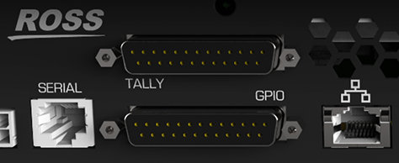
Enhanced External Control
16 Parallel Tallies and Serial Tally (Serial or IP)
  24 GPI Inputs to trigger memories, transitions, and CCU joystick override functions. Each can be configured as a GPO
  RS-422 industry-standard editor control
  Ethernet port for DashBoardTM, Device Control, remote diagnostics, FTP Media Drive Access, and XPressionTM Live CG

Slide 28
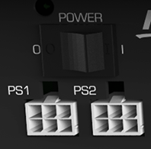
Power Implementation
  Redundant Power (chassis and panel) option
  100-240 dual external brick power supplies providing 12v to the units
  Locking power retainers
  Power switches on both the chassis and the panel

Slide 29
Removable Media
Removable USB drive holds stills, animations, memories, settings, and software upgrades. Access over the Network Via FTP!
Located on all-in-one panel, or 1RU chassis

Slide 30
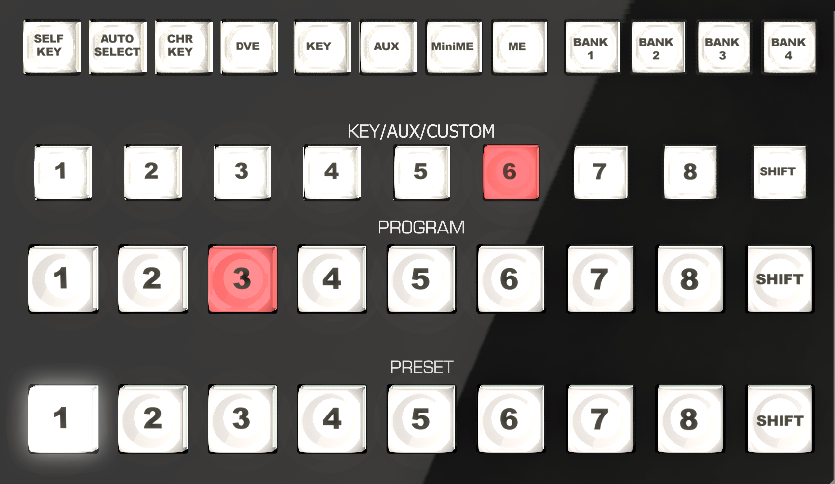
Buttons
High End 30-Bit LED Buttons
Panel Glow
  Button LEDs have user adjustable brightness and color
Color Coding
  Red=On Air, White=Selected, Green=Menu

Slide 31
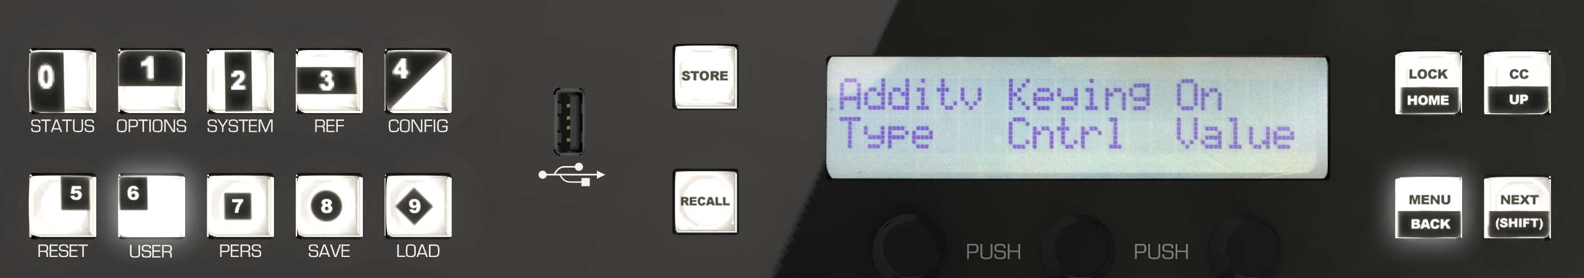
Multi-Purpose Menu Area
Context Sensitive Keypad
  Select Wipes
  Select DVE Effects
  Store and Recall Memories
  Manage Menu System
  Recall Media Items
  Trigger GPOs
  Quick Enable of Editor Port
  Program Custom Controls

Slide 32

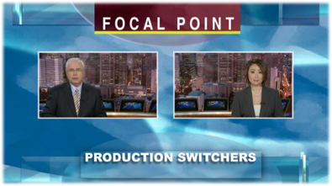

Next Transition Operation
True Next Transition Operation
  View a 2 Box effect in Preview prior to On-Air.
  Ability to easily transition between the 2 Box and each Box source
  Even include a locator key when box source is taken “Full” as a bonus!
On Air
Preview
On Air
Preview

Slide 33
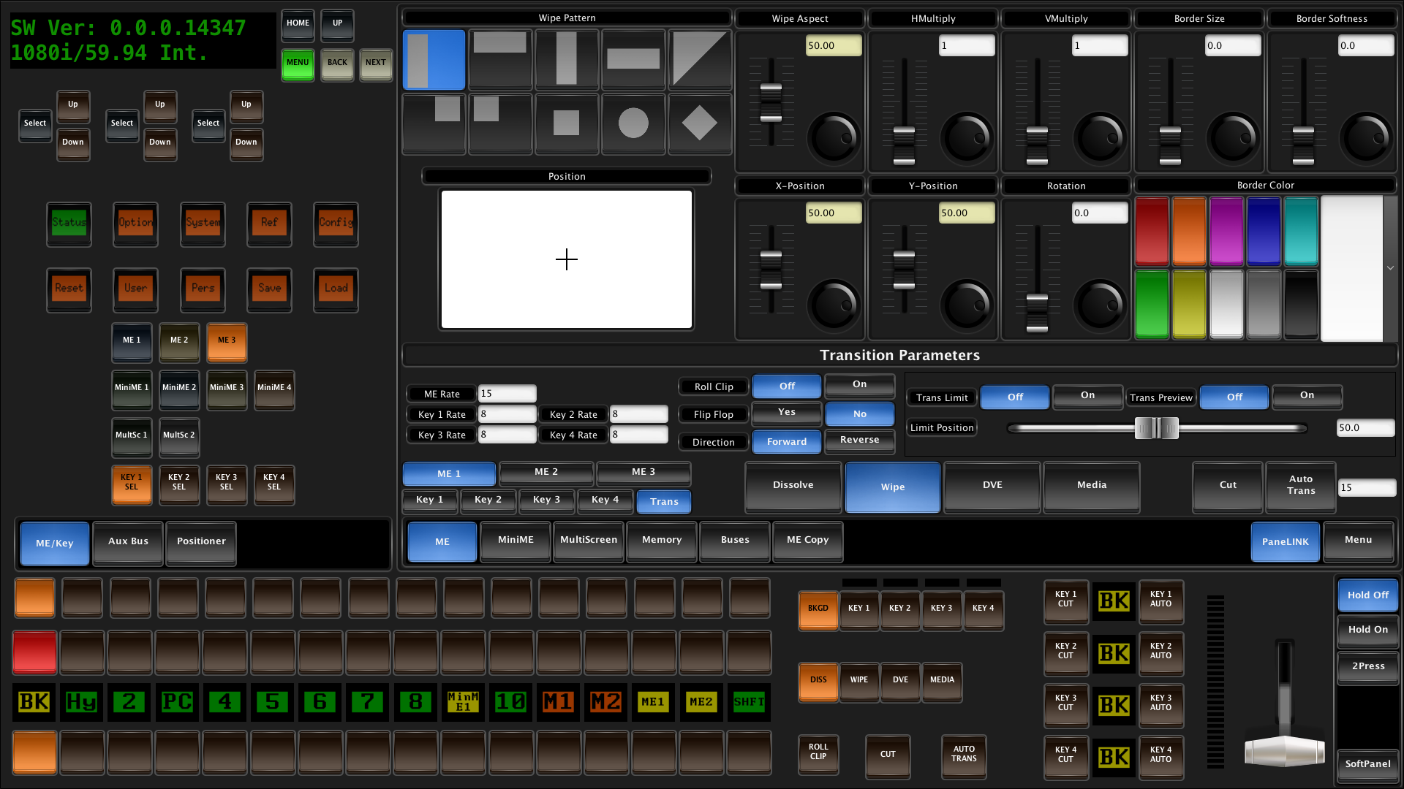
Operational SoftPanel
DashBoard based panel offers total system access
Can be used simultaneously with hard panel as alternative control point

Slide 34
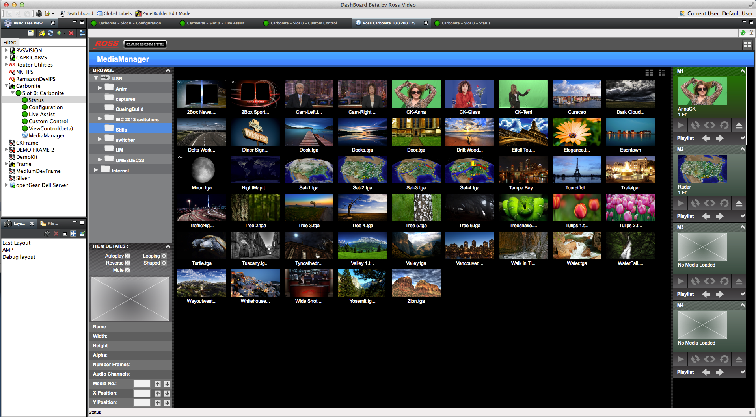
Carbonite Media Manager in DashBoard
GUI Navigation and Control of the Media-StoreTM Channels
Navigate the attached USB storage and Define the Media Item Parameters
All that is needed is a Network Connection! Use a Mac, Windows or Linux PC. No proprietary hardware needed

Slide 35
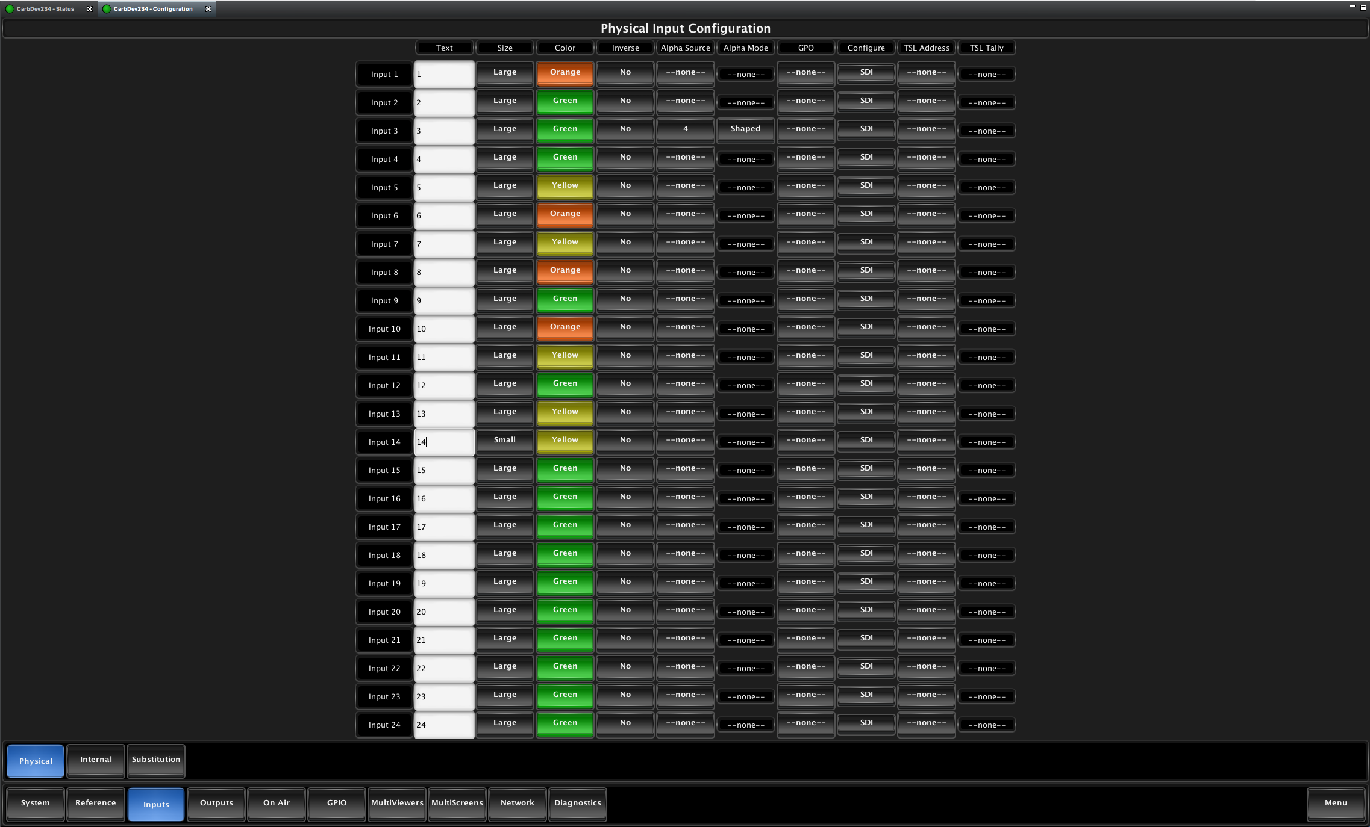
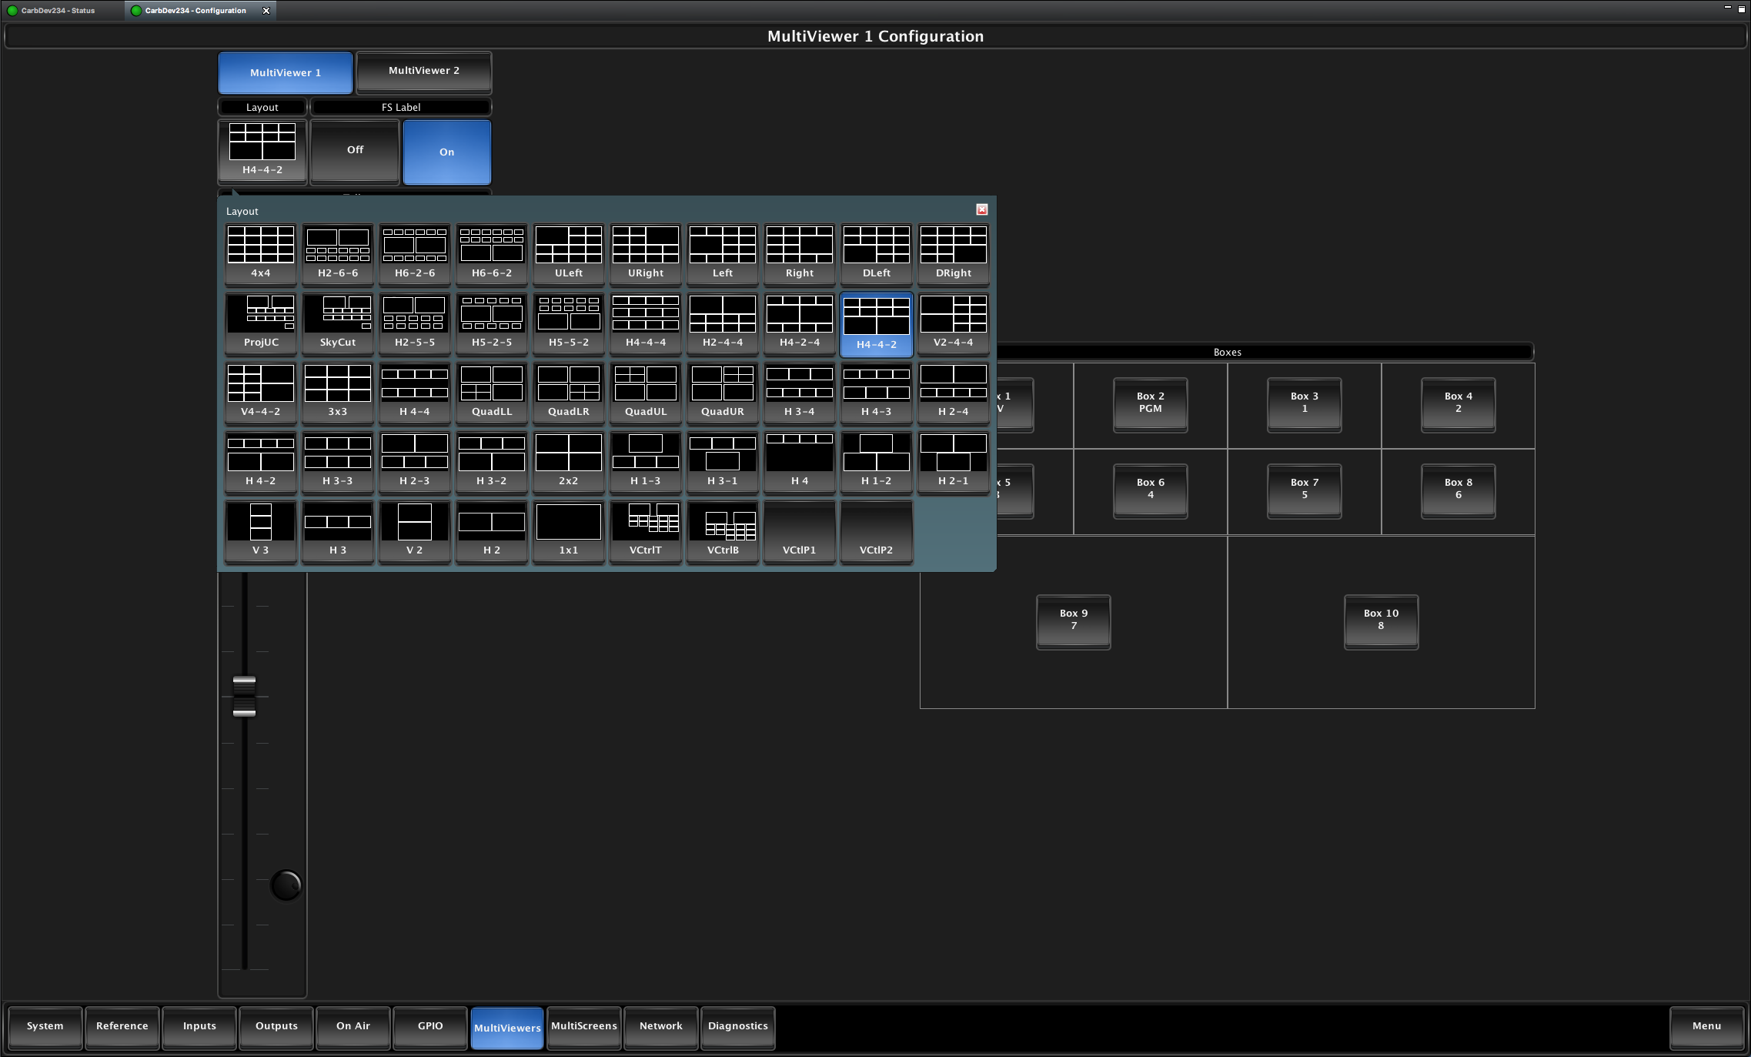
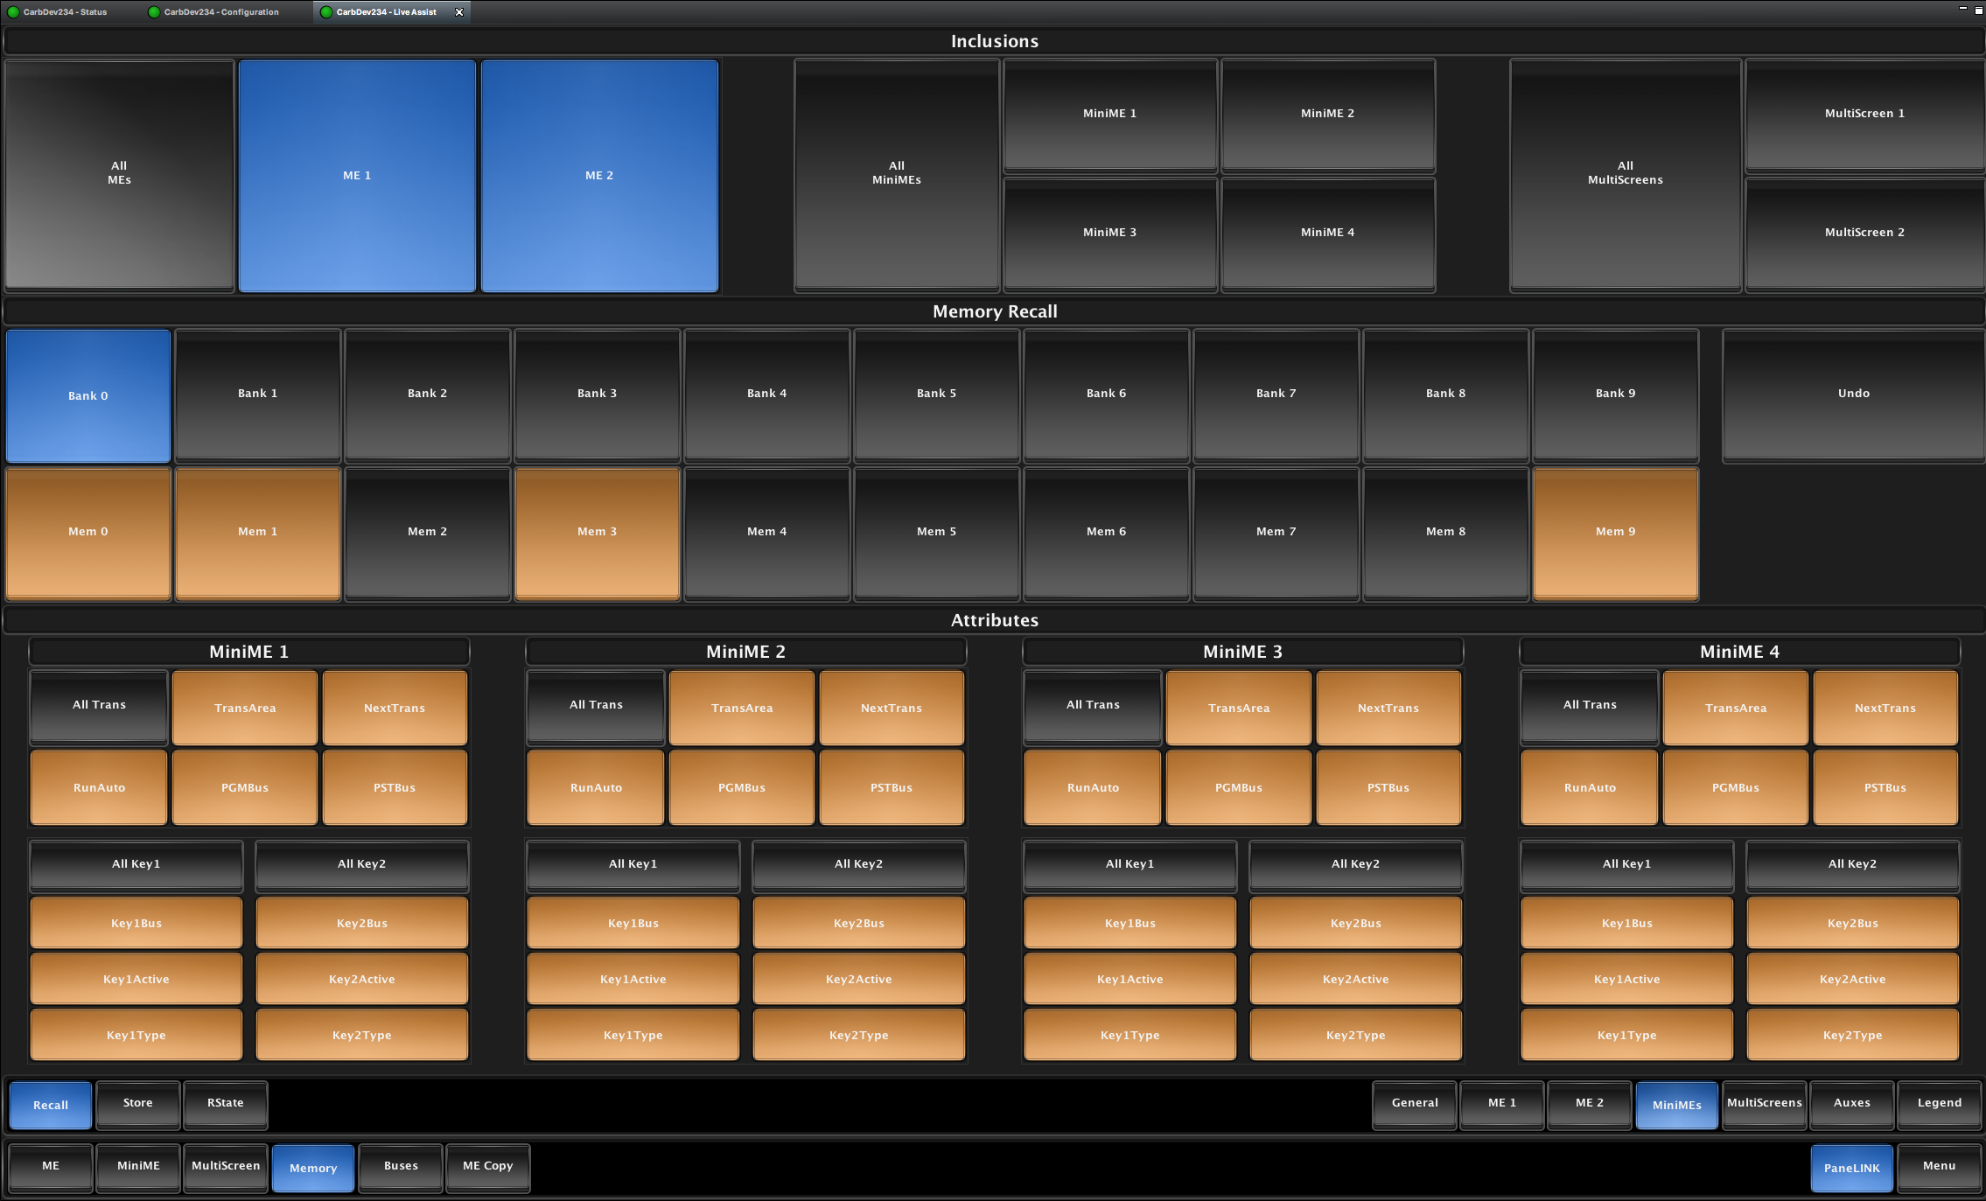
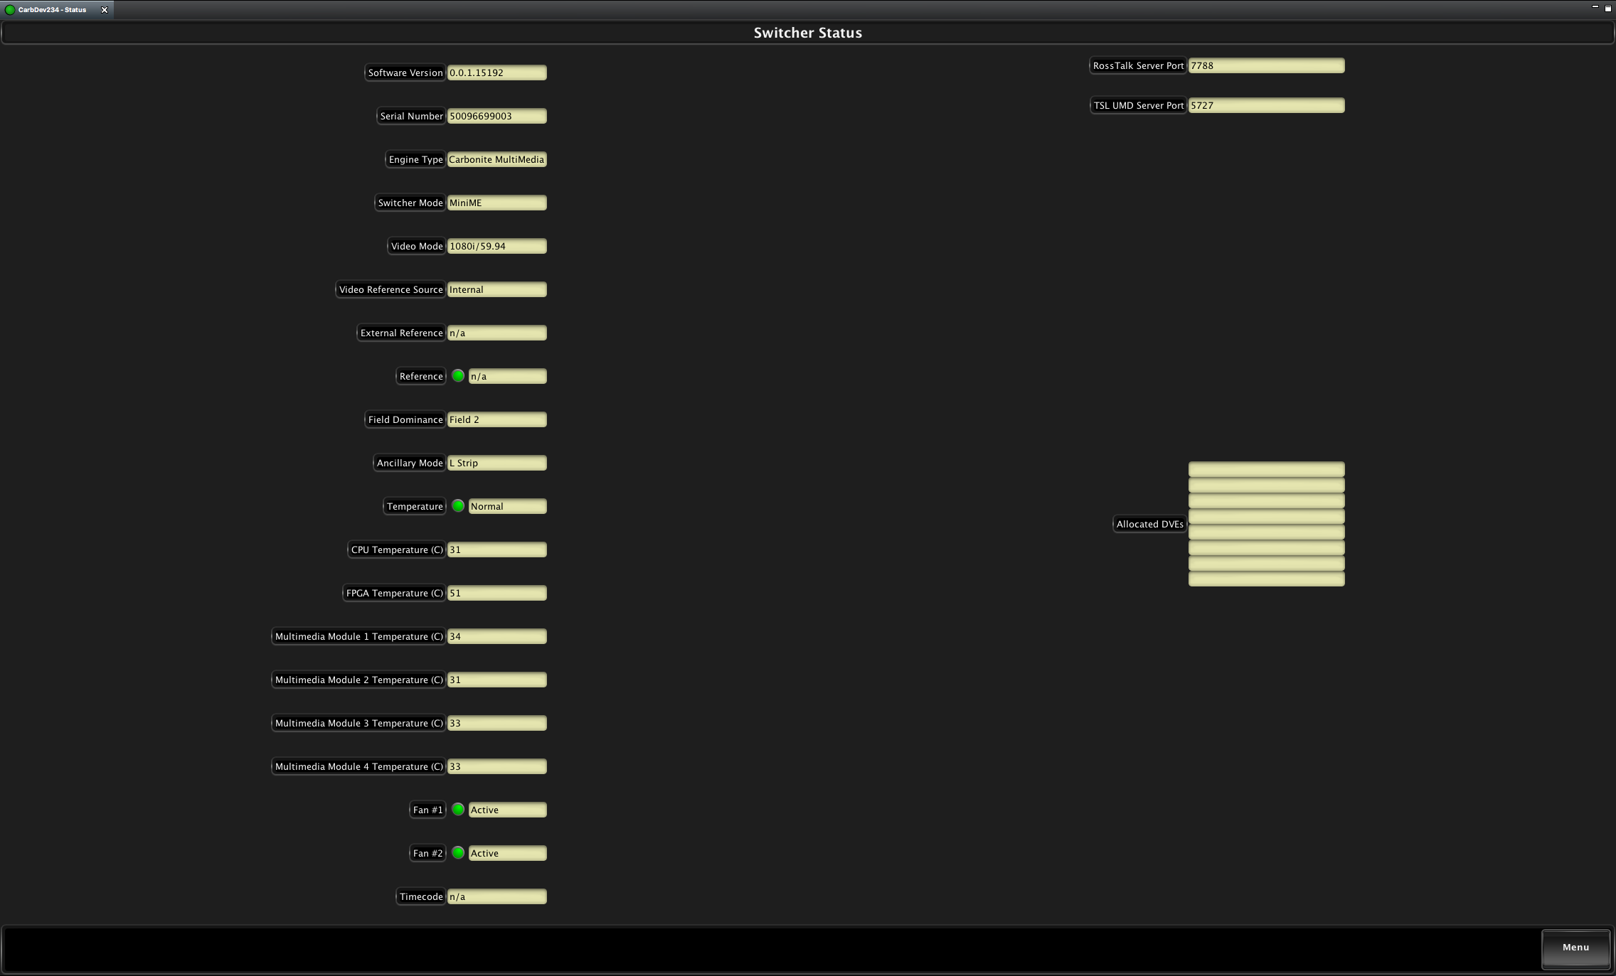
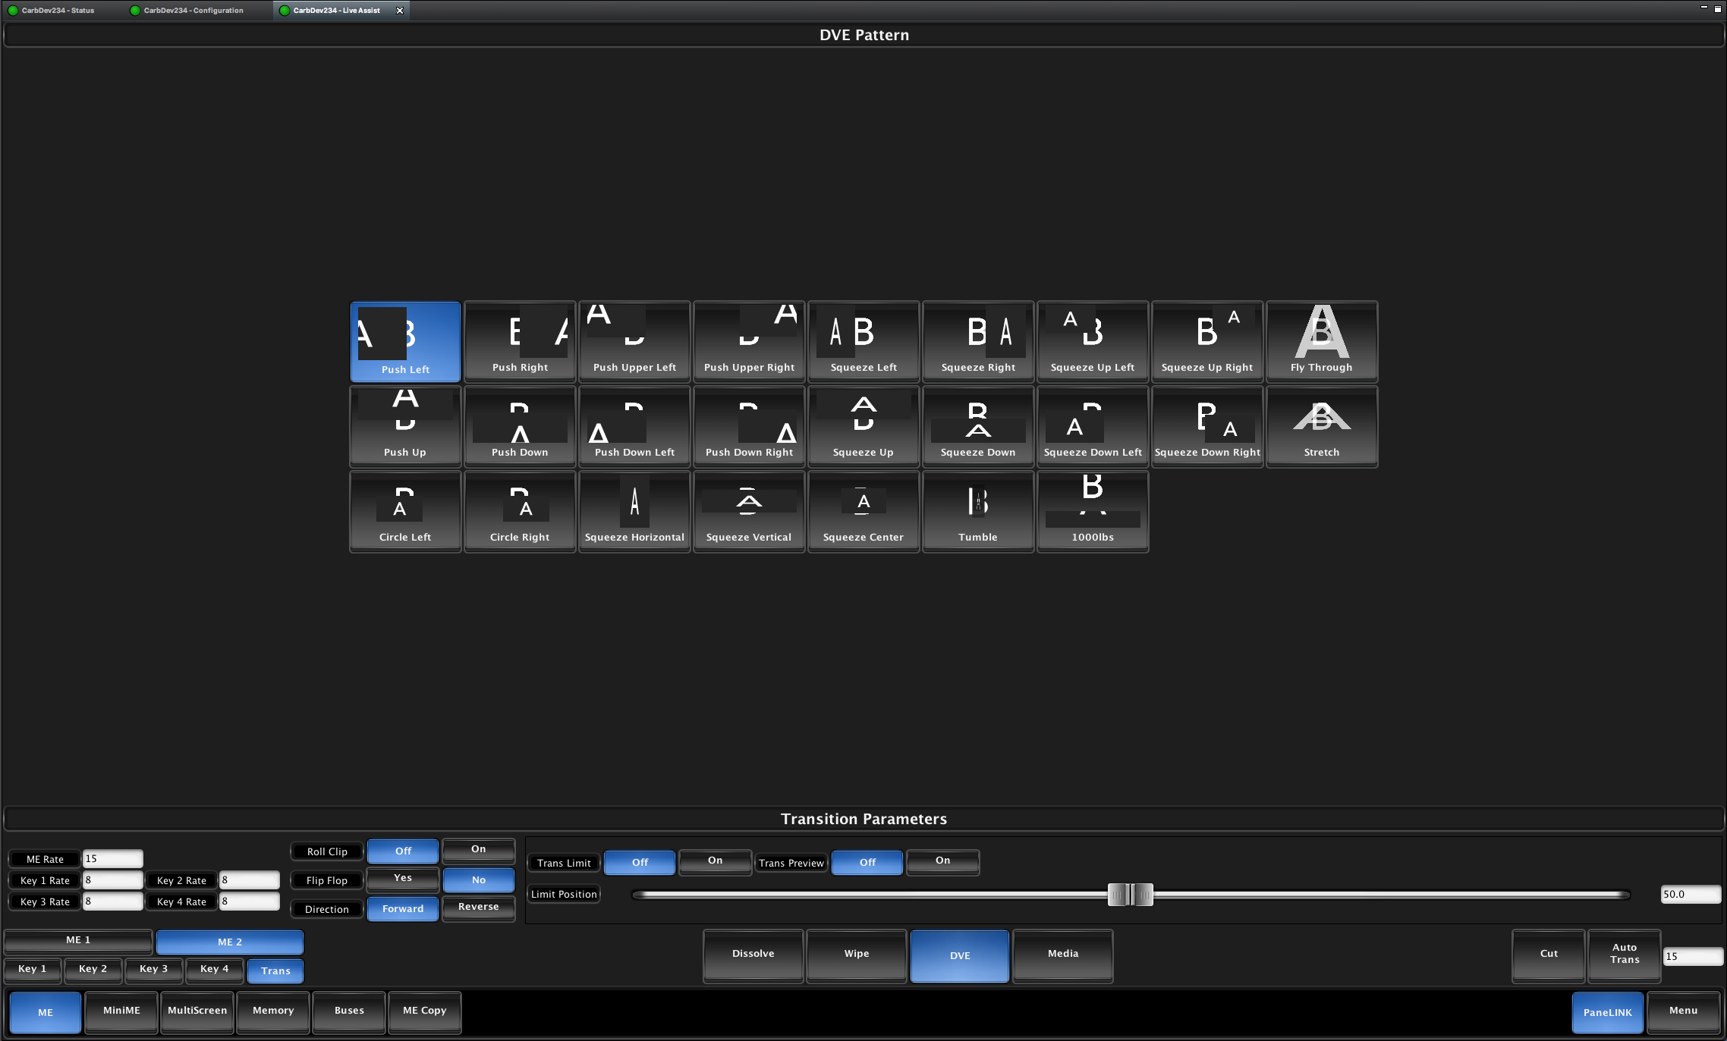
Carbonite DashBoard GUI
GUI Navigation and Control LiveAssist Menus and Functions
Also Full Status Menu as well!
Control All Keyer and Transition Controls, Memory Attributes and even Bus Source Selections
Custom Control Editing and Naming
Configuration Menus for Inputs, MultiViewers, MultiScreen, Video Format, Reference, and Outputs

Slide 36
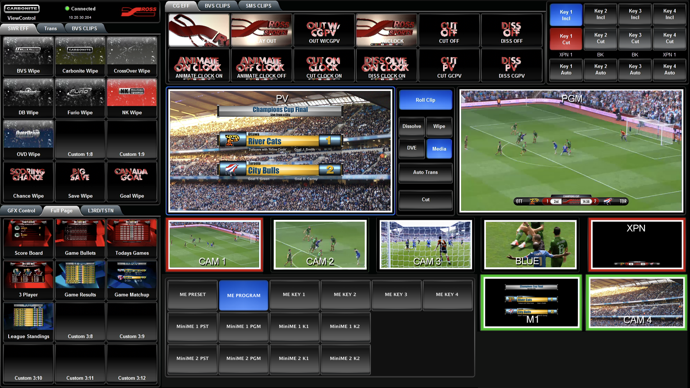
Carbonite ViewControlTM
Take Full Control of productions with a touch of the screen.
Incorporating the full production suite in an intuitive easy to use system.
No longer does a Production switcher need to be an intimidating set of buttons to the non “Technical” Directors!

Slide 37
Media Memory AI™
A Ross Patented Feature!
All “Shots” are stored as “On Air” within the Carbonite Memory System
Carbonite then uses these memories to intelligently allocate resources when the memory is recalled and placed in Preview

Slide 38
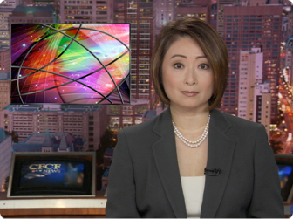
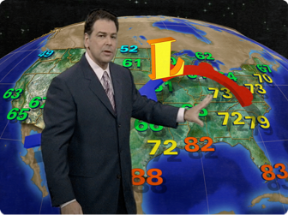
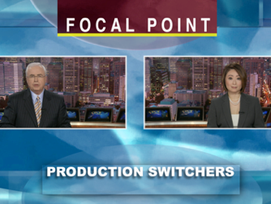
Shots are stored to Memories. These are normally stored into the PGM Output to create what is wanted when a memory is recalled.
Media Memory AI™
KEY 1
KEY 1
PGM
KEY 2
PGM
KEY 1
PGM
Memory 1
Memory 2
Memory 3

Slide 39
XPressionTM Live CG comes standard with all Carbonite Black Solo systems. It does require a customer supplied Windows PC or Laptop with Nvidia graphics or Ross Video XPressionTM workstation.
Live CG provides direct integration with the Carbonite internal Media-StoreTM channels. XPressionTM renders the still graphics from the users Laptop/PC over the network directly into the Carbonite Media-StoreTM channels in under 2 seconds
XPressionTM is able to put together a playlist and then run that playlist with the output rendering into Carbonite. This operation is just like running an independent graphics system, without the added cost of the expensive SDI hardware and without consuming switcher inputs.
XPression™ Live CG

Slide 40

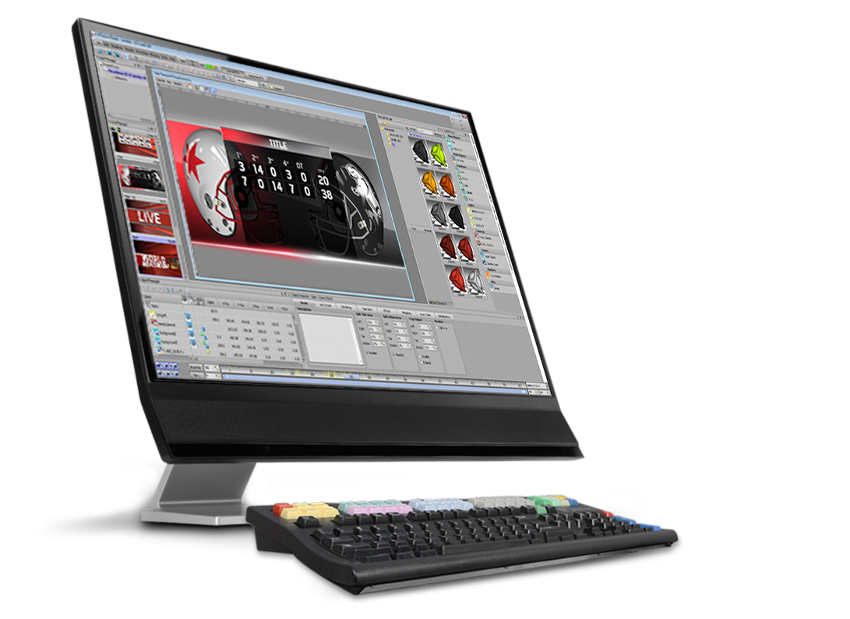
XPression™ Live CG
Media-StoreTM Channel 1
XPressionTM Laptop or PC
User Supplied Hardware
PGM Output
CG File Transfer
SD/HD-SDI Source Inputs
LAN
CG File Transfer

Slide 41
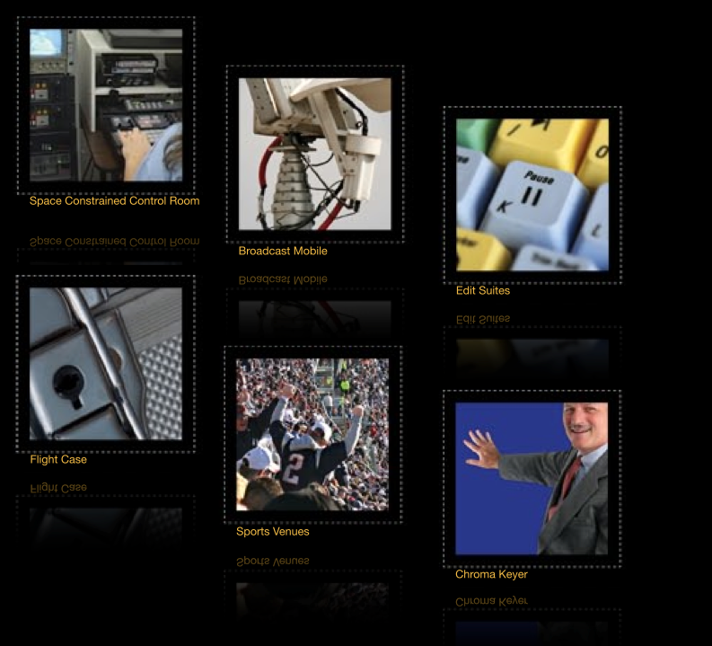
Carbonite Black Solo Applications
Space Constrained HD and/or SD Studios
Outdoor Broadcast (OB) Vans
Linear Edit Suites
Mobile or Flight Case
Entertainment and Sports Venues
Campus TV
Distance Learning
Operator Training
Standalone Chroma Keyer Replacement

Slide 42
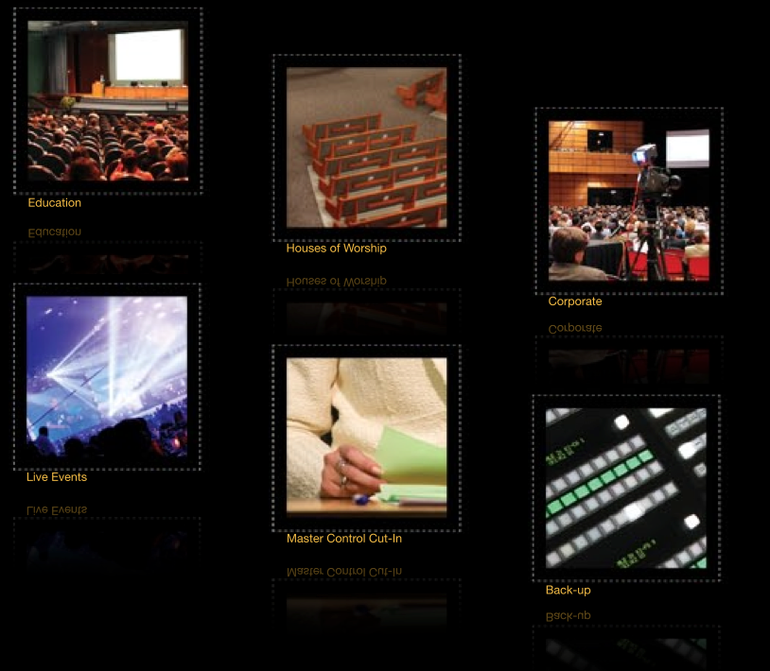
Carbonite Black Solo Applications
IMAG and Broadcast for:
  Education
  House of Worship
  Corporate
  Legislative Assemblies
  Live Events
Master Control “Cut-in" Switcher
  Weather Cut-in Chroma Keying

Slide 43
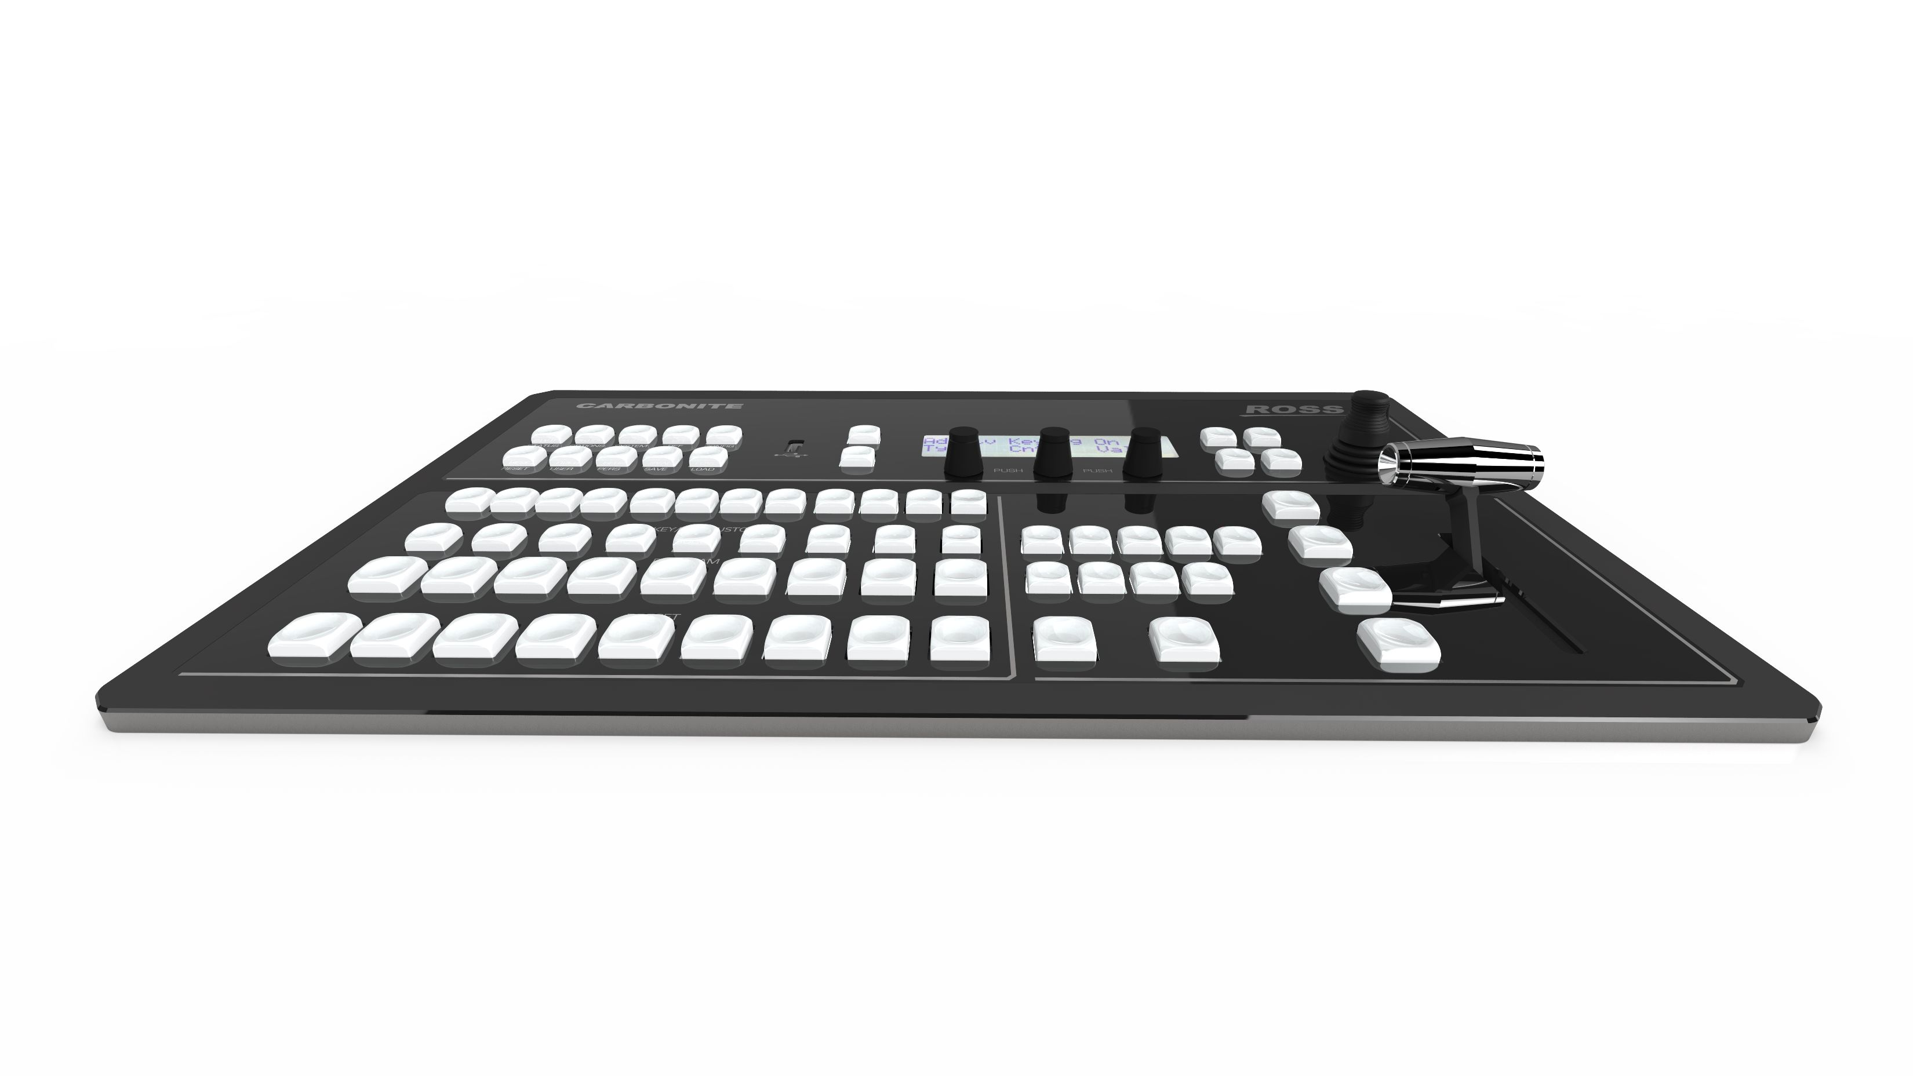
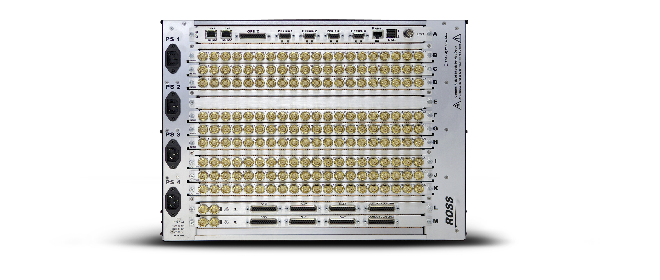
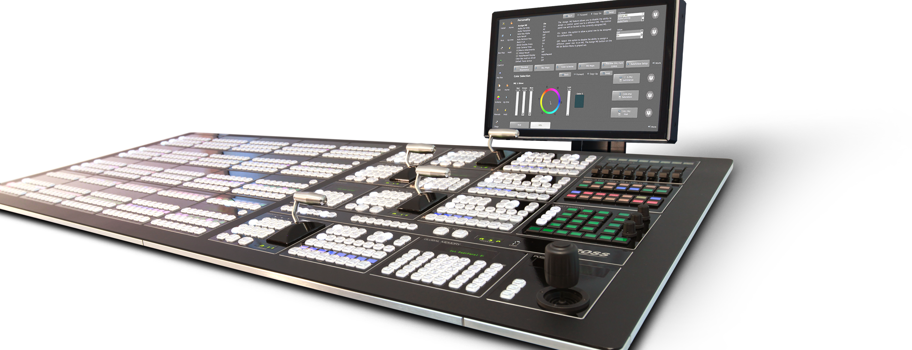
Carbonite Black Solo Applications
Emergency Backup / Redundancy for Primary Production Switcher. This includes the “Back Up MultiViewerTM” that is built in!

Slide 44

Services and Support
Technical Support is etched into every product ever manufactured by Ross Video so telephone or email support is included for the life of the product.
Ross is committed to provide a “Superior Customer Experience” on each and every customer interaction.
RossCare+ program
  Software maintenance
  Extended warranties
  No annual licensing fees
Notes:
Ross customer service and technical support is always ranked at the top in the industry. Phone/email support is always included. Optional software maintenance, hardware warranties, training, and creative services are available to customers, if required.

Slide 45
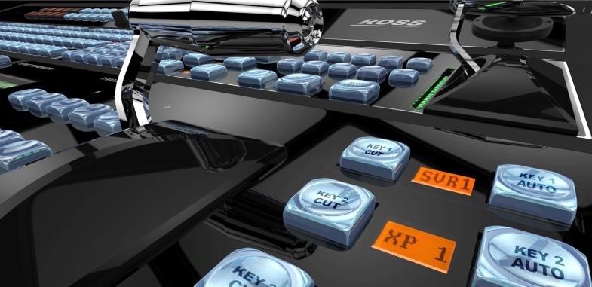
Services and Support
Professional Services
On-site commissioning/installation
On-site technical training
On-site troubleshooting
On-site operational training
Remote commissioning services – available on select products
  Rocket Surgery – Ross Creative Services
Broadcast design and motion graphics
Authoring and delivery for XPression
DashBoard and API development for data sources and control

Slide 46
Product Positioning
A compact production switcher based directly on the number one Mid-Size switcher in the world, by a very large margin- with thousands of users
An integrated environment with connectivity to a wide range of production systems using DashBoard, including the Ross Production Ecosystem
Choice of compact form factors to fit a variety of customer needs
Powerful processing capabilities provide resources typically found in larger systems to satisfy a broad range of production requirements.
Intuitive panel ergonomics and production efficiencies consistent with that of much larger switchers
Productivity enhancement with tools that assist in the simple creation and running of shows
Compact, powerful, and durable packaging offers a superior value for a wide range of production requirements
Ross Video Company Confidential- Do Not Distribute

Slide 47
Key Product Messages
  2 MiniMEs are assignable effects modules that include an independent Mixer and 2 Keyers: standard and DVE boxes
  Configurable, low latency MultiViewer has access to external and internal sources
  MultiScreen supports outputs for up to 2 projectors on a single screen, cross screen transitions, scaling across all screens, and display of multi-screen backgrounds from graphics systems and Media-Stores
  DashBoard LiveAssist control interface combines with MediaManager browser to provide control over switcher settings, Media Store graphics and animations
  ViewControl makes it possible to create an entire production from a simple and very intuitive interface
  MemoryAI resource management system recalls stored key and backgrounds to be independently previewed
  Four independent media player channels are available switcher-wide
  Standard system includes 6 internal frame synchronizers and format converters which permit mixed SD and HD formats
  UltraChrome™ chroma keyer perform detailed keying in the most demanding conditions
  2 high quality 2D DVE channels are available system-wide
  Direct control of external devices such as servers, robotics, select Audio Mixers and XPression graphics
  XPression Live CG included
Ross Video Company Confidential- Do Not Distribute

Slide 48
Carbonite Black Solo Resources
Sales Tools
Brochure
Web site section
Overview Video
Basic Demo video
Sales Tools – New
Internal Presentation and Customer Presentation
How to Sell Video
Tutorial Videos in Carbonite U
Ross Video Company Confidential- Do Not Distribute

Slide 49
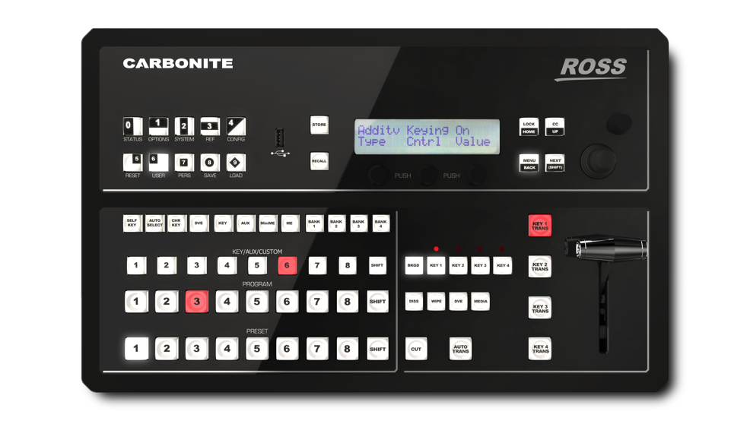
Hazards
Ross is the #1 Target of all competitors in 1 and 2 ME size. Expect everyone to be given each manufacturers version of ‘Why this is better than Carbonite”
The Carbonite ‘clones’ will all be positioned as less expensive, but they all have additional cost options that may be hidden.
Solo will be compared with BMD Atem, which is 4K (albeit limited). There is no 4K option for Solo, but for mainstream HD production it will outperform and outlast.
All in one PC based systems (TriCaster) offer more for less, XPression LiveCG & Carbonite combos lack clips. Solo has better production features is not a direct competitor. TriCaster cannot compete with Carbonite on function, performance, or reliability.
Ross Video Company Confidential- Do Not Distribute

Slide 50
Competitive Summary
BlackMagic Atem Production Studio 4K – Very Low Cost, Seemingly High Spec
8 inputs, 4 SDI & 4 HDMI. 4K limited Frame Rate. Questionable Quality and Reliability
Limited Keying, 2 ME keys 2 DSK
No Service and Support
Brings Business to Ross When Customers Understand Limitations
Low Cost, < $7k with Control Panel
For-A HVS-100/110
8 Inputs (stnd), 5 Outputs
Limited Keying, 2 ME keys,2 DSK
Priced from $8500 - $10500 (Street B&H)
Ross Video Company Confidential- Do Not Distribute

Slide 51
Competitive Summary
TriCaster and Broadcast Pix
All-in-one PC based systems
Suffer resource limitations, but popular
Equivalent system costs lower with limited spec graphics
DataVideo, Edirol, Panasonic
Low Cost & Limited Performance
Costs between $5,000 – $12,000
Ross Video Company Confidential- Do Not Distribute

Slide 52
Key Differentiators
None of These Competitors Have…
5 ME Keys (4 + 1)
2 x Full MiniMe’s
All of the Carbonite Standard Features
DashBoard
ViewControl
The Demonstrated Continuous Product Improvement w/ No one left behind
Their own Graphics Systems
Their own Robotics
Trackless VS, VS, UltraChrome & UltrachromeHR
A PRICE of >$8K for anything that is even close!
Ross Video Company Confidential- Do Not Distribute

